Slide 1
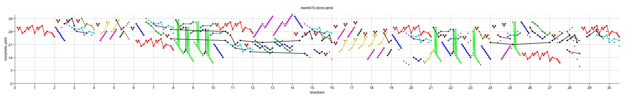

Geometric, Compression-based Pattern Discovery in Music
David Meredith

Slide 2
New Springer book on Computational Music Analysis
http://link.springer.com/book/10.1007/978-3-319-25931-4

Slide 3
Pattern discovery in Lrn2Cre8
We want to build systems that can learn to compose convincing novel music in recognizable styles
Such systems must learn in a bottom-up way from examples of pieces in a target style how pieces in that style are typically structured
  thematic and motivic structure
  metrical structure
  grouping structure and form
  harmonic and tonal structure
  rhythmic structure
  voice-leading structure and contrapuntal structure
  instrumentation
  production techniques
  ...

Slide 4
Pattern discovery in Lrn2Cre8
Focus here is on discovery of various classes of repeated pattern
  provides essential information for
    metrical structure
    grouping structure and form
    motivic/thematic structure
    voice-leading and contrapuntal structure
  can potentially be used to inform a system for automatic expressive performance

Slide 5
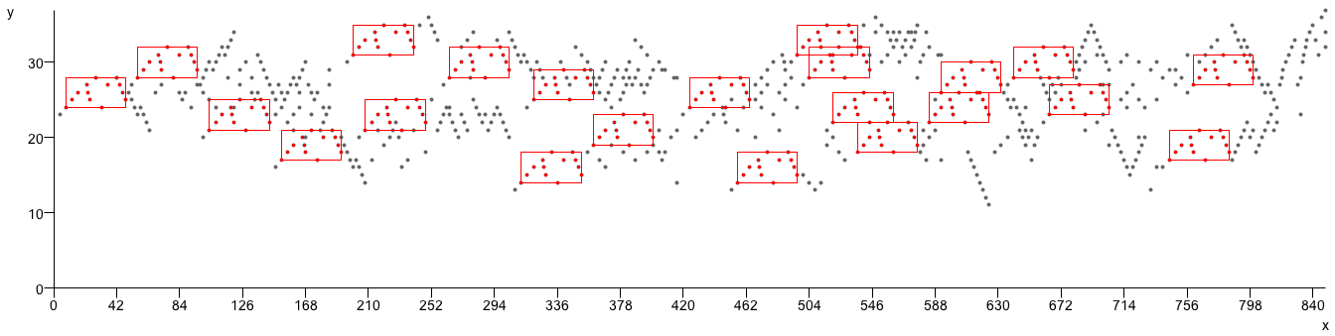

Repeated patterns in music
J.S. Bach, Fugue in C major, BWV 846
“the importance of parallelism [i.e., repetition] in musical structure cannot be overestimated. The more parallelism one can detect, the more internally coherent an analysis becomes, and the less independent information must be processed and retained in hearing or remembering a piece”
  Lerdahl and Jackendoff (1983, p.52)

Slide 6
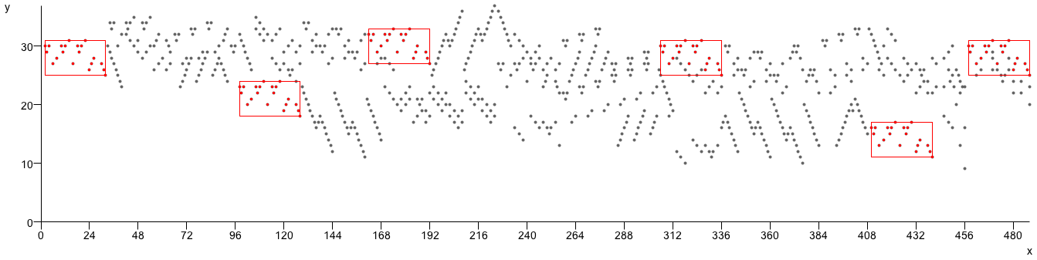
Repeated patterns in music
J.S. Bach, Fugue in C minor, BWV 847
repetition “is the basis of music as an art”
  Schenker (1954, p.5)
Notes:
Accepted among music analysts and music psychologists that identifying perceptually significant repetitions is an essential step in the process of achieving a rich understanding of a piece of music.

Slide 7
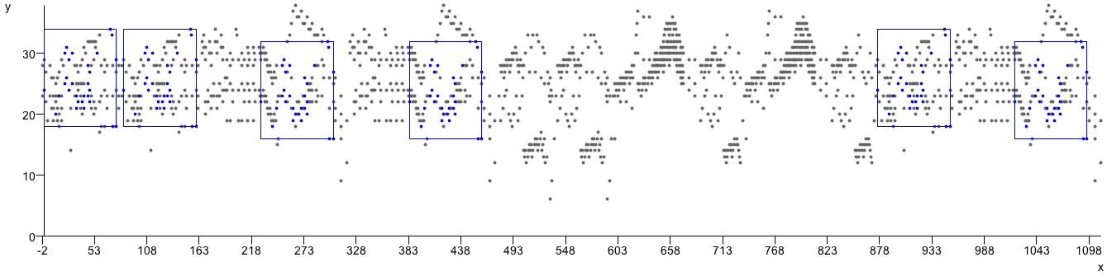
Repeated patterns in music
L. van Beethoven, Piano Sonata, Op.2, No.1, 3rd movement
“the central act” in all forms of music analysis is “the test for identity”
  Bent and Drabkin (1987, p.5)

Slide 8
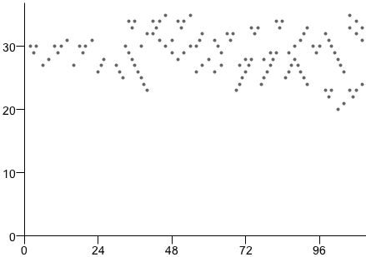
Representing music with point sets

Slide 9
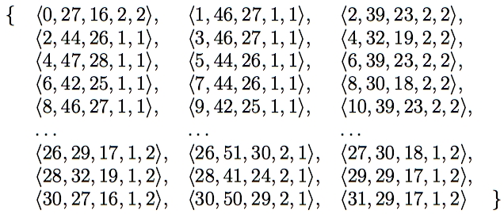
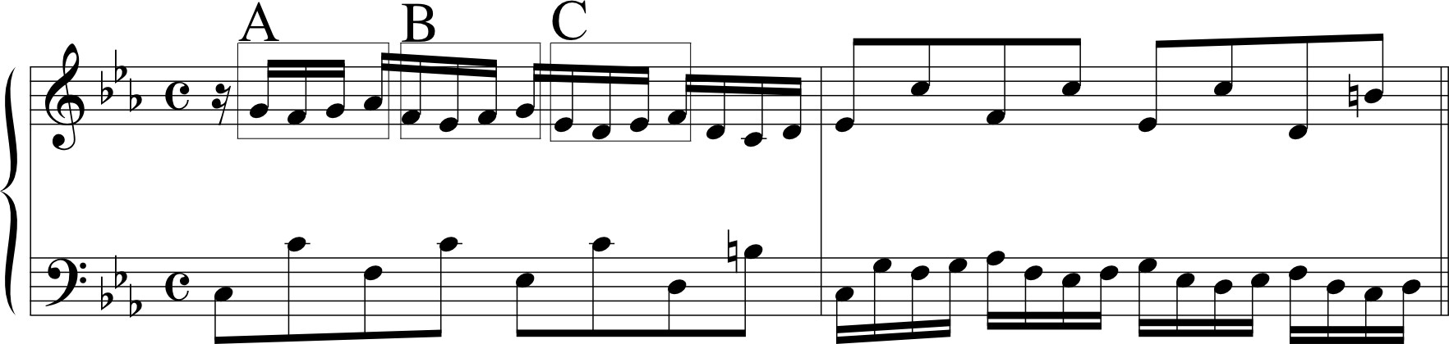

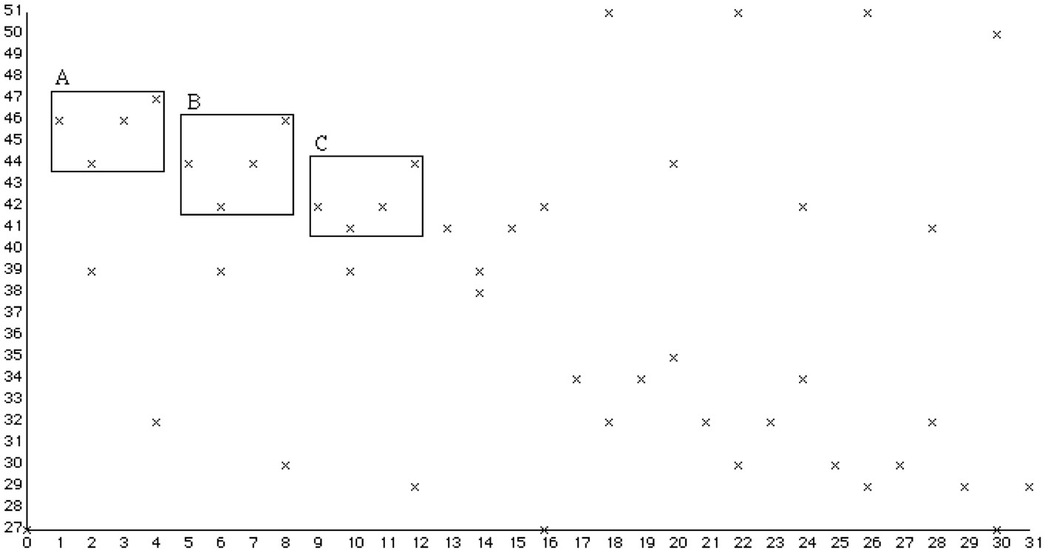
Using multidimensional point sets to represent music (1)
Notes:
I tried to avoid the problems I’ve just described by using multidimensional point sets instead of strings to represent the music and then developing algorithms to work on these point sets.
The algorithms developed work on point sets of any dimensionality.
There are many possible ways of representing a passage of music using a multidimensional point set but the way shown here has proved to be very useful.
Note that patterns A, B and C sound like versions of the same thing but have different representations in the chromatic-pitch-against time representation. Thus, to find these matches in this representation, you’d have to use an approximate matching algorithm.
However, the notation nicely represents the fact that these three patterns are heard as being versions of the same thing by representing each one as a falling step followed by two rising steps.
By using the diatonic pitch dimension and onset time, we can obtain such a representation.

Slide 10
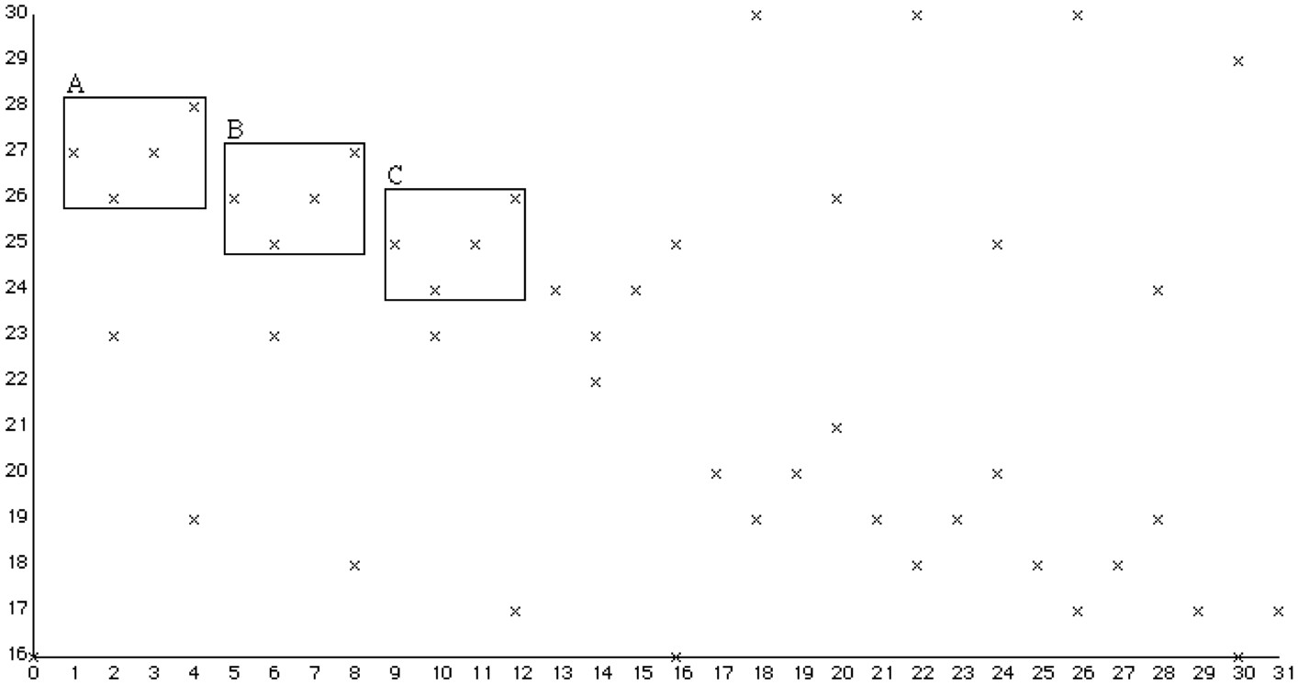
Using multidimensional point sets to represent music (2)
Notes:
However, when we’re trying to find interesting repeated patterns in tonal music, that is, music which has a key, it is often more fruitful to use a two dimensional projection which gives the diatonic pitch of the note and its onset time, as shown here.
Here, patterns A, B and C are exactly translationally equivalent and can thus be discovered using a fast exact matching algorithm.

Slide 11
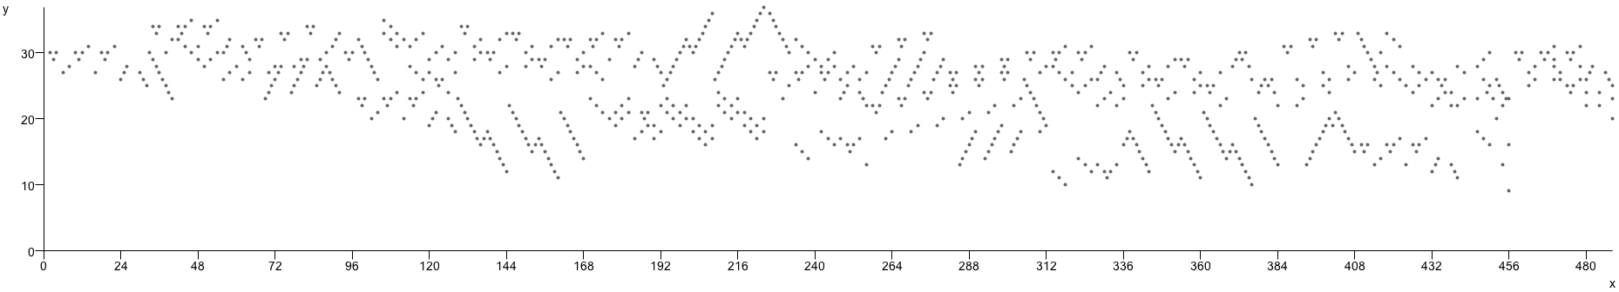
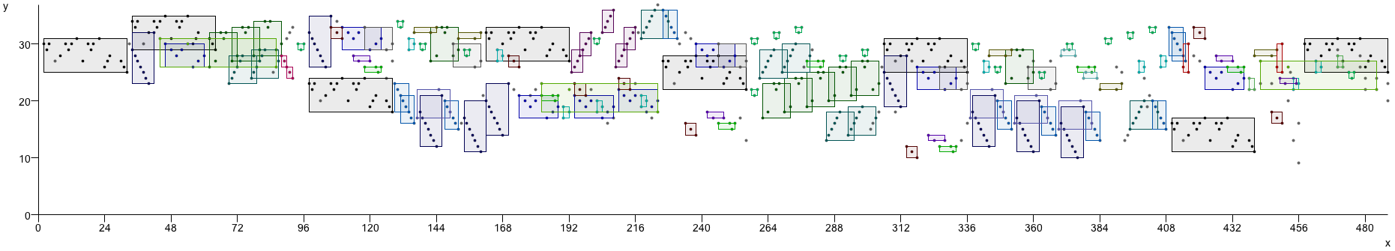
Motives, themes and translatable patterns in pitch-time space

Slide 12
Compression and explanation
Hypothesis: The shortest descriptions provide the best explanations
  Ockham’s razor, MDL, MML, Solomonoff’s theory of inductive inference
Suggests that knowledge can be extracted from data by finding short descriptions of it (i.e., by compressing it)
Identifying the maximal repeated patterns and their occurrences is an excellent strategy for compressing data

Slide 13
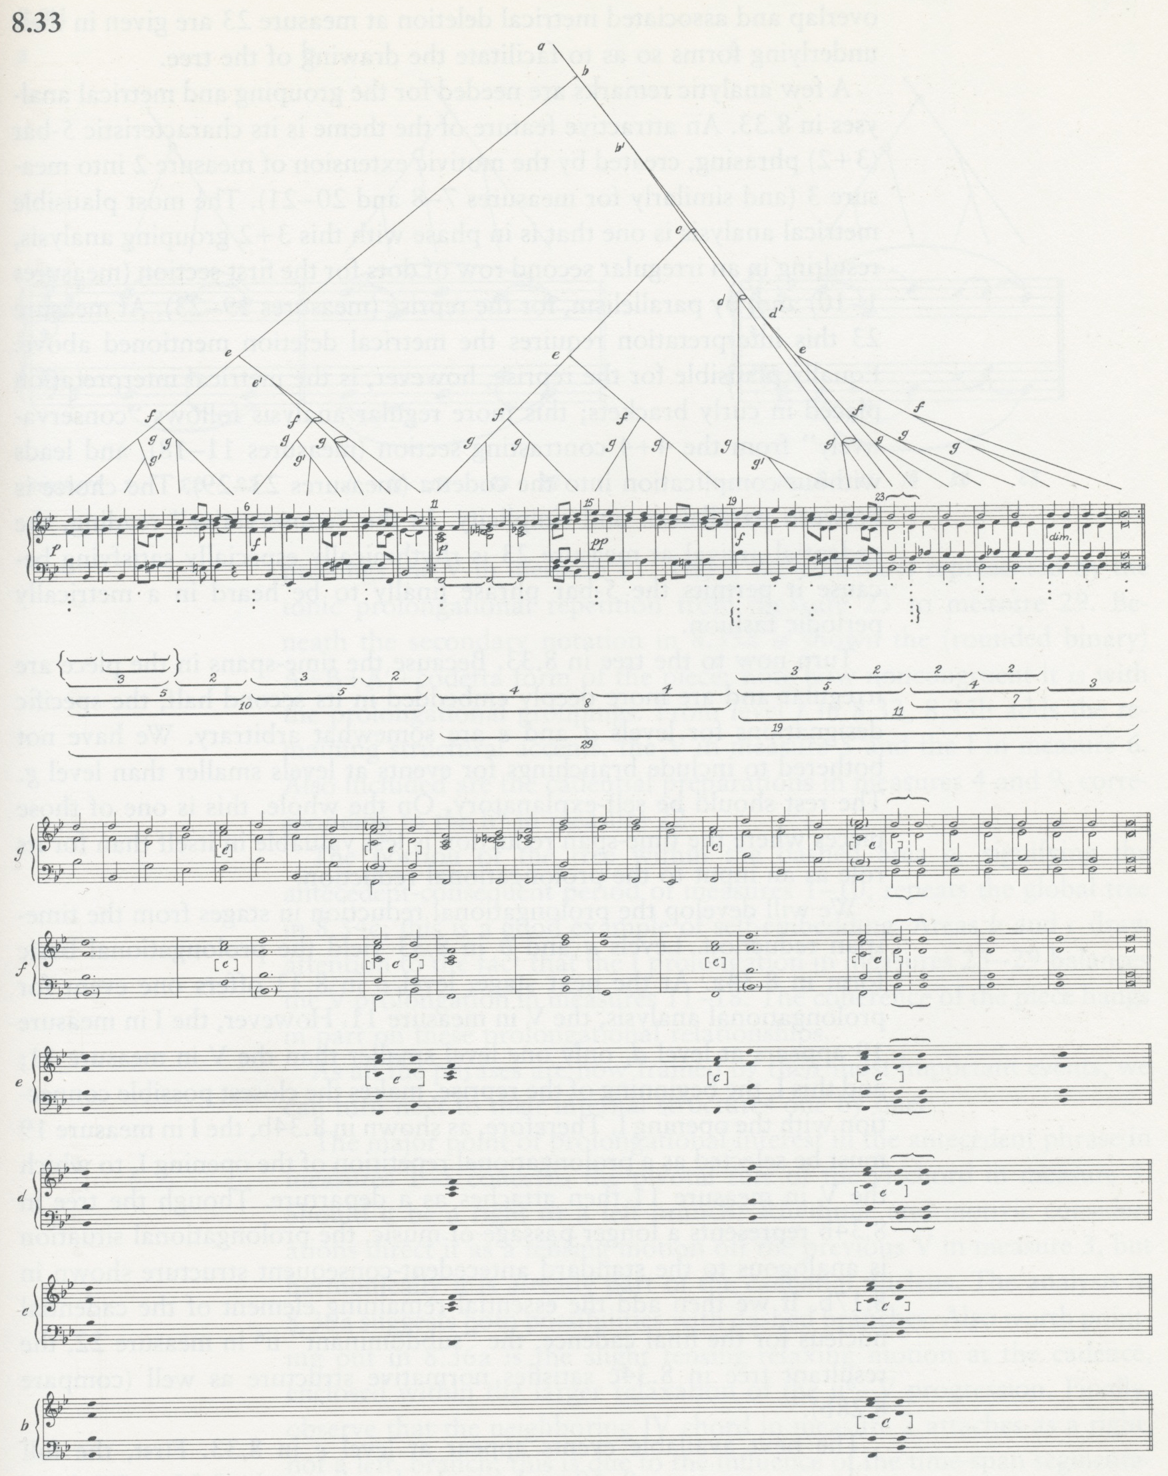
The goal of music analysis
The goal of music analysis is to find the best possible explanations for musical works
  not model how average listeners interpret a piece the first time they hear it
The “best possible” explanation for a musical work is one that allows you to
  remember it most easily
  identify errors most accurately
  predict best what will come next
Lerdahl and Jackendoff (1983, p.205)

Slide 14
A musical analysis as a program
A musical analysis can be represented (or encoded) as a program or algorithm
  The program must generate an in extenso representation of the music to be explained as its only output
The program is usually a compact or compressed encoding of its output
The program is a description of its output
If this description is short enough, it becomes an explanation of its output
Meredith (2012)
Notes:
Some notes
----- Meeting Notes (08/11/2012 15:10) -----
Some meeting notes

Slide 15
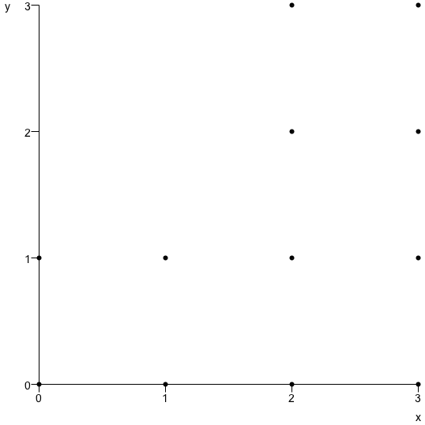
Program length as a measure of complexity
P(p(0,0),p(0,1),p(1,0),p(1,1),p(2,0),p(2,1),p(2,2),p(2,3),p(3,0),p(3,1),p(3,2),p(3,3))
T(P(p(0,0),p(0,1),p(1,0),p(1,1)),V(v(2,0),v(2,2)))
From Kolmogorov (1965) complexity theory:
  can use the length of a program to measure the complexity of its corresponding explanation
  The shorter the program, the simpler and better the explanation

Slide 16
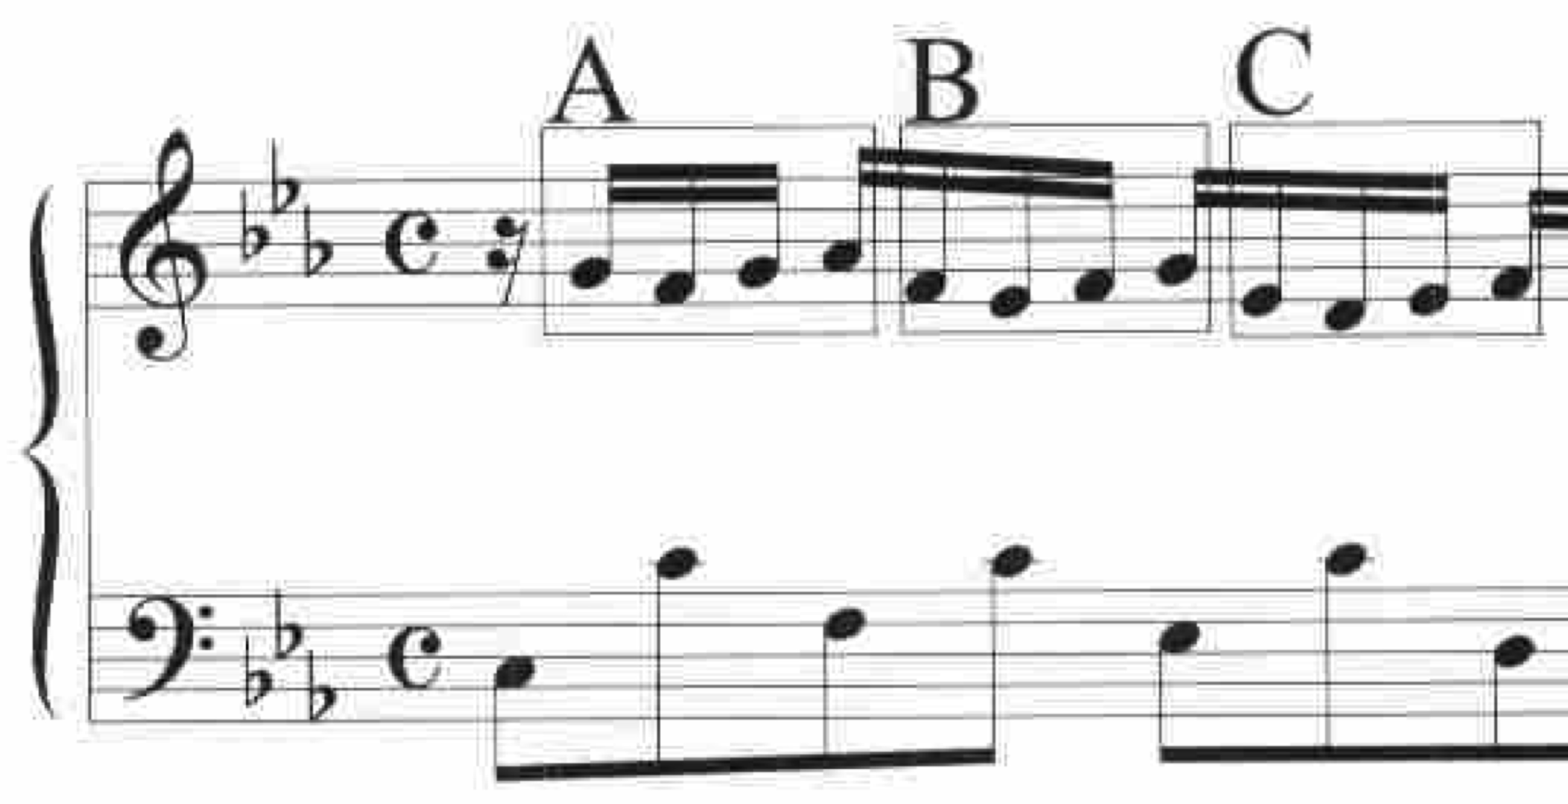
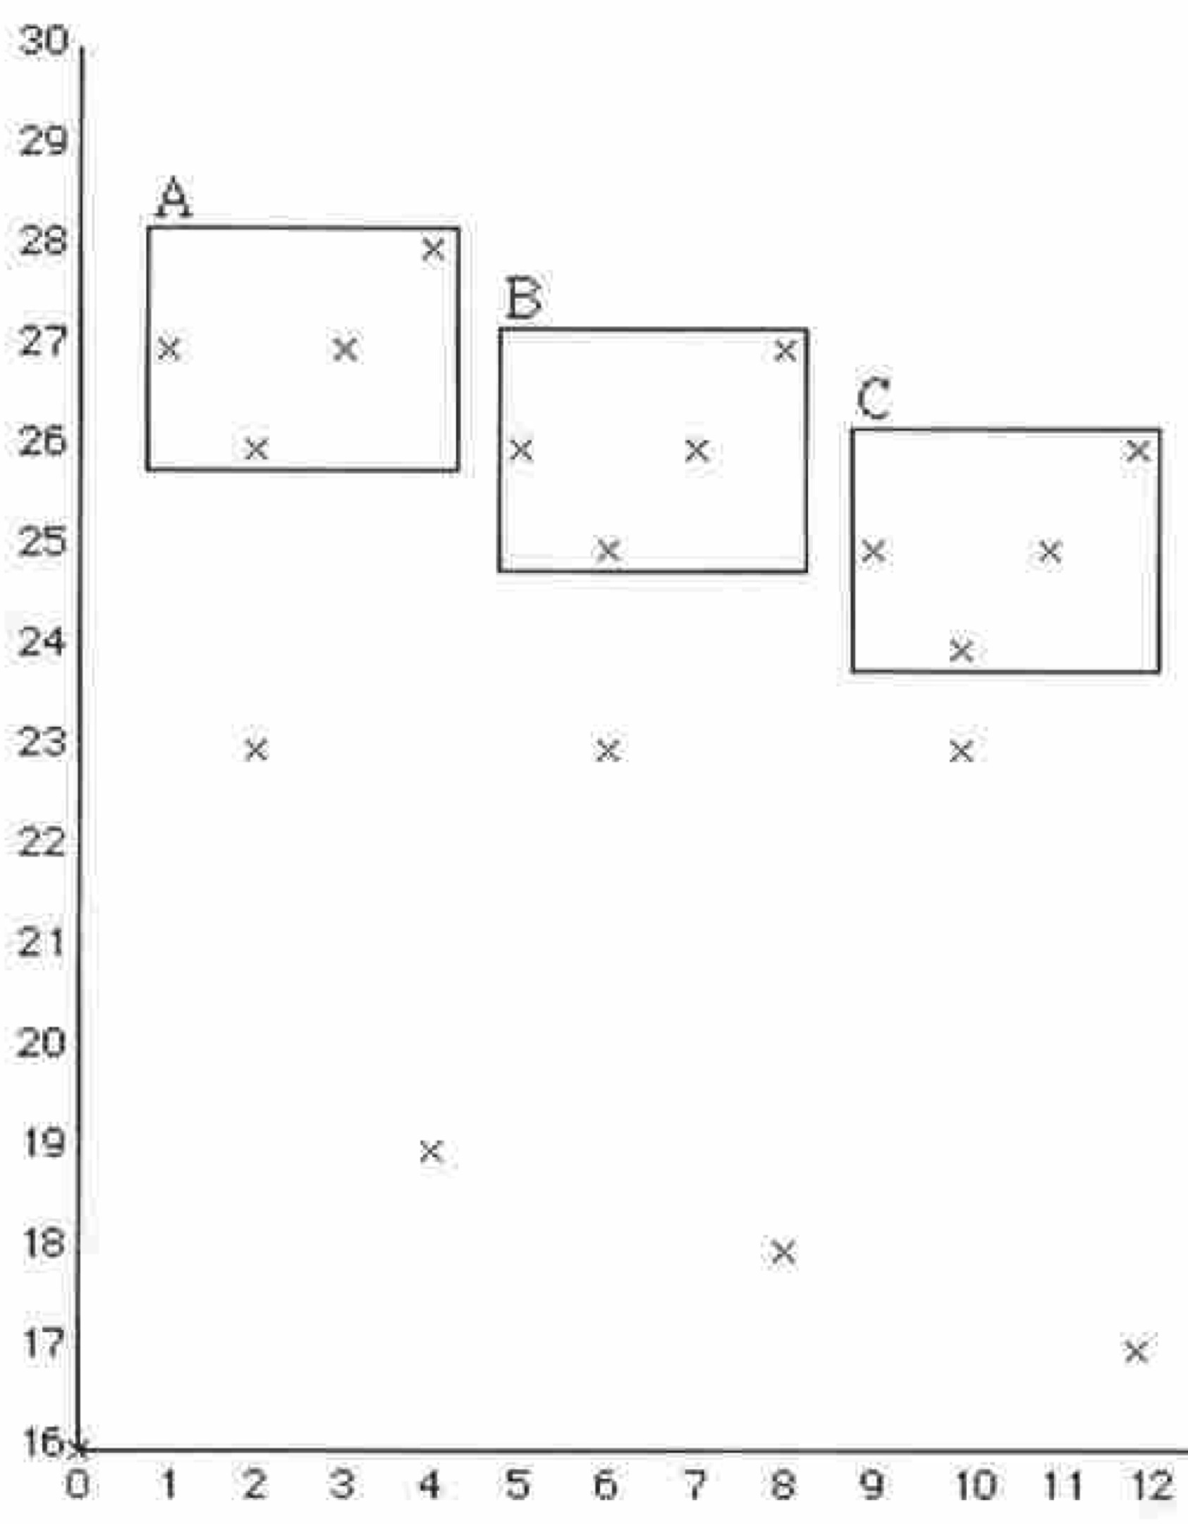
Music analysis aims to compress music
P(p(1,27),p(2,26),p(3,27),p(4,28),p(5,26),p(6,25),p(7,26),p(8,27),p(9,25),p(10,24),p(11,25),p(12,26))
T(P(p(1,27),p(2,26),p(3,27), p(4,28)),V(v(4,-1),v(8,-2)))
Since the best explanations are the shortest descriptions, the aim of music analysis is to compress music as much as possible
Meredith, Lemström and Wiggins (2002)

Slide 17
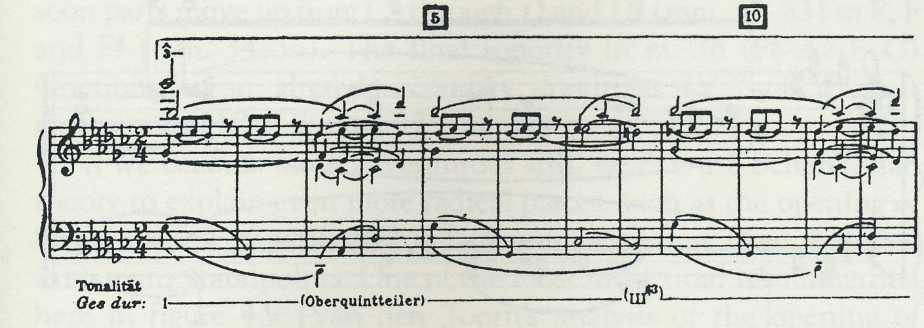
Perceptual organisations of surfaces
Analysis of Chopin Op.10, No.5
Schenker (1925, p.92)
Music analysis aims to find the most successful perceptual organisations that are consistent with a musical surface
  could be a score or a performance
Analysis of first bar of Chopin Op.10, No.5
Meredith (2012)

Slide 18
Musical objects are interpreted in the context of larger containing objects
A musical object (phrase, section, movement, work, corpus, ...) is usually interpreted within the context of some larger object that contains it
  e.g., a work is often interpreted in the context of its composer’s other works (C), or other works in the same genre or form (F) or other works for the same instrument(s) (I)
Corresponds to a two-part code
  characteristic function of the context set
  codeword to identify object as member of this set
M
I
T
W
S
P
C
F

Slide 19
Music analysts look for short programs that compute collections of musical objects
The analyst tries to find the shortest program that computes a set of in extenso descriptions of
  the object to be explained (the explanandum)
  other objects, related to the explanandum, defining a context within which the explanandum is to be interpreted
P

Slide 20
Listener interprets new music in the context of previously heard music
When the (expert) listener interprets a new piece, the existing explanation (program), P, for all music previously heard is modified (as little as possible), to produce a new program, P', to account for the new music in addition
P
P'

Slide 21
Perceived structure represented by process by which object is generated
Perceived structure of new musical object represented by specific way in which P' computes that object
On this view, both music analysis and music perception are the compression of collections of musical objects
P
P'

Slide 22
Perception and analysis are non-optimal compression
Both analyst and (expert) listener aim to find shortest encodings
Neither analyst nor listener achieve this aim in general
Hampered by limitations of memory and perceptual system
    e.g., require recognizable patterns to be fairly compact in pitch-time space (Collins et al., 2011)

Slide 23
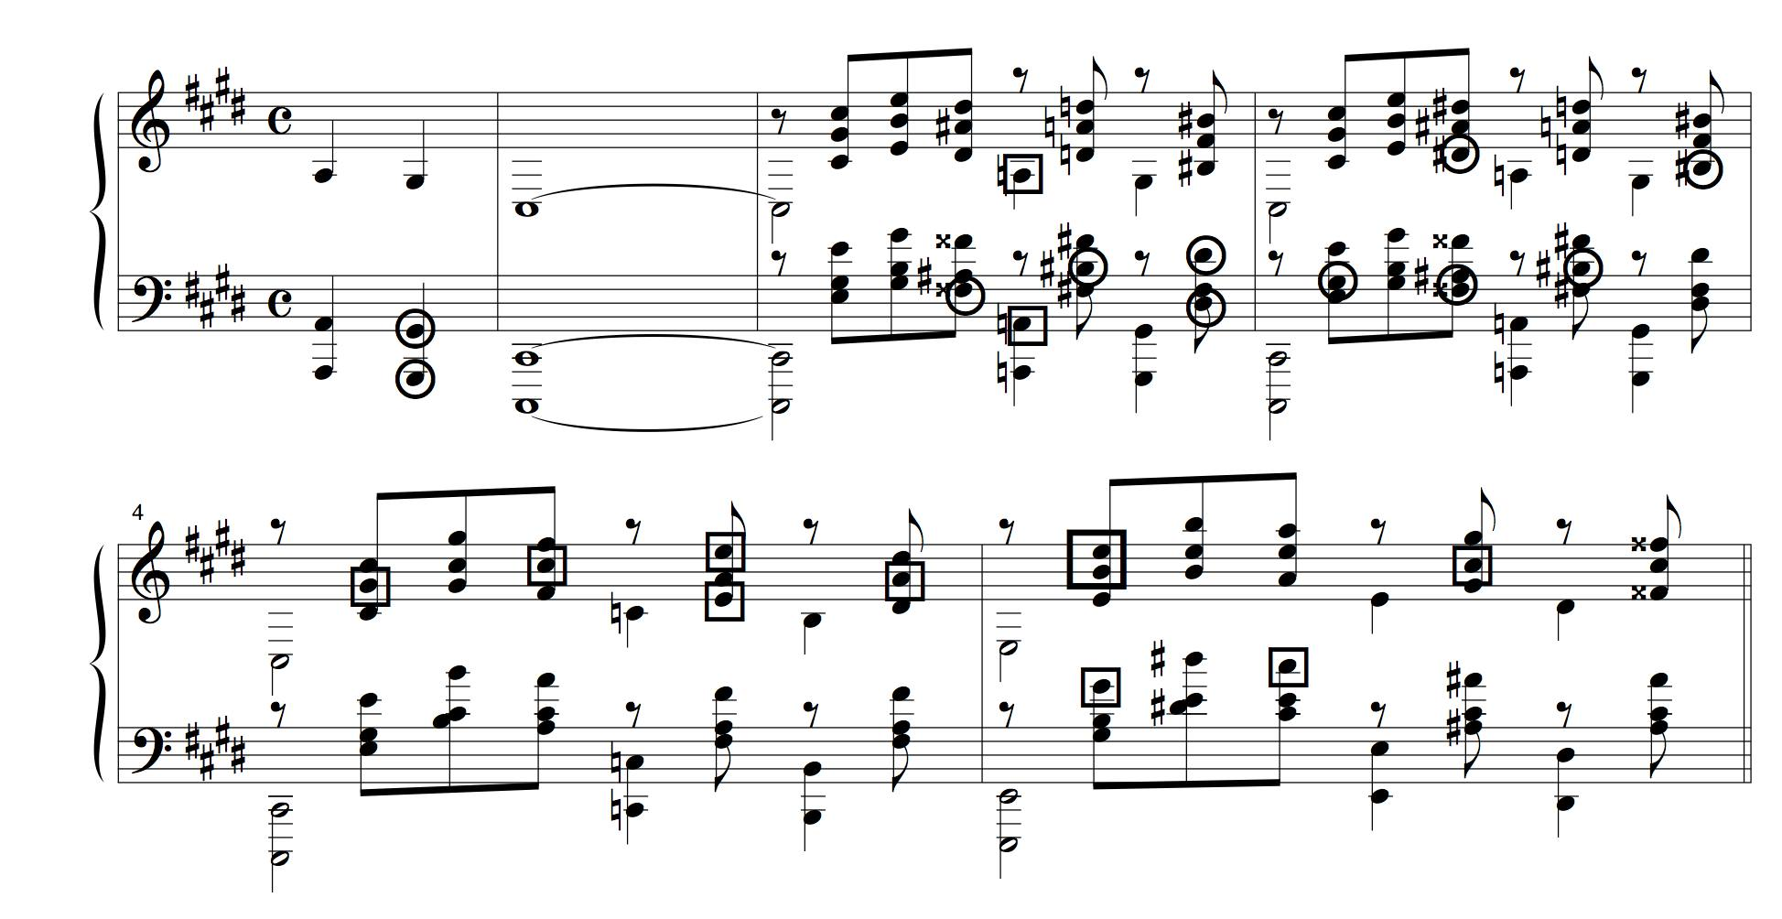
Most musical repetitions are neither perceived nor intended
S. Rachmaninoff, Prelude in C sharp minor, Op.3, No.2
Notes:
Although identifying the important repetitions in a passage of music is an essential part of understanding it, most of the pattern repetitions that occur in music are neither perceived nor intended by the composer.
For example, here we have the first few bars of Rachmaninoff’s Prelude in C sharp minor, Op.3, No.2.
The pattern consisting of the notes in elliptical boxes is repeated 7 crotchets later, transposed up a minor ninth to give the pattern consisting of the notes in square boxes.

Slide 24
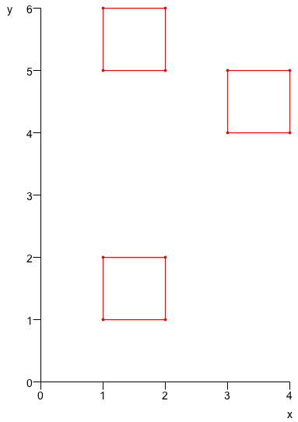
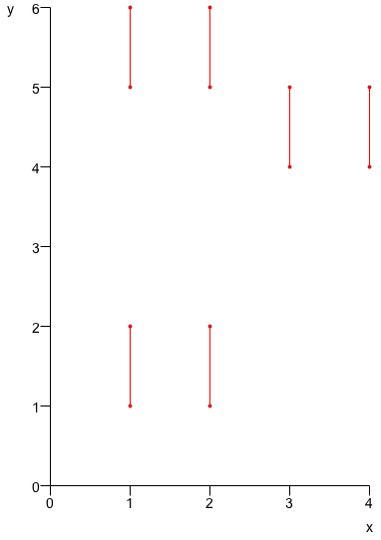
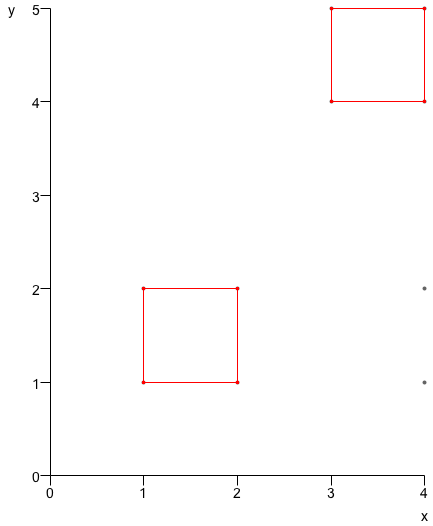
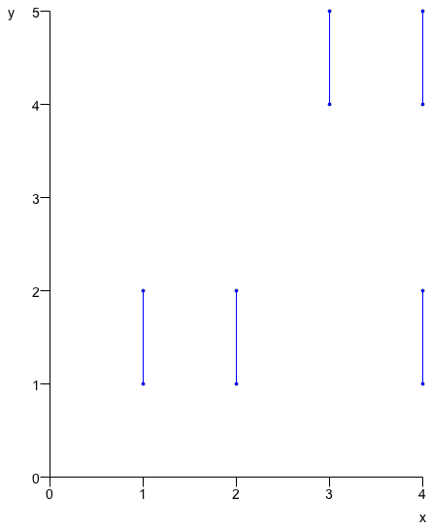
Individual differences depend on order of presentation of context
Prefer to re-use previous encodings wherever possible
  “greedy algorithm”: means that way in which a new object is understood depends on the order of presentation of previous objects
Implies that each individual will have a different interpretation of the same musical object that depends, not only on what previous music has been heard, but also the order in which it was encountered

Slide 25
Music analysis and point-set compression
Meredith, D. (2015). Music analysis and point-set compression. Journal of New Music Research, 44(3):245-270.
  http://www.tandfonline.com/doi/abs/10.1080/09298215.2015.1045003
Meredith, D. (2016). Analysing music with point-set compression algorithms. In Meredith, D. (ed.) Computational Music Analysis, pages 335-366. Springer.
  http://link.springer.com/chapter/10.1007/978-3-319-25931-4_13

Slide 26
Maximal translatable patterns (MTPs)

Slide 27
Translational equivalence classes (TECs)

Slide 28
Compression with TECs

Slide 29
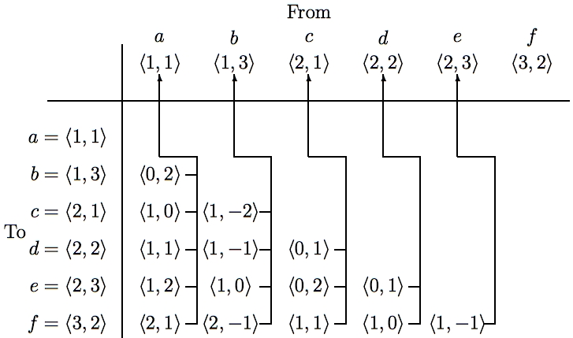
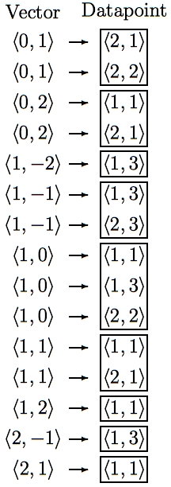
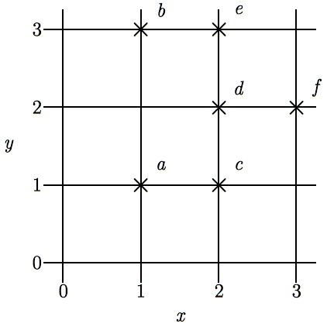
SIA - Discovering all maximal translatable patterns (MTPs)
Pattern is translatable by vector v in dataset if it can be translated by v to give another pattern in the dataset
MTP for a vector v contains all points mapped by v onto other points in the dataset
O(kn² log n) time, O(kn²) space
O(kn²) time if use direct address table to store vectors
Notes:
The first algorithm I’m going to describe is the SIA algorithm which takes as input a multidimensional point set and discovers, for every vector, the points in this point set that are mapped onto other points in the point set by that vector.
For convenience, I’ll call the complete set of points being analyzed the DATASET and any subset of the dataset a PATTERN.
I say that a pattern is TRANSLATABLE by a particular vector within a dataset if it can be translated by that vector to give another pattern in the dataset. For example, the pattern {a,d} here is translatable within this dataset by the vector <1,0>.
And the pattern that contains ALL the points that are mapped onto other points in the dataset by a particular vector is the MAXIMAL TRANSLATABLE PATTERN for that vector. So the maximal translatable pattern or MTP in this dataset for the vector <1,0> is the pattern {a,b,d} and the MTP for the vector <1,1> in this dataset is {a,c}.
So SIA discovers all the non-empty maximal translatable patterns in a dataset.
It does this by first sorting the points in the dataset into lexicographical order and then computing the vector from each point to every other point in the dataset that is lexicographically greater. These vectors are stored in a table like this one here which we call a VECTOR TABLE. And each vector is stored with a pointer that points back to the origin point for which it was computed, as indicated by these arrows here.
The vectors in this table are then sorted into lexicographical order to give a list like the one here on the right and the MTP for each vector can be found directly by reading off the points attached to the adjacent occurrences of that vector in this list.
The most expensive step is sorting the vectors which can be done in O(kn^2 log n) time. However, by storing the origin points in a hash table and hashing the vectors to get the slot indices, this time complexity can be reduced to O(kn^2).
And also, obviously, the space used is O(kn^2)

Slide 30
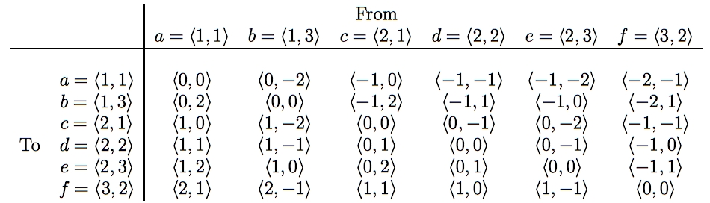
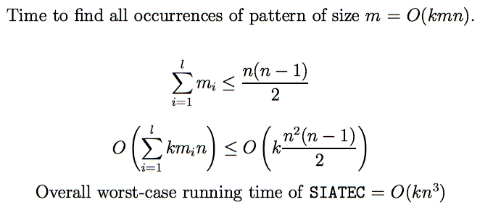
SIATEC - Discovering all occurrences of all MTPs
Translational Equivalence Class (TEC) is set of all translationally invariant occurrences of a pattern
Notes:
SIA only finds one occurrence of each MTP and one vector by which that MTP is translatable within the dataset.
SIATEC, on the other hand, finds all the MTPs using a slightly modified version of SIA and then finds all the vectors by which each MTP is translatable within the dataset.
In other words, it finds all the non-empty MTPs and then all the patterns within the dataset that are translationally equivalent to each MTP.
In SIA, we only needed to compute the vector from each point to every lexicographically greater point because the MTP for a particular vector -v is the same as the pattern that you get by translating the MTP for v by v itself.
However, in this simple implementation of SIATEC, we can find all the occurrences more efficiently by computing all the interpoint vectors and storing them in a table like this one here.
If the points in the dataset are sorted into lexicographical order first, then the vectors in this table increase lexicographically as you descend a column and go from right to left along a row.
Each column contains all the vectors by which the point at the top of the column is translatable within the dataset.
Therefore the set of vectors by which a given pattern in the dataset is translatable is equal to the intersection of the columns headed by the points in that pattern. For example, the pattern {a,c} is translatable within this dataset by the intersection of the columns for which a and c are the original points.
By exploiting the orderedness of this table, we can find all the occurrences of a k-dimensional pattern of size m in a dataset of size n in a worst case running time of O(kmn).
Now, all the MTPs in a dataset can be found by reading through the list of sorted vectors generated by SIA so we know that sum of the cardinalities of the MTPs is less than or equal to n(n-1)/2.
Therefore the worst case time complexity of this implementation of SIATEC is [as shown] which implies that it is O(kn^3).
And, obviously, it uses O(kn^2) space.

Slide 31
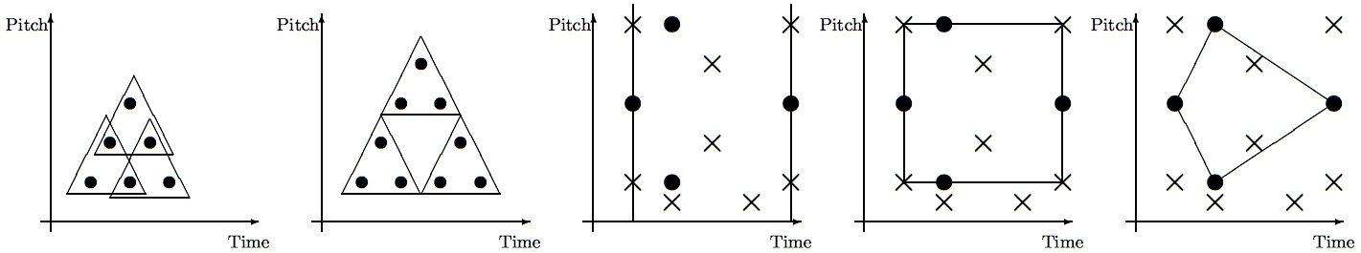
Heuristics for isolating the “best” patterns
Cov=6 CR=6/5 | Cov=9 CR=9/5 | Comp = 1/3 | Comp = 2/5 | Comp = 2/3
Notes:
We found we could go some way towards isolating the themes and motives in a piece of music by using just three simple heuristics which I will now describe.
First, let’s define the coverage of a pattern to be the number of distinct points in the dataset in occurrences of the pattern. For example, the coverage of this triangular pattern in this dataset is 6, but in this dataset, its coverage is 9.
In general, the coverage of a pattern is greater for larger, non-overlapping patterns that occur frequently.
if we represent a passage of music as a set of points in graph of pitch against time, musical themes generally seem to have relatively high coverage.
Next, let’s define the compactness of a pattern to be the ratio of the number of points in a pattern to the number of points in the region spanned by the pattern.
The region spanned by a pattern can be defined in various ways.
For example, we can define the region spanned by a pattern in a pitch-time representation of a passage of music to be the segment containing all the notes that start between the first and last note onsets in the pattern.
Alternatively, we could define the region spanned by a pattern in such a representation to be the bounding box or convex hull of the pattern.
As you can see here, the compactness value obviously depends on how the region spanned by a pattern is defined.
However, musical themes typically have at least one occurrence with relatively high compactness since this will make the pattern easier to perceive. However, other occurrences may be highly embellished and thus have lower compactness.
Another interesting heuristic that seems to be useful for isolating themes is the compression ratio that can be achieved by representing the set of points covered by all the occurrences of a pattern by specifying just one occurrence of the pattern together with all the vectors by which the pattern is translatable within the dataset.
For example, by doing this with the triangular pattern in this dataset, we achieve a compression ratio of 6/5. However, in this dataset, the same pattern can be used to achieve a compression ratio of 9/5.

Slide 32
Dual or conjugate TECs

Slide 33
Redundant translators
Square pattern starting on (0,0) can be translated by (1,0), (2,0), (2,1) and (2,2)
But only need two of these to cover whole dataset
So (1,0) and (2,1) can be removed from the set of translators to give a shorter encoding

Slide 34
COSIATEC
Start
Dataset
SIATEC
List of <Pattern, Translator_set> pairs
Add best TEC, <P,V> to encoding
Remove points covered by <P,V> from dataset
Is dataset empty?
No
Yes
Output encoding
Notes:
We can use SIATEC together with the heuristics I’ve just described to construct a simple compression algorithm which I call COSIATEC. COSIATEC works like this.
First we use SIATEC to generate a list of <Pattern, Translator_set> pairs in which each pattern is an MTP and each translator set contains all the non-zero vectors by which the pattern is translatable within the dataset. This generally gives a more efficient representation of the set of points covered by the occurrences of a pattern.
Then we can use the heuristics I’ve just described - compression ratio, coverage and compactness - to choose the “best” pattern P and this pattern is printed out together with its translator set.
Then all the points covered by P and its occurrences are removed from the dataset.
Then if the dataset is empty, we end; otherwise, we again run SIATEC on the remaining points in the dataset.
The result is a print out of the “best” pattern and its translators for each iteration of the cycle and this printout is usually a compressed representation of the input dataset.
Obviously, the degree of compression achieved depends on the amount of repetition in the dataset.

Slide 35
Forth’s algorithm
(Forth 2012, Forth and Wiggins 2009)

Slide 36
SIACT and SIAR
(Collins et al. 2010, Collins 2011)

Slide 37
SIATECCompress
Adds a TEC to encoding if its <P,Θ> representation is shorter than the set of new points covered

Slide 38
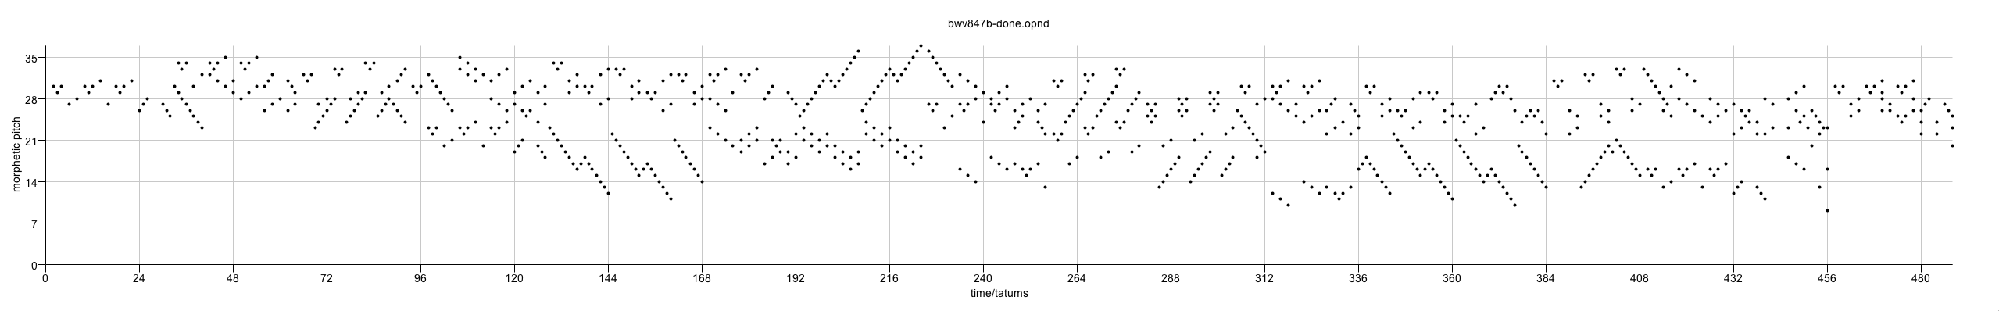
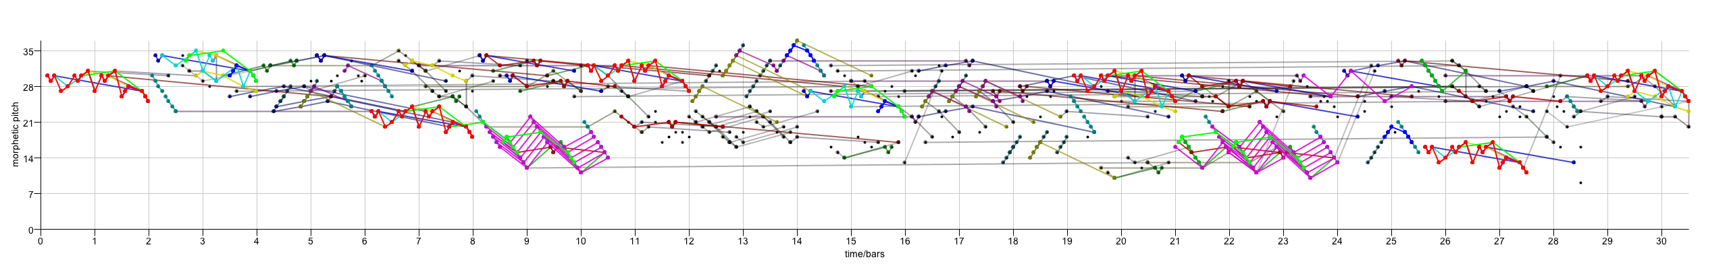
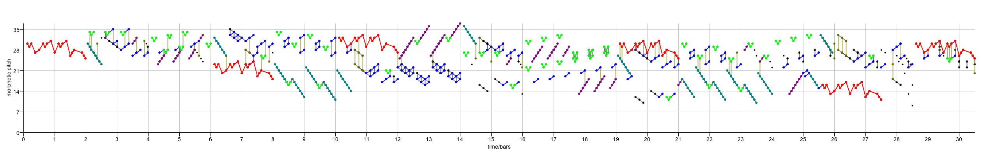
Music analysis and point-set compression
Input point set
J. S. Bach, Fugue in C minor, BWV 847
COSIATEC
SIATECCompress
Forth’s algorithm

Slide 39
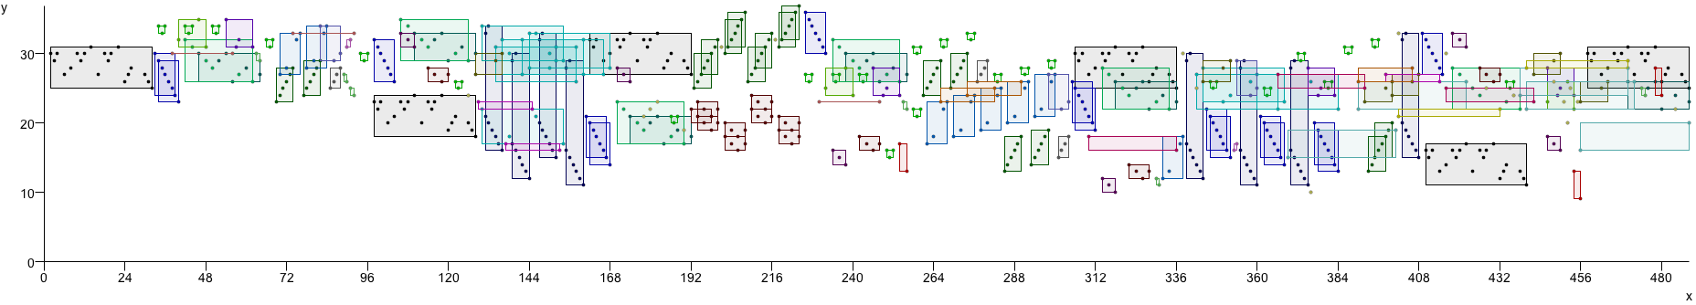
COSIATEC
J.S. Bach, Fugue in C minor, BWV 847
Number of TECs: 26
Encoding length: 268
Number of notes: 751
Encoding length without residual point set: 248
Number and proportion of residual points: 20, 2.66%
Compression ratio: 2.80
Compression ratio excluding residual point set: 2.95

Slide 40
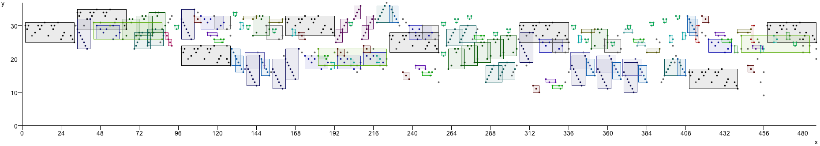
COSIACTTEC
J.S. Bach, Fugue in C minor, BWV 847
Number of TECs: 21
Encoding length: 277
Number of notes: 751
Encoding length without residual point set: 210
Number and proportion of residual points: 67, 8.92%
Compression ratio: 2.71
Compression ratio excluding residual point set: 3.26

Slide 41
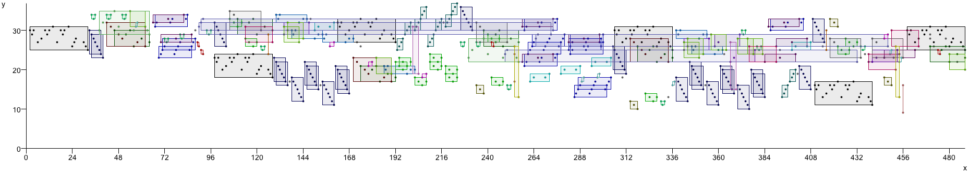
COSIARTEC
J.S. Bach, Fugue in C minor, BWV 847
Number of TECs: 26
Encoding length: 269
Number of notes: 751
Encoding length without residual point set: 248
Number and proportion of residual points: 21, 2.80%
Compression ratio: 2.79
Compression ratio excluding residual point set: 2.94

Slide 42
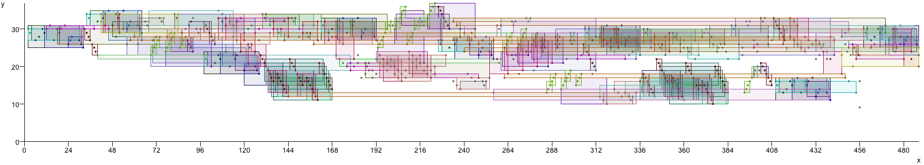
SIATECCompress
J.S. Bach, Fugue in C minor, BWV 847
Number of TECs: 26
Encoding length: 496
Number of notes: 751
Compression ratio: 1.51

Slide 43
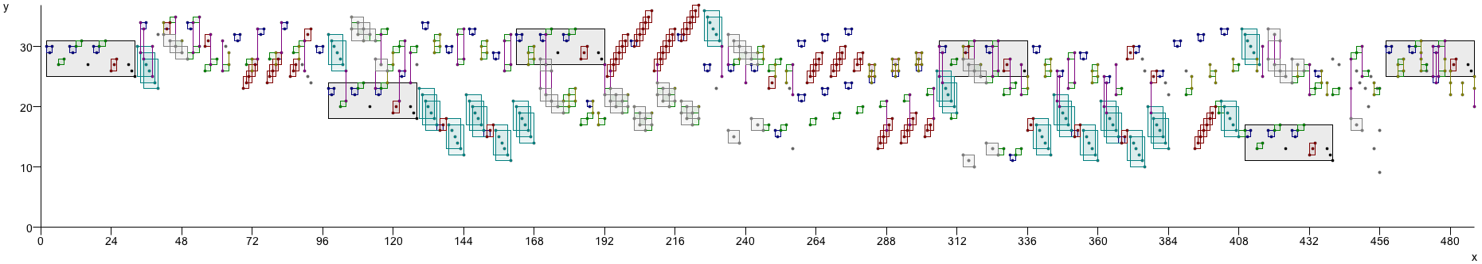
Forth’s algorithm
J.S. Bach, Fugue in C minor, BWV 847
Number of TECs: 8
Compression ratio: 1.4
Encoding length: 534
Number of points in dataset: 751
Total number of points covered: 725
Total proportion of points covered: 0.97

Slide 44
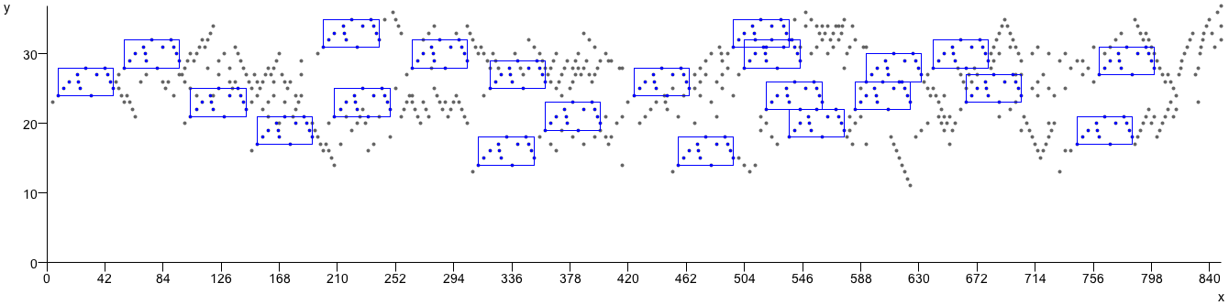
J.S. Bach, Fugue in C major, BWV 846
Fugue in C major, BWV 846
  Input length: 729 points
  Encoding length: 249 points or vectors
  26 TECs used to account for piece
  24 notes (3.29%) not included in repeated patterns
  Compression ratio: 2.93

Slide 45
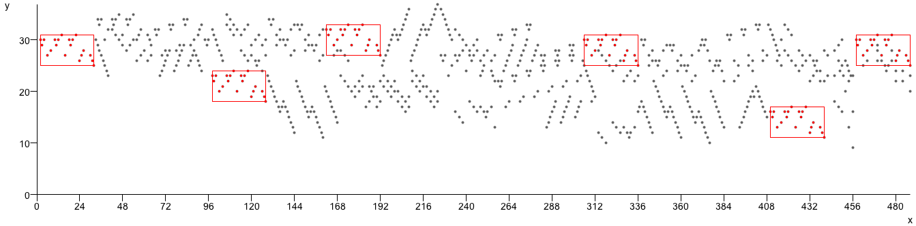
J. S. Bach, Fugue in C minor, BWV 847
Fugue in C minor, BWV 847
  Input length: 751 points (notes)
  Encoding length: 273 points or vectors
  25 TECs (patterns) used to account for piece
  22 notes (2.66%) not included in a repeated pattern
  Compression ratio: 2.75

Slide 46
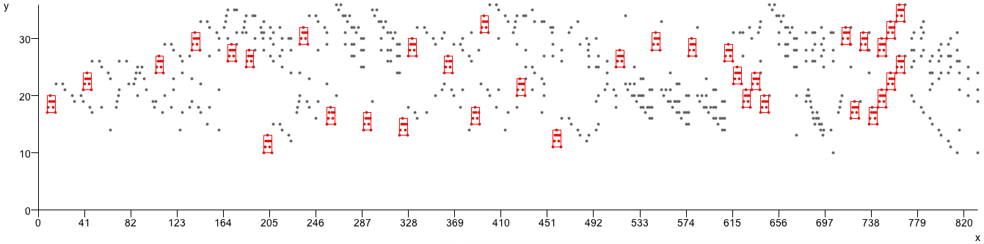
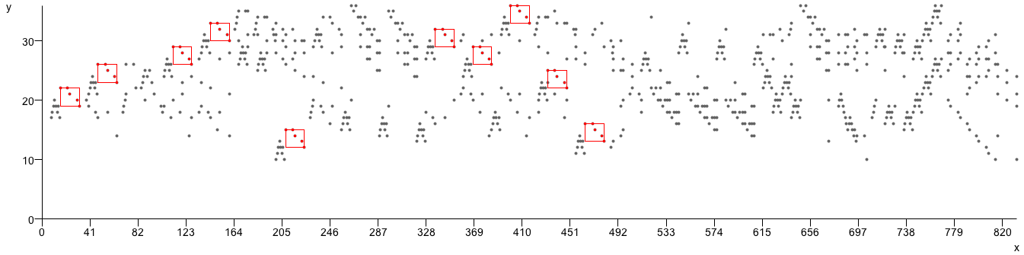
J.S. Bach, Fugue in D major, BWV 850
Fugue in D major, BWV 850
  Input length: 772 points
  Encoding length: 260 points or vectors
  28 TECs used to account for the piece
  Compression ratio: 2.97
  26 notes (3.37%) not included in repeated patterns

Slide 47
Using point-set compression algorithms for folk-song classification

Slide 48
Example COSIATEC encoding of NLB folk song
(NLB015569_01, “Daar zou er een maagdje vroeg opstaan 2”, from the Nederlandse Liederen Bank, http://www.liederenbank.nl. Courtesy of Peter van Kranenburg.)

Slide 49
MIREX 2013:
Discovery of repeated themes and sections
First MIREX competition on pattern discovery
  http://www.music-ir.org/mirex/wiki/2013:Discovery_of_Repeated_Themes_%26_Sections
JKU Pattern Development database
  https://dl.dropbox.com/u/11997856/JKU/JKUPDD-noAudio-Jul2013.zip
  Five pieces, each with a set of “ground-truth” patterns (occurrence sets)
    Patterns come from analyses by well-known analysts (e.g., Schoenberg, Bruhn)

Slide 50
Johannes Kepler University Patterns Development Database
(JKU-PDD)
Gibbons, “Silver Swan” (madrigal) (1612)
J. S. Bach, Fugue in A minor (BWV 889) from 2nd book of the WTC (1742)
Mozart, Piano Sonata in E flat major (K. 282), 2nd movement (1774)
Beethoven, Piano Sonata in F minor, Op.2, No.1 (1795)
Chopin, Mazurka in B flat minor, Op.24, No.4 (1836)

Slide 51
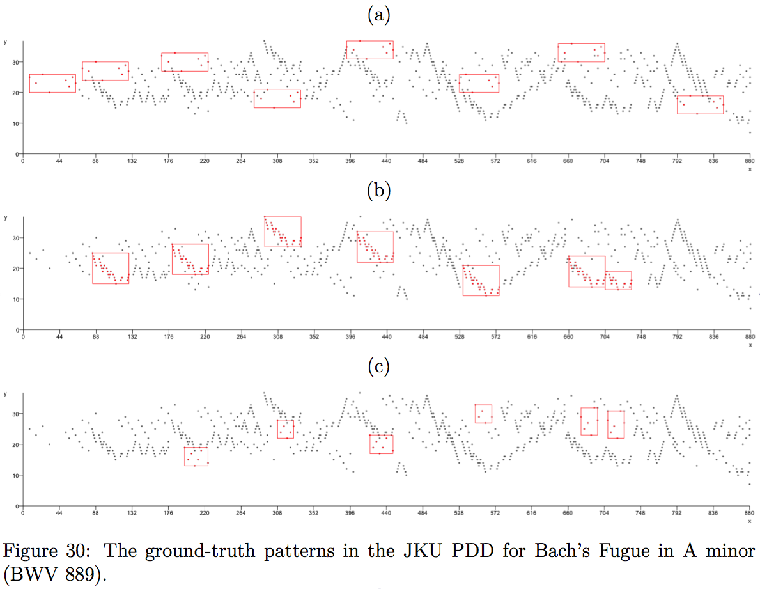

Slide 52
Raw, BB and Segment modes

Slide 53
Point-set compression algorithms on JKU-PDD

Slide 54
Results on MIREX 2013 test set
DM10 (SIATECCompressSegment) generally performed best overall
Full results available at
http://www.music-ir.org/mirex/wiki/2013:Discovery_of_Repeated_Themes_%26_Sections_Results

Slide 55
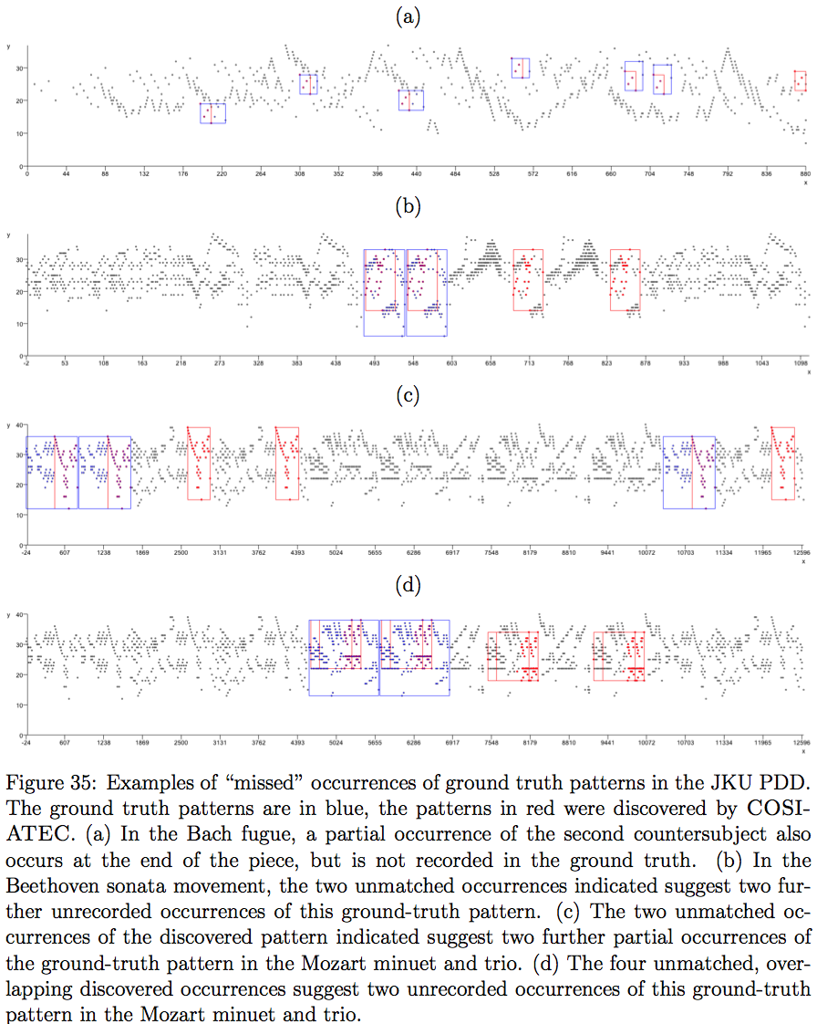

Slide 56
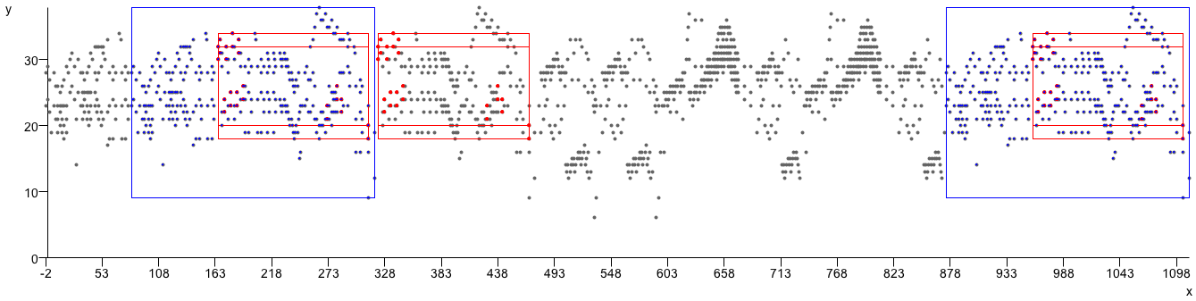
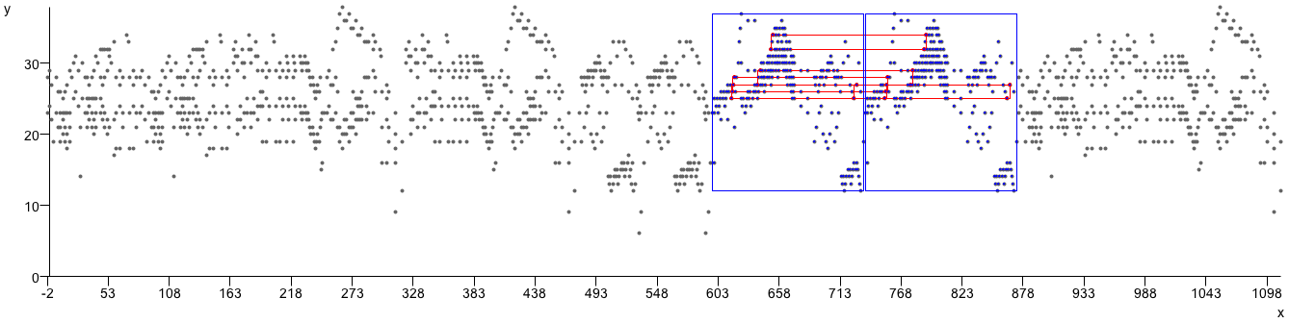
Example outputs
Blue = ground-truth, Red = COSIATEC

Slide 57
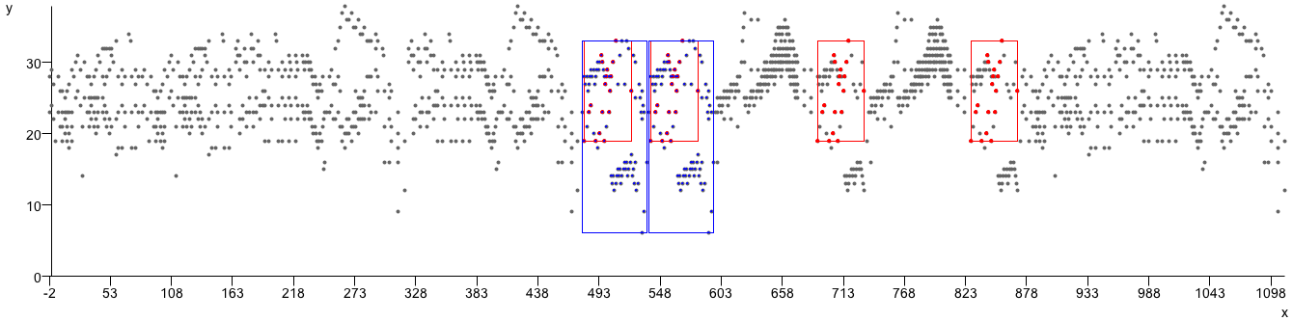
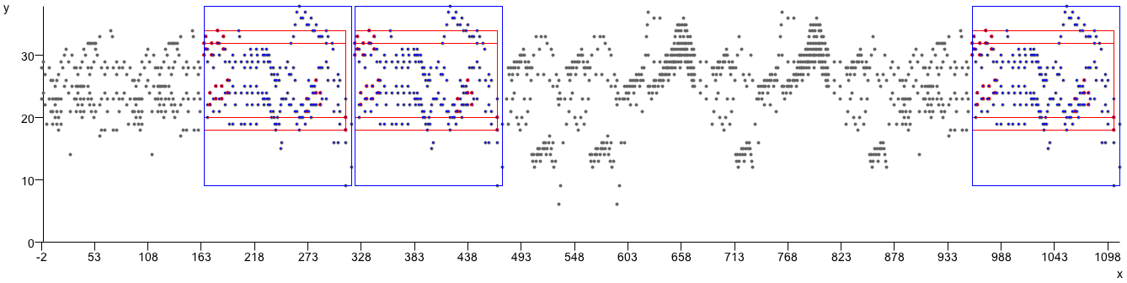
Example outputs
Blue = ground-truth, Red = COSIATEC

Slide 58
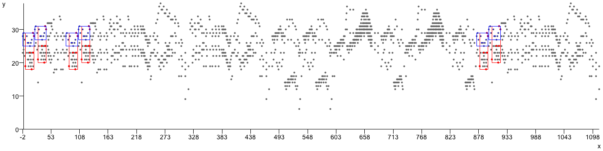
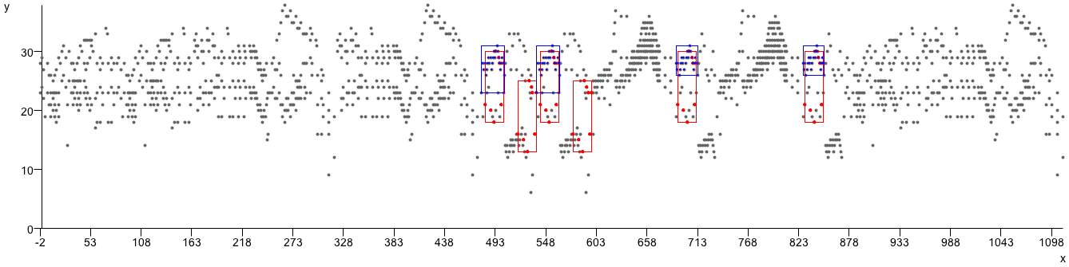
Example outputs
Blue = ground-truth, Red = COSIATEC

Slide 59
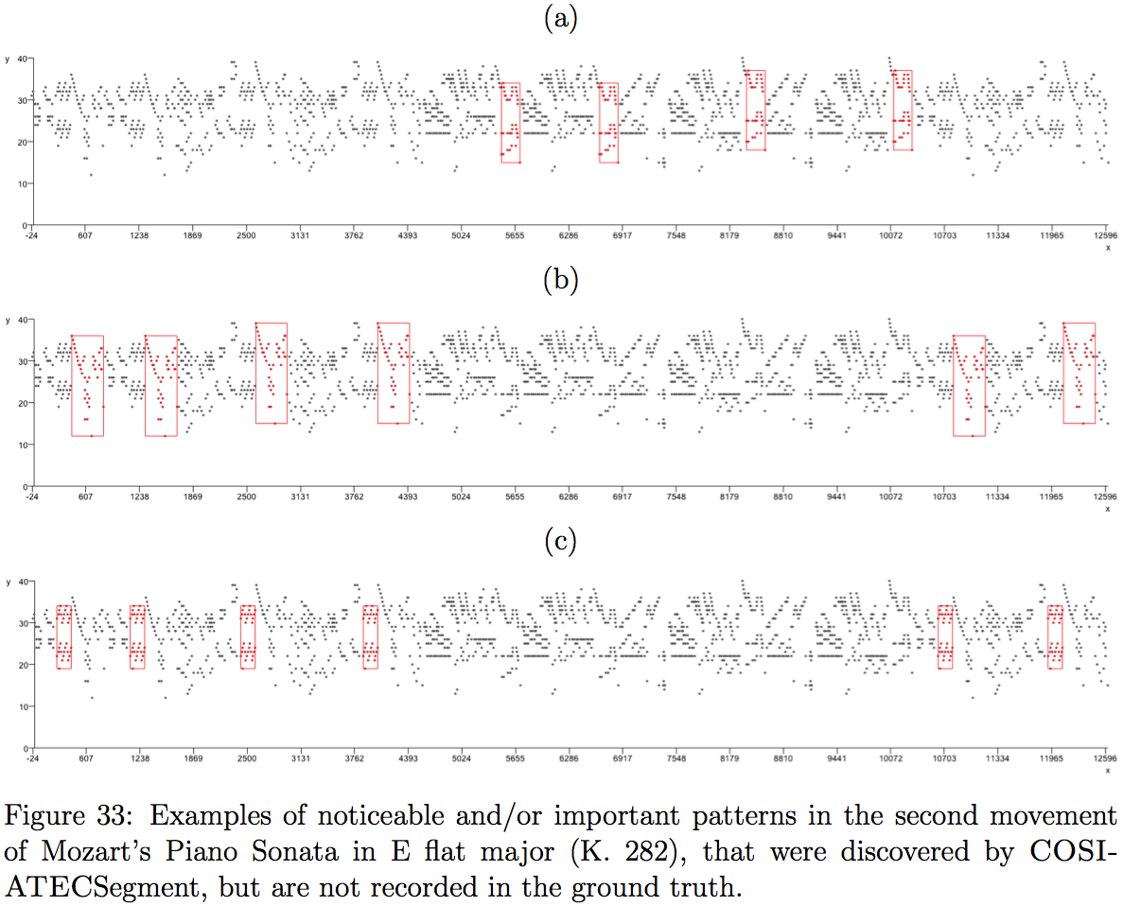

Slide 60


Some interesting non-ground-truth patterns discovered by COSIATEC

Slide 61
Some interesting non-ground-truth patterns discovered by COSIATEC

Slide 62
Discovering fugue subjects and counter subjects in WTC1

Slide 63
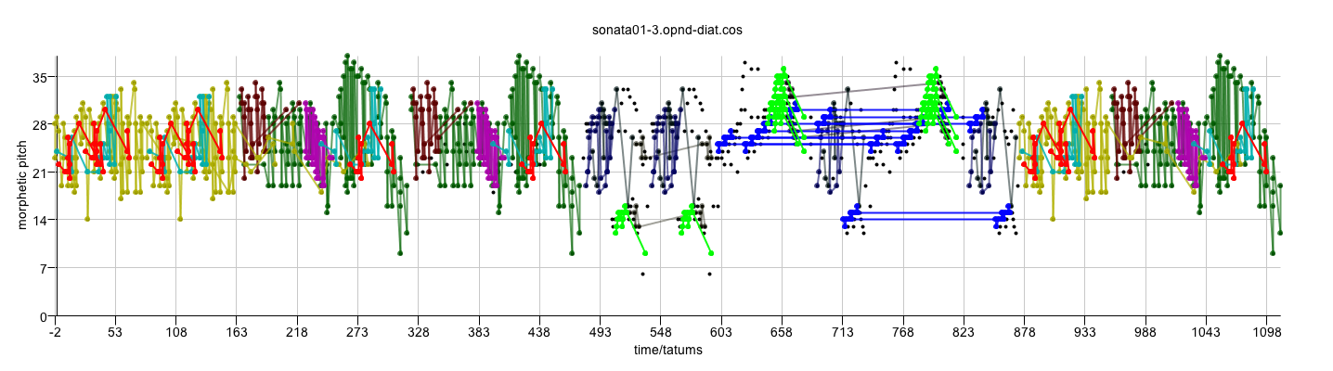
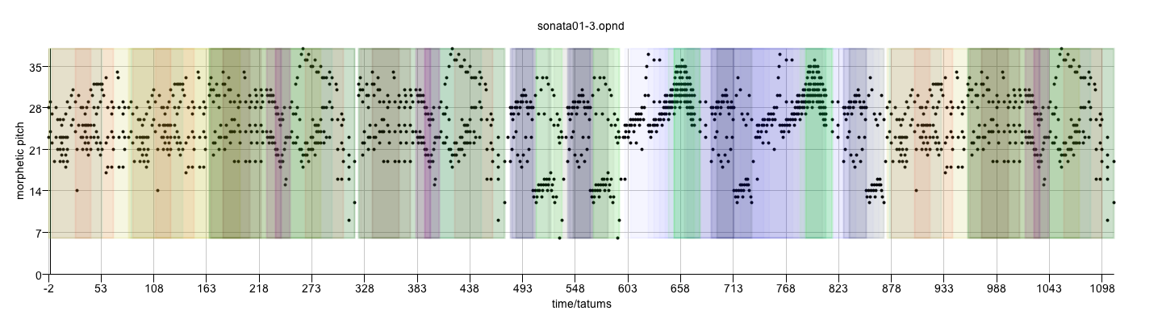
From point-set analyses to segmentations

Slide 64


Generating segmentations from point-set analyses
Using segmentations generated from point-set analyses for
  improving expressive performance (with OFAI)
  automatically generating large-scale structures of lounge music pieces to constrain generation (with SONY)

Slide 65
Using general-purpose compression algorithms for music analysis
Louboutin, C. and Meredith, D. (2016). Using general-purpose compression algorithms for music analysis. Journal of New Music Research, 45(1):1-16.

Slide 66
Results of point-set compression algorithms does not fully support parsimony principle – why?

Slide 67
Using general-purpose compression algorithms for music analysis
Compared LZ77, LZ78, Burrows-Wheeler and COSIATEC on classifying folk songs in the NLB
  k-nearest neighbour
  combined representations (ensemble) classification method
  novel similarity metric, corpus compression distance, based on NCD
Compared LZ77 and COSIATEC on discovery of fugue subject and countersubject entries in WTC1

Slide 68
Viewpoints

Slide 69
Corpus compression distance
NCD is not constrained to being between 0 and 1
For two different compression algorithms, the range of NCD values is different
We wanted to combine NCD values from different compressors to get a new measure of similarity
We therefore defined corpus compression distance as the normalized NCD over the corpus:

Slide 70
Single-viewpoint NLB classification

Slide 71
Combined viewpoints NLB classification
(Ensemble classifiers)
10’ is obtained by combining 8 of the 10 best compressed viewpoints, omitting (LZ77, int0 * ioi) and (COSIATEC,int)

Slide 72
Comparing LZ77 and COSIATEC on discovery of fugue subject and countersubject entries
Correlation between CF and TLF1: r= 0.86, N = 9, p = 0.003
(NB: SIATECCompressBB achieved TLF1 of 0.301)

Slide 73




SIAM - Pattern matching using SIA (Finding maximal matches)
Query pattern
Dataset
O(knm log(nm)) time
O(knm) space
O(knm) average time with hashing
Notes:
SIA can easily be adapted for point set pattern matching, that is, for finding all the maximal matches under translation of a query point set of size m within some dataset of size n.
Let’s suppose we want to find, for each possible vector, the best match for this k-dimensional query pattern in this k-dimensional dataset.
We sort the points in the query pattern and the points in the dataset into lexicographical order and then compute the vector from each query pattern point to each dataset point and store the vectors in a vector table like this with a pointer from each vector back to its origin point.
Then we sort the vectors in this table to get a list like this.
The maximal match for a given vector is given by the points attached to the consecutive occurrences within this list of the vector.
This algorithm works in O(knm log(nm)) time and O(knm) space. But, again, by storing the origin points in a hash table and hashing the vectors to get the slot indices, the average time complexity can be reduced to O(knm).
Note that to do this in the completely naive way by trying all possible alignments between the query and the dataset and then seeing which query points match up for each alignment would take O(kn^2m^2) time.

Slide 74
Improving SIAM - Ukkonen, Lemström & Mäkinen (2003)
Use sweepline-like scanning of the dataset (Bentley and Ottmann, 1979)
Generalized to approximate matching of sets of horizontal line-segments
Improved running time to O(mn log m) (without hashing) and working space to O(m)

Slide 75
Improving SIAM - MSM
(Clifford et al., 2006)
Finding size of maximal match is 3SUM hard (i.e., O(n²) )
Reduce problem of multi-dimensional point-set matching to 1d binary wildcard matching
  Random projection to 1D
  Length reduction by universal hashing
  Binary wildcard matching using FFTs
  Find best match and check in O(m) time exactly how many points match at the location that can be inferred from this match
Reduces time complexity to O(n log n)

Slide 76
Evaluating MSM: Precision-Recall
Compared with OMRAS (Pickens et al., 2003)
Test set of 2338 documents, 480 used as queries
All score encodings in strict score time
Queries had notes deleted, transposed and inserted

Slide 77

Evaluating MSM: Running time
Run on prefixes of various sizes of first movement of Beethoven’s 3rd Symphony
Each prefix matched against itself
Compared with largest common subset algorithm of Ukkonen, Lemström and Mäkinen (2003)
  MSM nearly 2 orders of magnitude faster (log scale)

Slide 78
Demo of OMNISIA

Slide 79
The “Kolmogorov-Shannon” Divide
Kolmogorov
assumes data is ordered
complexity
simplicity (Koffka)
top-down
MDL principle
hierarchical structure
music analysis
composition
explanation
stories
algorithms
explicit learning
conscious
determinism
Lerdahl and Jackendoff
Browne and Butler
SIA
Shannon
assumes data is random
entropy
likelihood (Helmholtz)
bottom-up
Bayesiansm
Markov models
music perception
listening
prediction
counting
probability
implicit learning
unconscious
indeterminism
Meyer, Huron
Krumhansl
IDyOM

Slide 80

Problems with string-based approach - Polyphony
If searching polyphonic music and
  do not know voice to which each note belongs (e.g., MIDI format 0 file); or
  interested in patterns containing notes from 2 or more voices
then
  combinatorial explosion in number of possible string representations
  if don’t use all possible representations then may not find all interesting patterns

