Slide 1
Real-Time Software Design
Medialogy, 7th Semester http://mea.imi.aau.dk/course/view.php?id=8 Aalborg University David Meredith dave@imi.aau.dk

Slide 2
Sources
Sommerville, I. (2007). Software Engineering (8th Edition). Addison-Wesley. Chapter 15.
Stevens. P. and Pooley, R. (2006). Using UML: Software Engineering with Objects and Components (2nd Edition). Pearson Education/Addison-Wesley. Chapters 11-12.
Fowler, M. (2004). UML Distilled: A Brief Guide to the Standard Object Modeling Language (3rd Edition). Pearson Education/Addison-Wesley. Chapters 10-11.

Slide 3
Objectives
Introduce techniques used in designing real-time systems
Describe some generic real-time system architectures
Understand concept of a real-time system
Understand why real-time systems usually implemented as concurrent processes
Introduce a design process for real-time systems
Understand role of a real-time operating system
Know the generic process architectures for
monitoring and control systems
data acquisition systems

Slide 4
Introduction
Embedded, real-time software
controls a wide range of systems ranging from domestic machines to manufacturing plants
runs on computers that interact directly with hardware devices
reacts to events generated by the hardware and issues control signals in response to these events
responds in real time to events from the system’s environment
i.e., must respond within some (usually short) maximum time interval following an event

Slide 5
Definition of a real-time system
A real-time system is a software system where the correct functioning of the system depends on the results produced by the system and the time at which these results are produced.
A soft real-time system is one whose operation is degraded if the results are not produced according to the specified timing requirements.
A hard real-time system is one whose operation is incorrect if results are not produced according to the timing specification.

Slide 6
Speed is not necessarily important in a real-time system
A real-time system must produce its results within some specified maximum time interval of receiving an event.
This time interval is not necessarily a short interval
e.g. an automatic plant watering system would test the dryness of the soil at intervals but it is not critical that it activates the water supply within microseconds of taking a reading

Slide 7
Stimulus/Response Model of a Real-Time System
Real-time system is a stimulus/response system
Given a particular stimulus, system must produce an appropriate response
Can define behaviour of a real-time system by specifying:
the different types of stimuli received by the system
the appropriate response for each stimulus
the time interval within which each response must be produced

Slide 8
Periodic and Aperiodic Stimuli
Periodic stimulus
Inter-stimulus interval is constant
e.g., a sensor might be polled every 50ms
Aperiodic stimulus
Inter-stimulus interval is variable
Usually signalled using interrupts

Slide 9
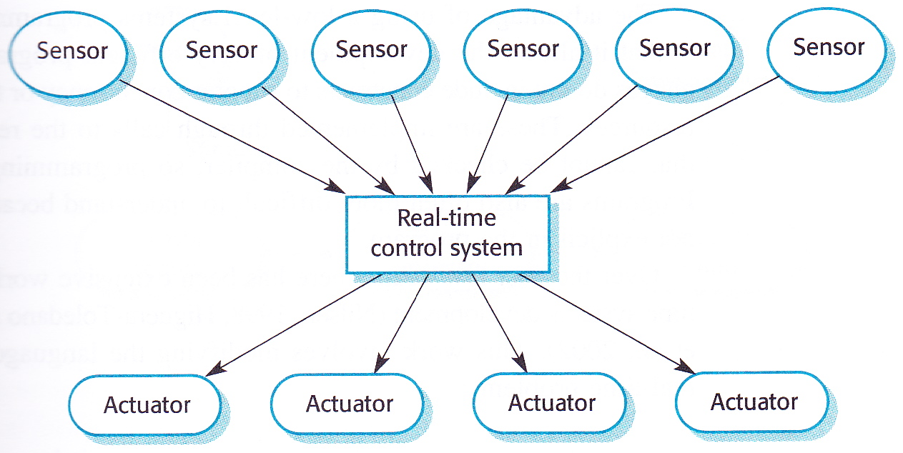
Sensor-System-Actuator Model
Periodic stimuli usually generated by sensors
Provide information about environment
System responds by sending messages to actuators
Usually control equipment that affects environment
Aperiodic stimuli
can be generated by actuators or sensors
often indicate exceptional condition (e.g., hardware failure)

Slide 10
Real-time operating system
Real-time system responds to stimuli that occur at different times
As soon as a stimulus is received, control is transferred to the correct handler
Therefore real-time systems normally designed as a set of concurrent, co-operating processes
Real-time operating system supports management of concurrent processes
Real-time facilities in operating system accessed through run-time support system for the real-time programming language used

Slide 11
Stimulus-Response Architecture
Three types of concurrent process:
sensor management process for each type of sensor
computational processes compute required responses
actuator control processes manage the actuators
Real-time architectures are instances of event-driven architecture in which stimuli generate events
Will also introduce two other architectures
monitoring and control system architecture
data-acquisition architecture

Slide 12
Programming languages for real-time systems
Must include facilities for accessing system hardware
Must be able to predict the timing of particular operations
Hard real-time systems that require a very fast response still sometimes programmed in assembly language
C is also widely used as there exist sophisticated compilers that can generate very efficient code
However, low-level languages do not provide good support for concurrency and management of shared resources
Have to be implemented as calls to the real-time operating system that cannot be checked at compile-time and are therefore hard to debug

Slide 13
Real-time programming in Java
Real-Time Specification for Java (RTSJ) (JSR 1)
http://jcp.org/en/jsr/detail?id=1
http://jcp.org/aboutJava/communityprocess/mrel/jsr001/index2.html
Specification for extending the specifications of the Java Language and the Java VM to provide an API for creation, verification, analysis, execution and management of Java threads whose correctness conditions include timeliness constraints (also known as real-time threads)

Slide 14
RTSJ guiding principles
Should apply to all Java environments
Should be backwards-compatible with non-real-time Java code
“Write Once, Run Anywhere” is important, but not as important as predictability
Should support current real-time system practice and allow for future developments
Predictable execution is first priority
No syntactic extension to standard Java language
Should specify semantics without limiting implementation (e.g., should not specify particular algorithms)

Slide 15
Overview of enhanced areas in RTSJ
Thread scheduling and dispatching
Allows for various different scheduling strategies
Memory management
automatic memory allocation and reclamation (garbage collection) specification that
does not depend on particular GC algorithm
Synchronization and resource sharing
implementation of synchronized include methods for preventing priority inversion
priority inversion is when a high-priority thread cannot access a resource because a lower priority thread already has a lock on it
Asynchronous event handling
classes represent things that can happen and the logic that executes when those things happen
execution of logic scheduled by an implemented scheduler
Asynchronous transfer of control
current point of logic executiong can immediately and efficiently be transferred to another location
RTSJ includes a mechanism for doing this that extends Java’s exception handling
need to write code that allows this in a specific way
Asynchronous thread termination
need a safe and fast way to transfer control from a real-time thread to its outer scope and thus terminate the the thread in a normal way
Physical memory access
Often required in a real-time system
classes defined to allow programmers byte-level access to physical memory and construction of objects in physical memory

Slide 16
Cannot cleanly separate hardware and software development
In most system design, can decide early which system capabilities implemented in software and which in hardware
Can then use top-down design process that starts with abstract model which is decomposed and developed in stages
Often not possible in real-time embedded systems (e.g., mobile devices) because
hardware costs and power consumption are critical
specific processors may be used
special-purpose hardware may have to be designed and built
In real-time systems, often need to make low-level decisions on hardware, support software and timing early in the process
limits flexibility of designers
might mean additional software functionality required such as battery and power management

Slide 17
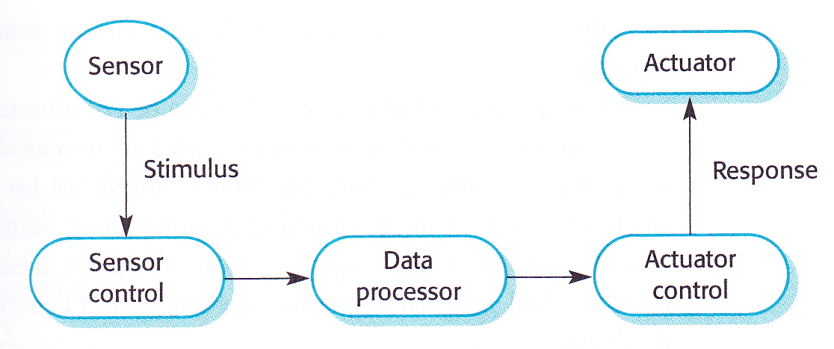
Real-time system design process
Events (not objects) are central to real-time software design
Identify stimuli and associated responses
Identify timing constraints for each stimulus and associated response
Choose execution platform (hardware and RTOS) (determined by timing constraints, power availability, experience, cost, etc.)
Aggregate stimulus and response processing into concurrent processes
Usually good idea to associate a process with each class of stimulus and response
For each stimulus and response, design algorithms to carry out computations (usually done early to discover amount of time required for processing)
Design a scheduling system that ensures processes are started in time to meet their deadlines
Not necessarily done in this order
sometimes need to orient software around hardware requirements
sometimes can develop software abstractly and make hardware choices later

Slide 18
Process co-ordination
Need process co-ordination in a real-time system
ensures mutually exclusive access to shared resources
Various methods available for this:
semaphores (Dijkstra 1968)
monitors (Hoare, 1974) (can use semaphores for locking resources)
critical regions (Brinch Hansen, 1973)
used in Java

Slide 19
Timing analysis
After choosing platform, designing an architecture and deciding on a scheduling policy, need to check that system meets its time requirements
Can be done through
static analysis of system (requires knowledge of timing for components)
simulation
Aperiodic (“sporadic”) stimuli are difficult to predict, so need to estimate probabilities of these stimuli occurring

Slide 20
Using a non-object-oriented approach
Sometimes cannot afford to use object-oriented approach in a real-time system because of time overheads of certain OO techniques (e.g., using getters and setters instead of accessing data members directly)
May even need to break “Write once” principle (unrolling loops) or avoid branching in order to make the code run fast enough to meet the required deadlines
Sometimes better to implement some system functions in hardware rather than software in order to increase performance

Slide 21
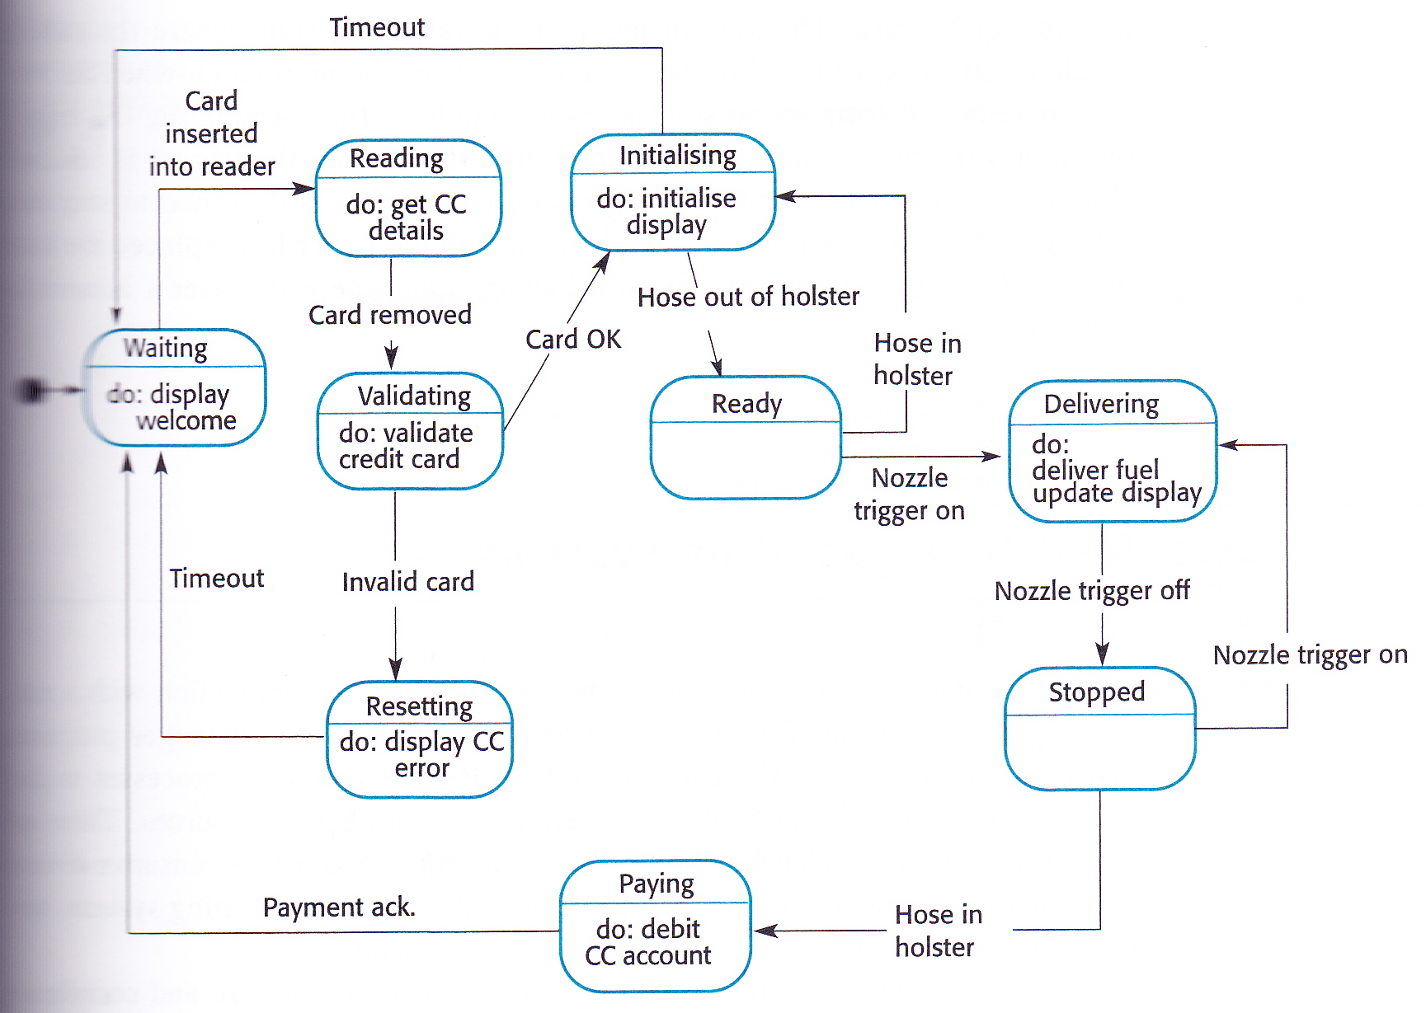
Real-time system modelling
Events (stimuli) in a real-time system cause it to move from one state to another
Therefore often use state machine diagrams to model real-time systems
Rounded rectangles represent states, arrows represent stimuli that cause transitions from one state to another
Non-standard use of “do” here – should be actions, not “do activities”
possibly entry and/or exit actions

Slide 22
UML state machine diagrams
Way in which an object responds to a message depends on its state
The state of an object is determined by the values in its attributes
A UML state machine diagram shows how the messages that an object receives change its state
Example:
Class Copy has boolean attribute, onShelf, which records whether or not a copy of a book is in the library or on loan
Initially, onShelf == true to indicate that the copy is in the library
When Copy object receives borrowed() message and onShelf is true, it changes the value of onShelf to false to indicate that it is now on loan
When the copy of the book is returned, a returned() message is sent to the Copy object and it changes the value of onShelf back to true
Copy object should never receive returned() message when onShelf is true
If it does, it should probably signal an error
Copy object has two states: on loan and on the shelf
Denoted by boxes with rounded corners
Change of state (e.g., from “on loan” to “on the shelf”) is called a transition
Indicated by arrows between states with solid lines and stick heads
Messages that affect Copy object’s state are events
Label transitions with events that cause them
Initial state indicated by start marker (black blob with arrow to initial state)
Copy object starts off in the state “on the shelf”

Slide 23
Actions and events
An event is something done to an object, such as being sent a message
E.g., copy.returned() in diagram above
An action is something an object does, such as it sending a message
E.g., book.copyReturned(self) in diagram above
Action caused by an event can be recorded on transition after a forward slash

Slide 24
Entry and exit actions
May be many different events causing a transition to a particular state
Each of these events might cause the same action
Recording event/action on every transition leading to a state would violate “write once” rule
Can record action once as being caused by the special “entry” event
Can also use special “exit” event
All diagrams on the left mean the same thing!
Almost – consider start marker!

Slide 25
Guards
It may be the case that an event only causes a transition if certain conditions are satisfied
Conditions can be specified in a guard (e.g., [last copy], [not last copy], [x <= 3], etc.)
Guard expression can be any expression that has a boolean value (i.e., true or false)
In a guard, can use normal language, object constraint language (OCL), programming language – anything that allows for an unambiguous condition to be specified

Slide 26
Internal activities
Entry and exit events trigger internal activities
Can also define your own internal activities
Unlike self-transitions, internal activities do not trigger entry and exit special events

Slide 27
Activity states
When object in a particular state, not always idly waiting for the next event
Could be engaged in carrying out some activity
Such a state is called an activity state
“Searching” state is an activity state
Ongoing activity indicated by “do/<activity>”
Called a do-activity
Once do-activity completed, transition without a label is taken
If “cancel” event occurs during “do/search for new hardware” then do-activity is aborted immediately
Do-activities can be interrupted but regular activities (actions) cannot

Slide 28
Superstates
Sometimes, several states share common transitions
Can move shared behaviour into a superstate
Without superstate here, would have to have a “cancel” transition on each state within “Enter connection details”

Slide 29
Concurrent states
Composite state can be decomposed into two or more orthogonal, concurrent state machine diagrams
Concurrent state machines separated by dashed line indicating concurrent boundary
The choices CD/Radio and Time/Alarm time are orthogonal (independent)
History pseudostate indicates that CD/Radio state machine goes back to state clock was in when switched off
History pseudostate points to state that is active when no history

Slide 30
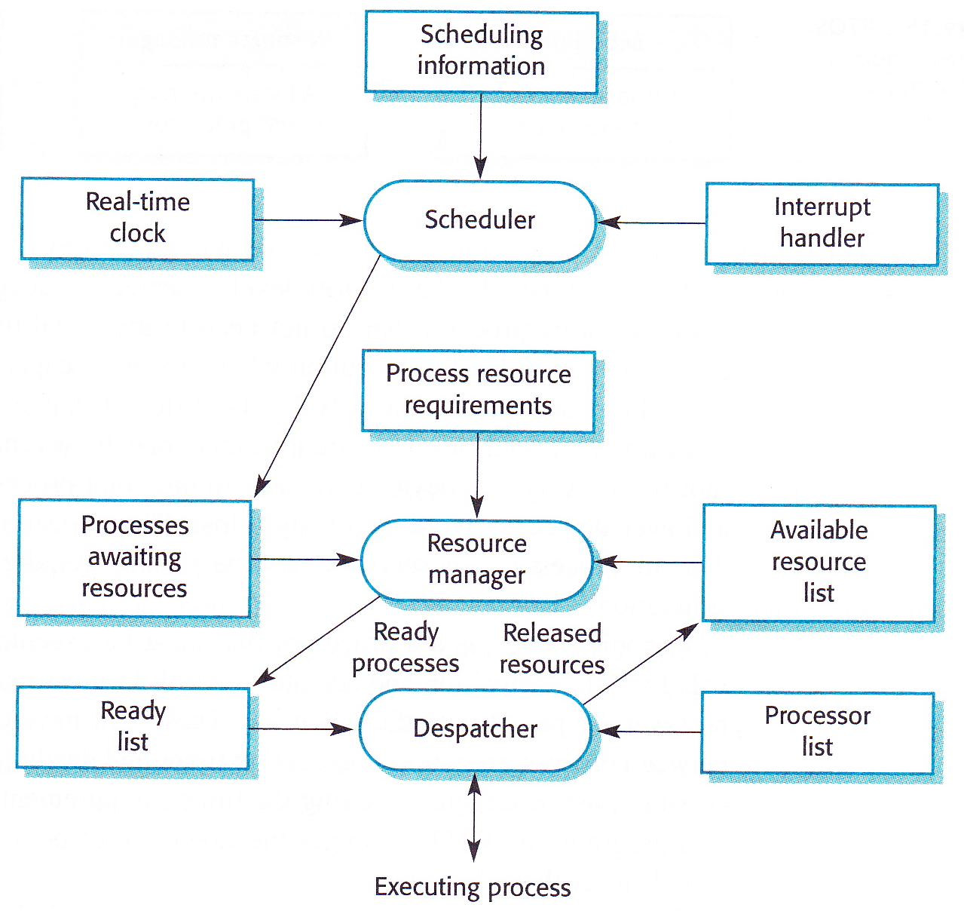
Real-time Operating System (RTOS)
Most embedded systems work with a real-time operating system (RTOS)
starts/stops processes
allocates memory and processor resources
Lots of different RTOSs available
small, simple systems for consumer devices
complex systems for phones and mobile devices

Slide 31
Real-time Operating System (RTOS)
Usually includes
Real-time clock
for scheduling periodically
Interrupt handler
for aperiodic requests
Scheduler
chooses which process to execute
Resource manager
allocates memory and processor time for a scheduled process
Dispatcher
starts a process

Slide 32
Process management
Real-time system must handle external events quickly and meet deadlines
Event-handling processes must
be scheduled in time to detect the event
must be allocated sufficient resources to meet their deadlines
Process manager in an RTOS is responsible for
choosing which processes to execute
allocating processor and memory resources
starting and stopping processes

Slide 33
Process Priority Levels
Process manager must manage processes with different priorities
Certain exceptional events have to be processed within specified time limits
Others may be delayed so that more critical processes can complete
RTOS must manage at least 2 priority levels
Interrupt level is the highest priority level used for processes that need a very fast response (e.g., real-time clock)
Clock level used for periodic processes
Possibly also background process level for processes that don’t have strict deadlines and can run whenever resources are available

Slide 34
Periodic processes
Must be executed at specified time intervals for data acquisition and actuator control
Often several periodic processes with different
periods
execution times
deadlines
RTOS uses timing requirements specified in program to make sure all periodic processes meet their deadlines

Slide 35
Periodic process management
Scheduler chooses process to execute depending on priorities, periods, execution times and deadlines of ready processes
If two processes should be executed at the same clock tick, one is delayed so long as its deadline can be met
Information about process to be executed passed to resource manager
Resource manager allocates memory and a processor
Process placed on ready list
When processor becomes available, dispatcher finds process on ready list that it can execute and starts it

Slide 36
Scheduling strategies
There may be several processes with different priorities scheduled for execution at the same time
Two strategies for deciding which to execute:
Non-pre-emptive scheduling
An executing process runs to completion or until it is blocked
Can lead to priority inversion where a high-priority process has to wait for a low-priority process to complete
Pre-emptive scheduling
An executing process may be stopped (or pre-empted) by a higher priority process that requires the resources it is using
Several scheduling algorithms have been developed:
Round-robin Each process is executed in turn
Rate-monotonic Process with shortest period is given priority
Shortest-deadline-first Process with the soonest deadline given highest priority

Slide 37
Monitoring and Control Systems
Important class of real-time systems
Check sensors and take actions depending on sensor readings
Monitoring system reacts to exceptional sensor readings
Control system continuously controls hardware depending on associated sensor values

Slide 38
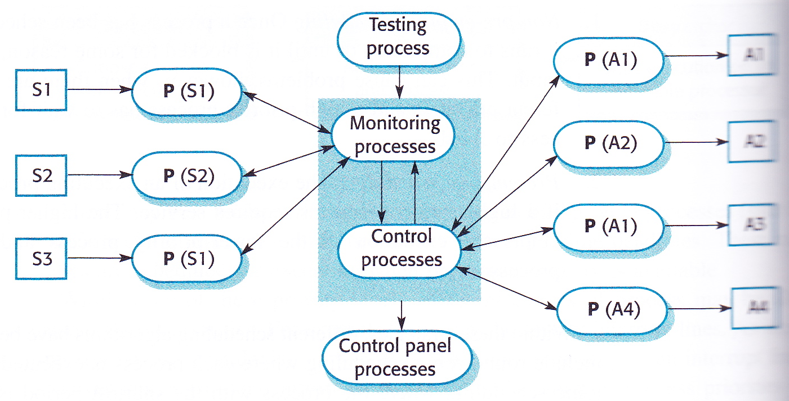
Monitoring and control system architecture
Each sensor and actuator has its own monitoring process
Monitoring process collects and integrates data and passes it to a control process
Control process makes decisions based on data and sends control commands to actuators
Can also be a testing process that runs hardware test programs and control panel process that manages user interface

Slide 39
Burglar Alarm System
Implement a software system to control a burglar alarm system in a commercial building
Uses several different types of sensor
movement sensors in rooms (≤ 200)
window sensors in ground-floor rooms (≤ 50)
door sensors on corridor doors (≤ 30)
When intruder detected, system calls police
Reports location of alarm using a voice synthesizer
Switches on lights in rooms around active sensor
Sets of audible alarm
Normally mains-powered but has battery backup
Power loss monitored using a separate power circuit monitor
Interrupts alarm system when voltage drop detected

Slide 40
Burglar Alarm System
Soft real-time system
no stringent timing requirements
Sensors do not have to detect high-speed events
polled twice per second
Follow design procedure outlined above

Slide 41
Identify aperiodic stimuli and responses
Two classes of stimulus:
Power failure
generated by the circuit monitor
response is:
to switch circuit to backup power by signalling an electronic power-switching device
Intruder alarm
generated by a system sensor
response is:
to compute room number of sensor
set up call to the police
initiate voice synthesizer
switch on audible alarm and building lights

Slide 42
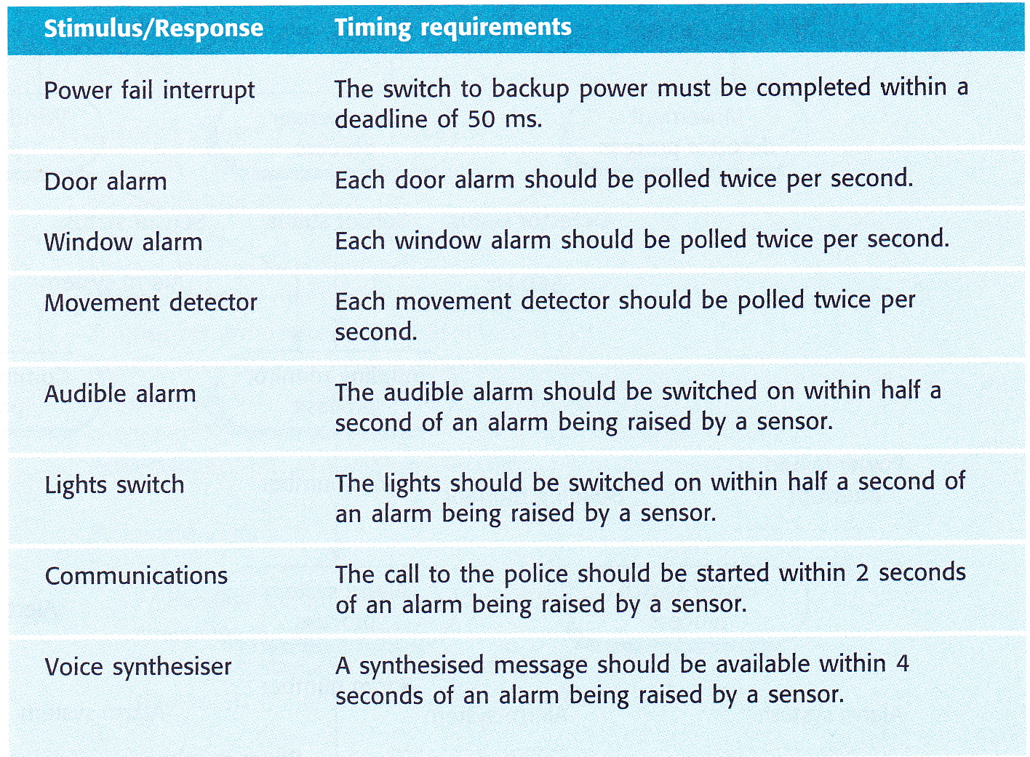
Specify timing constraints for each stimulus amd response

Slide 43
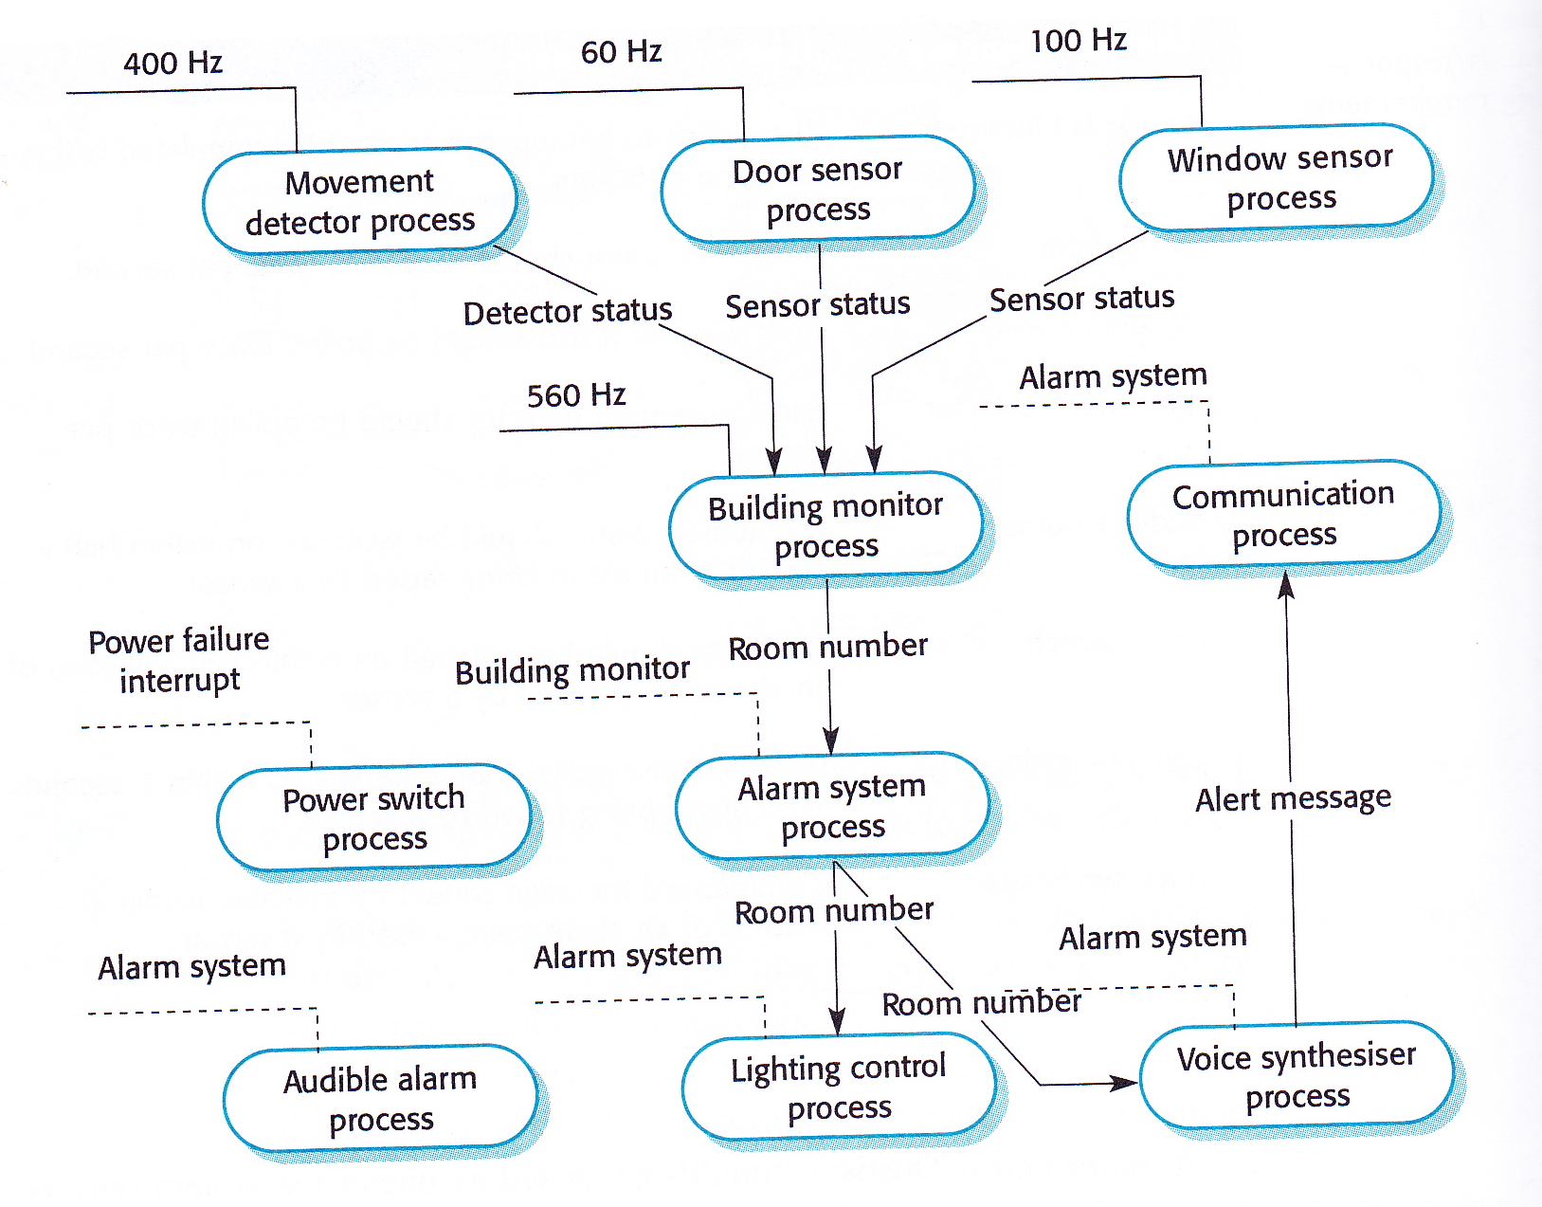
Allocation of system functions to concurrent processes
Three types of sensor that must be polled regularly, each with an associated process
Actuator processes:
Interrupt-driven system to handle power failure
Communications system
Voice synthesizer
Audible alarm system
Light switching system
Independent process controls each of these
Arrows indicate data flow between processes
Lines to top left of each process indicates how it is controlled
solid lines = periodic stimulus
dashed lines = aperiodic stimulus

Slide 44
Allocation of system functions to concurrent processes
Calculate how often each process should be scheduled using timing requirements
30 doors to be checked twice per second, therefore 60Hz
200 movement sensors twice per second, therefore 400 Hz
alarm controller and lighting controller started by explicit command from the Alarm process or “Power failure interrupt”

Slide 45
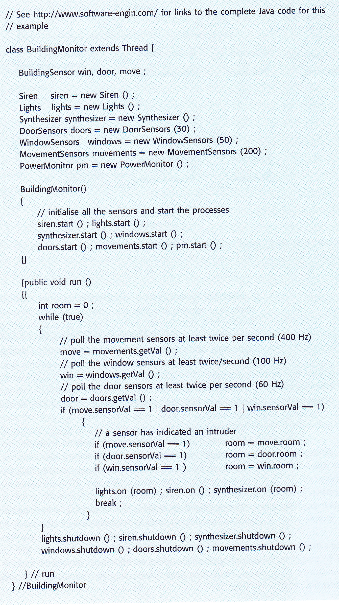
Implementation of BuildingMonitor
Can be implemented using Java Threads
This example uses standard Threads, which don’t allow for explicit reliable specification of timing constraints
Software polls system sensors
If intruder detected, software activates alarm

Slide 46
Designing algorithms for stimulus processing and response generation
Needs to be done quite early to ensure that system can meet its timing requirements
If algorithms are complex, then changes to timing constraints might be necessary
But real-time system algorithms are usually quite simple, such as
check a memory location
simple computation
signal to be dispatched to an actuator

Slide 47
Building heating system: Example of a control system
Burglar Alarm is a monitoring system as does not have actuators that are affected by normal sensor readings
only responds when sensor readings are unusual
Building heating system is a control system
Turns heaters on and off in response to periodic temperature readings in order to maintain a constant temperature defined by a thermostat
Soft or hard real-time system?

Slide 48
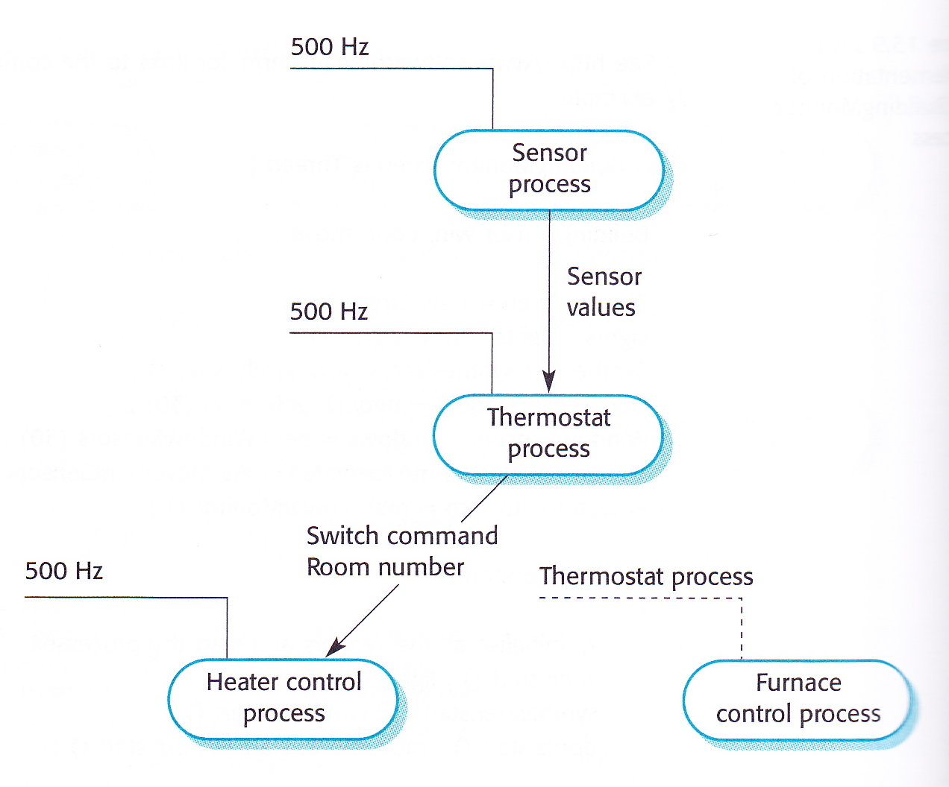
Architecture of heating system
Monitors temperature sensors in different rooms
Turns heaters on or off depending on temperature in room and temperature set on thermostat

Slide 49
Data acquisition system
Collects data from sensors for subsequent processing and analysis
Used when want to collect lots of data from environment but don’t need to process the data in real-time
Commonly used in scientific experiments and process control systems where physical processes happen very quickly
Main problem is to ensure that sensor reading is recorded before it changes

Slide 50
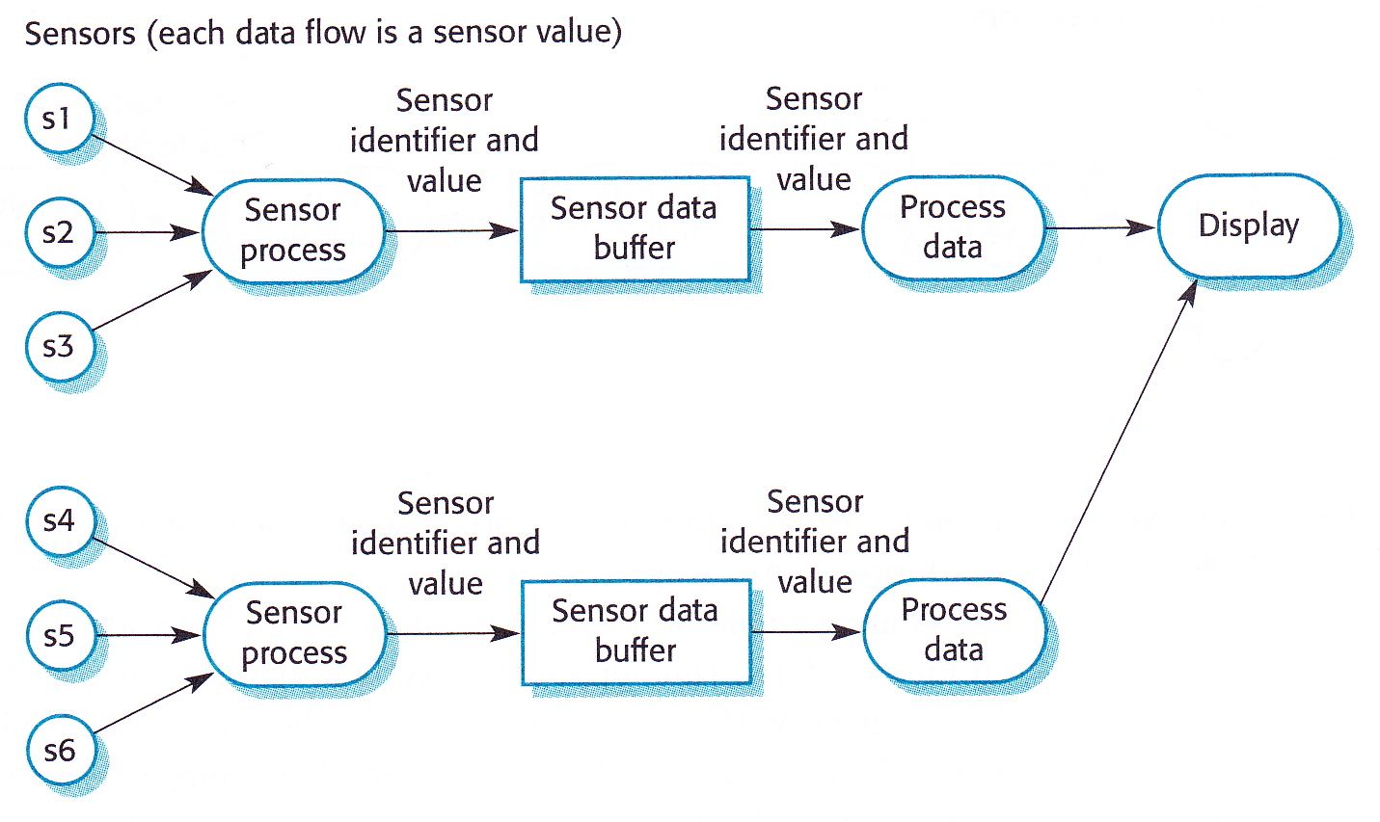
Data acquisition system architecture
Each group of sensors has three processes associated with it:
process that interfaces with the sensor and converts analogue data to digital values if necessary (ADC)
buffer process
process that consumes data and carries out further processing
Most data acquisition systems have display and reporting processes that aggregate collected data and process it further

Slide 51
Neutron flux data acquisition
Collects data from sensors monitoring the neutron flux in a nuclear reactor
JRE licence explicitly says that Java is not to be used in a nuclear facility!
Sensor data placed in a buffer from which it is extracted and processed
The moving average flux level is displayed on an operator’s display

Slide 52
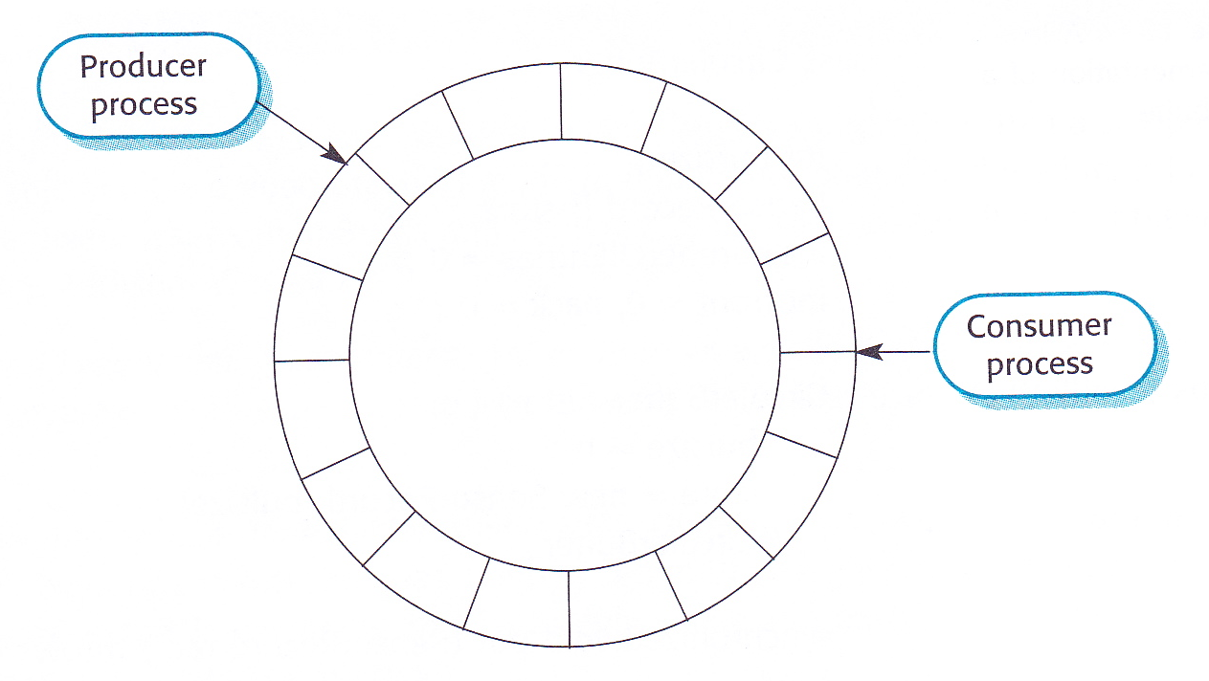
Using a ring buffer
In a real-time data acquisition system, periods and speed of acquisition process (the producer) may become out-of-step with the processing system (the consumer)
if lots of processing, data acquisition might go faster than processing
if very simple computations, processing might go faster than acquisition
Can solve this using a circular (or ring) buffer
Producer and consumer must have mutually exclusive access to buffer
Producer must not add data to a full buffer
Consumer must not try to take data from an empty buffer

Slide 53
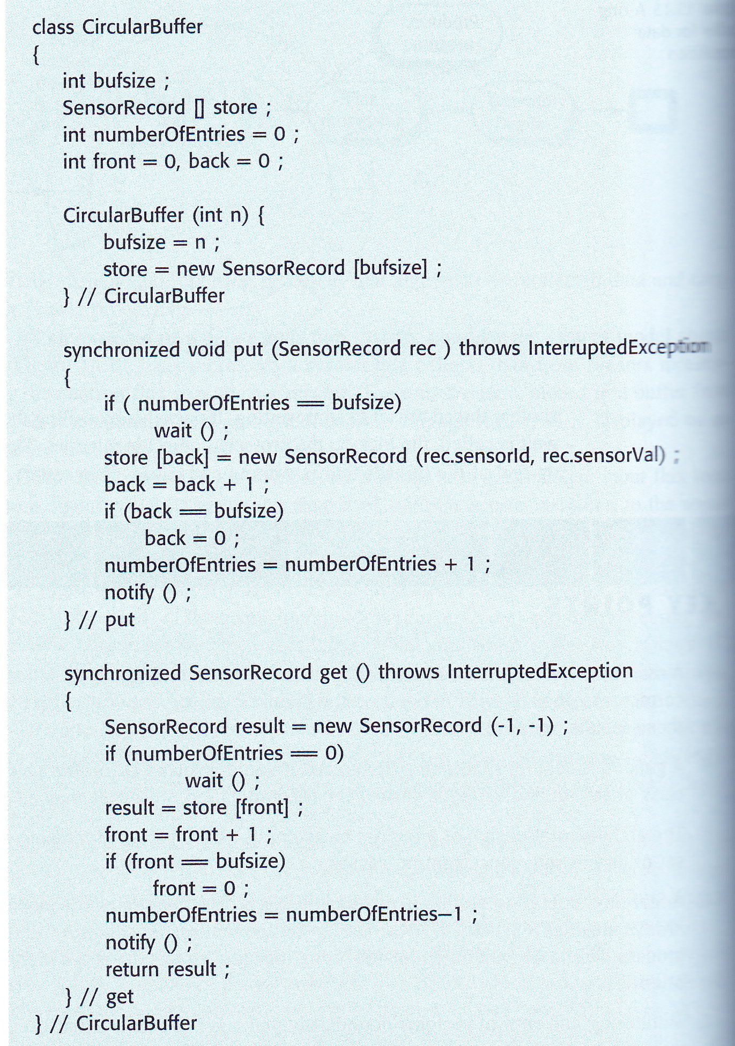
Java implementation of a ring buffer
Values in buffer are of type SensorRecord
get takes item from buffer
put puts item into buffer
constructor sets size of buffer
mutually exclusive access to buffer ensured using synchronized keyword
use wait and notify to ensure that data neither written to a full buffer nor read from an empty buffer

Slide 54
Summary
A real-time system responds to events in real-time
Correctness depends not only output but also on time when its output is produced
A common model of real-time systems architecture involves associating a separate process with each class of sensor and actuator device. Other coordination processes might also be needed
A real-time system is usually a set of concurrent, interacting processes
A real-time operating system is responsible for process and resource management
always includes a scheduler which chooses process to be executed
scheduling decisions made using process priorities
Monitoring and control systems periodically poll sensors and issue commands to actuators depending on sensor values
Data acquisition systems are usually designed according to the producer-consumer model
producer puts data into a circular buffer
consumer consumes data from circular buffer
buffer is a process which avoids conflict between producer and consumer

