Slide 1
Consciousness
David Meredith
Aalborg University

Slide 2
Source
Blackmore, S. (2010). Consciousness: An Introduction. (Second Edition). Hodder Education, London. ISBN: 978-1-444-104-875.
Introduction, Chapters 1, 2, 7

Slide 3
What do we mean by consciousness?
No generally accepted definition, despite many attempts (Nunn, 2009)
Used in various ways in everyday language
The opposite of unconscious: responsive, awake
Being aware of something
e.g., “She was conscious of the embarrassment she had caused”
Here it is used to mean subjectivity:
An organism if conscious if it has a point of view, if it has experiences
Means you are conscious (by this definition) while dreaming when you are asleep
You are unconscious if you are not experiencing anything
In a sense, if you are unconscious, then “you” don’t exist at all!
You may or may not be conscious when under anaesthesia
You are either unconscious or you are conscious and forget what you experienced when you “wake up” and become responsive again
You are conscious if there is something it feels like to be you

Slide 4
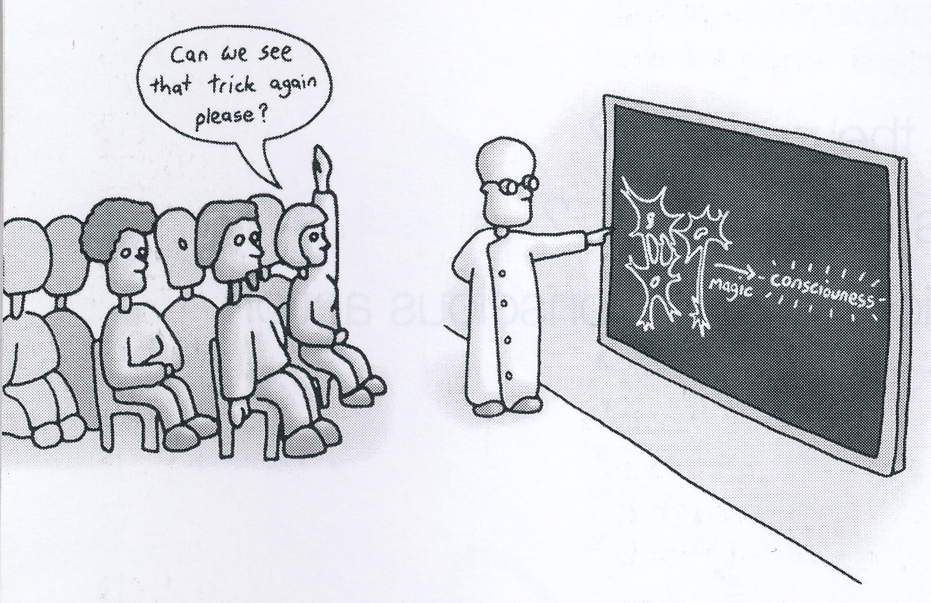
What is the world made of?
The problems of consciousness are tightly bound up with some of the oldest philosophical questions
“What is the world made of?”
“What is free will?”
“What am I?

Slide 5
Dualism
When trying to understand consciousness, it is hard to avoid some form of dualism
The idea that there seem to be two different types of “stuff”:
Mind stuff that has consciousness and subjectivity
Physical stuff that inanimate objects are made of
Arises from the difficulty of understanding how physical material can be arranged in such a way that it starts having experiences and even becomes aware of itself

Slide 6
Monism
Idealism or mentalism
George Berkeley (1685 - 1753) did away with dualism by suggesting that only ideas or perceptions exist – he called them “sensations in mind”
Materialism
Belief that only matter and energy exist and the laws governing the interaction of matter and energy are the only laws – so no such thing as “non-physical” stuff
Identity theory: mental states = physical states
Functionalism: mental states = functional states

Slide 7
Epiphenomenalism
Idea that mental states are created by physical processes but cannot have any causal effect on physical events
Seems to deny possibility of free will
Often attributed to de la Mettrie (1748)
Actually seems to be supported by experiments on the timing of decision making (Libet 1985)
Suggest that our decisions to act are made before we become aware of having decided to act

Slide 8
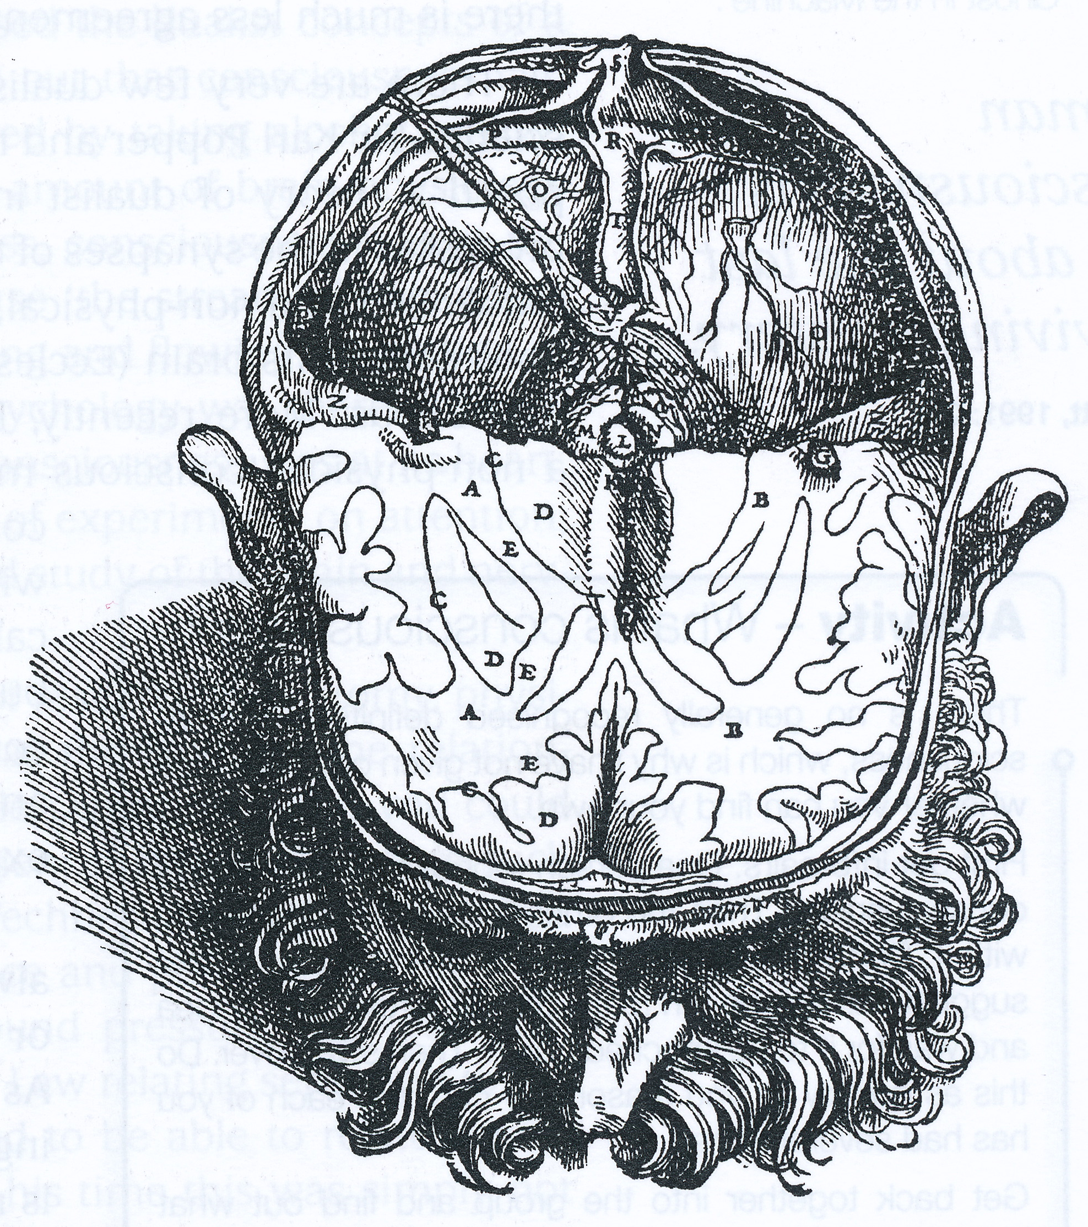
Cartesian dualism
“Cogito ergo sum” (“I think, therefore I am”.) (Descartes, 1641)
Was trying to identify what he actually knew
Proposed that the “mind” is made of unextended, thinking stuff that is different from the extended stuff from which physical objects are made
A form of substance dualism
How does mind stuff interact with physical stuff?
Descartes proposed they interacted through the pineal gland in the centre of the brain
Dualism doesn’t work!
It’s the same as believing in ghosts or magic!

Slide 9
There are still some dualists around
Popper and Eccles (1977) proposed a theory of dualist interaction
suggested that the critical processes in the synapses of the brain are so finely poised that they can be influenced by a non-physical(!), thinking and feeling self
Libet (2004) proposed that a non-physical “conscious mental field” gives rise to the unity and continuity of subjective experience and free will

Slide 10
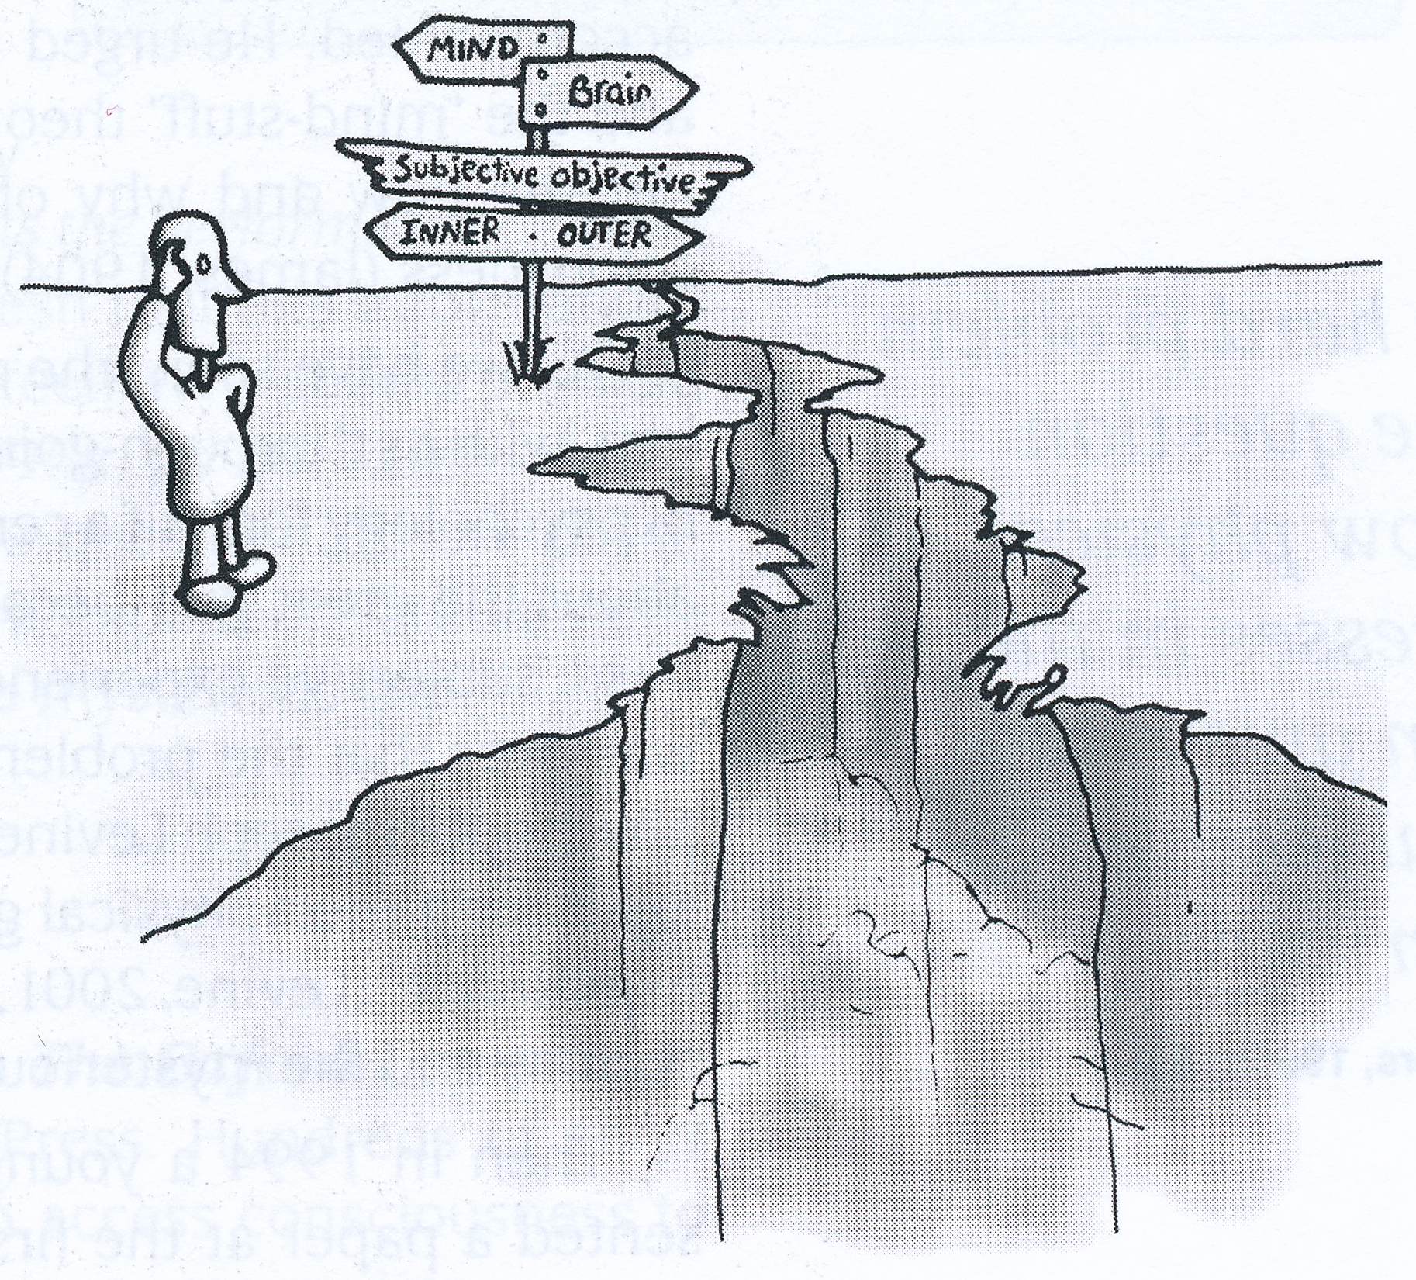
The mysterious gap
Dennett (1991): “Human consciousness is just about the last surviving mystery”
Defines a mystery as something we don’t know how to think about
We have a handle on many problems that used to be complete mysteries (e.g., origin of the universe, nature of life, etc.)
But still don’t have a secure handle on how to think about consciousness

Slide 11
The “hard problem”
Chalmers (1995) proposed that the problems of consciousness can be divided into the “easy” problems and the truly “hard problem”
“Easy problems” are ones that can be studied using the standard methods of cognitive science
e.g., discrimination of stimuli, attention, accessing and reporting mental states, deliberate control of behaviour, differences between waking and sleep
“Hard problem” is experience: what it is like to be an organism
How can physical processes in the brain give rise to subjective experience?

Slide 12
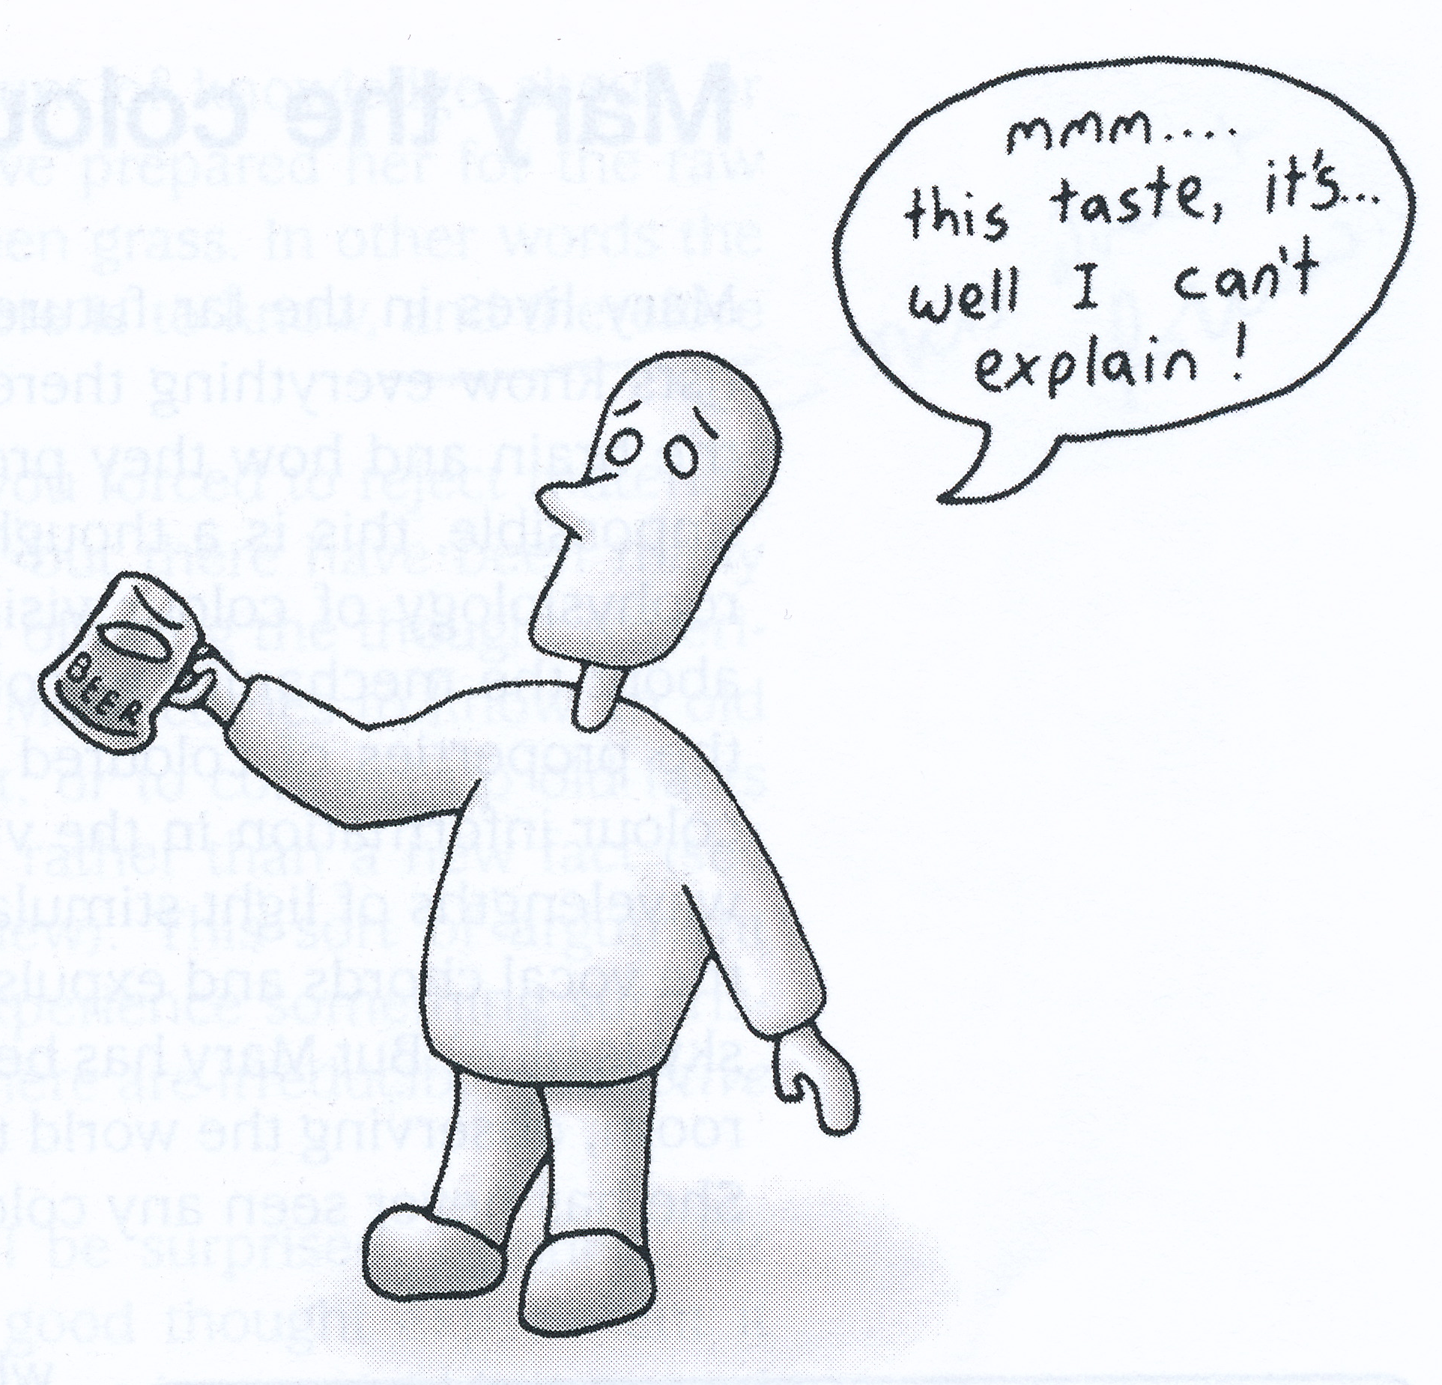
Qualia
“How beer tastes” is a quale
So are
“what red looks like”
“what coffee smells like”
“what love feels like”
Qualia are what you experience directly
Substance dualist says qualia are made of different stuff from what the physical world is made of
Epiphenomenalist says qualia exist but have no effect on the physical world
Idealist says that qualia are the only things that exist

Slide 13
The philosopher’s zombie
Imagine someone who is identical to you in every way except that he/she is not conscious
no point of view, no qualia, no experiencing
but otherwise identical to you
This is the philosopher’s zombie
Easy to imagine and many believe it to be possible in principle or “logically possible” (Searle, 1992; Chalmers, 1996)
If you believe this is logically possible, then you are an epiphenomenalist and you believe that consciousness is inessential

Slide 14
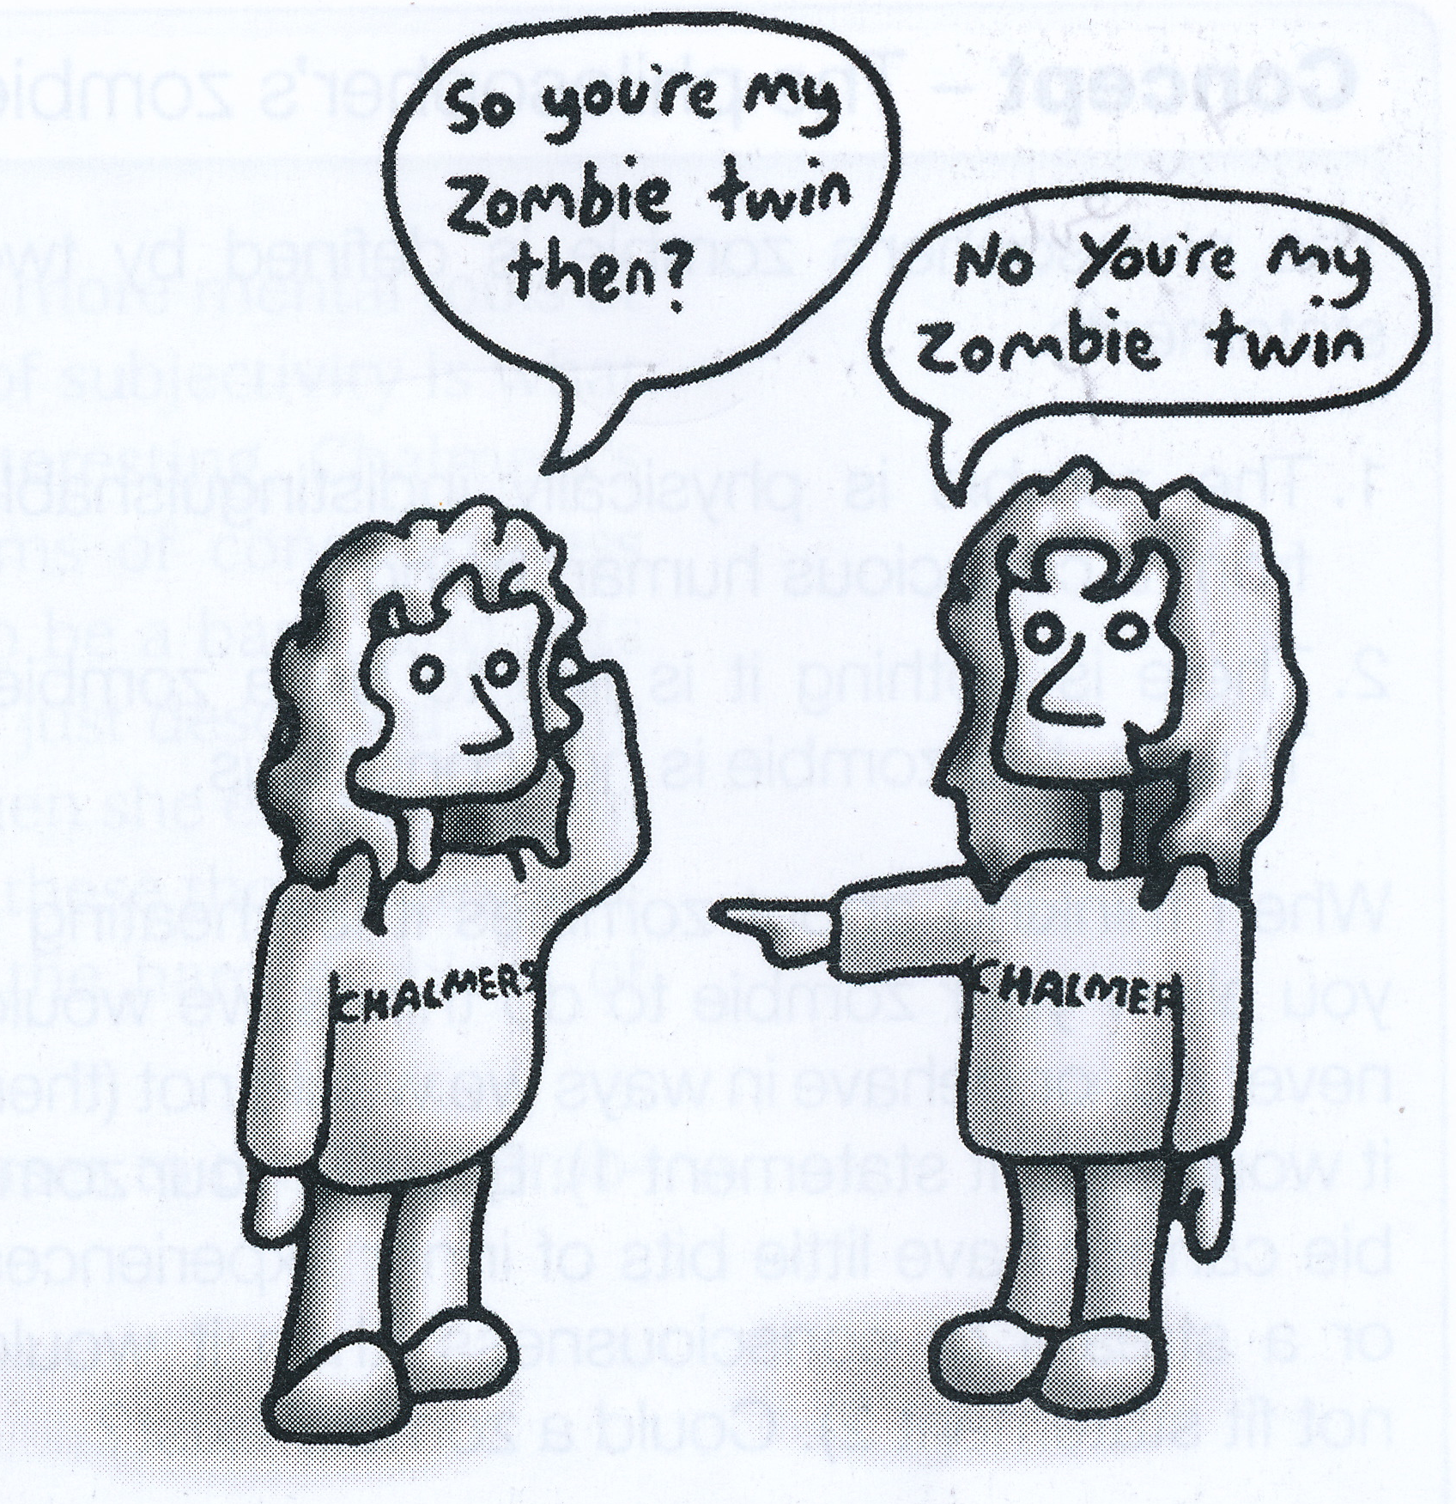
Are zombies possible in principle?
Moody (1994) points out that a philosopher’s zombie would have to use expressions like “think”, “imagine”, “dream”, “believe”, “understand” but there would be no meaning to the zombie in these terms – indeed there is nothing in the zombie that can experience meaning
Suggests that the fact these terms have arisen in our language is strong evidence that we are not zombies (as though we really needed evidence...)

Slide 15
Are zombies possible in principle?
Churchland (1996) calls the philosopher’s zombie a “demonstration of the feebleness of thought experiments”
Dennett (1991) thinks it is based on bogus feats of the imagination
We can only imagine a zombie that behaves identically to you but isn’t conscious because we don’t know for sure what effect consciousness has on observable behaviour
The fact that we can imagine it, doesn’t mean that it is logically possible

Slide 16
Dennett’s zimboes
Suppose we have a simple zombie, artificial or natural (imagine a small bug, or a simple robot)
This simple zombie behaves in response to its environment but its actions and the information entering its senses (or sensors) is not experienced
Now add a system to this zombie which monitors the state and actions of the zombie, including its internal activities in an “indefinite upward spiral of reflexivity” (Dennett, 1991). Call this more complex zombie a zimbo.
Because a zimbo monitors its own processes, it could answer questions about its own thought processes
Dennett proposes that we are zimboes: complex, self-monitoring zombies that can talk, think and have mental images, dreams and feelings

Slide 17
Do you believe in zombies?
If you believe in the (logical) possibility of zombies, then you believe that consciousness is inessential
Or, if you don’t believe in the possibility of zombies, then you presumably believe that anything that is made to be identically like you and behaves identically to you will necessarily be conscious

Slide 18
Responses to Chalmers’ “hard problem”
Can identify 4 types of responses to the hard problem
It is insoluble (Nagel, McGinn, Pinker)
Let’s try to solve it – possibly with some new kind of science (Gray, Clarke, Chalmers, Libet, Penrose)
Let’s solve the “easy” problems first (e.g., Crick and Koch)
There is no hard problem (Churchland, Dennett)

Slide 19
Response type 1: “The hard problem is insoluble”
The “new mysterians” believe that the hard problem (what gives rise to experience) is insoluble
Nagel: we don’t have a conception of what a physical explanation for a mental phenomenon would be
McGinn (1999): We are cognitively closed to the problem.
Us trying to understand the hard problem is like a dog trying to read the newspaper – we just don’t have the right type of brain for the job
Pinker (1997): “forever beyond our conceptual grasp”

Slide 20
Response type 2: “Let’s try to solve it (even if it means making a new kind of science)”
Chalmers: dual-aspect theory of information
all information has two aspects, physical and experiential
conscious experience is one aspect of an information state
need a new theory of information...
Clarke (1995) mind is “non-local” like quantum phenomena, emerges in the universe before space and time(!)
Clarke and Chalmers are both close to panpsychism – the notion that everything is conscious to some degree
Libet (2004) proposes a “conscious mental field” because “a knowledge of nerve cell structures and functions can never, in itself, explain or describe conscious subjective experience”
Penrose (1989): consciousness depends on non-algorithmic processes
Hameroff and Penrose (1996): experience is a quality of space-time related to “quantum coherence” in the microtubules of nerve cells
All these theories propose radical changes in the way we understand the universe

Slide 21
Response type 3: “Tackle the ‘easy’ problems first”
Lots of theories of attention, learning, memory, perception
Few theories of subjectivity
Crick and Koch (1990): propose visual feature binding result of synchronised oscillations in brain waves
Chalmers: why should synchronized brain waves give rise to a unitary percept? - Tells us nothing about the hard problem!
On this view, most theories of aspects of conscious perception and cognition bring us no closer to a solution to the hard problem (how experience arises in a physical organism)
Crick and Koch (2003): Attempting to find the neural correlates of consciousness (NCC) – if we can find what causes consciousness, then this will make the hard problem easier

Slide 22
Response type 4: “There is no hard problem”
O’Hara and Scutt (1996): 3 reasons for ignoring the hard problem
should start by trying to solve the “easy” problems
solutions to the “easy” problems will change the way we look at the hard problem
we don’t understand the problem properly, so we won’t recognize a solution even if we find one

Slide 23
Response type 4: “There is no hard problem”
Churchland (1996): the hard problem is a “hornswoggle problem” (a problem that deceives us – a “red herring”)
cannot predict in advance which problems will be hard and which easy
e.g., biologists though we’d have to understand protein folding before we could understand the biological basis of heredity
base-pairing in DNA provided the answer and we still don’t understand protein folding!
based on false assumption that if we understood perception, attention, memory, etc. then there would still be something left to explain – something we have that a zombie doesn’t

Slide 24
The self
If there are experiences, then there must be an experiencer, right?
In everyday life, we each talk unproblematically about ourselves:
“I had trouble getting up this morning”
“I’m going to the cinema this evening”
“I’m depressed”
“I’m in love”
The self apparently has all sorts of attributes and capabilities
The self has a personality, has moods, opinions, hopes, fears
Your “self” is the reason why anything matters to you at all

Slide 25
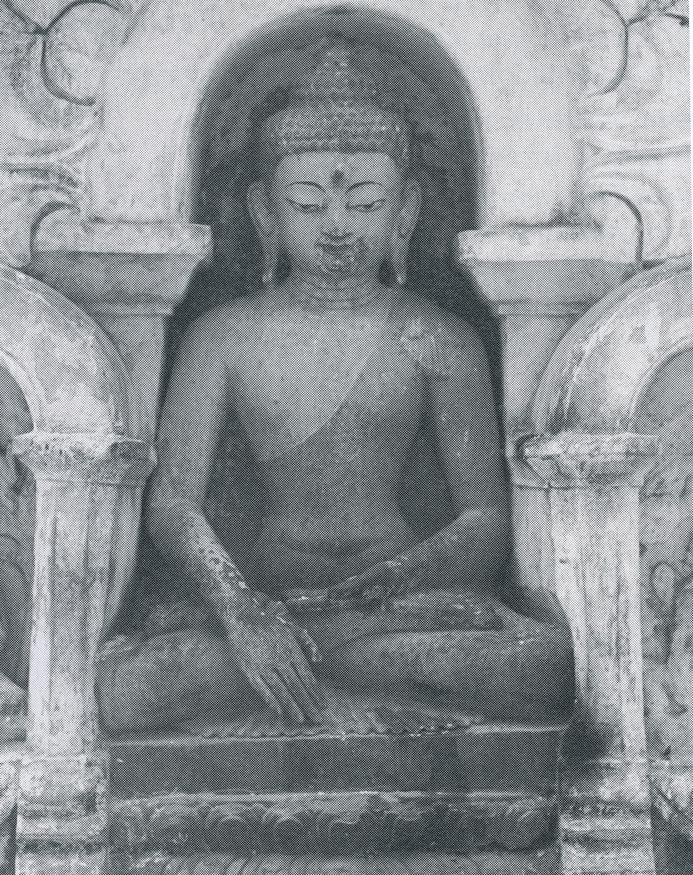
Do selves exist?
Buddha (6th century BC) proposed doctrine of anatta (“no self”)
The “self” is just a label given to something that doesn’t really exist
Why does it seem as though I am a single, continuous self who has experiences?
Ego theories: because there really is some kind of continuous self
Bundle theories: the feeling that you are a self is an illusion – there is no experiencer of your experiences
If it is an illusion, who or what is being deluded?

Slide 26
Ego theories
Most religions entail notions of spirits or souls: these are essentially ego theories
Buddhism denies the existence of selves: it is a kind of bundle theory
Bloom (2004) showed that most children are natural dualists: they seem to see the world as containing bodies and souls
Children as young as 4 know that biological functions stop at death
As they get older, they separate biological and psychological functions
Older children and adults attribute beliefs to the dead but not perceptions (Bering and Bjorklund, 2004)

Slide 27
Bundle theories
David Hume (1739) argued that we are nothing but a bundle of perceptions that follow each other rapidly in a continuous stream
“when I enter most intimately into what I call myself, I always stumble on some particular perception or other...I can never catch myself at any time without a perception”
Proposes that without any perception there is no perceiver!

Slide 28
Thought experiments with the self
In the middle of the night, a mad scientist swaps your brain with that of your friend, John: when you wake up, whose body will you feel yourself to be in?
If you think you’ll wake up in the wrong body, then you must believe that the conscious self depends on the brain and the brain alone

Slide 29
Another thought experiment
In the middle of the night, while you are asleep, a mad Martian scientist scans your brain and that of your friend, John, and swaps only the patterns of neural information, leaving the brains in place
Which body do you wake up in?

Slide 30
Ego vs. Bundle theories
If you thought there was an answer in the previous thought experiments, then you are an ego theorist who believes that there is a unitary and continuing self
A bundle theorist does not believe in the existence of continuing experiencing selves, so there is no answer to the question

Slide 31
The teleporter thought experiment
Someone offers you a ride in a teleporter
You will be scanned in minute detail and the information gained will be used to create an exact replica of you somewhere else in the universe
Your body will be destroyed after it has been scanned
Will you go for a ride in the teleporter?

Slide 32
The teleporter (Parfit, 1987)
Since the replica has a brain in exactly the same state as yours was when it was scanned, the replica will remember living your life right up to the point you got on the teleporter
An ego theorist would probably not go, claiming that the replica, though identical to himself would not “really be” himself
Consider what would happen if the original is not destroyed – in this case, the original is just scanned, which clearly causes no change in the person’s experience (Broks, 2003)
A bundle theorist might well go, claiming that there is no continuous, persistent self to be destroyed by the process

Slide 33
References
Bering, J. M. and Bjorklund, D. F. (2004). The natural emergence of reasoning about the afterlife as a developmental regularity. Journal of Cognition and Culture, 2:263-308.
Bloom, P. (2004). Descartes' Baby: How Child Development Explains What Makes Us Human. Heinemann, London.
Broks, P. (2003). Into the Silent Land: Travels in Neuropsychology. Atlantic Books, London.
Chalmers, D. (1995). The puzzle of conscious experience. Scientific American, Dec. 1995, 62-68.
Chalmers, D. (1996). The Conscious Mind. Oxford University Press, Oxford.
Churchland, P. S. (1996). The Hornswoggle problem. Journal of Consciousness Studies, 3(5-6):402-8.
Clarke, C. J. S. (1995). The nonlocality of mind. Journal of Consciousness Studies, 2(3):231-240.
Crick, F. and Koch, C. (1990). Towards a neurobiological theory of consciousness. Seminars in the Neurosciences, 2:263-275.
de la Mettrie, J. O. (1748). L'Homme Machina.
Dennett, D. C. (1991). Consciousness Explained. Little, Brown and Co., Boston, MA.
Descartes, R. (1641). Meditations on First Philosophy. Paris, trans. 1901 by John Veitch.
Hameroff, S. R. and Penrose, R. (1996). Conscious events as orchestrated space-time selections. Journal of Consciousness Studies, 3(1):36-53.
Hume, D. (1739). A Treatise on Human Nature.
Libet, B. (1985). Unconscious cerebral initiative and the role of conscious will in voluntary action. The Behavioral and Brain Sciences, 8:529-539.
Libet, B. (2004). Mind Time. Harvard University Press, Cambridge, MA.
McGinn, C. (1999). The Mysterious Flame: Conscious Minds in a Material World. Basic Books, New York.
Moody, T.C. (1994). Conversations with zombies. Journal of Consciousness Studies, 1(2):196-200.
Nagel, T. (1986). The View from Nowhere. Oxford University Press, New York.
Nunn, C. (ed.) (2009). Defining Consciousness. Journal of Consciousness Studies, 16(5).
O'Hara, K. and Scutt, T. (1996). There is no hard problem of consciousness. Journal of Consciousness Studies, 3(4):290-302.
Parfit, D. (1987). Divided minds and the nature of persons. In C. Blakemore and S. Greenfield (eds.) Mindwaves. Blackwell, Oxford. 19-26.
Penrose, R. (1989). The Emperor's New Mind. Vintage, London.
Pinker, S. (1997). How the Mind Works. W.W.Norton, New York.
Popper, K. R. and Eccles, C. (1977). The Self and its Brain. Springer, New York.
Searle, J. (1992). The Rediscovery of the Mind. MIT Press, Cambridge, MA.

