Slide 1
Sphero
David Meredith
dave@create.aau.dk

Slide 2
Source
http://developer.gosphero.com/
https://github.com/orbotix/Sphero-Android-SDK

Slide 3
Getting started
Install the Android Development Tools Bundle for your system
http://developer.android.com/sdk/index.html
Download the latest version of the Sphero Android SDK
https://github.com/orbotix/Sphero-Android-SDK/zipball/master

Slide 4
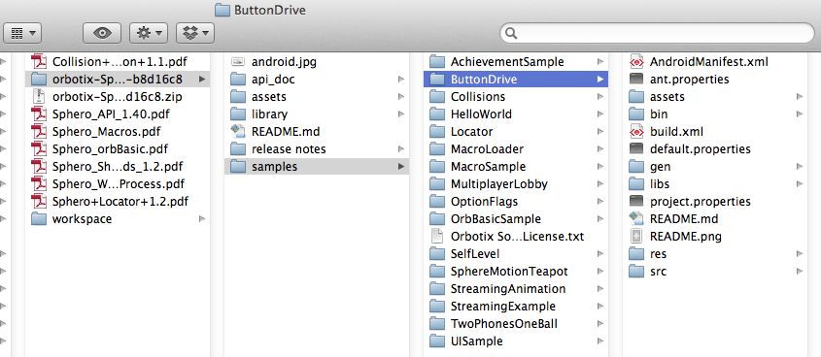
Importing the Sphero SDK sample programs
Good place to start is to import the SDK sample programs into a new workspace in the ADT version of Eclipse

Slide 5
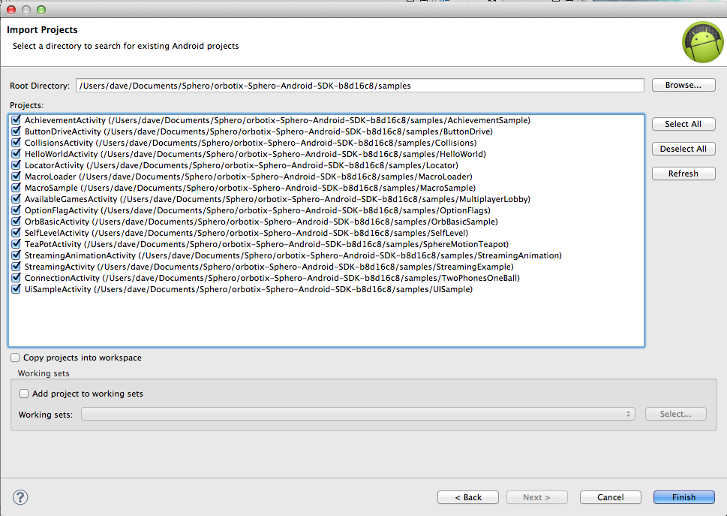
Importing SDK samples into Eclipse

Slide 6
Samples
AchievementActivity – basics of adding achievements to SpheroWorld
ButtonDriveActivity – demonstrates driving a sphero using buttons
CollisionsActivity – demonstrates how to use the Sphero firmware collision detection system
HelloWorldActivity – shows how to connect a Sphero and blink its LED
LocatorActivity – shows how to use the firmware Locator feature to provide real-time position and velocity information
MacroLoader – shows how to import MacroLab macros into your app
MacroSample – how to programmatically create macros and run them on multiple Spheros
OptionsFlagActivity – shows how to set option flags (e.g., to keep the tail light on)
OrbBasicActivity – how to load and execute OrbBasic programs on the Sphero itself
SelfLevelActivity – demonstrates self-level feature (attempts to gain horizontal orientation)
StreamingActivity – shows streaming of sensor data from sphero to Android device
StreamingAnimationActivity – using Sphero streaming data to control motion of a sprite around the screen
TeaPotActivity – uses IMU values to control orientation of a Teapot image on the screen
UiSampleActivity – Using the StartupActivity instead of the SpheroConnectionView

Slide 7
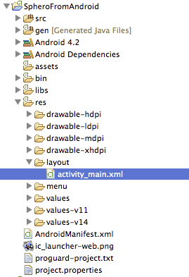
Creating a Sphero project from scratch
Create an Android application project

Slide 8
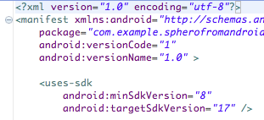
Setting API levels and Java compliance
Ensure
Android API level 8 (Android 2.2) or greater in AndroidManifest.xml
Java language compliance level 6.0 (1.6) or higher

Slide 9
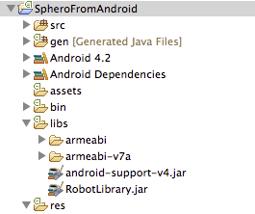
Integrating the Sphero libraries
Add the Sphero libraries to the libs folder
in the library/libs/ folder in the SDK
Eclipse should automatically add RobotLibrary.jar to the Android dependencies folder

Slide 10
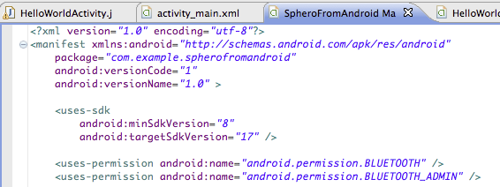
Adding bluetooth permissions to the manifest file
Add permissions to the Android manifest file to allow the app to use Bluetooth
Make sure you have bluetooth on in the device settings!

Slide 11
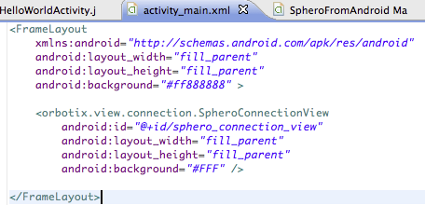
Connecting to a Sphero
RobotLibrary contains a View called SpheroConnectionView
Fires off an onRobotConnected event when a robot is connected
Need to add SpheroConnectionView to the Activity’s xml layout file (see above)
SpheroConnectionView should be the last defined view in a FrameLayout
Makes sure that when you hide it (after a Sphero has connected) the rest of your UI becomes available

Slide 12
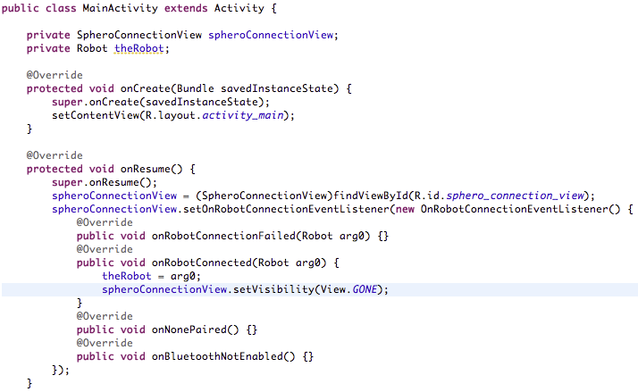
Connecting to a Sphero – overriding onResume()
Must attach an OnRobotConnectionEventListener to the spheroConnectionView object
defines what happens when a Sphero is connected using the SpheroConnectionView
Should hide SpheroConnectionView when a Sphero becomes connected
i.e., onRobotConnected is called

Slide 13
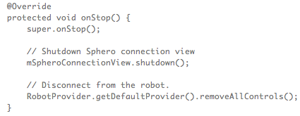
Shutting down the Sphero connection
Override Activity’s onStop method in order to
disconnect Sphero and return it to its default stable state
shutting down SpheroConnectionView
important if user does not enable bluetooth!

Slide 14
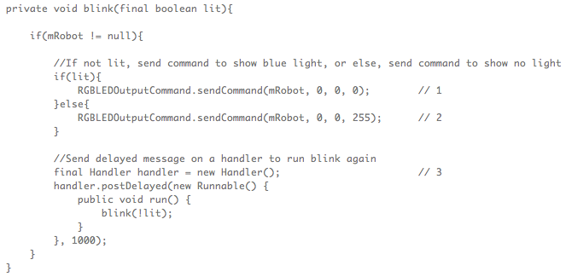
Blink the LED
Sphero commands are carried in subclasses of the DeviceCommand class
Sent to the Sphero using the DeviceMessenger singleton
DeviceCommand.sendCommand() method posts a message to the DeviceMessenger

Slide 15
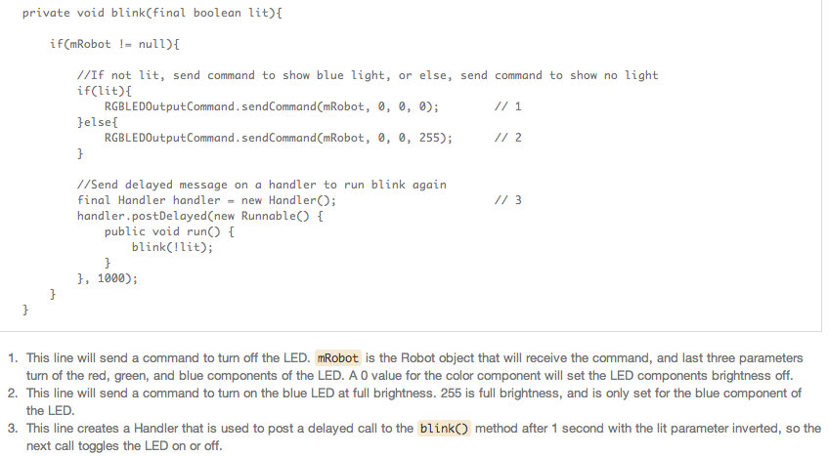
Sending commands to the Sphero

