Slide 1
Growth of Functions
David Meredith
dave@create.aau.dk

Slide 2
Source
Chapter 3 of
Cormen, T. H., Leiserson, C. E., Rivest, R. L. and Stein, C. (2001). Introduction to Algorithms (Second Edition). MIT Press, Cambridge, MA.

Slide 3
Introduction
Order of growth of the running time of an algorithm indicates algorithm’s efficiency
When n, the input size, is large enough, merge sort with it’s Θ(n lg n) worst case running time beats insertion sort whose worst-case running time is Θ(n²)
When processing lots of data (e.g., in many multimedia applications) then we only worry about the highest-order terms in the order of growth
We ignore constants and we ignore the lower-order terms

Slide 4
Asymptotic behaviour
Only generally concerned with how the running time (or space) increases in the limit
That is, the asymptotic behaviour of the algorithm

Slide 5
Asymptotic notation
Asymptotic running time usually stated in terms of functions whose domains are the set of natural numbers, N = {0, 1, ,2, ...}
Worst-case running time, T(n), usually defined on integral input sizes
Notation often abused
e.g., by extending to domain of real numbers
But should be careful not to misuse the notation

Slide 6
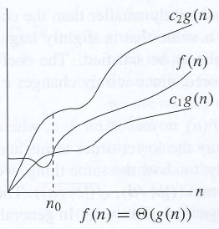
Θ-notation
Worst-case running time of insertion sort is Θ(n²)
If g(n) is a function, then Θ(g(n)) is the set of functions, f(n), such that 0 ≤ c₁g(n) ≤ f(n) ≤ c₂g(n) for all n ≥ n₀ for some given values of c₁, c₂ and n₀

Slide 7
Θ-notation
Θ(g(n)) is a set so we can write
In fact, we actually usually write
This may be confusing, but we’ll see later that it has its advantages

Slide 8
Θ-notation
In figure on left, f(n) is between c₁g(n) and c₂g(n)
g(n) is an asymptotically tight bound for f(n)
Θ(g(n)) must be asymptotically non-negative
f(n) must be non-negative when n is large enough

Slide 9
Θ-notation
Let’s show that if
Need to find c₁, c₂ and n₀ such that for all n ≥ n₀

Slide 10
Θ-notation
Divide by n² to get
RH inequality holds for n ≥ 1 if c₂ ≥ ½
LH inequality holds for n ≥ 7 if if c₁ ≤ 1/14
So if c₁ = 1/14, c₂ = 1/2 and n₀ = 7, we can verify that

Slide 11
Θ-notation
Let’s now show that
Suppose c₂ and n₀ exist such that for all n ≥ n₀
But then n ≤ c₂/6 which cannot hold for all n greater than some number n₀

Slide 12
Θ-notation
Can generally ignore all but the highest-order terms in the growth function
If then where c₁ is slightly less than a₁ and c₂ is slightly greater than a₁

Slide 13
Θ-notation
A constant function, c, is said to be Θ(n⁰) = Θ(1)
If the running time of an algorithm is Θ(1), we say it is constant time

Slide 14
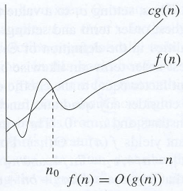
O-notation
Θ-notation gives tight asymptotic bounds on a function from above and below
When we only have an asymptotic upper bound, we use O-notation
O(g(n)) is the set of functions 0 ≤ f(n) ≤ cg(n) for all n ≥ n₀ for some given values of c and n₀

Slide 15
O-notation

Slide 16
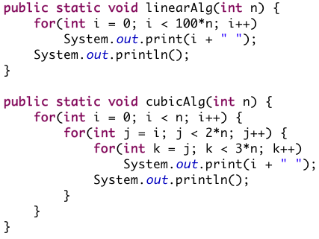
O-notation and loop structure
Can often infer upper bound on worst-case just by inspecting loop structure of an algorithm
Algorithm at top left is linear: O(n)
Algorithm at bottom left is cubic: O(n³)

Slide 17
O-notation
If use O-notation to bound the worst-case running time, then we have an upper bound on the time for every input
this is because the bound is not necessarily tight
Thus, the running time for every input on insertion sort is O(n²) – EVEN THE LINEAR BEST CASE!
Note that the running time for every input is NOT given by Θ-notation
e.g., best-case running time of insertion sort is Θ(n) which is NOT Θ(n²)

Slide 18
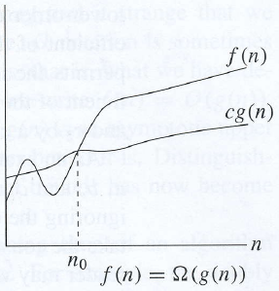
Ω-notation
Ω-notation gives an asymptotic lower bound
cf. O-notation which gives an asymptotic upper bound

Slide 19
Theorem relating Θ, O and Ω
If f(n) is Θ(g(n)), this means f(n) has tight upper and lower bounds of the form cg(n)
If f(n) is Ω(g(n)), then f(n) has a lower bound of the form cg(n)
If f(n) is O(g(n)), then f(n) has an upper bound of the form cg(n)
If both the upper and lower bounds are cg(n), then these bounds must be tight, so f(n) is Θ(g(n))

Slide 20
Ω-notation
When Ω is used to bound the best case, then it bounds the running time for all inputs
For example, the best-case running time of insertion sort is Ω(n), so the running time of insertion sort is Ω(n) (for all inputs)
The worst-case running time of insertion sort is Ω(n²) (and Ω(n))
But the running time of insertion sort is NOT Ω(n²) because the best case is Θ(n)

Slide 21
Asymptotic notation in equations

Slide 22
o-notation
The bound provided by O-notation may or may not be tight
The bound provided by o-notation is necessarily not tight
o(g(n)) is the set of functions, f(n), such that for any positive constant, c > 0, there exists a constant, n₀ > 0, such that 0 ≤ f(n) ≤ cg(n) for all n ≥ n₀
For example, 2n = o(n²) but 2n² ≠ o(n²)
The difference between o-notation and O-notation is that O only has to hold for at least one constant, c, whereas o has to hold for all constants c greater than 0

Slide 23
ω-notation
ω-notation is to Ω-notation what o-notation is to O-notation
ω-notation gives a lower bound that is not asymptotically tight
ω(g(n)) is the set of functions, f(n), such that for any positive constant, c > 0, there exists a constant, n₀>0, such that 0 ≤ cg(n) < f(n) for all n > n₀

Slide 24
Transitivity

Slide 25
Reflexivity

Slide 26
Symmetry and transpose symmetry

Slide 27
Analogy with comparison between numbers
f(n) is asymptotically smaller than g(n) if f(n)=o(g(n))
f(n) is asymptotically larger than g(n) if f(n)=ω(g(n))

Slide 28
Trichotomy
For real numbers, it must be true that a = b or a < b or a > b
However some functions are not asymptotically comparable
that is, f(n) is neither O(g(n)) nor Ω(g(n))
For example, the function n and n^{1+sin n} are not comparable because the value in the exponent of n^{1+sin n} oscillates between 0 and 2, taking all values in between

