Slide 1
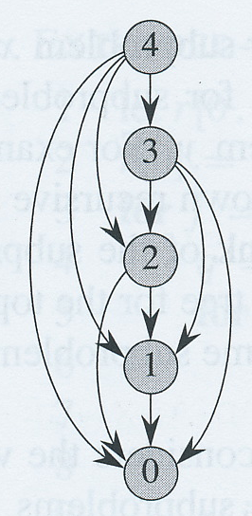
Dynamic programming
David Meredith
dave@create.aau.dk

Slide 2
Source
Chapter 15 of
Cormen, T. H., Leiserson, C. E., Rivest, R. L. and Stein, C. (2009). Introduction to Algorithms. (Third edition). MIT Press, Cambridge, MA.

Slide 3
Introduction
Dynamic programming is used to solve optimization problems
Make a set of choices to arrive at an optimal solution
Each choice involves solving the same type of sub-problem
Dynamic programming lets you avoid having to solve the same sub-problem more than once by storing the solutions to the sub-problems
Similar to divide-and-conquer method used to write recursive algorithms
“Programming” here refers to a tabular method, not to writing computer code

Slide 4
Overlapping sub-problems
If your problem decomposes into sub-problems that are all the same type but disjoint, then maybe you need a recursive algorithm
If your sub-problems might overlap then maybe you can use dynamic programming
Your sub-problems share sub-sub-problems
If you have overlapping sub-problems, then recursion is inefficient because you end up having to do the same work more than once
Dynamic programming saves solutions to sub-problems in a table so that they can be looked up quickly after computing them just once

Slide 5
Optimization problems
Dynamic programming is used to solve optimization problems
An optimization problem can have many possible solutions – we are interested in finding just one of the best solutions
i.e., a solution with some optimal (usually minimum or maximum) value

Slide 6
4 steps to dynamic programming
Characterize structure of an optimal solution
Recursively define value of an optimal solution
Compute value of an optimal solution (usually in a bottom-up manner)
Construct optimal solution from computed information
May require extra information to be saved in step 3

Slide 7
Optimization problems soluble with dynamic programming
Rod cutting – how do you cut up a rod into shorter lengths so that you maximize the value
Matrix multiplication – how do you multiply a chain of matrices so that you do the least number of multiplications
Finding the longest common subsequence in two strings

Slide 8
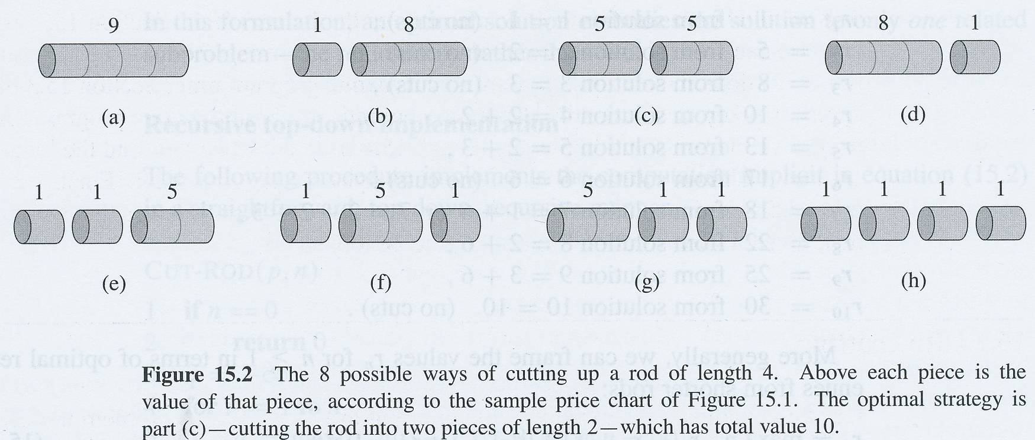
Rod-cutting
Given a rod of length n and a table of prices, p_{i}, for lengths i, the maximum revenue r_{n} you can get by cutting up the rod and selling the pieces
Diagram shows case where n = 4

Slide 9
Rod-cutting
There are 2^{n-1} ways of cutting up a rod of length n when length of each piece must be an integer
Can either cut or not cut at each n-1 positions
So number of ways of cutting is number of different numbers you can represent with n-1 bits

Slide 10
Rod-cutting
Suppose an optimal way of cutting the rod is into k pieces, n = i₁ + i₂ + ... + i_{k}
This gives maximum possible revenue

Slide 11
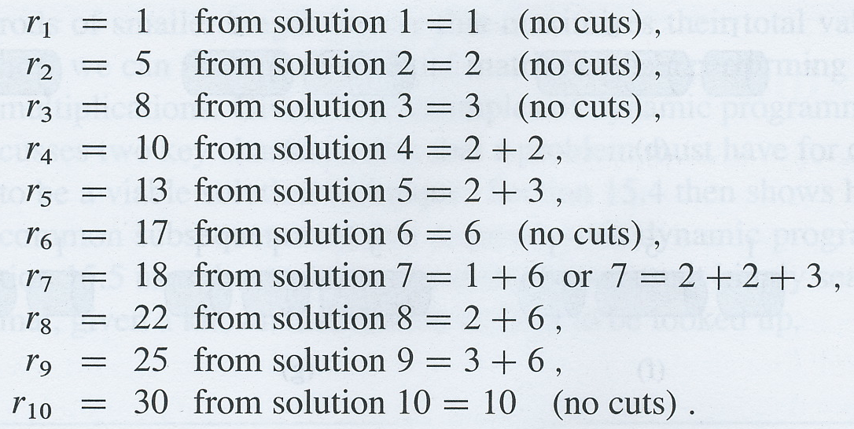
Rod-cutting
Can find optimal revenue figures for each rod lengths between 1 and 10 by inspection
To solve for n, we solve smaller problems of the same type
We can reuse our solutions for small particular values of n to solve for larger values of n

Slide 12
Optimal substructure
Rod-cutting exhibits optimal substructure:
Optimal solutions to a problem incorporate optimal solutions to related subproblems, that we can solve independently

Slide 13
Rod-cutting: A recursive solution
Viewed recursively, we see a particular solution to the rod-cutting problem as being a first piece cut off the left-hand end of length i and an optimal decomposition of the remainder of length n – i
So the “no-cuts” solution is i = n, remainder = 0, revenue is p_{n}
Recursive solution is therefore

Slide 14
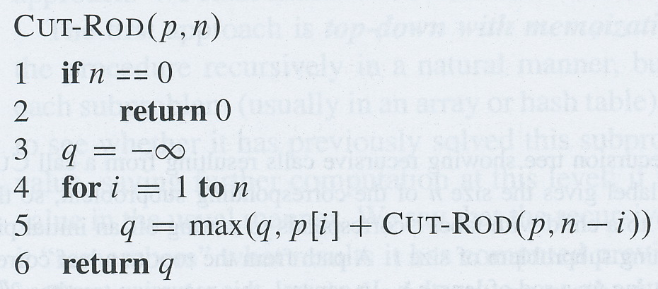
Rod-cutting: A recursive solution
Algorithm implements recursive formula
Takes price array, p, and rod length, n
Returns maximum possible revenue for rod of length n
If n = 0, return 0 in line 2
line 5 implements the formula
Running time approximately doubles when you increase n by 1
i.e., running time is O(2^{n})

Slide 15
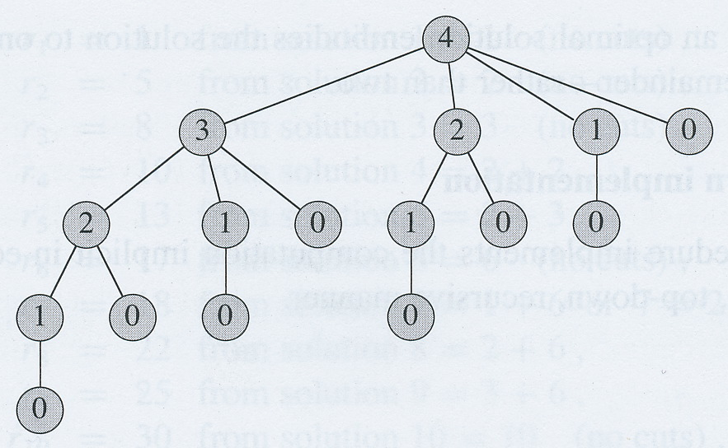
Rod-cutting: A recursive solution
Why is CUT-ROD so inefficient?
CUT-ROD calls itself over and over again with the same parameter values
e.g., when n = 4, CUT-ROD(p,2) called twice and CUT-ROD(p,1) called 4 times
CUT-ROD checks every possible way of cutting up the rod!

Slide 16
Using dynamic programming for rod-cutting
Recursive solution solves the same problem over and over again
We need to arrange for each distinct sub-problem to be solved just once, saving its solution
We can then look up the solution to a sub-problem if we need it again later
So dynamic programming needs more memory to save all the sub-problem solutions
example of time-memory trade-off
Dynamic programming can turn an exponential time program into a polynomial time program!
if number of distinct subproblems is polynomial and each subproblem can be solved in polynomial time

Slide 17
Top-down with memoization
Write a recursive procedure, but save the result of each subproblem
Usually in an array or a hash table
Procedure checks if it has already solved a subproblem before solving it
We say recursive procedure has been memoized

Slide 18
Bottom-up method
Assumes subproblems can be ordered naturally by “size” and that each subproblem depends only on “smaller” subproblems
Sort the subproblems by size and solve them in non-decreasing order of size
Save the solutions as we solve them so that we can use them to solve larger problems when we come to them

Slide 19
Top-down vs. bottom-up
Same asymptotic running time
Except when top-down method does not examine all possible sub-problems (rare)
Bottom-up method often has better constant factors because of less overhead for procedure calls

Slide 20
Rod-cutting, top-down with memoization
MEMOIZED-CUT-ROD sets up an array, r, to store the solutions to the subproblems of size 0 to n (line 1)
initializes slots in array to -∞
Then calls MEMOIZED-CUT-ROD-AUX to find the max revenue for a rod of length n with the price array, p, and the array of previously solved subproblems, r

Slide 21
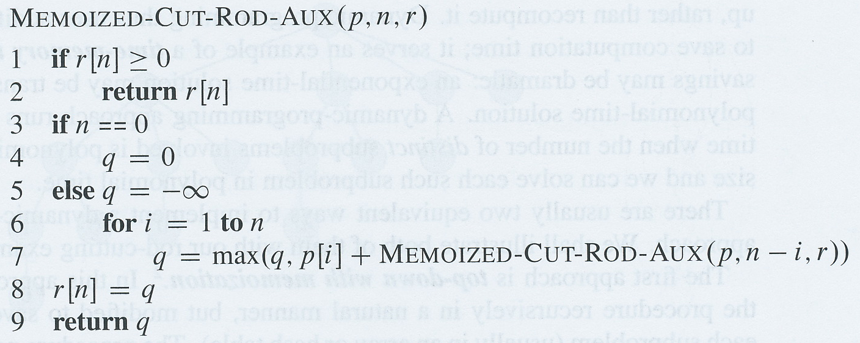
Rod-cutting, top-down with memoization
MEMOIZED-CUT-ROD-AUX first checks if r already contains a solution for the given rod length, n (lines 1-2)
Then it checks if n is 0, in which case it just returns a max revenue of 0 without any further recursive call to itself (lines 3-4)
Otherwise, for each possible first cut position (1-n), it finds the maximum revenue for that cut position by calling itself on the remainder of the rod (lines 5-7), keeping track of the max value in q
Stores q in r at position n
Note that n in MEMOIZED-CUT-ROD-AUX is only equal to n in MEMOIZED-CUT-ROD the first time it is called!

Slide 22
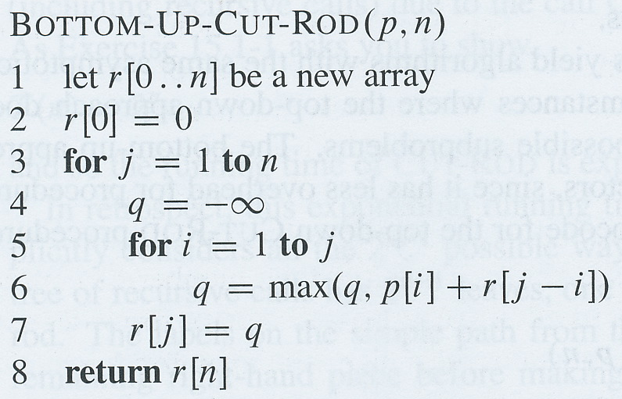
BOTTOM-UP-CUT-ROD
Bottom-up method is actually simpler
Solves subproblems in increasing order of size
If need optimal revenue for rod of length n, then solve problem for lengths of 0 up to n in that order
Line 1 sets up an array, r, to hold the solutions
Line 2 sets r[0] to be 0, since no rod means no revenue!
Lines 3-7 find the optimal solution for rod of length j where j takes all values in order from 1 to n
Line 6 finds the decomposition of the new value of j that gives the best revenue by looking up all the max revenues for smaller values in the array r
The max revenue for n is now in the slot in r with index n

Slide 23
Asymptotic running time
Asymptotic running time is Θ(n²) for both bottom-up and top-down methods
Easy to see this in BOTTOM-UP-CUT-ROD, since has two nested loops of order Θ(n)

Slide 24
Subproblem graphs
Need to know what subproblems are and how they depend on each-other
Can show this with a subproblem graph
Directed graph with a vertex for each subproblem and edges from each vertex to the vertices for the subproblems that it depends on
In the bottom-up method, the order in which we solve the subproblems is such that all the other problems that a subproblem depends on have already been solved by the time we get to it
vertices are reverse topologically sorted
Running time is proportional to the sum of the number of vertices and the number of edges
Solve each subproblem once (each vertex)
To solve a subproblem, must visit each of the vertices it depends on

Slide 25
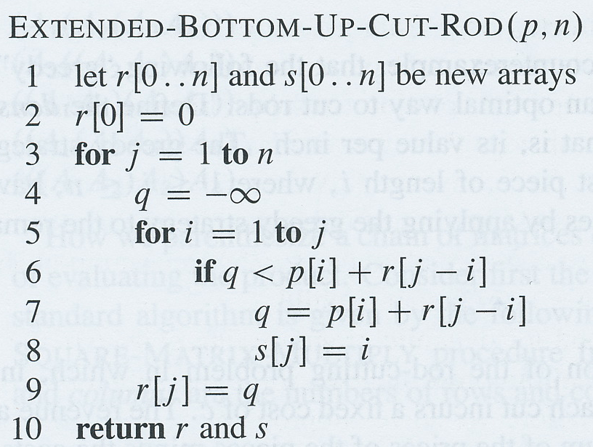
Reconstructing a solution
So far, we’ve only calculated how much revenue we can get from a rod of length n
We haven’t got our algorithms to tell us exactly how we’re supposed to cut up the rod to get this maximum revenue
EXTENDED-BOTTOM-UP-CUT-ROD does this
array r[j] stores maximum revenue for rod of size j
array s[j] stores optimal size of first piece to cut for a rod of size j

Slide 26
Printing out a rod-cutting solution
PRINT-CUT-ROD-SOLUTION takes a price table p and a rod size n
Calls EXTENDED-BOTTOM-UP-CUT-ROD to compute array s of optimal first piece sizes
Starting with n, prints out best first cut, then subtracts size of first cut from n and prints out best first cut for new size of n until n is 0
PRINT-CUT-ROD-SOLUTION(p, 7) prints out
1 (the optimal first cut for 7) and then
6 (the optimal first cut for 7-1)

Slide 27
Subsequences
Suppose A and B are strings such that
A = “abcbdab” and B = “bdcaba”
A subsequence of a string, S, is a sequence that can be formed by deleting elements in S
e.g., “abc”, “acda” are subsequences of A
A common subsequence of two strings, A and B, is a string that is a subsequence of both A and B
e.g., “bd”, “bcb” and “bdab” are common subsequences of A and B

Slide 28
Longest common subsequence
String C is a longest common subsequence (or LCS) of two strings, A and B, if there is no common subsequence of A and B that is longer than C
e.g., if A = “abcbdab” and B = “bdcaba” then “bdab” and “bcba” are both LCSs of A and B
Longest common subsequence problem is that of finding an LCS of two given strings
Used in music information retrieval for comparing melodies and in bioinformatics for comparing gene sequences
LCS problem can be solved efficiently using dynamic programming

Slide 29
Brute-force approach
Given two input strings, X and Y, enumerate all the subsequences of X and check if it’s a subsequence of Y
Keep track of the longest common subsequence
If X has length n, then there are 2^{n} subsequences to check, which is impractical for long strings

Slide 30
Prefix of a string
If X is a string, x₁x₂...x_{m}, the ith prefix of X, denoted by X_{i} is x₁x₂...x_{i} (0 ≤ i ≤ m)
e.g., if X = “abcde” then X₃ = “abc”, X₀ = “” and X₅=“abcde”

Slide 31
Optimal substructure of an LCS
If the last elements in X and Y are the same, then this must also be the last element in the LCS, Z
X = “abcdefg”, Y = “defabcg”, Z = “abcg”
If the last elements of X and Y not the same and the last element in Z is not the last element in X then Z must be an LCS of Y and X_{m-1}
X = “abcdefg”, Y = “defabcgd”, Z = “abcd”
If the last elements of X and Y are not the same and the last element in Z is not the last element in Y then Z must be an LCS of X and Y_{m-1}
X = “abcdefg”, Y = “defabcgd”, Z = “abcg”

Slide 32
Optimal substructure property of LCS problem
Theorem above tells us that and LCS of two sequences contains within it an LCS of prefixes of the two sequences
LCS problem therefore has optimal substructure property
Optimal solution incorporates optimal solutions to related subproblems, that we can solve independently

Slide 33
LCS: Recursive solution
Optimal substructure theorem tells us that we must examine either 1 or 2 subproblems when finding an LCS of X = x₁x₂...x_{m} and Y = y₁y₂...y_{n}
If x_{m} = y_{n}, then we need to find LCS of X_{m-1} and Y_{n-1} and then append x_{m} to this to get an LCS of X and Y
If x_{m} ≠ y_{n}, then we need to find
LCS of X_{m-1} and Y, and
LCS of X and Y_{n-1}
and then take the longest of these two

Slide 34
LCS: Overlapping subproblems
X = “abcdefg”, Y = “defabcd”
Last elements not equal: need to find LCS of
LCS(“abcdef”, “defabcd”) (last elements not equal)
LCS(“abcdef”, “defabc”) LCS(“abcde”, “defabcd”) LCS(“abcdefg”, “defabc”) (last elements not equal)
LCS(“abcdefg”, “defab”)
LCS(“abcdef”, “defabc”)
Actually there are a lot of overlapping sub-problems!

Slide 35
Recursive solution
c[i,j] is the length of an LCS of the prefixes, X_{i} and Y_{j}
X = “abcbcd”, Y = “bccbedf” LCS is “bc”, c[4,3] = 2
If i = 0 or j = 0, then one of the prefixes is empty so the LCS length is 0
If last elements in prefixes are the same, then c[i,j] is one more than c[i-1,j-1]
If last elements of prefixes are not the same, then c[i,j] is the greater of c[i,j-1] and c[i-1,j]
Nature of problem allows us to eliminate all but at most two possible subproblems of relevance for any given pair of strings

Slide 36
Computing length of an LCS
Equation above lets us easily write an exponential time recursive algorithm to solve LCS problem
But there are only Θ(mn) distinct subproblems since there are m prefixes for X and n prefixes for Y
We can use dynamic programming to compute the LCS bottom-up

Slide 37
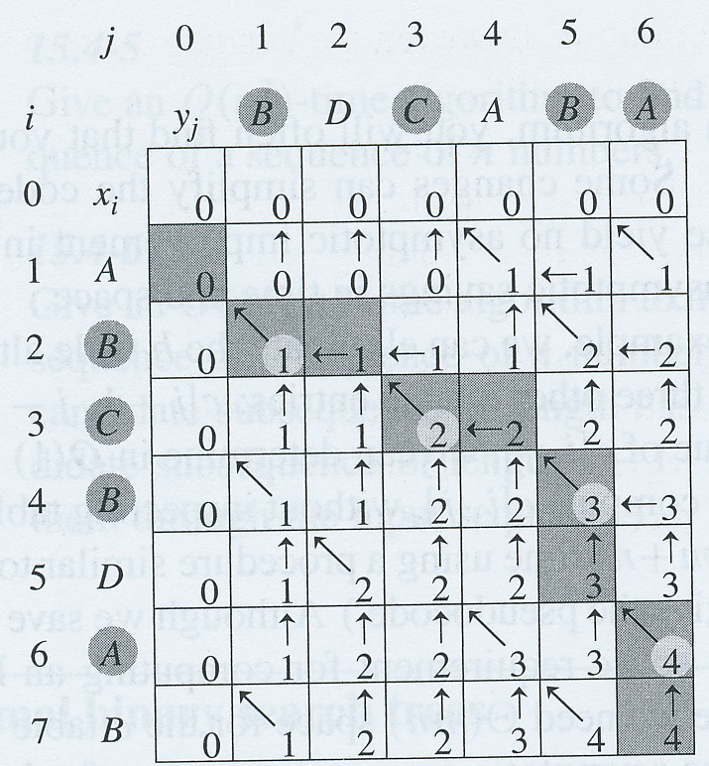
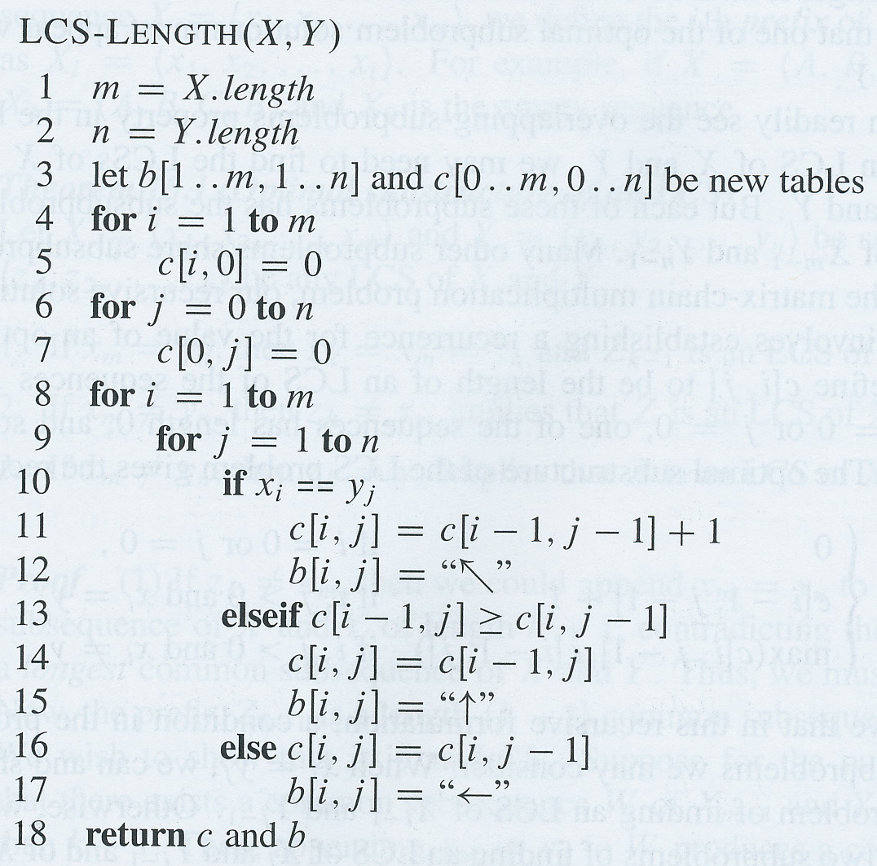
LCS-LENGTH
Entries calculated in row-major order
b[i,j] points at optimal subproblem solution chosen when computing c[i,j]
Procedure returns tables b and c
c[m,n] gives length of LCS of X and Y
Runs in Θ(mn) time
cf. exponential time of brute-force method!

Slide 38
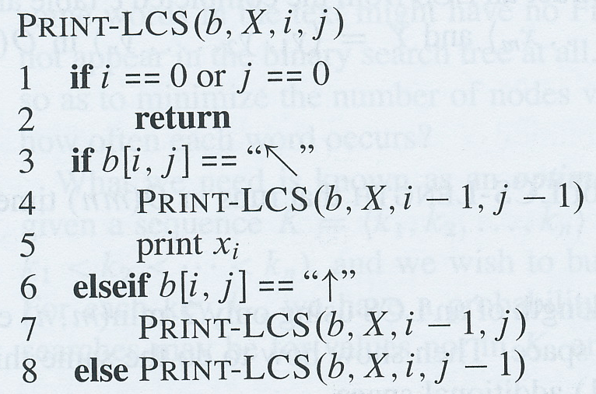
Printing out an LCS
Table b lets us construct an LCS in O(m+n) time
Start at b[m,n] and follow the arrows through the table
If we encounter a  at b[i,j] then that means that x_{i} = y_{j} and this element is a character in the LCS that LCS-LENTH found
Means we find the LCS characters in reverse order
PRINT-LCS(b, X, X.length, Y.length) prints out an LCS of X and Y in forward order in O(m+n) time

