Slide 1
RecurSIA-RRT: Recursive translatable point-set pattern discovery with removal of redundant translators
David Meredith
dave@create.aau.dk
Aalborg University, Denmark

Slide 2
Compression-driven point-set pattern discovery in music
Principle of parsimony:
Given two models that equally accurately describe the data, the simpler one is less likely to be an accurate description by chance
Have applied compression-based point-set cover algorithms to a number of different musicological tasks with some success
classification of folk songs, simulation of human analyses, discovery of subjects and counter-subjects in fugues
Some evidence that better compression is correlated with better performance (Louboutin and Meredith, JNMR, 2016) and better simulation of cognition (Collins et al., Music Perception, 2011)
Motivated to develop techniques that give us better compression, in the hope that the more compressed encodings of musical objects will represent better ways of understanding them
COSIATEC
SIATECCompress
Forth’s algorithm

Slide 3
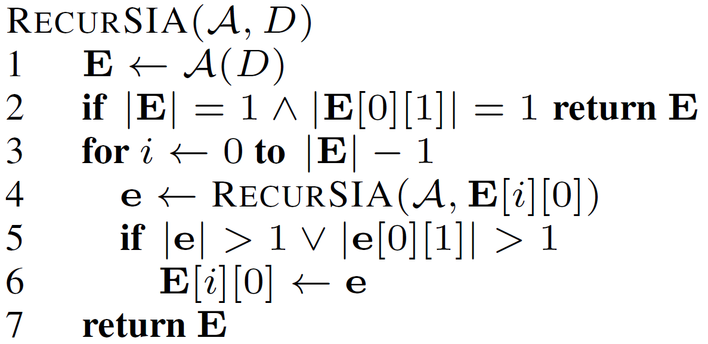
RecurSIA: Recursive translatable pattern discovery
4
3
2
1
0
0
1
2
3
4
5
6
7
8
9

Slide 4
RecurSIA: Recursive translatable pattern discovery
4
3
2
1
0
0
1
2
3
4
5
6
7
8
9

Slide 5
RecurSIA: Recursive translatable pattern discovery
4
3
2
1
0
0
1
2
3
4
5
6
7
8
9

Slide 6
RecurSIA: Recursive translatable pattern discovery
4
3
2
1
0
0
1
2
3
4
5
6
7
8
9

Slide 7
RecurSIA: Recursive translatable pattern discovery
4
3
2
1
0
0
1
2
3
4
5
6
7
8
9

Slide 8
RecurSIA: Recursive translatable pattern discovery
4
3
2
1
0
0
1
2
3
4
5
6
7
8
9
Compression factor without RecurSIA = 24/(8+2) = 2.4

Slide 9
RecurSIA: Recursive translatable pattern discovery
4
3
2
1
0
0
1
2
3
4
5
6
7
8
9

Slide 10
RecurSIA: Recursive translatable pattern discovery
4
3
2
1
0
0
1
2
3
4
5
6
7
8
9

Slide 11
RecurSIA: Recursive translatable pattern discovery
4
3
2
1
0
0
1
2
3
4
5
6
7
8
9
Compression factor with RecurSIA = 24/(3+1+2+2) = 3.0

Slide 12
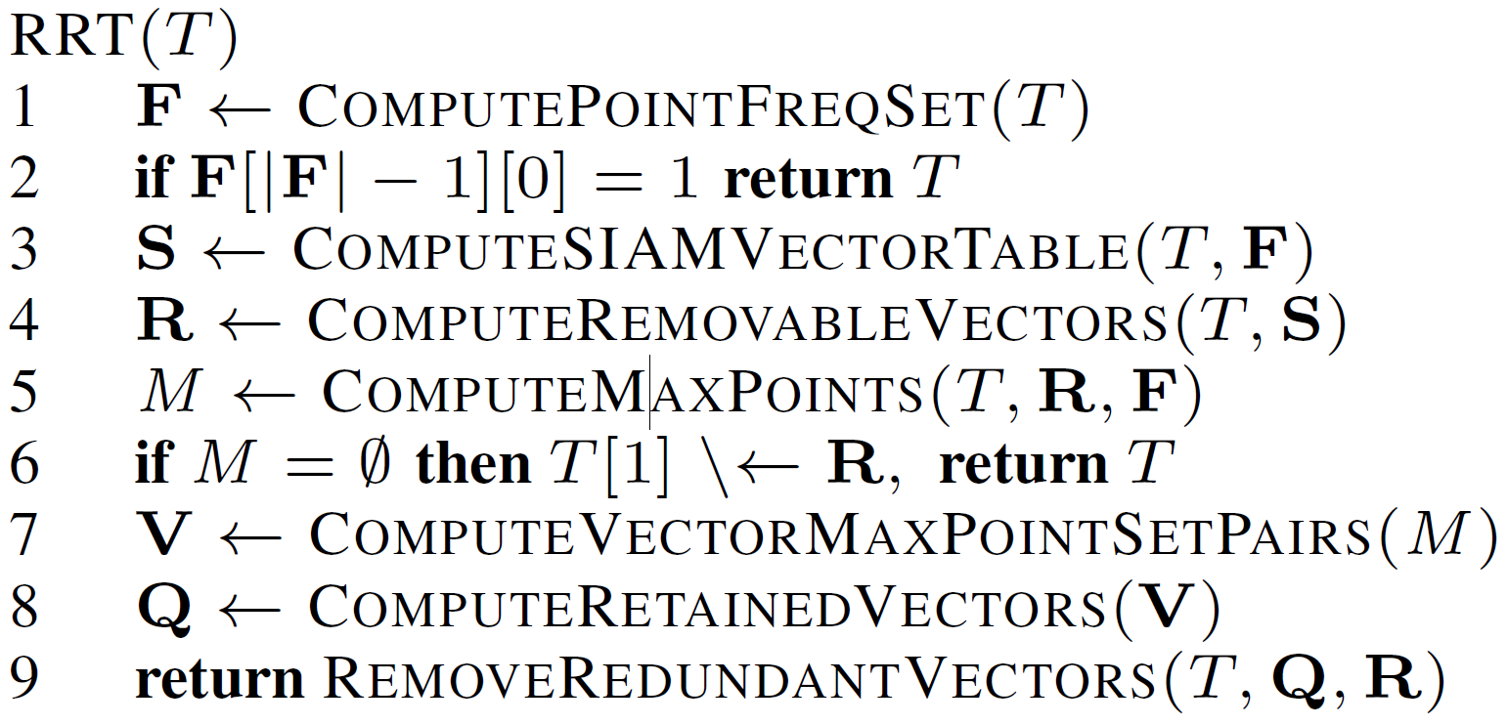
RRT: Removing redundant translators
v4
T(P(a,b,c,d),V(v1,v2,v3,v4))
Length = 8
a
b
v3
c
d
v2
v1
v4
T(P(a,b,c,d),V(v2,v4))
Length = 6
a
b
Come to the poster for more details!
c
d
v2

