Slide 1
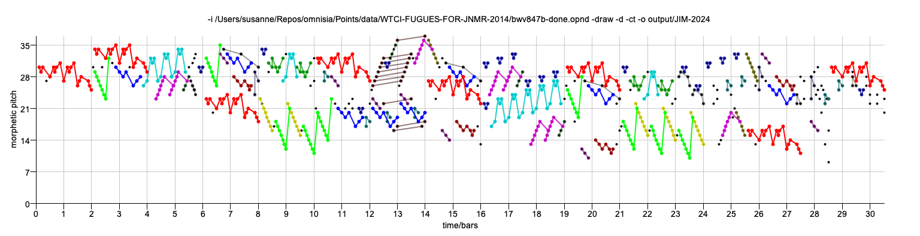

Geometric Algorithms for Music Analysis
David Meredith
dave@create.aau.dk
https://www.titanmusic.com
https://github.com/chromamorph/omnisia
https://scholar.google.com/citations?user=bs-237cAAAAJ
Notes:
Thank you for the introduction and thank you to the organising committee for inviting me to speak.
As the title says, I’ll be talking to you today about Geometric algorithms for music analysis, which is a topic that I’ve been working on with a number of different collaborators for many years.
At the top of this slide you can see a visualization of an analysis generated by one of the algorithms that I’ll describe of the C minor fugue from the first book of the WTC by J. S. Bach.

Slide 2
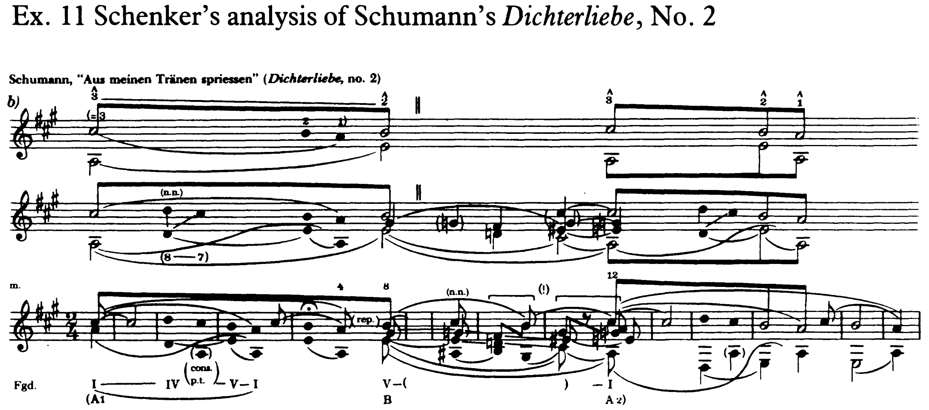
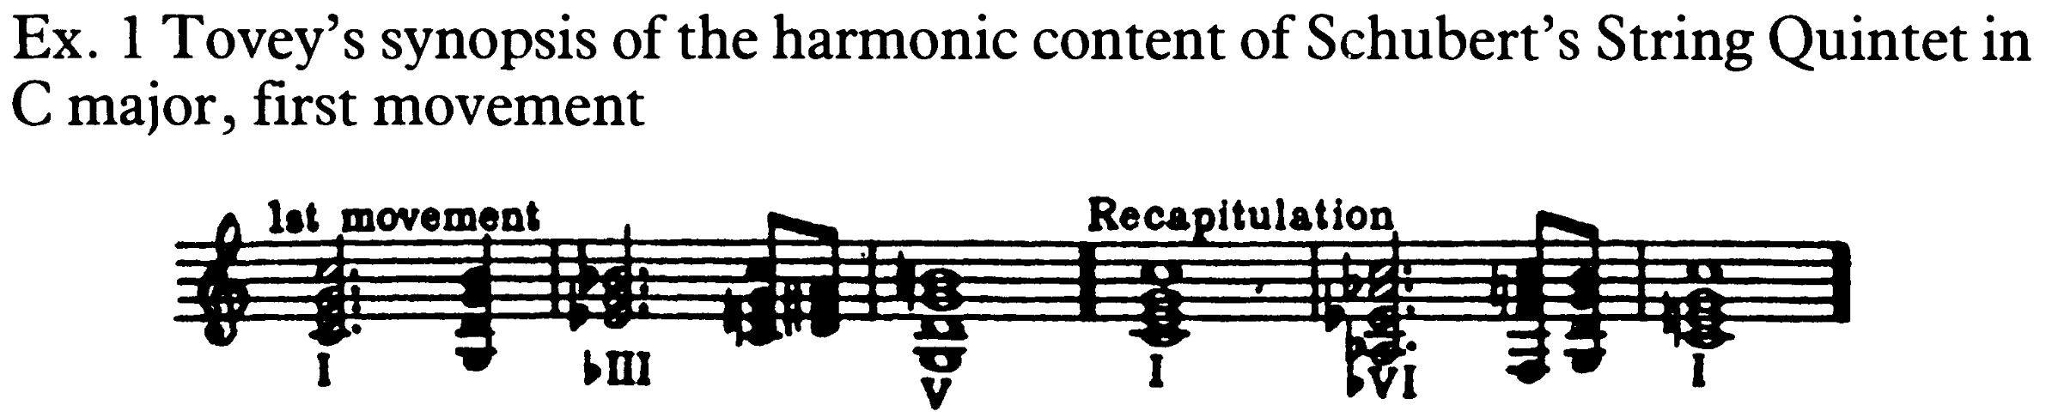
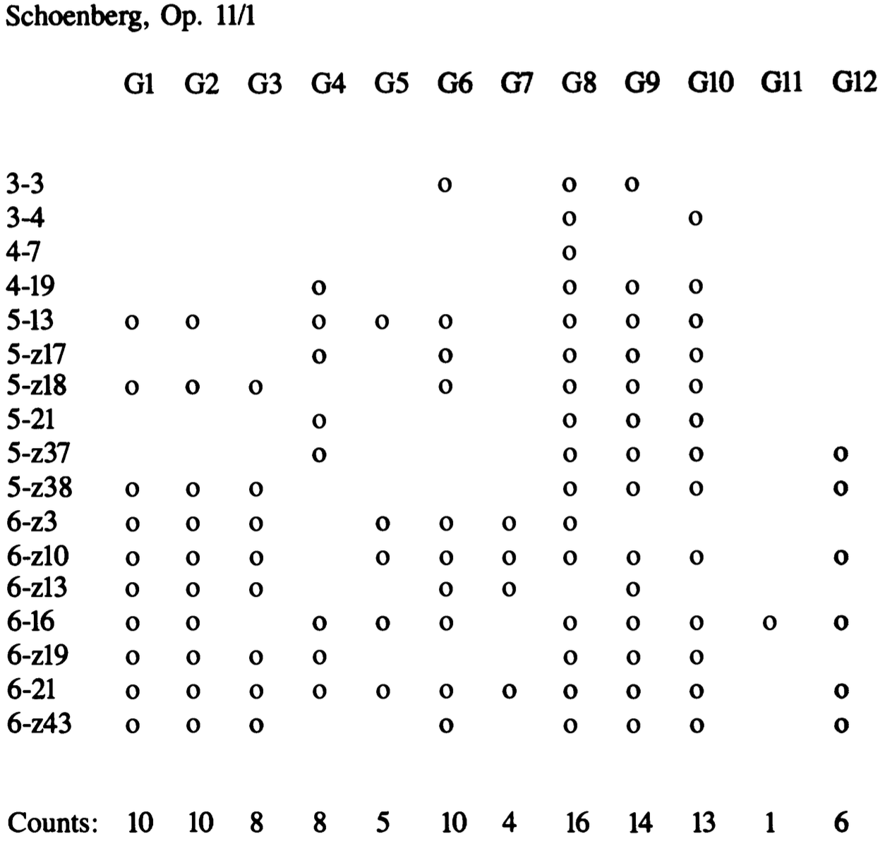
The goal of music analysis
From Agawu (1989, p. 289)
From Agawu (1989, p. 277)
A musical analysis is a representation of a way of understanding certain aspects of the structure of a musical object
A musical object can be any quantity of music from a single note to a collection of works
The analyst constructs a musical analysis from a given set of representations or encodings of the musical object that we’ll call input encodings
  These are roughly equivalent to what other researchers have called the “musical surface”
The goal of music analysis is to discover and communicate the best possible explanations for musical objects
  That is the best possible ways of understanding the musical objects considered
The “best possible” explanations for a musical object are those that allow you to best carry out certain tasks, such as
  memorising a piece
  identifying the composer of an unattributed piece
  completing an unfinished piece
  performing a piece
In principle, the best possible explanation for one task may not be the best possible explanation for another
However, we can hypothesize that there will be some single set of equally good, explanations that are the best explanations for all tasks
From Forte (1988, p. 239)

Slide 3
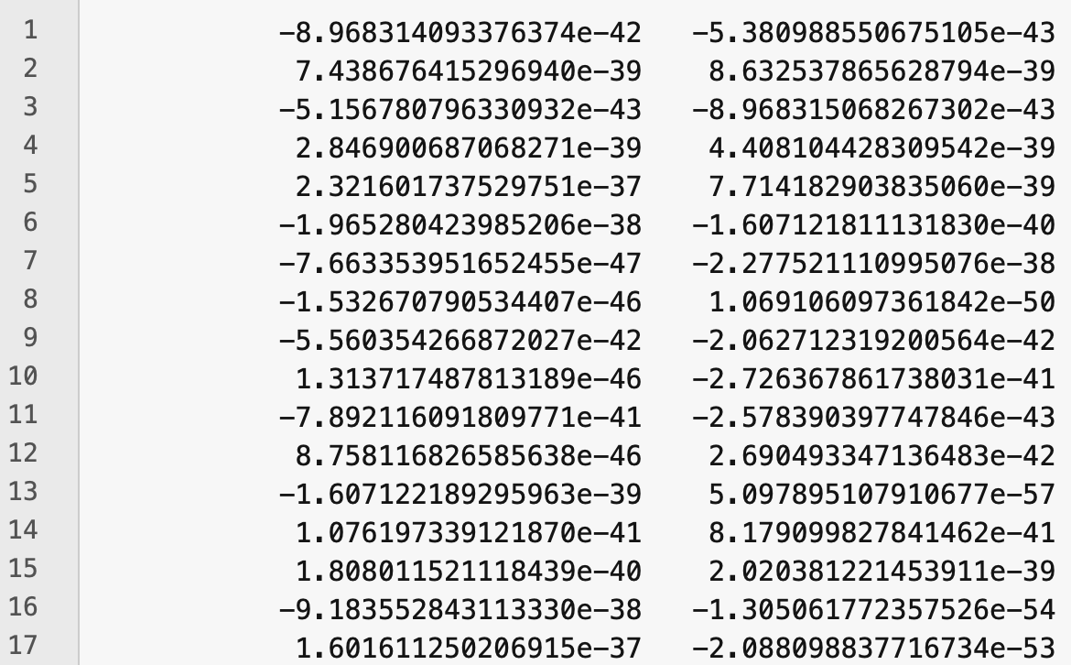
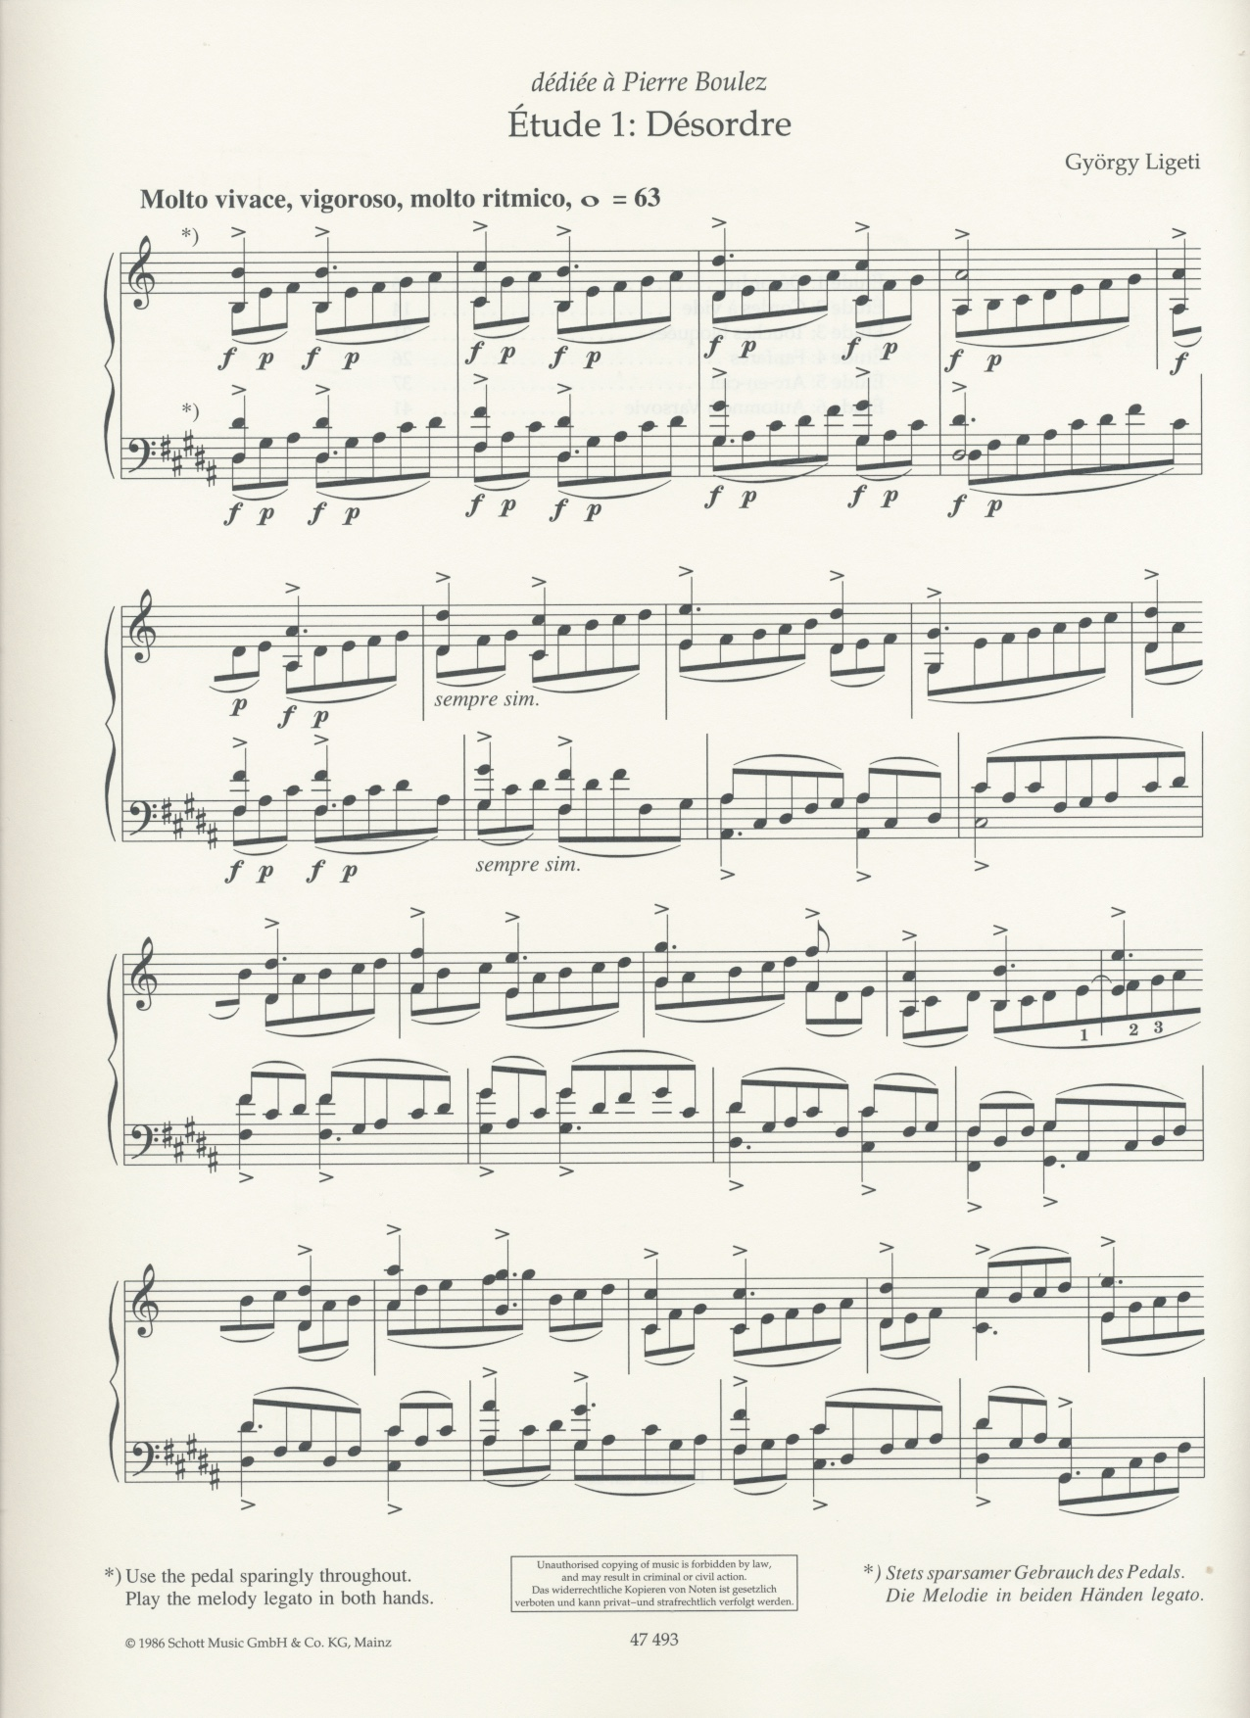
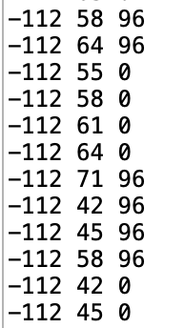
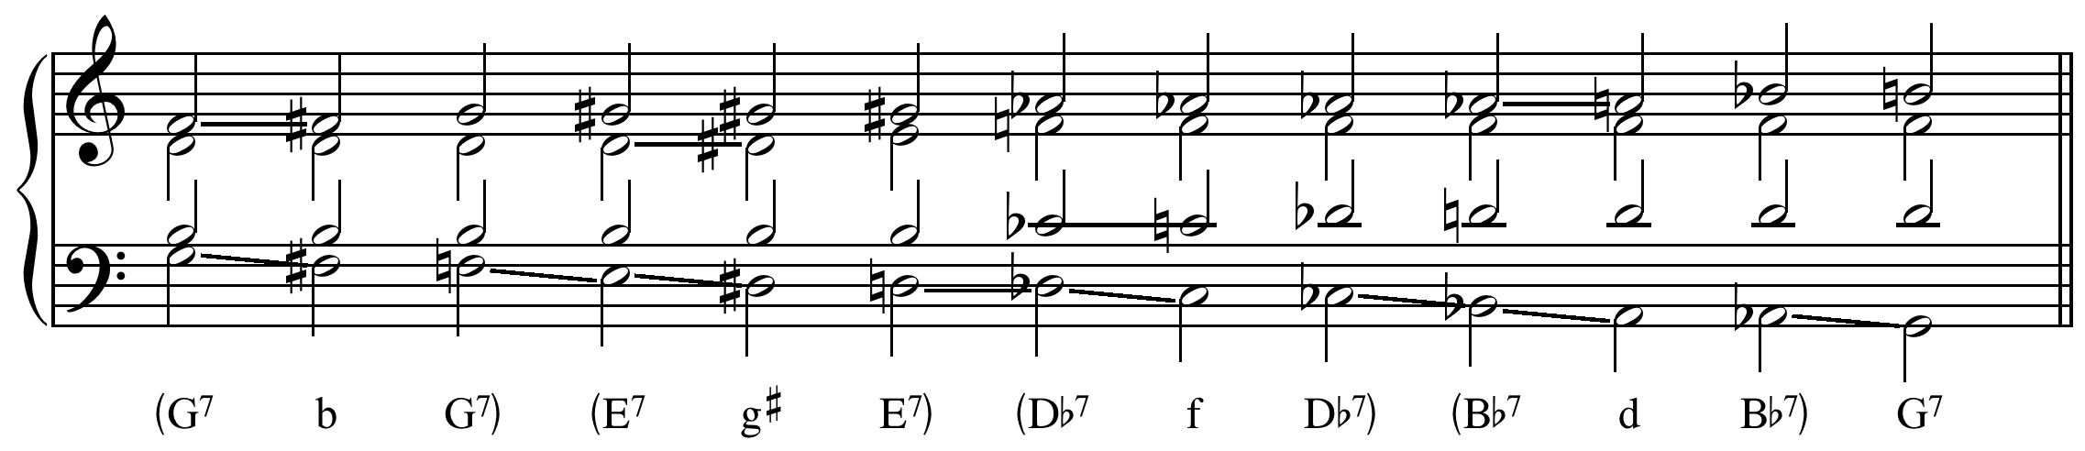
Input encodings
Input encoding are typically extensional descriptions of musical objects
This means they take the form of an explicit listing of the properties of a set of atoms
For example
  in a notated score, each atom is a note and its properties include its onset time, duration, pitch and so on
  in a PCM audio file, each atom is a sample and its properties include its timestamp, its value and its channel
  in a MIDI file, each atom is a MIDI event whose properties include its message type and data that depends on its message type
  in a chord sequence, each atom is a chord and its properties include the chord root and quality
We assume the input encoding does not represent any groupings of atoms or structural relationships between them
An extensional input encoding therefore represents the musical object as though it is a meaningless collection of unrelated, randomly selected atoms
Note that the description of a musical object never needs to be longer than an extensional description

Slide 4
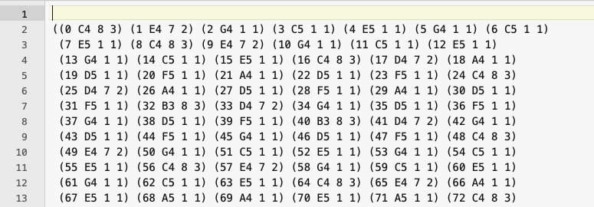
The musical surface or input encoding
Input encodings represent the musical object at some particular level of granularity or detail
They represent only certain structural aspects of the musical object
  e.g., OPNDV file (bottom left) gives onset, pitch name, duration and voice, but says nothing about metre or grouping
We assume input encodings give a complete and accurate description of the structural aspects of the musical object in which we’re interested
Input encodings usually provide enough information for a performance of the musical object to be rendered
  either by a human, if the encoding is, e.g., a score or lead sheet
  or a machine, if the encoding is, e.g., a MIDI file, magnetic tape, vinyl record or audio file

Slide 5
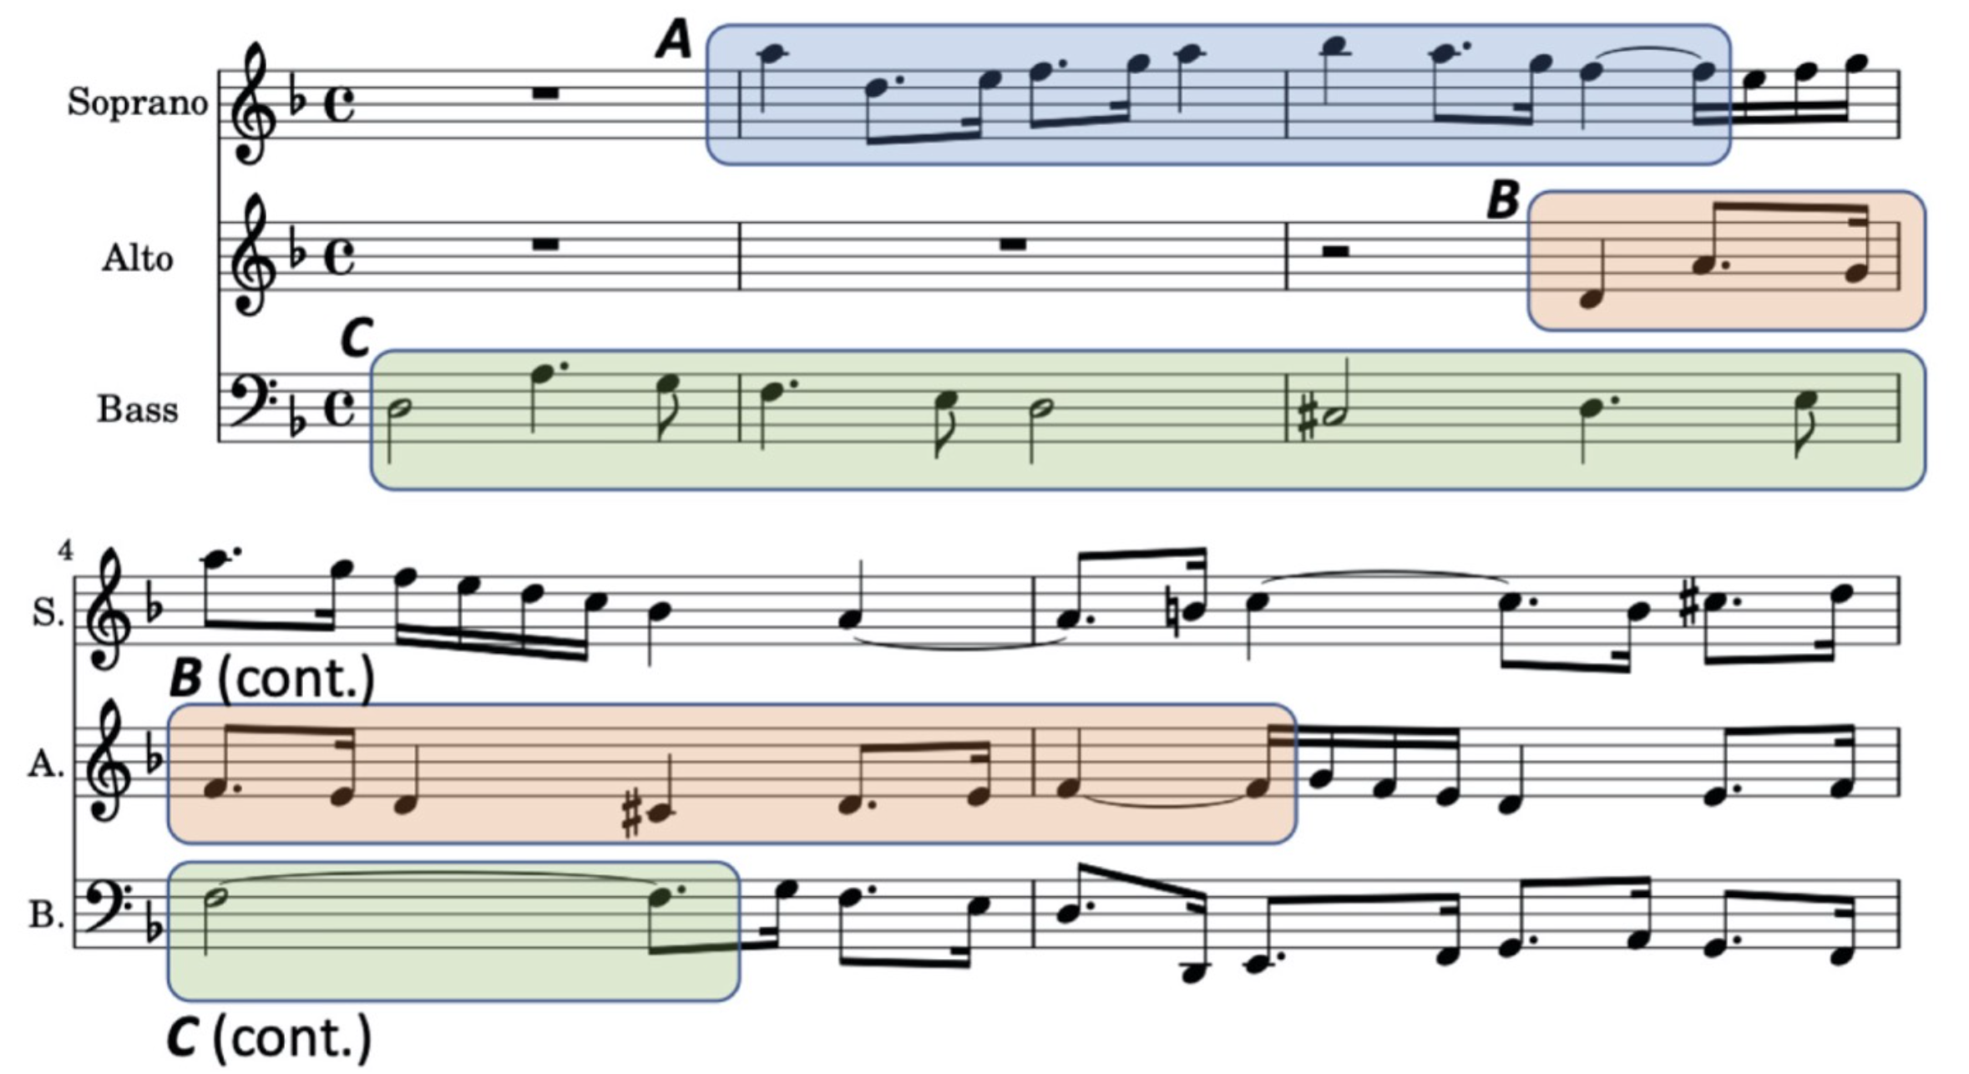
A musical analysis identifies structural units and relationships between these units
Like an input encoding, a musical analysis is also a description of a musical object
Input encodings typically describe a musical object as though it is a meaningless collection of independent atoms (e.g., samples, notes, midi messages)
However, a musical analysis typically
  groups atoms into structural units of various types
    e.g., chords, phrases, motives, voices
  categorises these structural units
    e.g., main theme, fugal subject, C major triad
  specifies relationships between structural units
    e.g., second entry is a diminished inversion of the first entry
Bars 1-5 of Contrapunctus VI from J. S. Bach’s Die Kunst der Fuge, BWV 1080. Pattern C is an inverted augmentation of pattern A and pattern B is an inversion of pattern A.
https://open.spotify.com/track/4L3LZiEQEKgcJk8Vs7abRB?si=61c0bdd50869442c

Slide 6
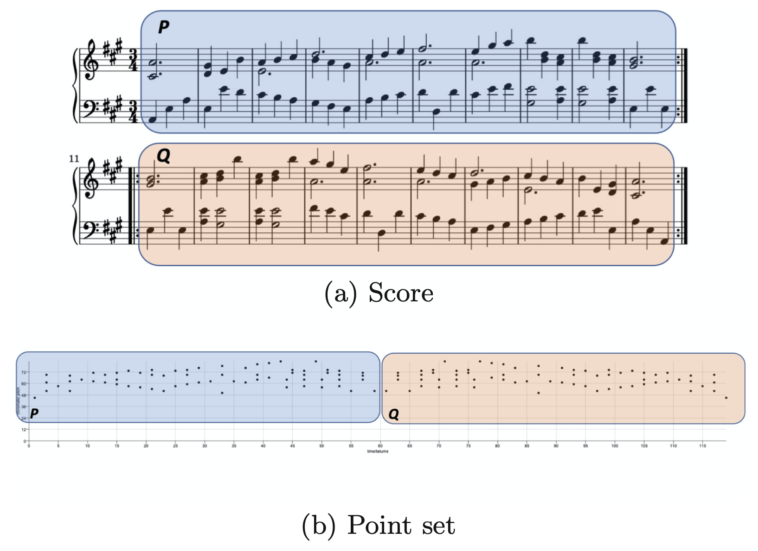
Why does an analysis identify structural units, categorise them and specify relationships between them?
Because this leads to a shorter, more parsimonious description of the musical object that can convey as much – or even more – information than the extensional input encoding
For example, by identifying that the second half, Q, of the minuet on the left is the same as first half, P, only reversed, we spare ourselves from having to explicitly state what each note is in Q
We just need to give an extensional description of P and then a description of the transformation that maps P onto Q
If this transformation can be described using fewer bits of information than extensionally describing the Q, then we have achieved a more efficient, compressed description of the whole piece
Categorisation allows us to relate groups of atoms to other groups that occur in other objects of a similar type, thus achieving compression over entire genres or repertoires
2nd mvt from Haydn’s Sonata in A major, Hob.XVI:26, Op.13 No.6 (“Menuetto al Rovescio”). The second half of the piece, Q, is an exact retrograde of the first half.

Slide 7
A musical analysis as a program
A musical analysis can be represented (or encoded) as a program that generates the extensional input encoding as its only output
The program describes a process that generates the musical surface
  and therefore serves as a hypothesis as to how the surface came about
  that is, it is an explanation for the surface
Usually, such a program is shorter than the extensional input encoding because it exploits structure in the object in order to compress it
If an object has no structure, then it is incompressible and algorithmically random (Li and Vitányi, 2019, p.49)
Ideally, we want the shortest possible description of the input encoding
Ambiguity arises when there are two or more shortest descriptions
The length in bits of the shortest possible description of any object is called that object’s Kolmogorov complexity
Meredith, D. (2012). A geometric language for representing structure in polyphonic music. In Proceedings of the 13th International Society for Music Information Retrieval Conference (ISMIR 2012) (8-12 October 2012), Porto, Portugal, pp. 133-138. [Full paper] [Online publication]
Notes:
Some notes
----- Meeting Notes (08/11/2012 15:10) -----
Some meeting notes

Slide 8
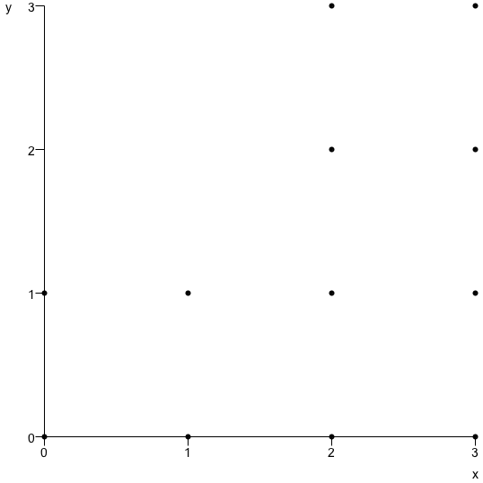
Program length as a measure of complexity
P(p(0,0),p(0,1),p(1,0),p(1,1),p(2,0),p(2,1),p(2,2),p(2,3),p(3,0),p(3,1),p(3,2),p(3,3))
T(P(p(0,0),p(0,1),p(1,0),p(1,1)),V(v(2,0),v(2,2)))
Above are two descriptions of the set of 12 points on the left
The upper description just lists the points – it is an extensional description
The lower description is a short program that generates the 12 points by specifying a 4-point pattern and then translating that pattern by a set of two vectors
The lower description is shorter and imbues the point set with meaning by exploiting structure, redundancy and symmetry in the data

Slide 9
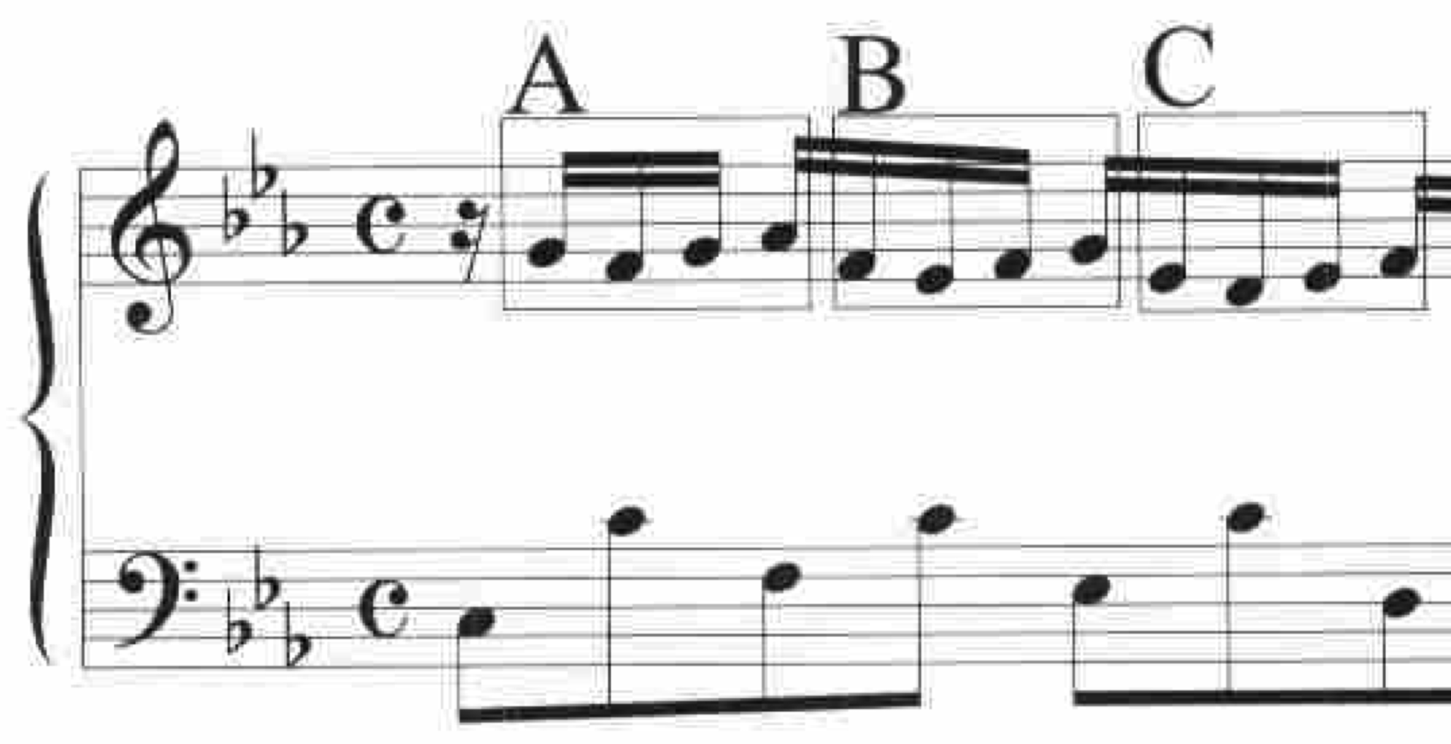
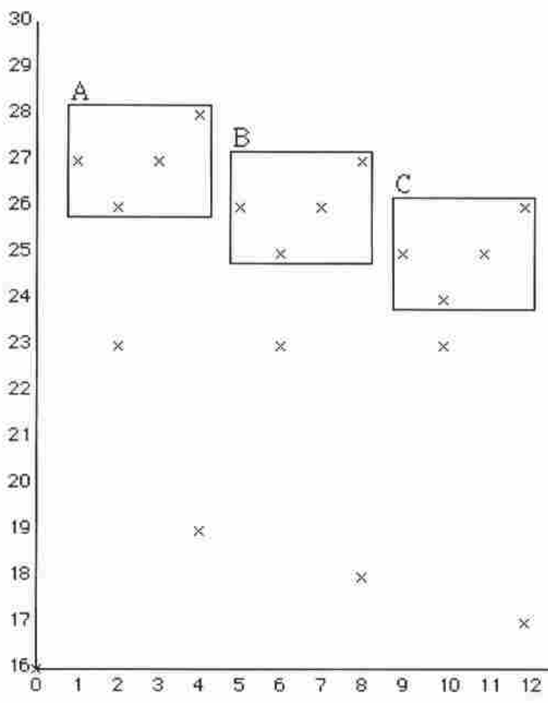
Music analysis aims to compress music
P(p(1,27),p(2,26),p(3,27),p(4,28),p(5,26),p(6,25),p(7,26),p(8,27),p(9,25),p(10,24),p(11,25),p(12,26))
T(P(p(1,27),p(2,26),p(3,27), p(4,28)),V(v(4,-1),v(8,-2)))
Here is a musical analogue of the previous example
The 12 points covered by the three patterns A, B and C can be described extensionally using the upper expression above
Or they can be generated using a shorter “program” that describes pattern B and C as being generated by translating A in pitch-time space
The shorter description achieves compression and imbues the notes with meaning by describing how they could have come about as the result of a pattern being repeated and transformed
Music analysis aims to find such short descriptions of processes that could have generated the musical surfaces that we want to understand
Meredith, D., Lemström, K. and Wiggins, G. A. (2002). Algorithms for discovering repeated patterns in multidimensional representations of polyphonic music. Journal of New Music Research, 31(4), pp. 321-345. [Online publication]

Slide 10
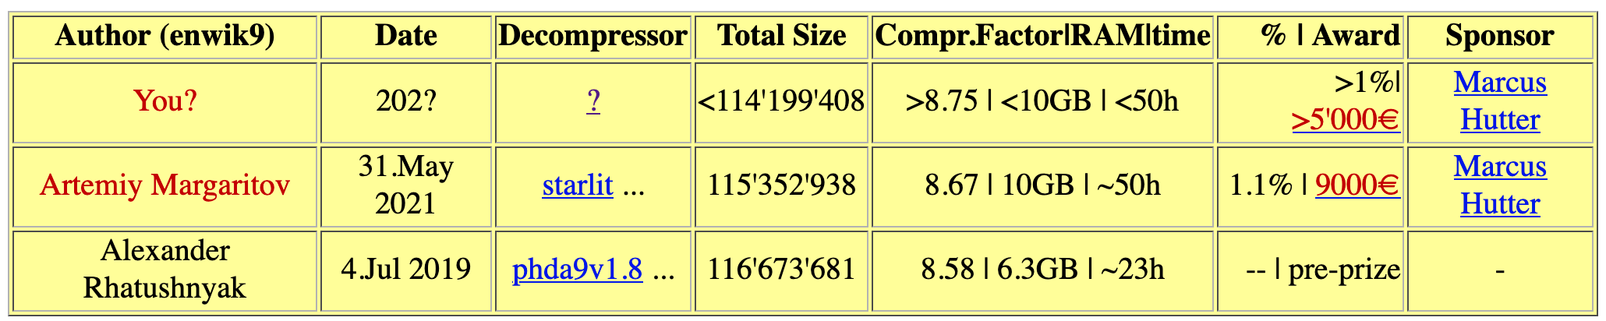
Compression and explanation
Hypothesis: The shortest descriptions provide the best explanations
  Ockham’s razor, MDL, MML, Solomonoff’s theory of inductive inference, Kolmogorov’s sufficient algorithmic statistic
Suggests that knowledge can be extracted from data by finding short descriptions of the data (i.e., by compressing it)
  see, for example, the Hutter Prize (http://prize.hutter1.net/)
Suggests that the best explanations for musical objects will be represented by the shortest losslessly compressed descriptions of those objects
  Note that it is always possible to shorten a description by giving less information – i.e, lossy compression (e.g., MP3)

Slide 11
Musical objects are interpreted in the context of larger containing objects
A musical object (phrase, section, movement, work, corpus, ...) is usually interpreted within the context of some larger object that contains it
  e.g., a work (W) is often interpreted in the context of its composer’s other works (C), or other works in the same genre or form (F) or other works for the same instrument(s) (I)
Understanding an object as being an instance of some category of objects, corresponds to a two-part code (Li and Vitányi, 2019, p.410)
  the “model description” which is the characteristic function of the context set
  the data-to-model code uniquely identifying the object as member of the context set – this part is random
M
I
T
W
S
P
C
F
Meredith, D. (2013). Analysis by compression: Automatic generation of compact geometric encodings of musical objects. The Music Encoding Conference 2013 (22-24 May 2013), Mainz Academy for Literature and Sciences, Mainz, Germany. pp. 41-53. [Extended abstract] [Slides] [Full paper] [Proceedings]

Slide 12
Music analysts look for short programs that compute collections of musical objects
The analyst tries to find the shortest program that computes a set of extensional descriptions of
  the object to be explained (the explanandum)
  other objects, related to the explanandum, defining a context within which the explanandum is to be interpreted
P
Meredith, D. (2013). Analysis by compression: Automatic generation of compact geometric encodings of musical objects. The Music Encoding Conference 2013 (22-24 May 2013), Mainz Academy for Literature and Sciences, Mainz, Germany. pp. 41-53. [Extended abstract] [Slides] [Full paper] [Proceedings]

Slide 13
Listener interprets new music in the context of previously heard music
When a listener interprets a new piece, the existing explanation (program), P, for all music previously heard is modified (as little as possible), to produce a new program, P', to account for the new music in addition to the music already understood
This can potentially change the way that you understand music that you have previously heard
P
P'
Meredith, D. (2013). Analysis by compression: Automatic generation of compact geometric encodings of musical objects. The Music Encoding Conference 2013 (22-24 May 2013), Mainz Academy for Literature and Sciences, Mainz, Germany. pp. 41-53. [Extended abstract] [Slides] [Full paper] [Proceedings]

Slide 14
Perceived structure represented by process by which object is generated
Perceived structure of each musical object in the context set (including new object), is represented by the specific way in which P' computes that object
On this view, both music analysis and music perception boil down to being the compression of musical objects
The compression can either be done incrementally or globally
  Incremental compression is where you find the shortest description of the new thing in terms of what you already know, without changing the way you understand what you already know
  Global compression is where you try to find to find the globally optimal (simplest) way of understanding everything you already know that is relevant to understanding the new thing
Global compression is more expensive than incremental compression, but can potentially produce better insights
Global compression corresponds to scientific revolution, whereas incremental compression corresponds to scientific evolution
P
P'
Meredith, D. (2013). Analysis by compression: Automatic generation of compact geometric encodings of musical objects. The Music Encoding Conference 2013 (22-24 May 2013), Mainz Academy for Literature and Sciences, Mainz, Germany. pp. 41-53. [Extended abstract] [Slides] [Full paper] [Proceedings]

Slide 15
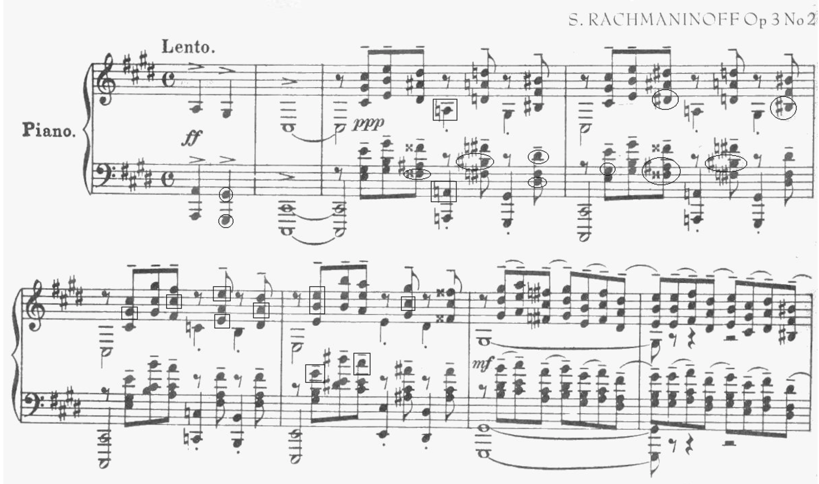
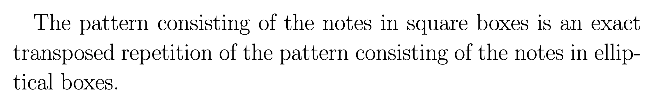
Perception and analysis are non-optimal compression
Analysts and listener aim to find the shortest encodings
But typically they do not achieve this because they are constrained by limitations of memory, time and the nature of the perceptual and cognitive system (i.e., the brain)
    For example, we are typically not good at recognising repeated patterns that are embedded among distractors – see example on left
https://open.spotify.com/track/3rd1Chqzxr95fcyBaJl0JZ?si=47d5b1c078ea4804

Slide 16
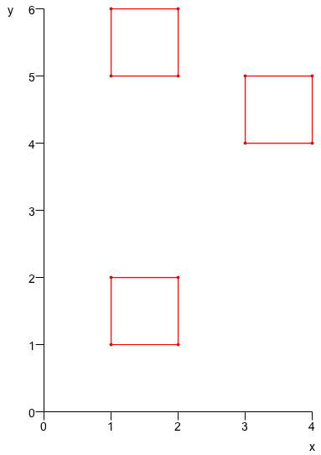
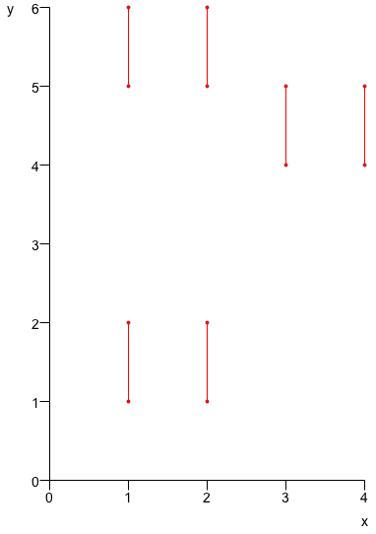
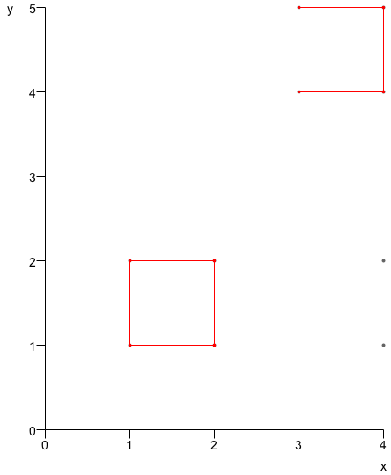
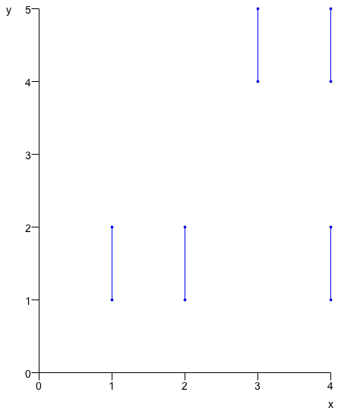
Individual differences depend on order of presentation of context
Prefer to re-use previous encodings wherever possible
  “greedy algorithm”: means that way in which a new object is understood depends on the order of presentation of previous objects
Implies that each individual will have a different interpretation of the same musical object that depends, not only on what previous music has been heard, but also the order in which it was encountered
Meredith, D. (2012). A compression-based model of musical learning. DMRN+7: Digital Music Research Network One-day Workshop 2012 (18 December 2012), Queen Mary University of London. [Abstract] [Slides]

Slide 17
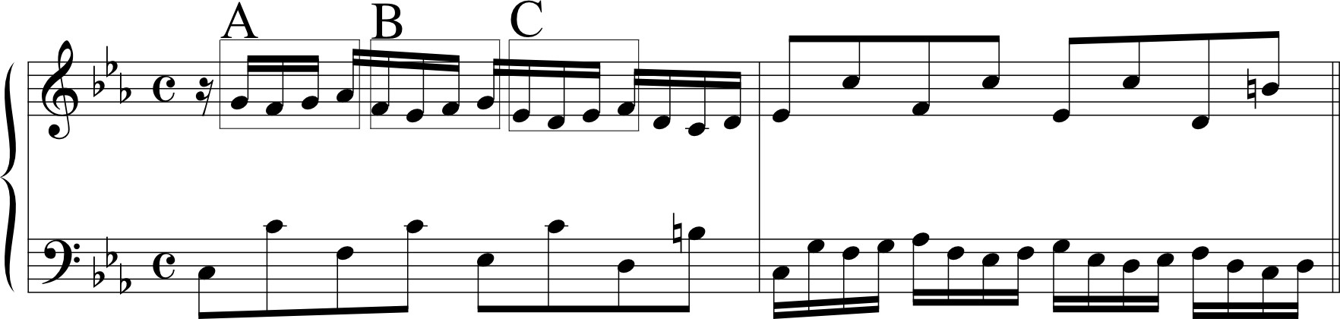
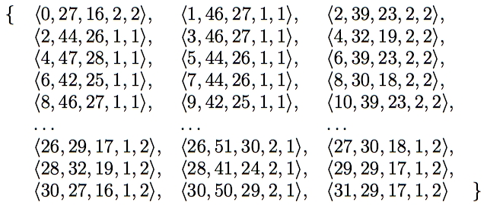
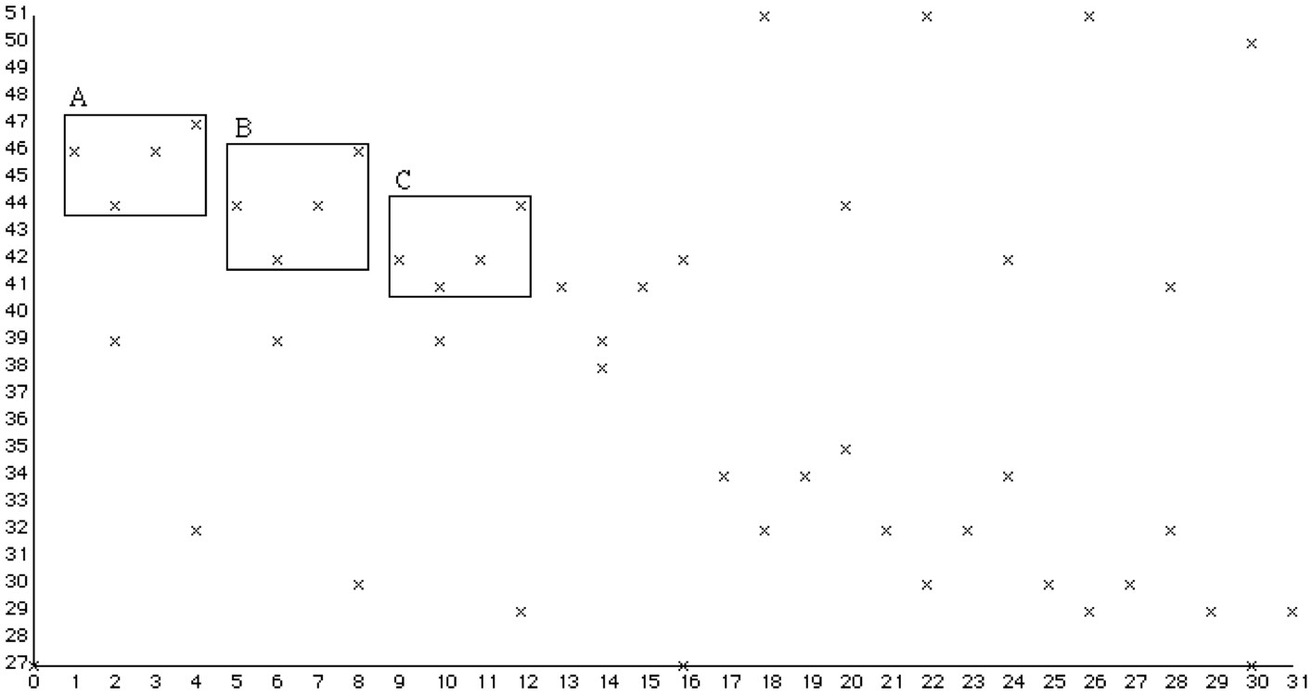
Representing music with point sets
Meredith, D., Lemström, K. and Wiggins, G. A. (2002). Algorithms for discovering repeated patterns in multidimensional representations of polyphonic music. Journal of New Music Research, 31(4), pp. 321-345. [Online publication]

Slide 18
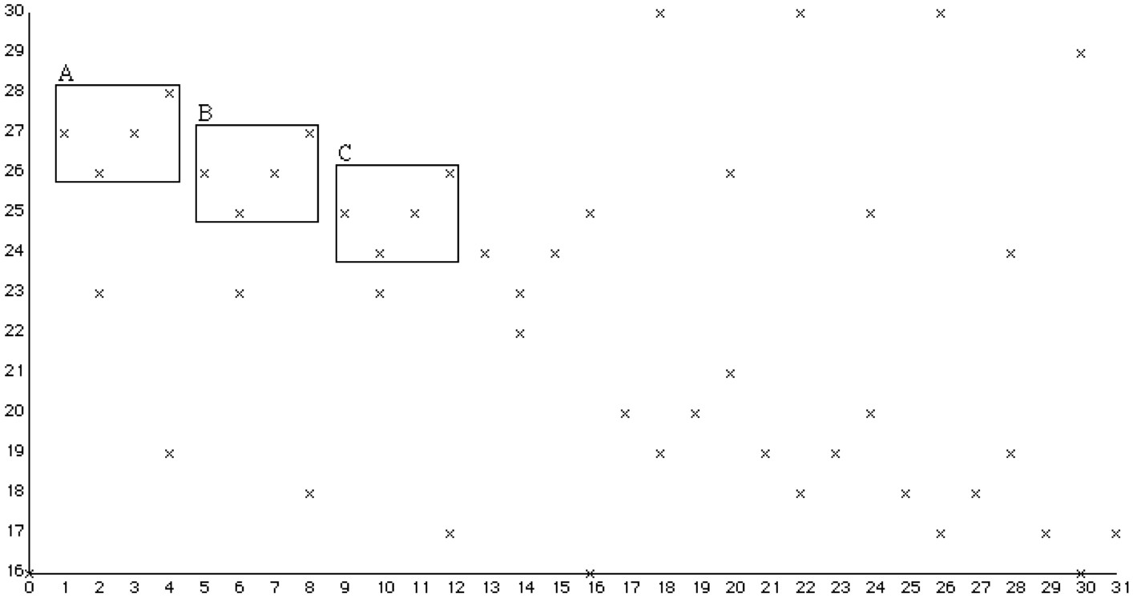
Representing music with point sets
Meredith, D. (2006). The ps13 pitch spelling algorithm. Journal of New Music Research, 35(2), pp. 121-159. [Online publication]
Meredith, D., Lemström, K. and Wiggins, G. A. (2002). Algorithms for discovering repeated patterns in multidimensional representations of polyphonic music. Journal of New Music Research, 31(4), pp. 321-345. [Online publication]

Slide 19
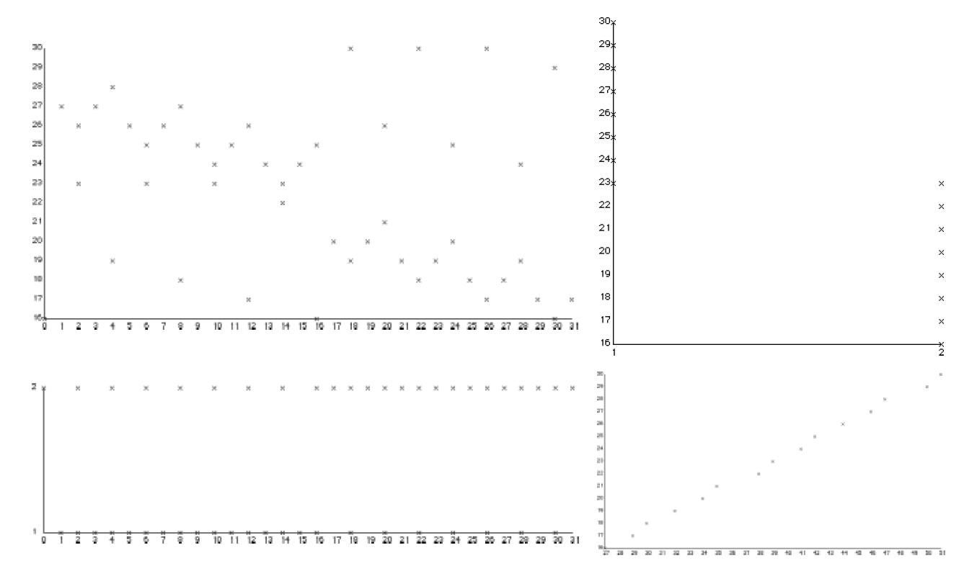
Other projections of a multidimensional representation of a musical object
Top-left: morphetic pitch against onset time
Top-right: Morphetic pitch against voice
Bottom-left: voice against onset time
Bottom-right: morphetic pitch against chromatic pitch
Meredith, D., Lemström, K. and Wiggins, G. A. (2002). Algorithms for discovering repeated patterns in multidimensional representations of polyphonic music. Journal of New Music Research, 31(4), pp. 321-345. [Online publication]

Slide 20
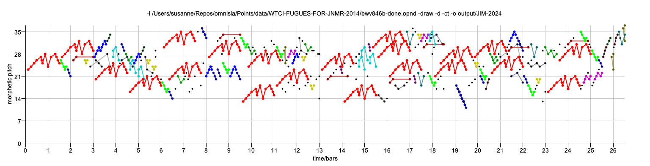
Repeated patterns in music
J.S. Bach, Fugue in C major, BWV 846
“the importance of parallelism [i.e., repetition] in musical structure cannot be overestimated. The more parallelism one can detect, the more internally coherent an analysis becomes, and the less independent information must be processed and retained in hearing or remembering a piece”
  Lerdahl and Jackendoff (1983, p.52)
repetition “is the basis of music as an art”
  Schenker (1954, p.5)
“the central act” in all forms of music analysis is “the test for identity”
  Bent and Drabkin (1987, p.5)

Slide 21
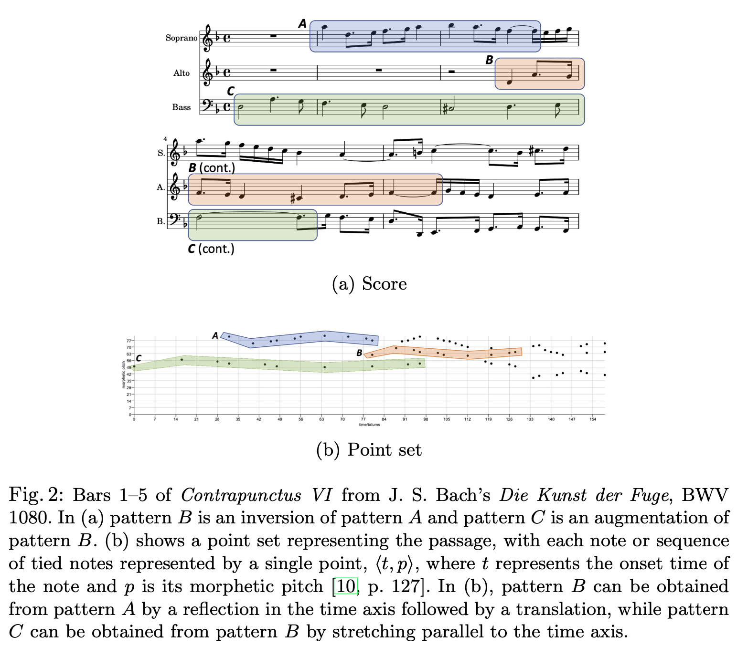
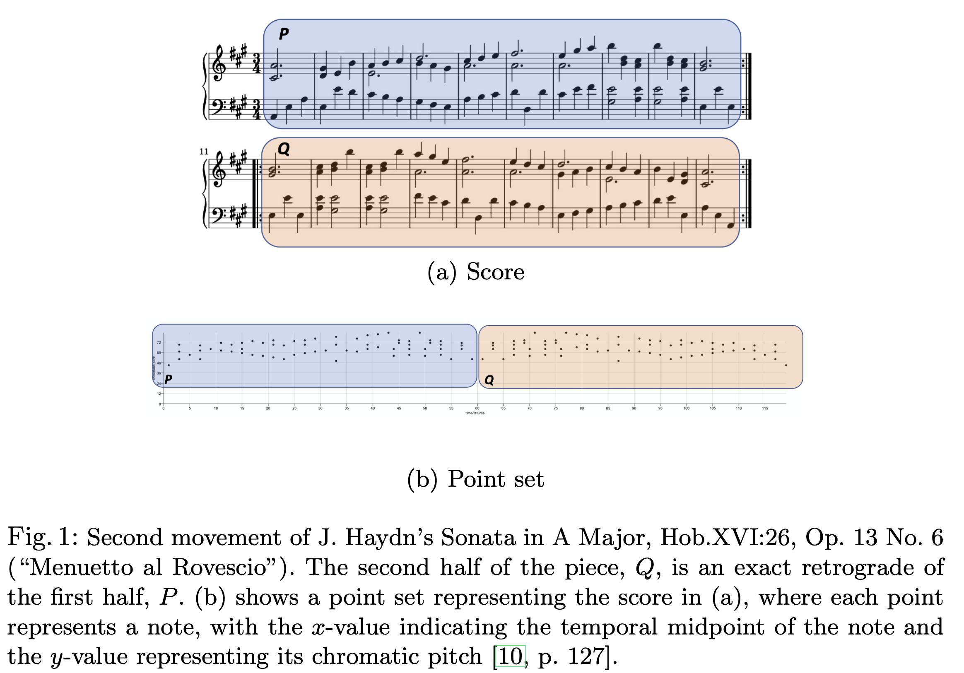
Musical patterns are often transformed when they are re-stated
Haydn:
https://open.spotify.com/track/2vqPkHpaGNKRc38x7N6wWv?si=a6ecfce42d614c9a
Bach:
https://open.spotify.com/track/4L3LZiEQEKgcJk8Vs7abRB?si=ba81e8cda02a4fe0
Meredith, D. (2023). Understanding and compressing music with maximal transformable patterns. 11th International Conference on Culture and Computing. 23-28 July 2023, Copenhagen, Denmark. LNCS Vol. 14035, pp. 309-325. Springer, Cham, Switzerland. [CRC] [Online publication] [Slides]

Slide 22
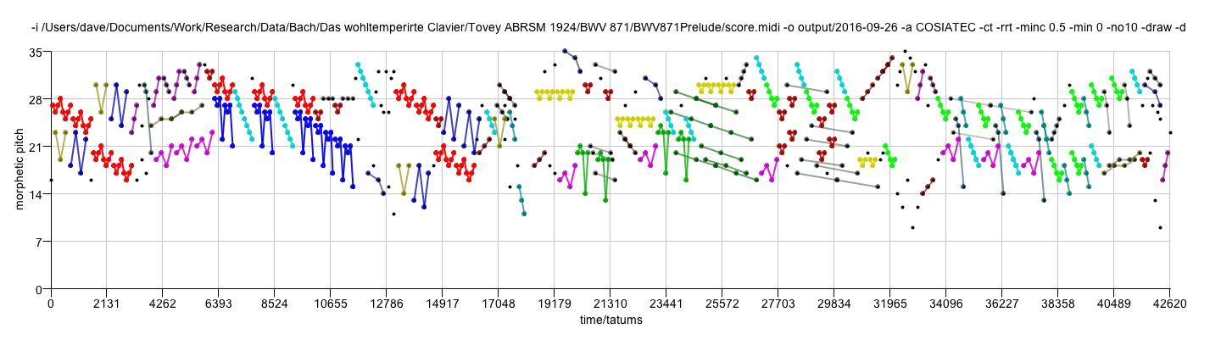

Geometric, compression-based pattern discovery in music
J. S. Bach, Prelude No. 2 in C minor, BWV 871
from Book 2 of The Well-Tempered Clavier
Performed by Angela Hewitt

Slide 23
Maximal translatable patterns (MTPs)

Slide 24
Translational equivalence classes (TECs)
Translational equivalence class (TEC) of a pattern P is the set of all patterns in the dataset that are translationally equivalent to P
A TEC can be compactly expressed as a <pattern,vector set> pair
Covered set of a TEC is the set of points that are members of patterns in the TEC

Slide 25
Compressed representation of a TEC
A translational equivalence class is a set of translationally equivalent patterns
Could encode such a set by simply listing the points in each occurrence
Can be encoded more parsimoniously by listing the points in one occurrence of the pattern along with the vectors that map that occurrence onto the other occurrences
  i.e., a <pattern, vector set> pair
12 points = 24 numbers
3 points + 3 vectors = 12 numbers

Slide 26
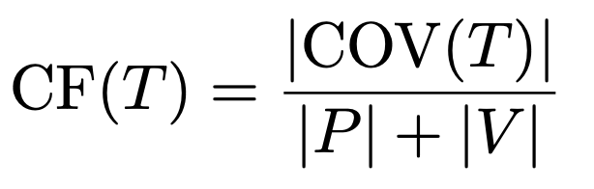
Compression with TECs

Slide 27
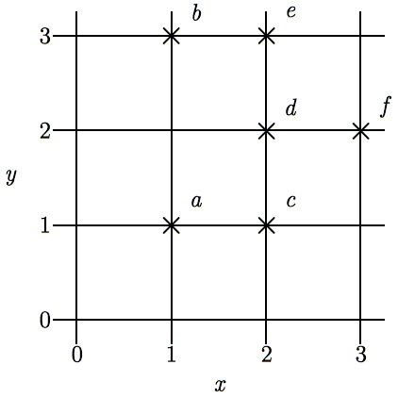
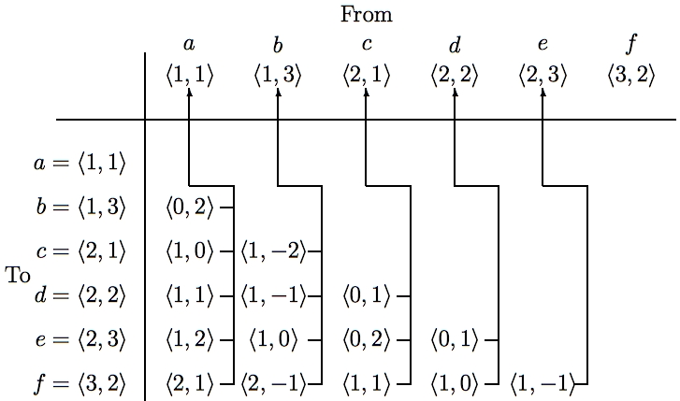
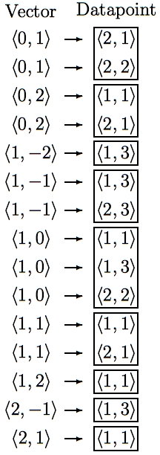
SIA: Discovering all maximal translatable patterns (MTPs)
Pattern is translatable by vector v in dataset if it can be translated by v to give another pattern in the dataset
MTP for a vector v contains all points mapped by v onto other points in the dataset
O(kn² log n) time, O(kn²) space
O(kn²) time if use direct address table to store vectors
Laaksonen & Lemström (2022) present a method that decreases the space complexity to O(kn) space
Meredith, D., Lemström, K. and Wiggins, G. A. (2002). Algorithms for discovering repeated patterns in multidimensional representations of polyphonic music. Journal of New Music Research, 31(4), pp. 321-345. [Online publication]
Laaksonen, A. and Lemström, K. (2022). On the memory usage of the SIA algorithm family for symbolic music pattern discovery. In Mathematics and Computation in Music (MCM 2022), Lecture Notes in Computer Science, Vol. 13267, pages 180– 191, Cham, Switzerland. Springer. Available online at https://link.springer.com/ content/pdf/10.1007/978-3-031-07015-0_15.pdf.
Notes:
The first algorithm I’m going to describe is the SIA algorithm which takes as input a multidimensional point set and discovers, for every vector, the points in this point set that are mapped onto other points in the point set by that vector.
For convenience, I’ll call the complete set of points being analyzed the DATASET and any subset of the dataset a PATTERN.
I say that a pattern is TRANSLATABLE by a particular vector within a dataset if it can be translated by that vector to give another pattern in the dataset. For example, the pattern {a,d} here is translatable within this dataset by the vector <1,0>.
And the pattern that contains ALL the points that are mapped onto other points in the dataset by a particular vector is the MAXIMAL TRANSLATABLE PATTERN for that vector. So the maximal translatable pattern or MTP in this dataset for the vector <1,0> is the pattern {a,b,d} and the MTP for the vector <1,1> in this dataset is {a,c}.
So SIA discovers all the non-empty maximal translatable patterns in a dataset.
It does this by first sorting the points in the dataset into lexicographical order and then computing the vector from each point to every other point in the dataset that is lexicographically greater. These vectors are stored in a table like this one here which we call a VECTOR TABLE. And each vector is stored with a pointer that points back to the origin point for which it was computed, as indicated by these arrows here.
The vectors in this table are then sorted into lexicographical order to give a list like the one here on the right and the MTP for each vector can be found directly by reading off the points attached to the adjacent occurrences of that vector in this list.
The most expensive step is sorting the vectors which can be done in O(kn^2 log n) time. However, by storing the origin points in a hash table and hashing the vectors to get the slot indices, this time complexity can be reduced to O(kn^2).
And also, obviously, the space used is O(kn^2)

Slide 28
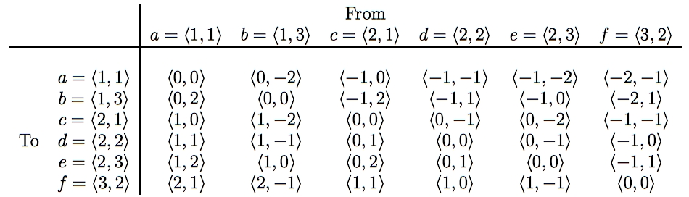
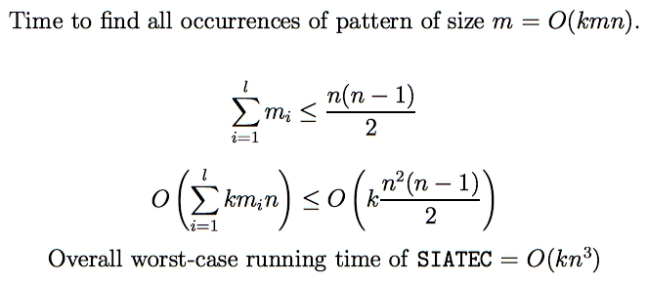
SIATEC Discovering all occurrences of all MTPs
Translational Equivalence Class (TEC) is set of all translationally invariant occurrences of a pattern
Meredith, D., Lemström, K. and Wiggins, G. A. (2002). Algorithms for discovering repeated patterns in multidimensional representations of polyphonic music. Journal of New Music Research, 31(4), pp. 321-345. [Online publication]
Notes:
SIA only finds one occurrence of each MTP and one vector by which that MTP is translatable within the dataset.
SIATEC, on the other hand, finds all the MTPs using a slightly modified version of SIA and then finds all the vectors by which each MTP is translatable within the dataset.
In other words, it finds all the non-empty MTPs and then all the patterns within the dataset that are translationally equivalent to each MTP.
In SIA, we only needed to compute the vector from each point to every lexicographically greater point because the MTP for a particular vector -v is the same as the pattern that you get by translating the MTP for v by v itself.
However, in this simple implementation of SIATEC, we can find all the occurrences more efficiently by computing all the interpoint vectors and storing them in a table like this one here.
If the points in the dataset are sorted into lexicographical order first, then the vectors in this table increase lexicographically as you descend a column and go from right to left along a row.
Each column contains all the vectors by which the point at the top of the column is translatable within the dataset.
Therefore the set of vectors by which a given pattern in the dataset is translatable is equal to the intersection of the columns headed by the points in that pattern. For example, the pattern {a,c} is translatable within this dataset by the intersection of the columns for which a and c are the original points.
By exploiting the orderedness of this table, we can find all the occurrences of a k-dimensional pattern of size m in a dataset of size n in a worst case running time of O(kmn).
Now, all the MTPs in a dataset can be found by reading through the list of sorted vectors generated by SIA so we know that sum of the cardinalities of the MTPs is less than or equal to n(n-1)/2.
Therefore the worst case time complexity of this implementation of SIATEC is [as shown] which implies that it is O(kn^3).
And, obviously, it uses O(kn^2) space.

Slide 29
Need for heuristics to isolate interesting MTPs and TECs
2^{n} patterns in a dataset of size n
Sum of MTP sizes is < n²/2
  sum of cardinalities of MTPs is n(n-1)/2
  => SIA generates small fraction of all patterns in a dataset
Many interesting patterns derivable from MTPs found by SIA
  e.g., bounding box or segment spanned by the patterns
BUT many of the patterns found by SIA are NOT interesting
    17519 patterns found by SIA in the fugue from BWV 847
    probably about 30 are interesting
=> Need heuristics for isolating interesting patterns in output of SIA and SIATEC
Meredith, D., Wiggins, G. A. and Lemström, K. (2001). A Geometric Approach to Repetition Discovery and Pattern Matching in Polyphonic Music. Computer Science Colloquium, Department of Computer Science, King's College London. [Slides with Notes (PDF, 328KB)]

Slide 30
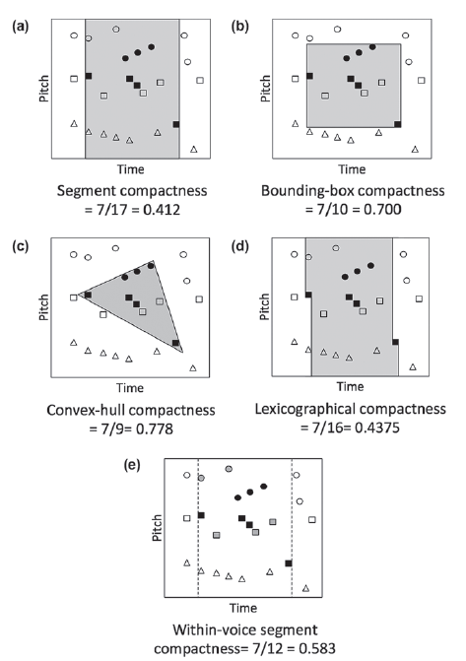
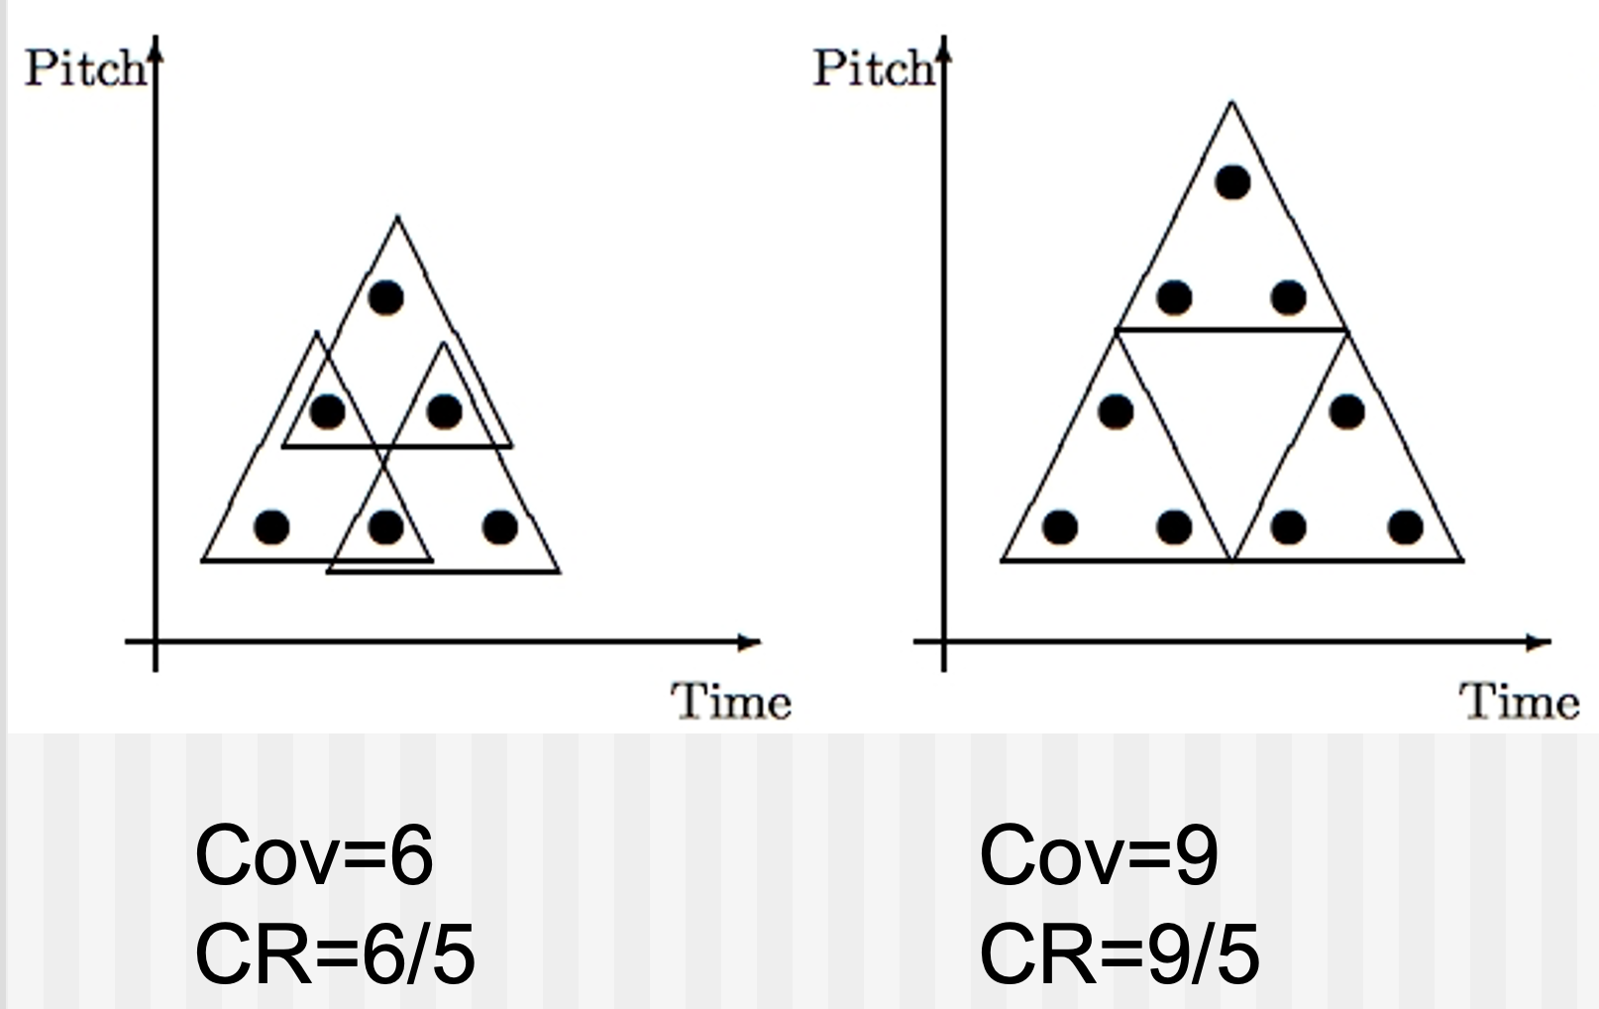
Heuristics for isolating the “best” patterns
Meredith, D. (2015). Music analysis and point-set compression. Journal of New Music Research, 44(3), pp. 245-270. [Online publication]
Collins, T., Laney, R., Willis, A., and Garthwaite, P. H. (2011). Modeling pattern importance in Chopin’s Mazurkas. Music Perception, 28(4):387–414. https://doi. org/10.1525/mp.2011.28.4.387.
Notes:
We found we could go some way towards isolating the themes and motives in a piece of music by using just three simple heuristics which I will now describe.
First, let’s define the coverage of a pattern to be the number of distinct points in the dataset in occurrences of the pattern. For example, the coverage of this triangular pattern in this dataset is 6, but in this dataset, its coverage is 9.
In general, the coverage of a pattern is greater for larger, non-overlapping patterns that occur frequently.
if we represent a passage of music as a set of points in graph of pitch against time, musical themes generally seem to have relatively high coverage.
Next, let’s define the compactness of a pattern to be the ratio of the number of points in a pattern to the number of points in the region spanned by the pattern.
The region spanned by a pattern can be defined in various ways.
For example, we can define the region spanned by a pattern in a pitch-time representation of a passage of music to be the segment containing all the notes that start between the first and last note onsets in the pattern.
Alternatively, we could define the region spanned by a pattern in such a representation to be the bounding box or convex hull of the pattern.
As you can see here, the compactness value obviously depends on how the region spanned by a pattern is defined.
However, musical themes typically have at least one occurrence with relatively high compactness since this will make the pattern easier to perceive. However, other occurrences may be highly embellished and thus have lower compactness.
Another interesting heuristic that seems to be useful for isolating themes is the compression ratio that can be achieved by representing the set of points covered by all the occurrences of a pattern by specifying just one occurrence of the pattern together with all the vectors by which the pattern is translatable within the dataset.
For example, by doing this with the triangular pattern in this dataset, we achieve a compression ratio of 6/5. However, in this dataset, the same pattern can be used to achieve a compression ratio of 9/5.

Slide 31
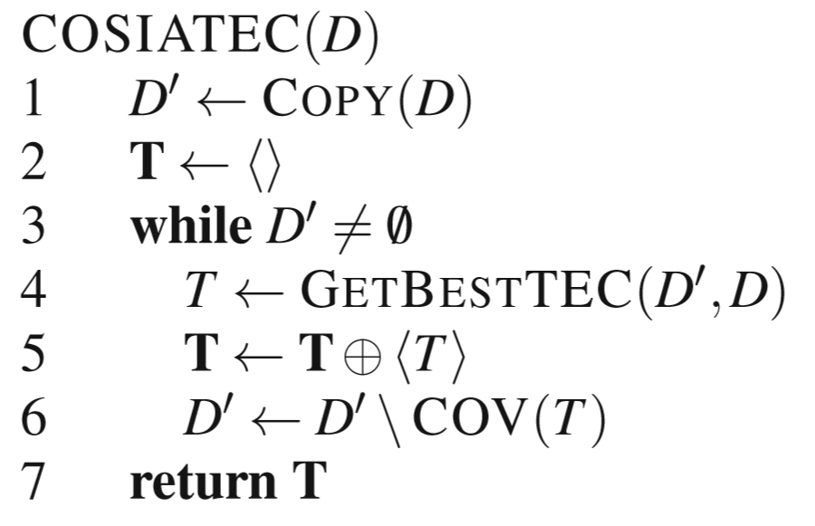
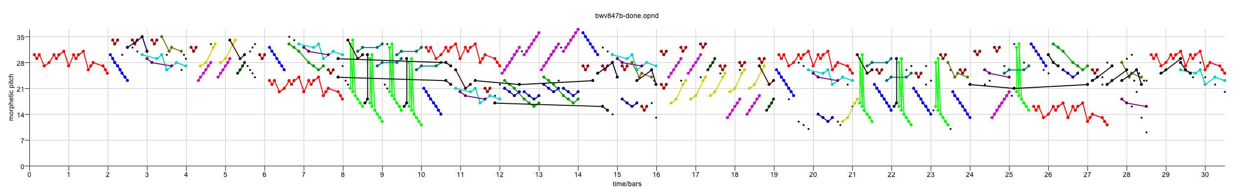
COSIATEC
Compression and covering with MTP TECs
Start
Dataset
SIATEC
Computes a set of TECs that collectively cover the input dataset
The dataset is exclusively and exhaustively partitioned into TEC covered sets
Typically gives better compression than the other strategies tried
GetBestTEC runs SIATEC and selects the best TEC using the heuristics
List of <Pattern, Translator_set> pairs
Add best TEC, <P,V> to encoding
Remove points covered by <P,V> from dataset
Is dataset empty?
No
Yes
Output encoding
Meredith, D., Lemström, K. and Wiggins, G. A. (2003). Algorithms for discovering repeated patterns in multidimensional representations of polyphonic music. Cambridge Music Processing Colloquium 2003, Department of Engineering, University of Cambridge. [Full paper]
Notes:
We can use SIATEC together with the heuristics I’ve just described to construct a simple compression algorithm which I call COSIATEC. COSIATEC works like this.
First we use SIATEC to generate a list of <Pattern, Translator_set> pairs in which each pattern is an MTP and each translator set contains all the non-zero vectors by which the pattern is translatable within the dataset. This generally gives a more efficient representation of the set of points covered by the occurrences of a pattern.
Then we can use the heuristics I’ve just described - compression ratio, coverage and compactness - to choose the “best” pattern P and this pattern is printed out together with its translator set.
Then all the points covered by P and its occurrences are removed from the dataset.
Then if the dataset is empty, we end; otherwise, we again run SIATEC on the remaining points in the dataset.
The result is a print out of the “best” pattern and its translators for each iteration of the cycle and this printout is usually a compressed representation of the input dataset.
Obviously, the degree of compression achieved depends on the amount of repetition in the dataset.

Slide 32
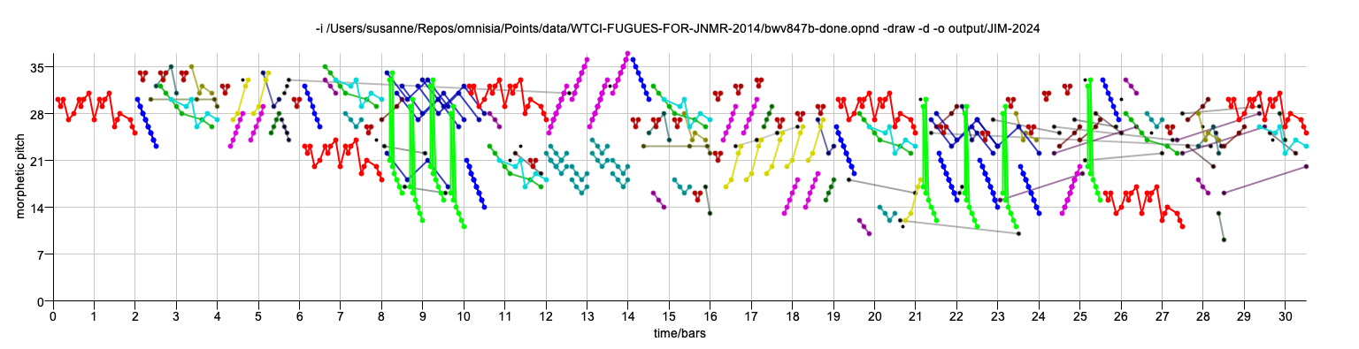
Example COSIATEC output
numberOfNotes 751
compressionRatio 2.7712177121771218
runningTime 9606
encodingLength 271
encodingLengthWithoutResidualPointSet 259
numberOfResidualPoints 12
percentageOfResidualPoints 1.5978695073235685
compressionRatioWithoutResidualPointSet 2.853281853281853
numberOfTECs 29

Slide 33
SIATECCompress
Compression and covering with MTP TECs
Sorts TECs into decreasing order by "quality"
  Quality is a function of compression factor, compactness and coverage
Scans list, adding TECs to output encoding if they increase encoding length by less than the number of extra points that they cover
TEC covered sets in the generated cover may intersect
Typically lower compression factor than COSIATEC
Adds a TEC to encoding if its <P,Θ> representation is shorter than the set of new points covered

Slide 34
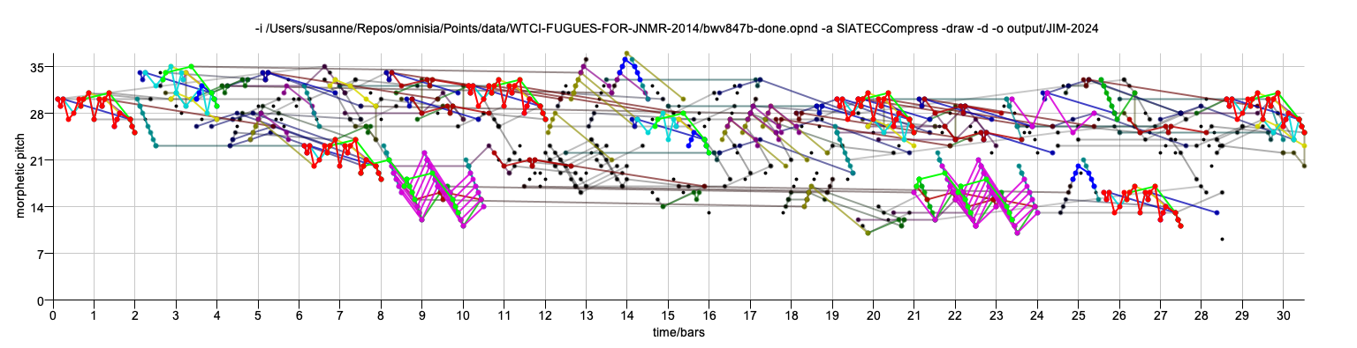
Example SIATECCompress output
numberOfNotes 751
compressionRatio 1.4930417495029822
runningTime 8024
encodingLength 503
encodingLengthWithoutResidualPointSet 406
numberOfResidualPoints 97
percentageOfResidualPoints 12.916111850865512
compressionRatioWithoutResidualPointSet 1.6108374384236452
numberOfTECs 27

Slide 35
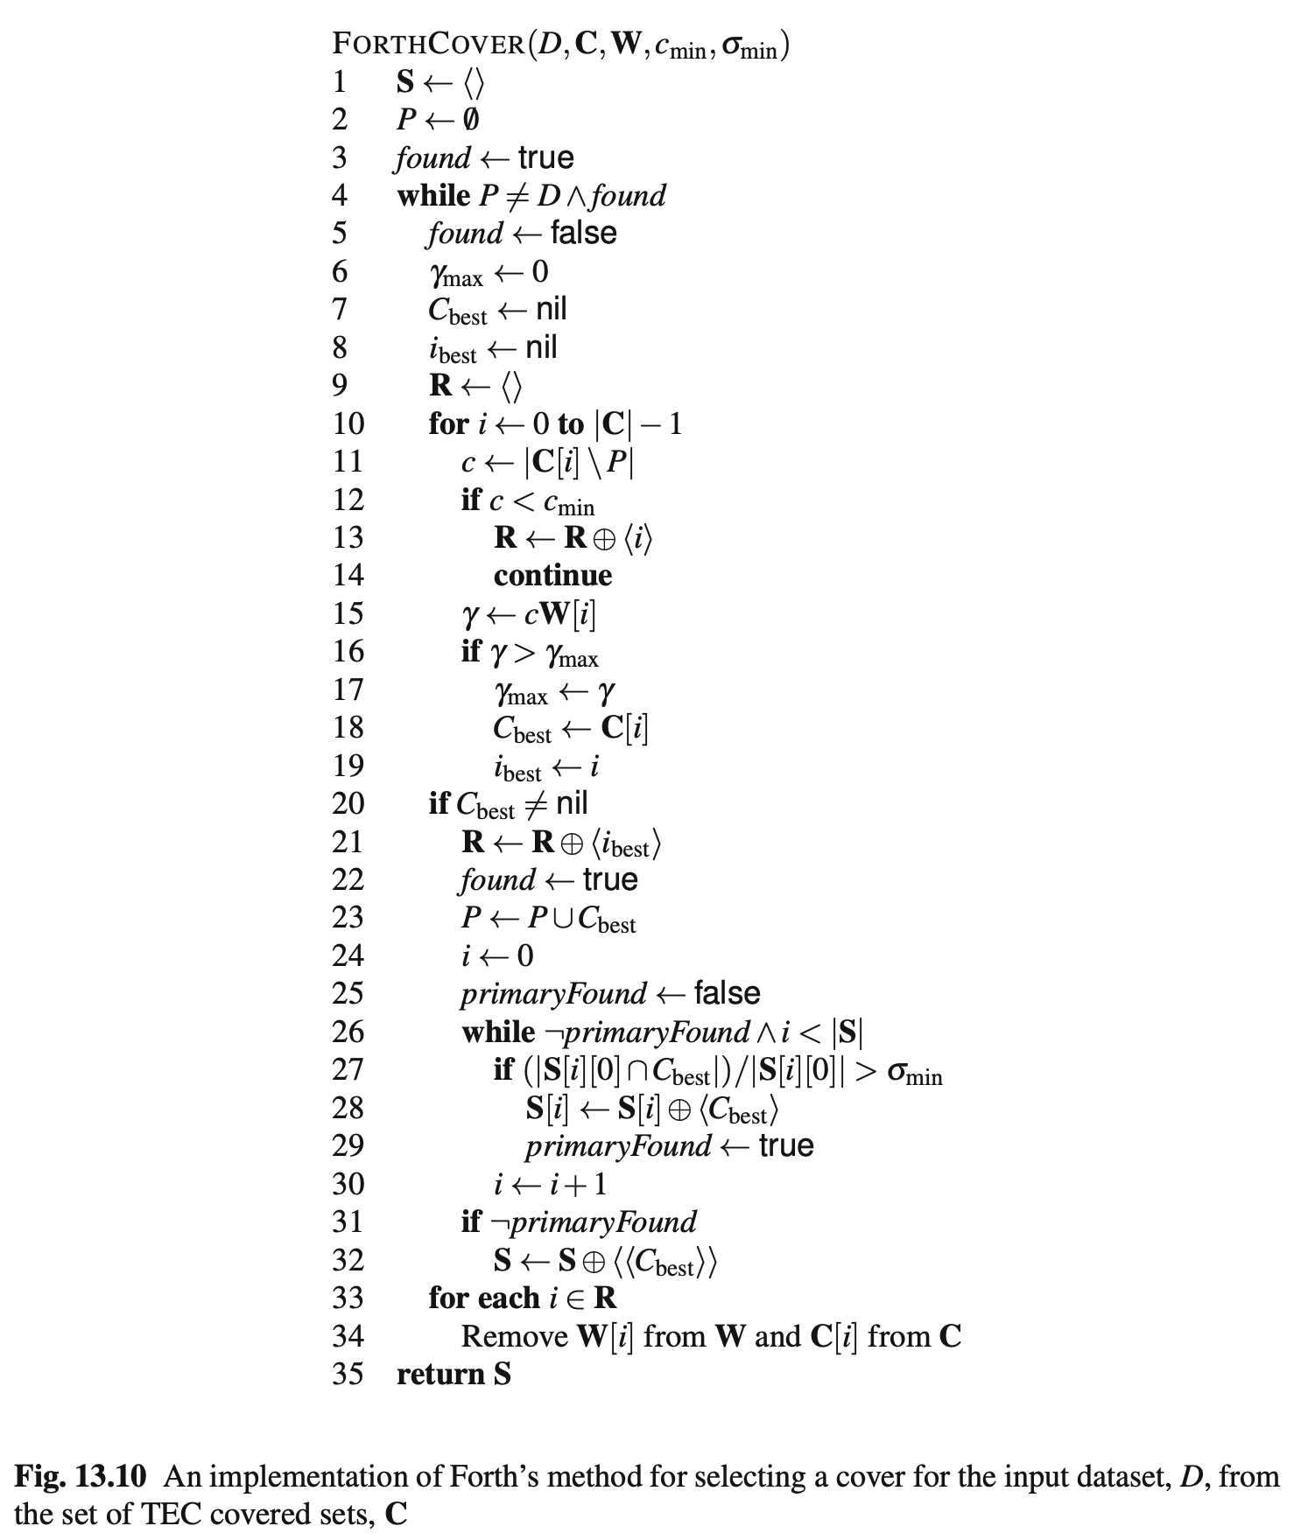
Forth’s algorithm
(Forth 2012, Forth and Wiggins 2009)
Forth, J. and Wiggins, G. A. (2009). An approach for identifying salient repetition in multidimensional representations of polyphonic music. In Chan, J., Daykin, J. W., and Rahman, M. S., editors, London Algorithmics 2008: Theory and Practice, pages 44–58. College Publications, London. https://research.gold.ac.uk/id/eprint/8578/1/ forth-wiggins-2009.pdf.
Forth, J. C. (2012). Cognitively-Motivated Geometric Methods of Pattern Discovery and Models of Similarity in Music. PhD thesis, Department of Computing, Goldsmiths, University of London. http://research.gold.ac.uk/id/eprint/7803/.
Pseudocode from: Meredith, D. (2016). Analysing music with point-set compression algorithms. In Meredith, D. (ed.) Computational Music Analysis, pp. 335-366. Springer. [On SpringerLink] [Author-created copy]

Slide 36
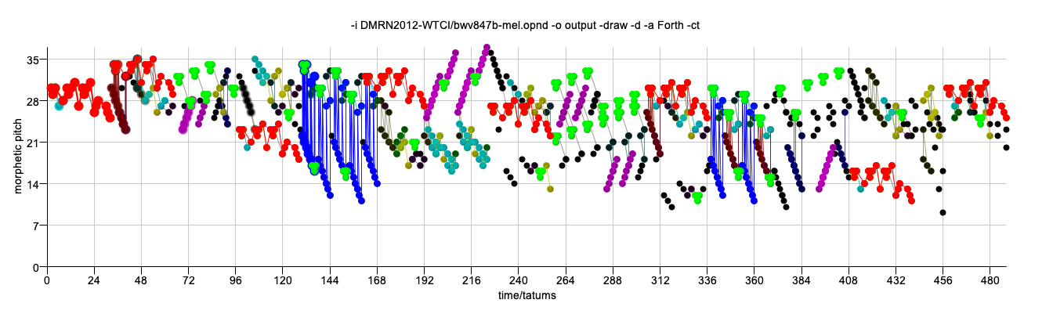
Forth’s algorithm
J.S. Bach, Fugue in C minor, BWV 847
numberOfNotes 751
compressionRatio 1.636165577342048
runningTime 643
encodingLength 459
encodingLengthWithoutResidualPointSet 362
numberOfResidualPoints 97
percentageOfResidualPoints 12.916111850865512
compressionRatioWithoutResidualPointSet 1.8066298342541436
numberOfTECs 15

Slide 37
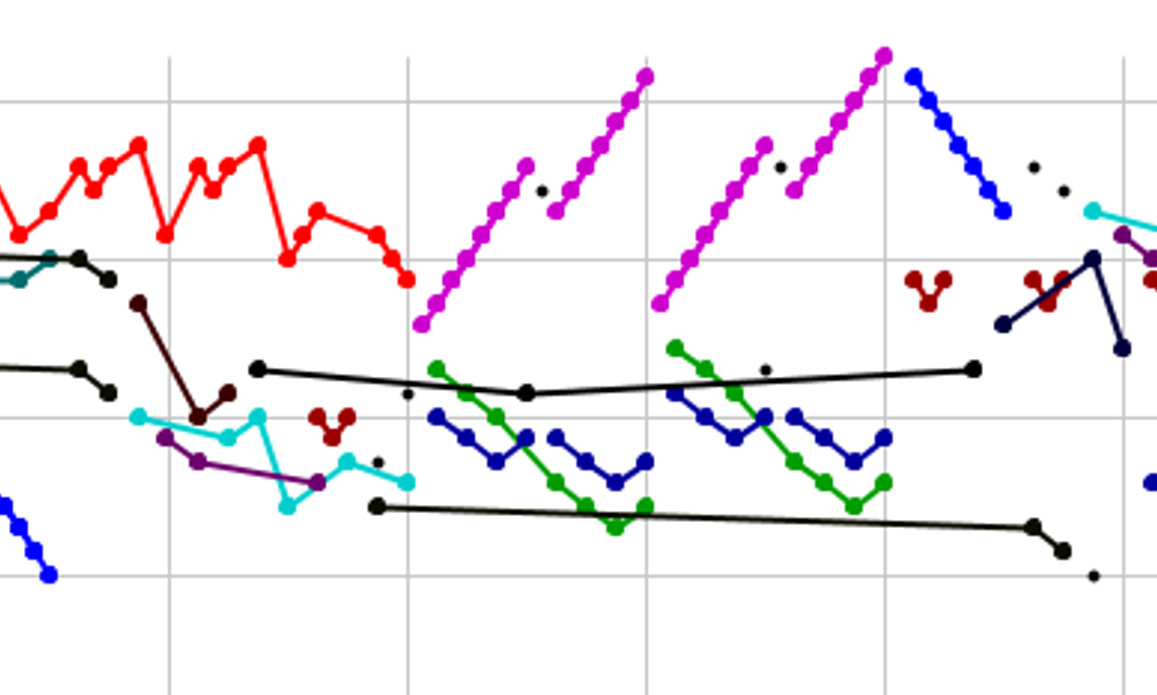
SIACT and SIAR
(Collins et al. 2010, Collins 2011)
r=2

Slide 38
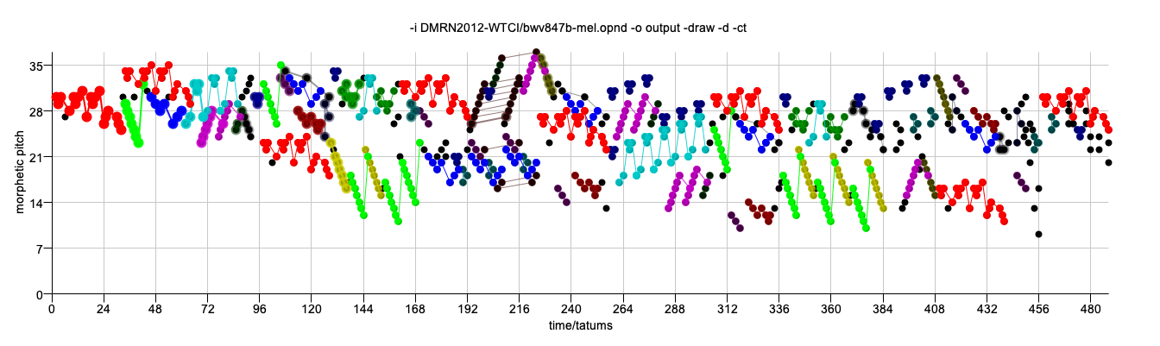
COSIACTTEC
J.S. Bach, Fugue in C minor, BWV 847
numberOfNotes 751
compressionRatio 2.589655172413793
runningTime 1899
encodingLength 290
encodingLengthWithoutResidualPointSet 205
numberOfResidualPoints 85
percentageOfResidualPoints 11.318242343541945
compressionRatioWithoutResidualPointSet 3.2487804878048783
numberOfTECs 20

Slide 39
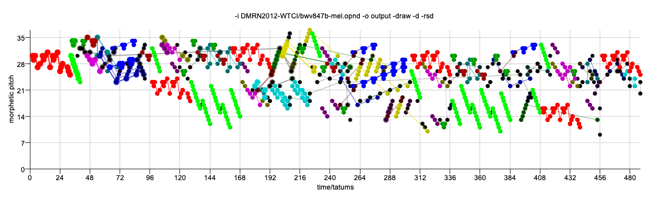
COSIARTEC
J.S. Bach, Fugue in C minor, BWV 847
numberOfNotes 751
compressionRatio 2.554421768707483
runningTime 5223
encodingLength 294
encodingLengthWithoutResidualPointSet 254
numberOfResidualPoints 40
percentageOfResidualPoints 5.326231691078562
compressionRatioWithoutResidualPointSet 2.7992125984251968
numberOfTECs 28

Slide 40
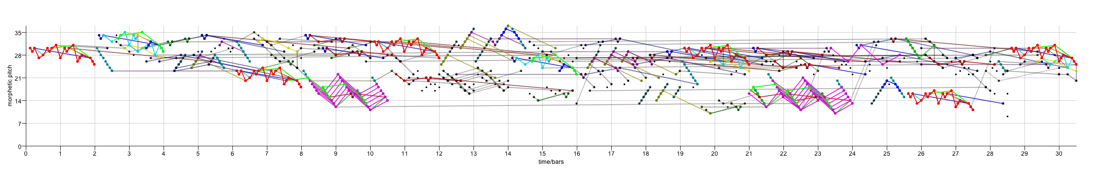
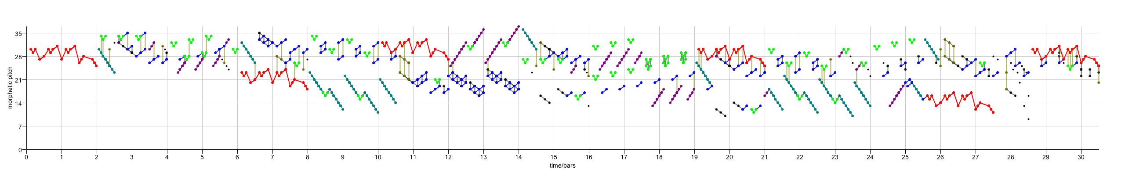
Compression-driven point-set pattern discovery in music
Principle of parsimony:
  Given two models that equally accurately describe the data, the simpler one is less likely to be an accurate description by chance
Have applied compression-based point-set cover algorithms to a number of different musicological tasks with some success
  classification of folk songs, simulation of human analyses, discovery of subjects and counter-subjects in fugues
Some evidence that better compression is correlated with better performance (Louboutin and Meredith, JNMR, 2016) and better simulation of cognition (Collins et al., Music Perception, 2011)
Motivated to develop techniques that give us better compression, in the hope that the more compressed encodings of musical objects will represent better ways of understanding them
COSIATEC
SIATECCompress
Forth’s algorithm

Slide 41
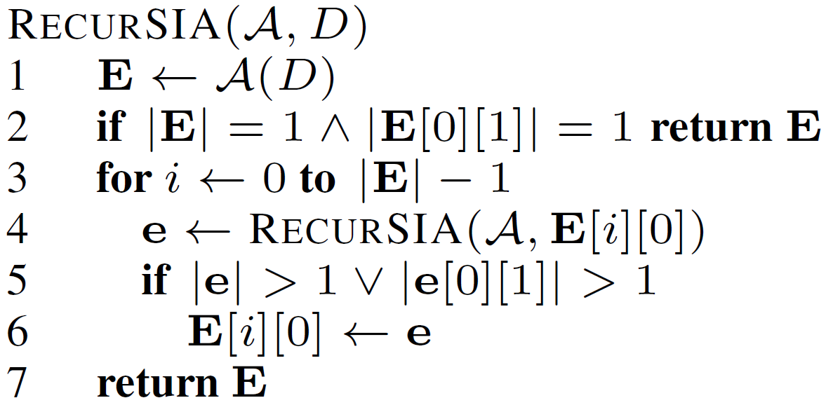
RecurSIA: Recursive translatable pattern discovery
4
3
2
1
0
0
1
2
3
4
5
6
7
8
9

Slide 42
RecurSIA: Recursive translatable pattern discovery
4
3
2
1
0
0
1
2
3
4
5
6
7
8
9

Slide 43
RecurSIA: Recursive translatable pattern discovery
4
3
2
1
0
0
1
2
3
4
5
6
7
8
9

Slide 44
RecurSIA: Recursive translatable pattern discovery
4
3
2
1
0
0
1
2
3
4
5
6
7
8
9

Slide 45
RecurSIA: Recursive translatable pattern discovery
4
3
2
1
0
0
1
2
3
4
5
6
7
8
9

Slide 46
RecurSIA: Recursive translatable pattern discovery
4
3
2
1
0
0
1
2
3
4
5
6
7
8
9
Compression factor without RecurSIA = 24/(8+2) = 2.4

Slide 47
RecurSIA: Recursive translatable pattern discovery
4
3
2
1
0
0
1
2
3
4
5
6
7
8
9

Slide 48
RecurSIA: Recursive translatable pattern discovery
4
3
2
1
0
0
1
2
3
4
5
6
7
8
9

Slide 49
RecurSIA: Recursive translatable pattern discovery
4
3
2
1
0
0
1
2
3
4
5
6
7
8
9
Compression factor with RecurSIA = 24/(3+1+2+2) = 3.0

Slide 50

RRT: Removing redundant translators
v4
T(P(a,b,c,d),V(v1,v2,v3,v4))
Length = 8
a
b
v3
c
d
v2
v1
v4
T(P(a,b,c,d),V(v2,v4))
Length = 6
a
b
c
d
v2

Slide 51

COSIATEC with RRT on BWV 847 Fugue
numberOfNotes 751
compressionRatio 2.8022388059701493
runningTime 8431
encodingLength 268
encodingLengthWithoutResidualPointSet 251
numberOfResidualPoints 17
percentageOfResidualPoints 2.263648468708389
compressionRatioWithoutResidualPointSet 2.9243027888446216
numberOfTECs 27

Slide 52

General framework for discovering patterns related by any user-specified class of bijections
We introduce a framework that allows users to specify the class (or classes) of transformations that they are interested in
If the dataset is k-dimensional, then the transformation class must be a set of bijections over the universe of k-dimensional points
We present an algorithm that takes a dataset, D, and a transformation class, F, and discovers all occurrences of the maximal transformable patterns in D wrt F
It then computes a short cover of D that consists of a subset of these occurrence sets
Paper

Slide 53

Example: F_{2STR}
F_{2STR} contains all transformations consisting of a scaling parallel to the the x-axis, followed by a translation and then optionally followed by a reflection in the x-axis
If our dataset is a pitch-vs-time representation of some music, then F_{2STR} contains the transformations corresponding to the traditional musical contrapuntal transformations of transposition, inversion, retrograde, diminution and augmentation
We can identify each transformation in F_{2STR} by a transformation parameter, (s,v,b), where
  s is the scale factor by which the x-coordinate is stretched
  v is the vector by which the point is translated
  b indicates whether or not the point is reflected in the x-axis
e.g., mapping black line to red line could be achieved using the following transformation parameters:
  (-2,(11,1),1)
  (2,(1,-6),-1)

Slide 54
Discovering inter-basis transformations
If we take two ordered pairs of points in a point set, (p1,p2) and (p3,p4), then there are at most two distinct transformations in F_{2STR} that map (p1,p2) onto (p3,p4) and we can define a function that discovers these transformations given (p1,p2) and (p3,p4)
Compare this with the case of F_{2T ,} computed by SIA, which contains all 2-dimensional translations. In this case,
  each instance of a transformation in F_{2T} can be represented by a single 2-d vector
  given a pair of points, p1 and p2, there is a unique translation that maps p1 onto p2

Slide 55
Basis pairs
Suppose we have
  a dataset, D, and a transformation class, F
  two ordered sets of points in D, P and Q, each of size 𝛽, such that there is at least one transformation in F that maps the points in P onto corresponding points in Q
  Then, for F, we can choose a basis size, 𝛽, which is just large enough so that there is a manageably small maximum number of distinct transformations in F that map P onto Q
    so for F_{2STR}, 𝛽=2, whereas for F_{2T}, 𝛽=1
We call P and Q an image basis and object basis, respectively

Slide 56

Maximal transformable patterns algorithm
We present an algorithm that computes the
(transformation,image basis) pairs for all basis pairs, then combines those pairs with the same transformation into maximal transformable patterns
We then find the set of occurrences of each maximal transformable pattern
We then attempt to select a subset of the occurrence sets that collectively cover the dataset as efficiently as possible
Above is the output of the algorithm for the running example (i.e., it correctly describes the method by which the dataset was constructed)

Slide 57


Ravel’s Menuet sur le nom d’Haydn
The example above shows a representation of the score of Ravel’s Menuet sur le nom d’Haydn, which contains 12 complete and 3 partial occurrences of the motif, B-A-D-D-G
The upper diagram shows the 15 examples, while the lower diagram shows the occurrences discovered by the algorithm (with some filters applied for maximum pattern size and minimum compactness)

Slide 58

Contrapunctus VI from Bach’s Die Kunst der Fuge
Bach’s Contrapunctus VI from Die Kunst der Fugue. Partial or complete matches with all 29 occurrences of the subject are found when the subject is given as a query

Slide 59
END OF PRESENTATION GIVEN AT JIM 2024
Other slides are provided below for further information

Slide 60
MIREX 2013:
Discovery of repeated themes and sections
First MIREX competition on pattern discovery
  http://www.music-ir.org/mirex/wiki/2013:Discovery_of_Repeated_Themes_%26_Sections
JKU Pattern Development database
  https://dl.dropbox.com/u/11997856/JKU/JKUPDD-noAudio-Jul2013.zip
  Five pieces, each with a set of “ground-truth” patterns (occurrence sets)
    Patterns come from analyses by well-known analysts (e.g., Schoenberg, Bruhn)

Slide 61
Discovering repeated themes and sections in the JKU PDD
Five pieces in database – polyphonic version used!
Three basic algorithms, COSIATEC, SIATECCompress and Forth’s algorithm
  with and without CT
  SIA or SIAR
  Raw, BB or Segment mode
Gives 36 algorithms formed by combining values from these 4 variables

Slide 62

Johannes Kepler University Patterns Development Database
(JKU-PDD)
Gibbons, “Silver Swan” (madrigal) (1612)
J. S. Bach, Fugue in A minor (BWV 889) from 2nd book of the WTC (1742)
Mozart, Piano Sonata in E flat major (K. 282), 2nd movement (1774)
Beethoven, Piano Sonata in F minor, Op.2, No.1 (1795)
Chopin, Mazurka in B flat minor, Op.24, No.4 (1836)

Slide 63
Point-set compression algorithms on JKU-PDD
Replacing SIA with SIAR had no significant result on precision, recall or F1
CT had a positive effect with Forth’s algorithm but generally a negative effect on COSIATEC or SIATECCompress (except in Raw mode)
Top-performing algorithms used Segment mode
Meredith, D. (2015). Music analysis and point-set compression. Journal of New Music Research, 44(3), pp. 245-270.

Slide 64
Problems with evaluating pattern discovery algorithms by comparison with human analyses
To what question is the JKU PDD supposed to be providing the correct answer?
  “What are the noticeable and/or important patterns in these five pieces?”
Do the analyses in the JKU PDD actually identify all and only the noticeable and/or important patterns in the pieces in the database?
  No!
    some important patterns are missing
    some important occurrences of recorded patterns are missing

Slide 65


Slide 66


Slide 67
Some interesting non-ground-truth patterns discovered by COSIATEC
The “most characteristic segment [of the second countersubject] contains the first four eighth-notes’
(Bruhn, 1993, http://www-personal.umich.edu/~siglind/wtc-ii-20.html)
Meredith, D. (2015). Music analysis and point-set compression. Journal of New Music Research, 44(3), pp. 245-270.

Slide 68
Discovering fugue subjects and counter subjects in WTC1

Slide 69
OMNISIA
OMNISIA is an implementation in Java of the following SIA-based algorithms
  SIA
  SIATEC
  COSIATEC
  Forth’s algorithm
  SIATECCompress
  RecurSIA and RRT
  SIAR and SIACT

Slide 70
Switches
-a Basic algorithm to use. Possible values are: SIA, SIATEC, COSIATEC, SIATECCompress, Forth, RecurSIA. Default is COSIATEC.
-i Path to input file (REQUIRED).
-o Path to output directory. Default is same directory as input file.
-d If present, then use morphetic (diatonic) pitch instead of chromatic pitch. If morphetic pitch is not available in the input data (e.g., MIDI format), then input data is pitch-spelt using the PS13s1 algorithm.
-h Help. If present, then this help screen to be printed. This happens if the program is called with no arguments or if it is unable to determine the values of all necessary parameters from the arguments provided.
-m If present, generates output in MIREX format.
-ct If present, uses Collins' compactness trawler, as used in his SIACT and SIARCT-CFP algorithms.
-cta The variable which Collins et al call 'a'. It is the minimum compactness permitted in the trawled patterns.
-ctb The variable which Collins et al call 'b'. It is the minimum size of the patterns trawled by the compactness trawler.
-rsd If present, limits SIA to r superdiagonals, as used in Collins' SIAR algorithm. Number of superdiagonals determined by the -rswitch.
-r Number of superdiagonals to analyse if limited with -rsd switch. Default value is 1.
-rrt If present, redundant translators are removed.
-minc Threshold value for minimum TEC compactness (default is 0.0).
-min Minimum allowed pattern size. Default is 0.
-max Maximum allowed pattern size. Default is 0, which means that patterns of all sizes are allowed.
-merge If present, TECs are merged.
-minm Minimum match size if TECs are merged. Default value is 5.
-spins Number of iterations if TECs are merged. Default value is 10.
-no10 If present, channel 10 (drum channel) is removed if input is in MIDI format.
-draw If present, generates an image file containing a visualization of the analysis.
-crlow Minimum compression ratio in Forth's algorithm. Default is 0.2.
-crhi Maximum compression ratio in Forth's algorithm. Default is 1.0.
-comlow Minimum compactness threshold in Forth's algorithm. Default is 0.2
-comhi Maximum compactness threshold in Forth's algorithm. Default is 1,0
-cmin c_min threshold in Forth's algorithm. Default is 15
-sigmin sigma_min threshold in Forth's algorithm. Default is 0.5.
-bbcomp If present, use bounding-box compactness in Forth's algorithm instead of within-voice segment compactness.
-nodate If present, then does not append date to output directory names.
-bbmode If present, then uses BB mode when generating output in MIREX format.
-segmode If present, then uses Segment mode when generating output in MIREX format.
-out If present, overrides -o and prints a single output encoding to the given path.
-top If present, limits output to top N patterns.
-recalg If RecurSIA is main algorithm used, then value of this switch determines which basic algorithm is used on each pattern. Possible values are COSIATEC, SIATECCompress or Forth.
-sortpat When using COSIATEC, getBestTEC sorts TECs with preference given to TECs with larger patterns.

Slide 71
END

Slide 72
Prelude in C minor from WTCII
BWV871

Slide 73
Combining switches
-a COSIATEC -ct -rrt -minc 0.5 -min 0 -no10 -draw -d
numberOfNotes 692
compressionRatio 2.283828382838284
runningTime 3661
encodingLength 303
encodingLengthWithoutResidualPointSet 231
numberOfResidualPoints 72
percentageOfResidualPoints 10.404624277456648
compressionRatioWithoutResidualPointSet 2.683982683982684
numberOfTECs 26
isDiatonic true

Slide 74

Input point set
(Prelude in C minor from WTC II
BWV 871)

Slide 75

SIA
numberOfNotes 692
compressionRatio 0.002737136053856712
runningTime 1021
encodingLength 252819
numberOfTECs 13947
isDiatonic true

Slide 76

SIATEC
numberOfNotes 692
compressionRatio 0.0024844809696656363
runningTime 3401
encodingLength 278529
encodingLengthWithoutResidualPointSet 278529
numberOfTECs 13079
isDiatonic true

Slide 77

COSIATEC
numberOfNotes 692
compressionRatio 2.276315789473684
runningTime 13813
encodingLength 304
encodingLengthWithoutResidualPointSet 279
numberOfResidualPoints 25
percentageOfResidualPoints 3.61271676300578
compressionRatioWithoutResidualPointSet 2.390681003584229
numberOfTECs 37

Slide 78

SIATECCompress
numberOfNotes 692
compressionRatio 1.3568627450980393
runningTime 7271
encodingLength 510
encodingLengthWithoutResidualPointSet 422
numberOfResidualPoints 88
percentageOfResidualPoints 12.716763005780347
compressionRatioWithoutResidualPointSet 1.4312796208530805
numberOfTECs 29
isDiatonic true

Slide 79

Forth
numberOfNotes 692
compressionRatio 0.9153439153439153
runningTime 4842
encodingLength 756
encodingLengthWithoutResidualPointSet 726
numberOfResidualPoints 30
percentageOfResidualPoints 4.335260115606936
compressionRatioWithoutResidualPointSet 0.9118457300275482
numberOfTECs 11
isDiatonic true

Slide 80
Switches on Forth’s algorithm
-crlow Minimum compression ratio in Forth's algorithm. Default is 0.2.
-crhi Maximum compression ratio in Forth's algorithm. Default is 1.0.
-comlow Minimum compactness threshold in Forth's algorithm. Default is 0.2
-comhi Maximum compactness threshold in Forth's algorithm. Default is 1,0
-cmin c_min threshold in Forth's algorithm. Default is 15
-sigmin sigma_min threshold in Forth's algorithm. Default is 0.5.
-bbcomp If present, use bounding-box compactness in Forth's algorithm instead of within-voice segment compactness.

Slide 81

Forth with crlow = 0.4, crhi = 0.6
numberOfNotes 692
compressionRatio 1.291044776119403
runningTime 5205
encodingLength 536
encodingLengthWithoutResidualPointSet 241
numberOfResidualPoints 295
percentageOfResidualPoints 42.630057803468205
compressionRatioWithoutResidualPointSet 1.6473029045643153
numberOfTECs 10
isDiatonic true

Slide 82

Forth with bbcomp
numberOfNotes 692
compressionRatio 1.0581039755351682
runningTime 4571
encodingLength 654
encodingLengthWithoutResidualPointSet 607
numberOfResidualPoints 47
percentageOfResidualPoints 6.791907514450867
compressionRatioWithoutResidualPointSet 1.0626029654036244
numberOfTECs 9
isDiatonic true

Slide 83


RecurSIA with COSIATEC
COSIATEC
RecurSIA with COSIATEC

Slide 84
RecurSIA with COSIATEC
COSIATEC
numberOfNotes 729
compressionRatio 2.904
runningTime 10026
encodingLength 251
encodingLengthWithoutResidualPointSet 225
numberOfResidualPoints 26
percentageOfResidualPoints 3.566
compressionRatioWithoutResidualPointSet 3.124
numberOfTECs 30
RecurSIA with COSIATEC
numberOfNotes 729
compressionRatio 2.927
runningTime 9846
encodingLength 249
encodingLengthWithoutResidualPointSet 223
numberOfResidualPoints 26
percentageOfResidualPoints 3.566
compressionRatioWithoutResidualPointSet 3.152
numberOfTECs 30

Slide 85
Collins et al.’s Compactness Trawler
-ct If present, uses Collins' compactness trawler, as used in his SIACT and SIARCT-CFP algorithms.
-cta The variable which Collins et al call 'a'. It is the minimum compactness permitted in the trawled patterns.
-ctb The variable which Collins et al call 'b'. It is the minimum size of the patterns trawled by the compactness trawler.

Slide 86

COSIATEC with CT
numberOfNotes 692
compressionRatio 2.096969696969697
runningTime 3865
encodingLength 330
encodingLengthWithoutResidualPointSet 238
numberOfResidualPoints 92
percentageOfResidualPoints 13.294797687861271
compressionRatioWithoutResidualPointSet 2.5210084033613445
numberOfTECs 28
isDiatonic true

Slide 87
Collins’ SIAR algorithm
-rsd If present, limits SIA to r superdiagonals, as used in Collins' SIAR algorithm. Number of superdiagonals determined by the –r switch.
-r Number of superdiagonals to analyse if limited with -rsd switch. Default value is 1.

Slide 88

COSIATEC with SIAR
numberOfNotes 692
compressionRatio 1.9329608938547487
runningTime 7831
encodingLength 358
encodingLengthWithoutResidualPointSet 301
numberOfResidualPoints 57
percentageOfResidualPoints 8.236994219653178
compressionRatioWithoutResidualPointSet 2.1096345514950166
numberOfTECs 35
isDiatonic true

Slide 89

Chromatic or morphetic pitch
-d If present, then use morphetic (diatonic) pitch instead of chromatic pitch. If morphetic pitch is not available in the input data (e.g., MIDI format), then input data is pitch-spelt using the PS13s1 algorithm.

Slide 90

Removing redundant translators
-rrt If present, redundant translators are removed.

Slide 91

COSIATEC with -rrt
numberOfNotes 692
compressionRatio 2.3221476510067114
runningTime 14443
encodingLength 298
encodingLengthWithoutResidualPointSet 265
numberOfResidualPoints 33
percentageOfResidualPoints 4.76878612716763
compressionRatioWithoutResidualPointSet 2.486792452830189
numberOfTECs 32
outputFileExtension cos
isDiatonic true

Slide 92

Minimum compactness
-minc Threshold value for minimum TEC compactness (default is 0.0).

Slide 93

Controlling pattern size
-min Minimum allowed pattern size. Default is 0.
-max Maximum allowed pattern size. Default is 0, which means that patterns of all sizes are allowed.

Slide 94

Sorting TECs with priority given to pattern size
-sortpat When using COSIATEC, getBestTEC sorts TECs with preference given to TECs with larger patterns.

Slide 95
Using point-set compression algorithms for folk-song classification
Meredith, D. (2015). Music analysis and point-set compression. Journal of New Music Research, 44(3), pp. 245-270.

Slide 96
Example COSIATEC encoding of NLB folk song
(NLB015569_01, “Daar zou er een maagdje vroeg opstaan 2”, from the Nederlandse Liederen Bank, http://www.liederenbank.nl. Courtesy of Peter van Kranenburg.)

Slide 97
Example COSIATEC encoding
(NLB015569_01, “Daar zou er een maagdje vroeg opstaan 2”, from the Nederlandse Liederen Bank, http://www.liederenbank.nl. Courtesy of Peter van Kranenburg.)
Input:
T(P(p(0,27),p(40,26),p(80,27),p(120,28),p(240,28),p(300,28),p(360,28),p(480,31),p(520,30),p(560,31),p(600,26),p(719,25),p(839,24),p(960,31),p(1020,30),p(1080,29),p(1140,30),p(1200,31),p(1260,32),p(1320,32),p(1500,31),p(1560,30),p(1740,29),p(1800,28),p(1920,28),p(1960,29),p(2000,30),p(2040,31),p(2159,28),p(2219,30),p(2280,29),p(2400,31),p(2440,30),p(2480,31),p(2520,28),p(2639,27),p(2759,26),p(2939,28),p(3000,27),p(3120,26),p(3180,27),p(3240,28),p(3300,29),p(3360,31),p(3400,30),p(3440,31),p(3480,25),p(3719,24)),V(v(0,0)))
(48 points)
Encoding:
T(P(p(0,27),p(40,26),p(80,27)),V(v(480,4),v(2400,4),v(3360,4)))
T(P(p(1080,29),p(1140,30),p(1200,31),p(1260,32)),V(v(2040,-3)))
T(P(p(960,31),p(1020,30),p(1500,31)),V(v(540,0),v(780,-2)))
T(P(p(600,26),p(719,25),p(839,24)),V(v(1920,2)))
T(P(p(120,28),p(240,28),p(300,28),p(360,28),p(1320,32),p(1920,28),p(1960,29),p(2000,30),p(2159,28),p(2219,30),p(2939,28),p(3000,27),p(3480,25),p(3719,24)),V())
(34 points or vectors)
Compression ratio: 1.41

Slide 98
Results of point-set compression algorithms does not fully support parsimony principle – why?
Louboutin, C. and Meredith, D. (2016). Using general-purpose compression algorithms for music analysis. Journal of New Music Research, 45(1), pp. 1-16.

Slide 99
Using general-purpose compression algorithms for music analysis
Compared LZ77, LZ78, Burrows-Wheeler and COSIATEC on classifying folk songs in the NLB
  k-nearest neighbour
  combined representations (ensemble) classification method
  novel similarity metric, corpus compression distance, based on NCD
Compared LZ77 and COSIATEC on discovery of fugue subject and countersubject entries in WTC1
Louboutin, C. and Meredith, D. (2016). Using general-purpose compression algorithms for music analysis. Journal of New Music Research, 45(1), pp. 1-16.

Slide 100
Viewpoints

Slide 101
Corpus compression distance
NCD is not constrained to being between 0 and 1
For two different compression algorithms, the range of NCD values is different
We wanted to combine NCD values from different compressors to get a new measure of similarity
We therefore defined corpus compression distance as the normalized NCD over the corpus:

Slide 102
Single-viewpoint NLB classification
Louboutin, C. and Meredith, D. (2016). Using general-purpose compression algorithms for music analysis. Journal of New Music Research, 45(1), pp. 1-16.

Slide 103
Combined viewpoints NLB classification
(Ensemble classifiers)
10’ is obtained by combining 8 of the 10 best compressed viewpoints, omitting (LZ77, int0 * ioi) and (COSIATEC,int)
Louboutin, C. and Meredith, D. (2016). Using general-purpose compression algorithms for music analysis. Journal of New Music Research, 45(1), pp. 1-16.

Slide 104
Comparing LZ77 and COSIATEC on discovery of fugue subject and countersubject entries
Correlation between CF and TLF1: r= 0.86, N = 9, p = 0.003
(NB: SIATECCompressBB achieved TLF1 of 0.301)

Slide 105

Haydn, Menuet from Sonata in A Major (Hob.VXI:26)

Slide 106

J. S. Bach, Contrapunctus 6 from Die Kunst der Fuge, BWV 1080

Slide 107
Scalable patterns
Concerned with pairs of patterns related by augmentation, diminution, inversion and retrograde
Musical transformation | Geometric transformation in pitch-time space | x scale factor | y scale factor
Repeat with transposition | Translation | 1 | 1
Inversion | Reflection in axis || re time axis | 1 | -1
Diminution | Directional horizontal scaling | < 1 | 1
Augmentation | Directional horizontal scaling | > 1 | 1
Retrograde | Reflection in axis || re pitch axis | -1 | 1

Slide 108
Springer book on Computational Music Analysis
http://link.springer.com/book/10.1007/978-3-319-25931-4

Slide 109
References
Forte, A. (1988). Pitch-class set genera and the origin of modern harmonic species. Journal of Music Theory, 32(2):187-270.
Agawu, V. K. (1989). Notation in theory and practice. Music Analysis, 8(3):275-301.

Slide 110
Other music-theoretic compression strategies
Voices
  Most notes within a voice end at the start of the next note – implies that offsets only have to be encoded in exceptional cases – reduces encoding length
Metre
  More frequently occurring time point categories encoded by short labels, corresponding to higher levels in a metrical hierarchy
  Compare Shannon–Fano coding
Pitch
  More frequently occurring pitch classes encoded with shorter labels, corresponding to higher levels in a tonal hierarchy
https://open.spotify.com/track/64w9ojtwgMzD9CWoKG0LVn?si=4ef75883d6074228

Slide 111

asd

