Slide 1
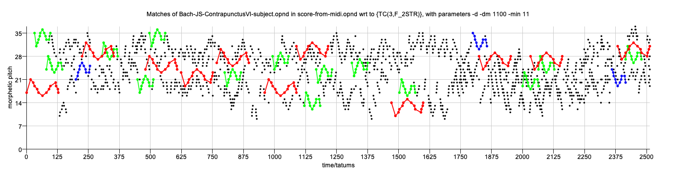
Parallel, geometric algorithms for transformed pattern matching and pattern discovery in polyphonic music
David Meredith
Aalborg University, Denmark
dave@create.aau.dk

Slide 2
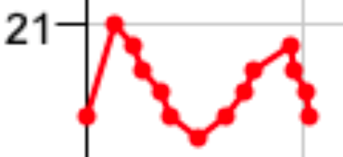
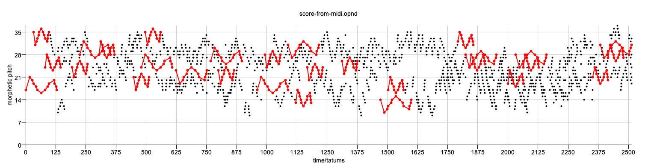

Pattern matching problem
Discover possibly transformed, maximal occurrences of a query pattern in a dataset, where the pattern can be transformed by some user-specified class of transformations
Query pattern
Dataset

Slide 3
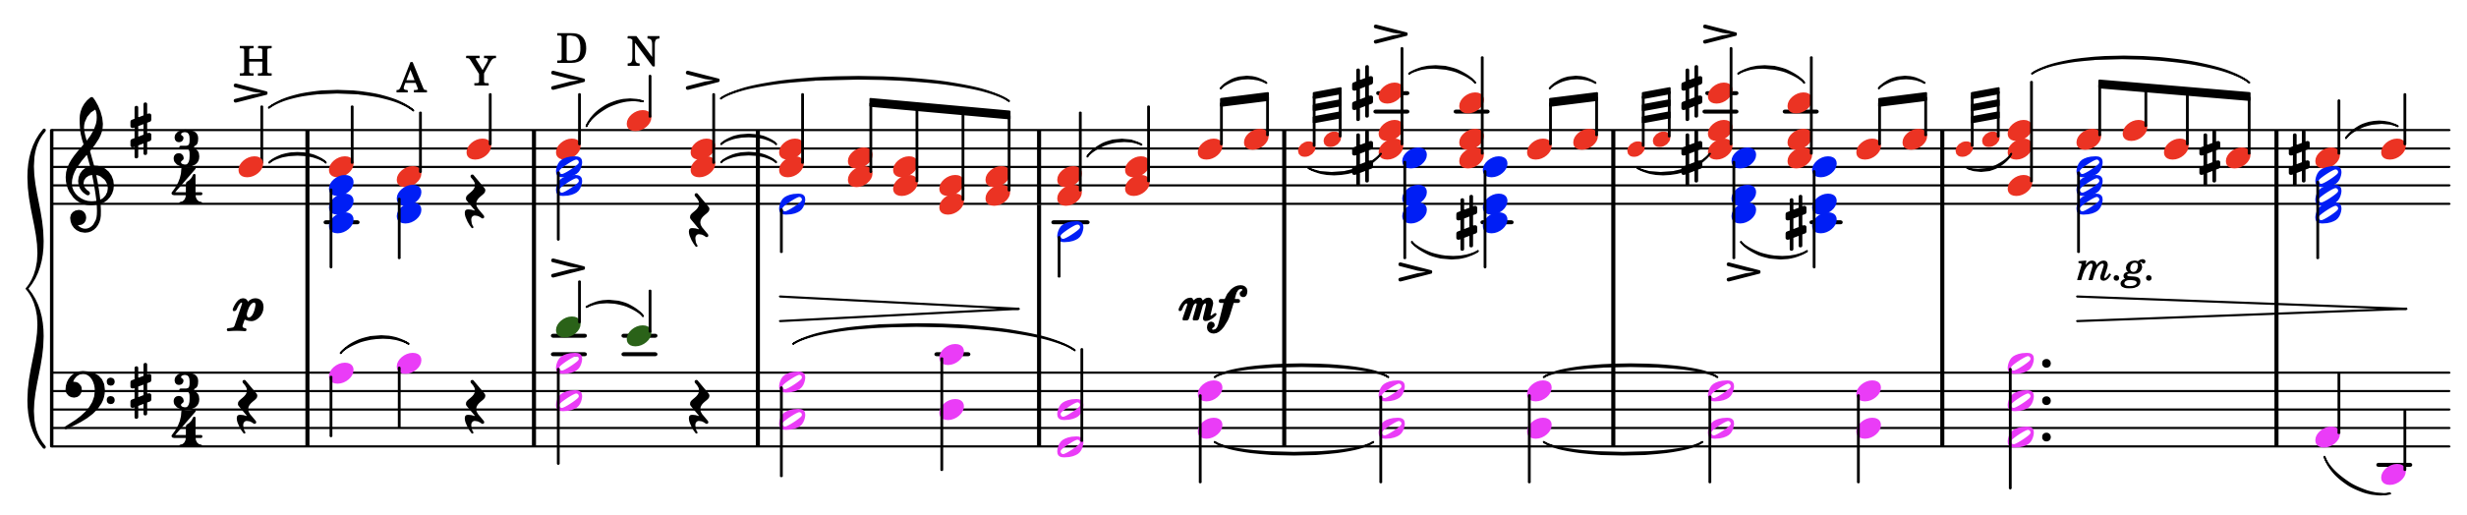
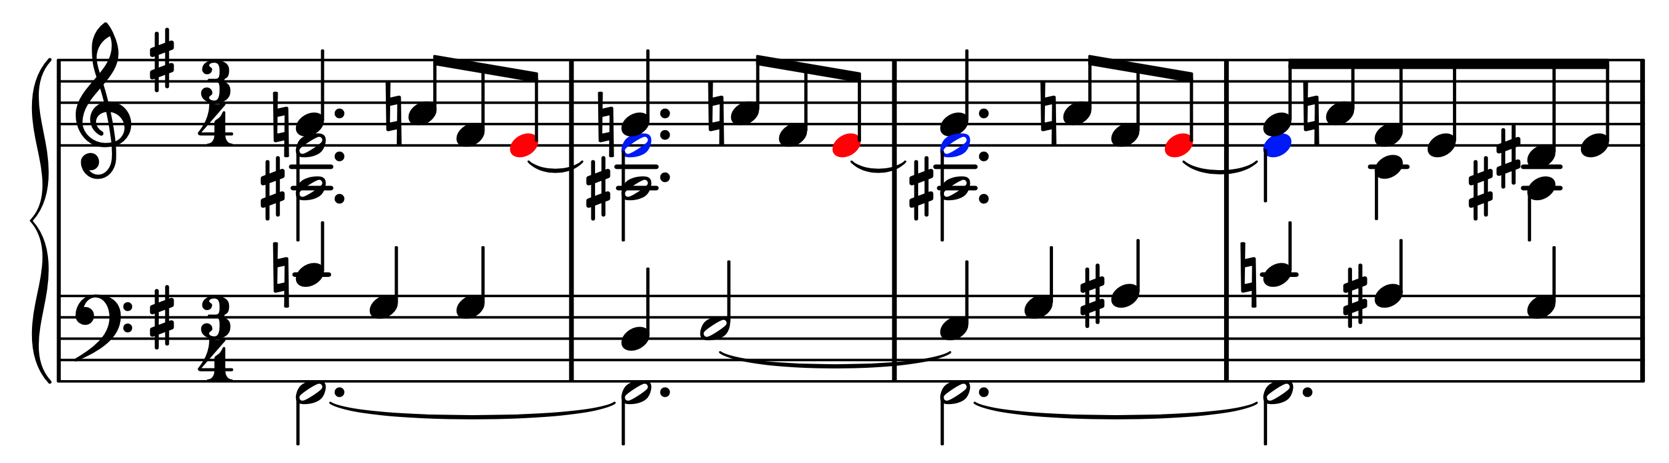
Unvoiced polyphonic music
'Voices' are subjective and ambiguous and may be sequences of chords rather than sequences of notes
Notes in different voices might be tied together!
We're particularly interested in the case where neither the query pattern nor the dataset can be unambiguously partitioned into voices or parts
  As is often the case in keyboard music – see examples above
We adopt a geometric approach, where each note is represented as a point, as this does not require the music to be represented as a set of voices

Slide 4
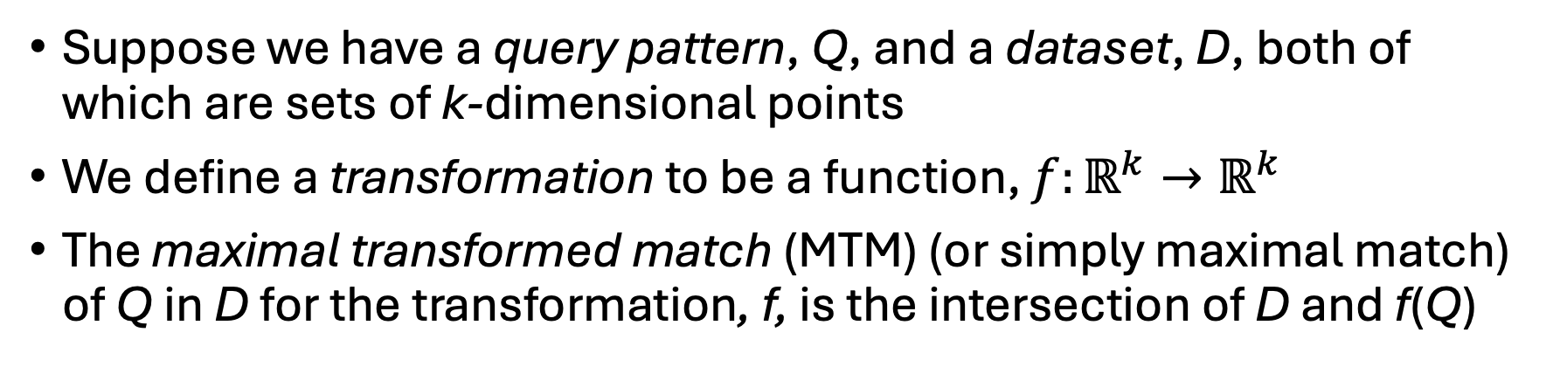
Maximal transformed matches
D
Q
Suppose we have a query pattern, Q, and a dataset, D, both of which are sets of k-dimensional points
We define a transformation to be a function, $f:ℝ^{k}→ℝ^{k}$
The maximal transformed match (MTM) (or simply maximal match) of Q in D for the transformation, f, is the intersection of D and f(Q)

Slide 5
Maximal transformed matches
D
Q
Suppose we have a query pattern, Q, and a dataset, D, both of which are sets of k-dimensional points
We define a transformation to be a function, $f:ℝ^{k}→ℝ^{k}$
The maximal transformed match (MTM) (or simply maximal match) of Q in D for the transformation, f, is the intersection of D and f(Q)

Slide 6
Maximal transformed matches
D
Q
Suppose we have a query pattern, Q, and a dataset, D, both of which are sets of k-dimensional points
We define a transformation to be a function, $f:ℝ^{k}→ℝ^{k}$
The maximal transformed match (MTM) (or simply maximal match) of Q in D for the transformation, f, is the intersection of D and f(Q)

Slide 7
Maximal transformed matches
D
Q
Suppose we have a query pattern, Q, and a dataset, D, both of which are sets of k-dimensional points
We define a transformation to be a function, $f:ℝ^{k}→ℝ^{k}$
The maximal transformed match (MTM) (or simply maximal match) of Q in D for the transformation, f, is the intersection of D and f(Q)

Slide 8
Maximal transformed matches
D
Q
Suppose we have a query pattern, Q, and a dataset, D, both of which are sets of k-dimensional points
We define a transformation to be a function, $f:ℝ^{k}→ℝ^{k}$
The maximal transformed match (MTM) (or simply maximal match) of Q in D for the transformation, f, is the intersection of D and f(Q)

Slide 9
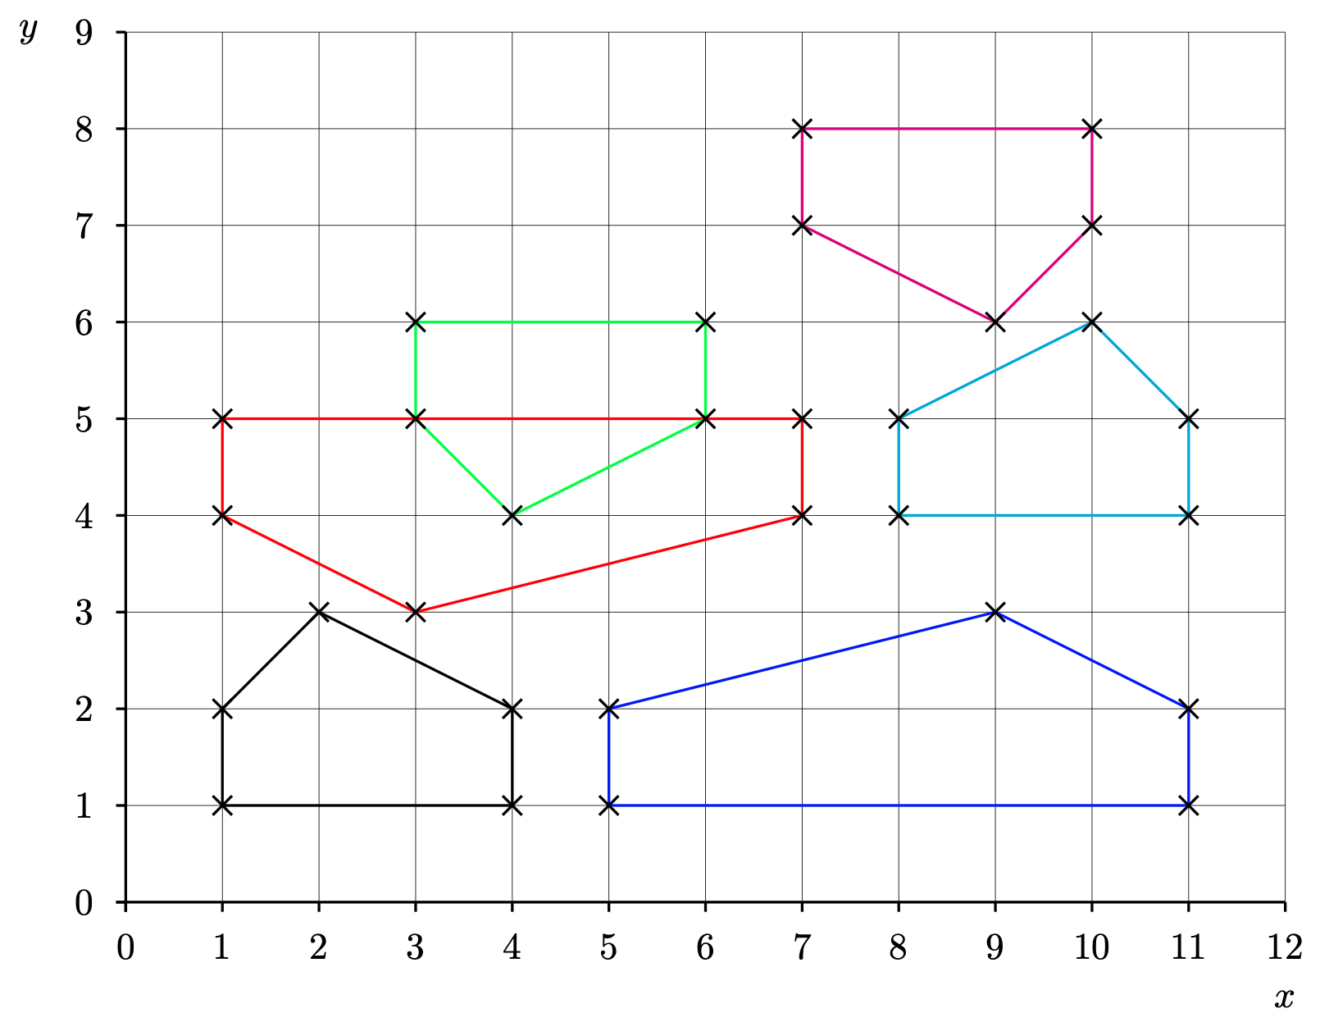
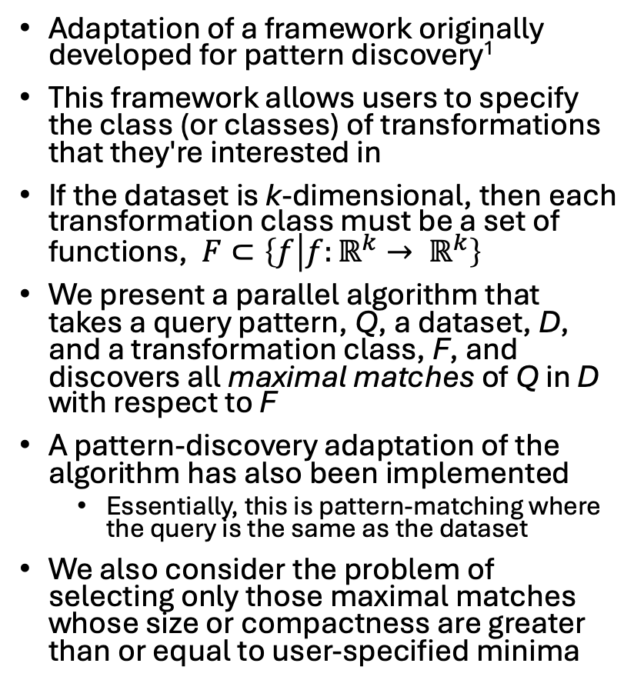
User-specified transformation classes
Adaptation of a framework originally developed for pattern discovery¹
This framework allows users to specify the class (or classes) of transformations that they're interested in
If the dataset is k-dimensional, then each transformation class must be a set of functions, $F⊂\left\{f | f:ℝ^{k}→ ℝ^{k}\right\}$
We present a parallel algorithm that takes a query pattern, Q, a dataset, D, and a transformation class, F, and discovers all maximal matches of Q in D with respect to F
A pattern-discovery adaptation of the algorithm has also been implemented
  Essentially, this is pattern-matching where the query is the same as the dataset
We also consider the problem of selecting only those maximal matches whose size or compactness are greater than or equal to user-specified minima
1. Meredith, D.: Understanding and compressing music with maximal transformable patterns. LNCS 14035, 309–325 (2023), https://link.springer.com/chapter/10.1007/978-3-031-34732-0_24

Slide 10
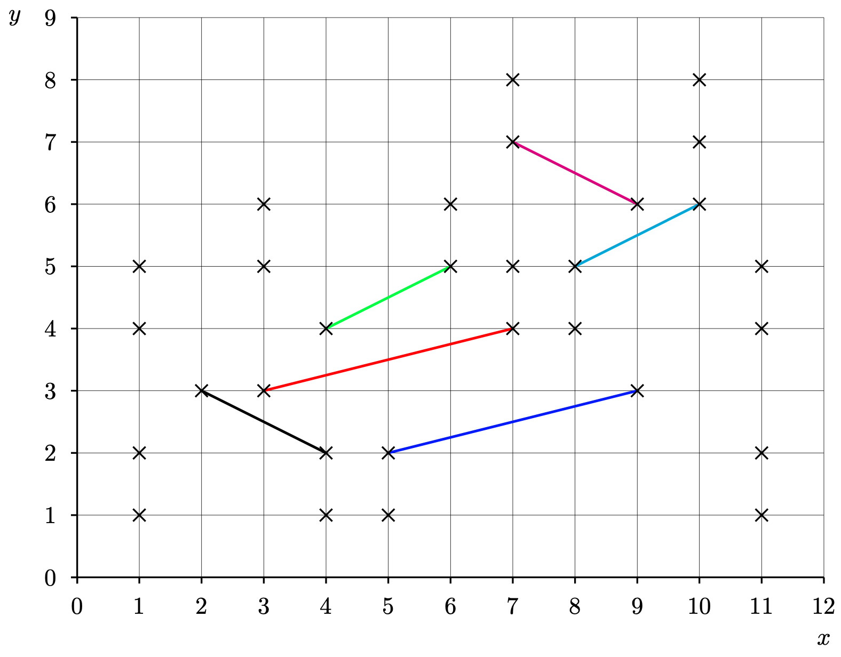
Example transformation class: F_{2STR}
F_{2STR} contains all transformations consisting of a scaling by a non-zero factor parallel to the x-axis, followed by a translation and then optionally followed by a reflection in the x-axis
If our dataset is a pitch-vs-time representation of some music, then F_{2STR} contains the transformations corresponding to the traditional musical contrapuntal transformations of transposition, inversion, retrograde, diminution and augmentation
We can identify each transformation in F_{2STR} by a transformation parameter, (s,v,b), where
  s is the scale factor by which the x-coordinate is stretched
  v is the vector by which the point is translated
  b indicates whether or not the point is reflected in the x-axis
e.g., mapping black line to red line could be achieved using the following transformation parameters:
  (-2,(11,1),1)
  (2,(-1,-6),-1)
These are the only transformations in F_{2STR} that map the black line onto the red line

Slide 11
Discovering inter-basis transformations
If we take two ordered pairs of points in a point set, (p1,p2) and (p3,p4), then there are at most two distinct transformations in F_{2STR} that map (p1,p2) onto (p3,p4) and we can define a function that discovers these transformations given (p1,p2) and (p3,p4)
Compare this with the case of F_{2T ,} which contains all 2-dimensional translations
  In this case,
    each instance of a transformation in F_{2T} can be represented by a single 2-d vector
    given a pair of points, p1 and p2, there is a unique translation that maps p1 onto p2

Slide 12
Basis pairs
Suppose we have
  a dataset, D, and a transformation class, F
  two ordered sets of points in D, P and Q, each of size 𝛽, such that there is at least one transformation in F that maps the points in P onto corresponding points in Q
  Then, for F, we can choose a basis size, 𝛽, which is the minimum size for which we can guarantee that there will always be a finite number of distinct transformations in F that map P onto Q
    so for F_{2STR}, 𝛽=2, whereas for F_{2T}, 𝛽=1
We call P and Q an image basis and an object basis, respectively

Slide 13
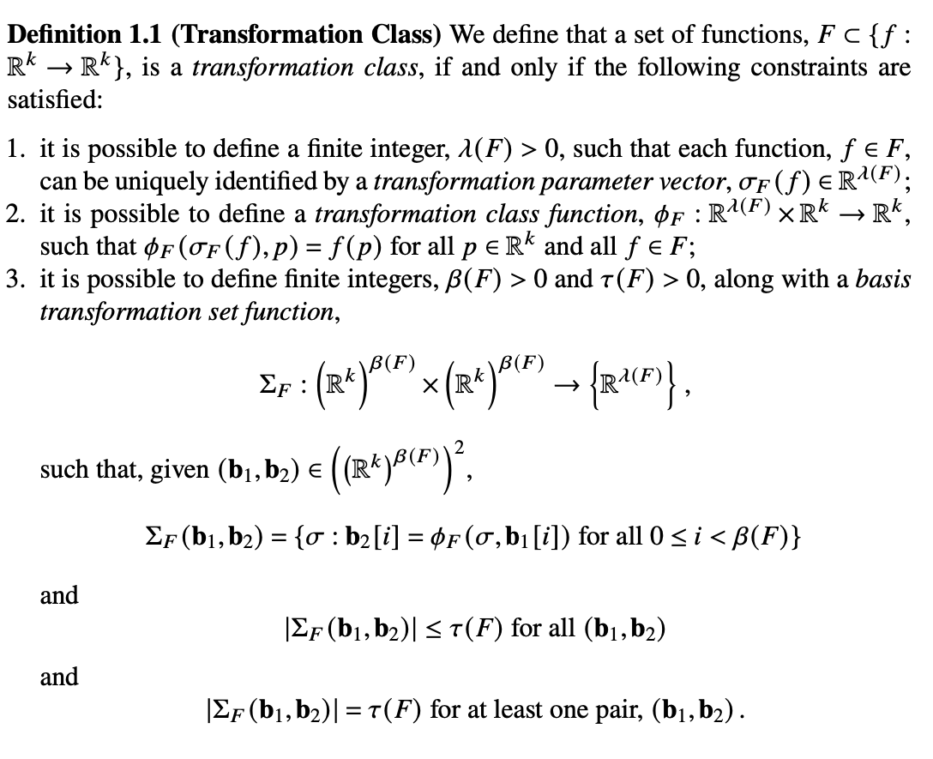
Transformation class
The transformation parameter vector is just a "linearisation" of the transformation parameter

Slide 14





F_{2T}
Set of 2-d translations

Slide 15
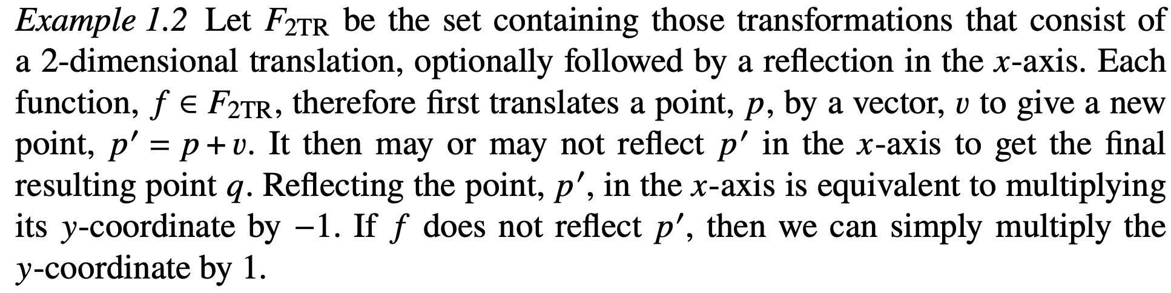




F_{2TR}
Set of transformations consisting of 2-d translation, optionally followed by a reflection in the x-axis

Slide 16
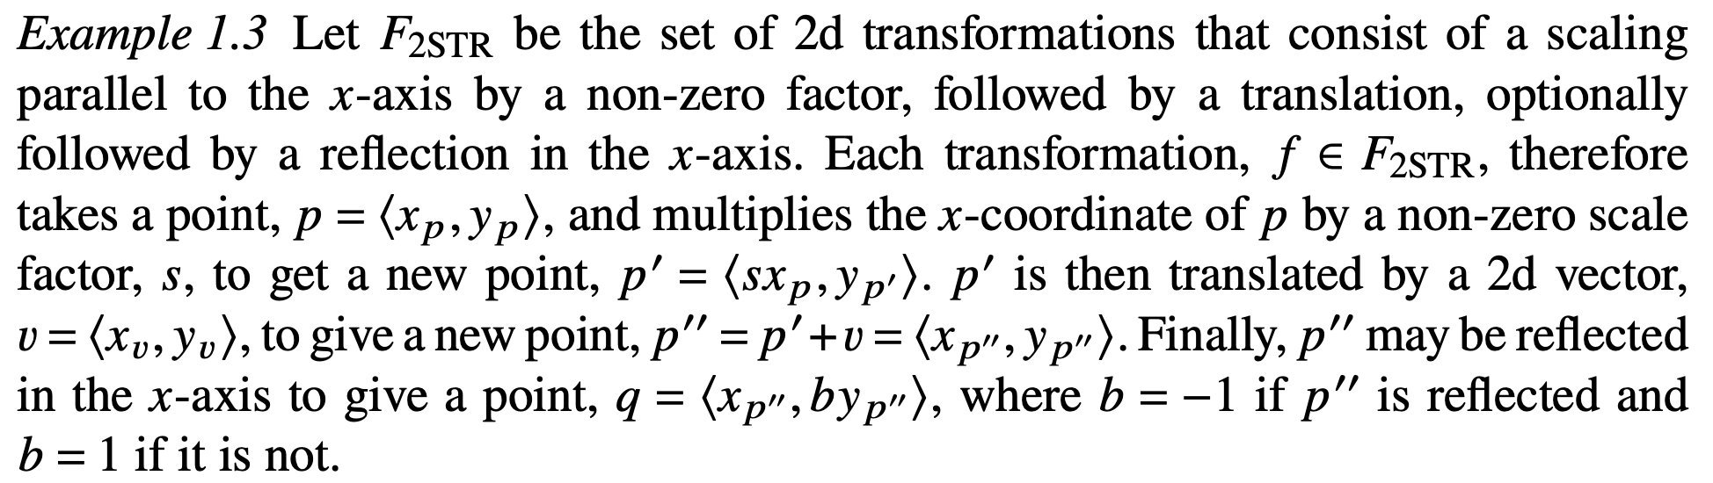


F_{2STR}

Slide 17
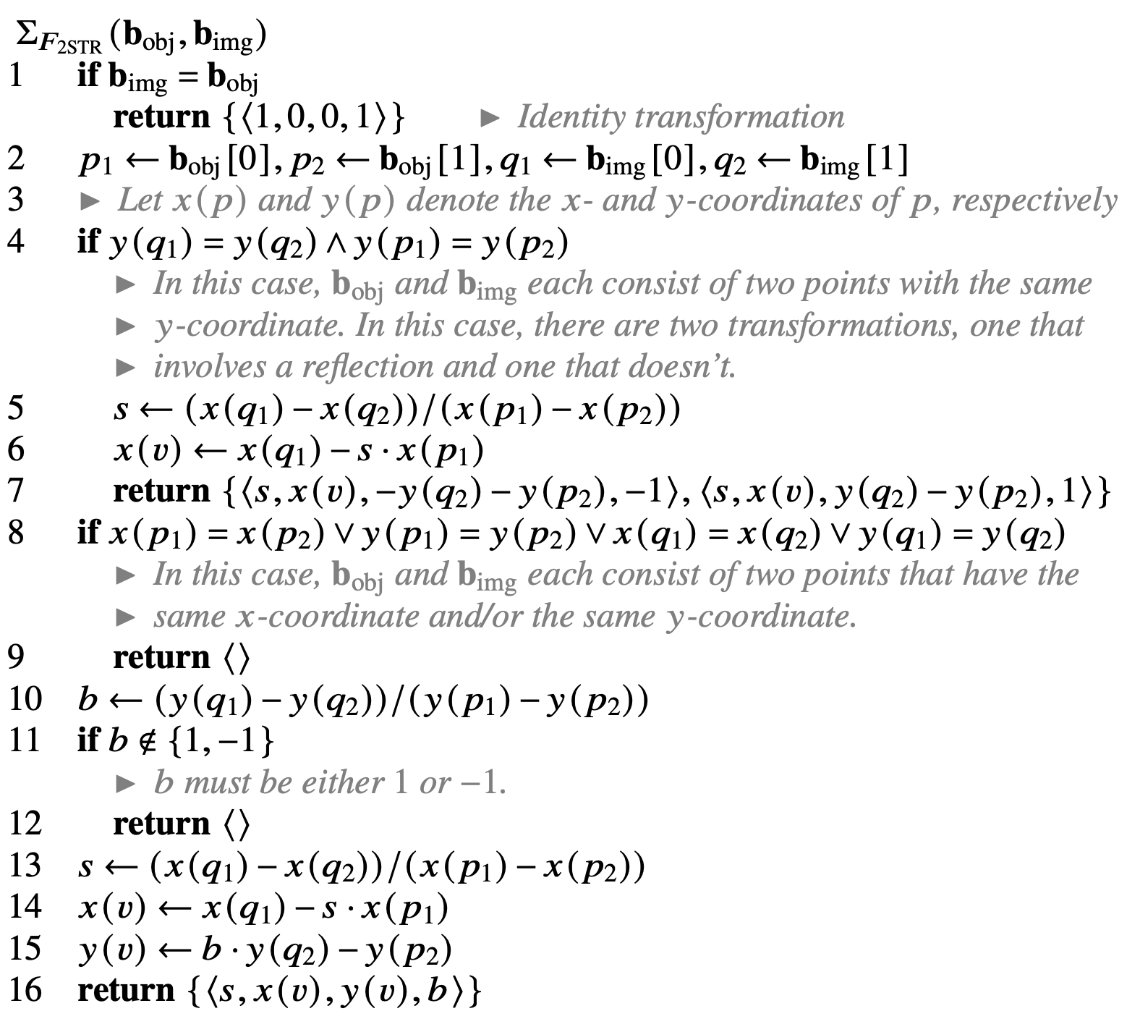
Basis transformation set function for F_{2STR}
An implementation of this algorithm, taking numerical stability into consideration is available at https://github.com/chromamorph/omnisia/blob/d087084259ddcbfe1accd8a94bb3b38557545b6b/MaxTranPatsJava/src/com/chromamorph/maxtranpatsjava/F_2STR.java#L62

Slide 18
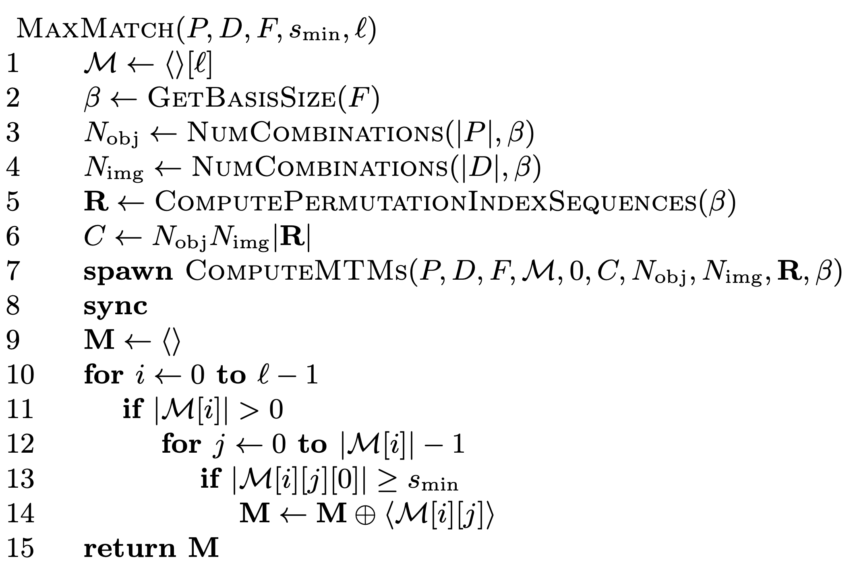
Parallel maximal match algorithm
The algorithm first constructs a hash table (line 1)
Each element in this hash table is a list of (f,Q) pairs, in each of which f is a transformation and Q is a point set that eventually becomes the maximal transformed match for f

Slide 19
The algorithm
In lines 2-8, the MTMs of P in D wrt F are computed in parallel using the kernel function, ComputeMTMs

Slide 20
The algorithm
ComputeMTMs needs to be provided with the basis size (line 2) and the total number of object bases and image bases, which are equal to the number of combinations of size equal to the basis size in the pattern P and dataset D, respectively (lines 3-4)
In line 5, the set of permutations of the sequence from 0 to beta - 1 is computed and stored in lexicographical order in R
  Note that the basis size is typically very small, so its factorial will also typically be small
Line 6 calculates the total number of computations to be carried out in parallel
ComputeMTMs is called on a new thread (line 7) with its start and end indices set to 0 and C

Slide 21
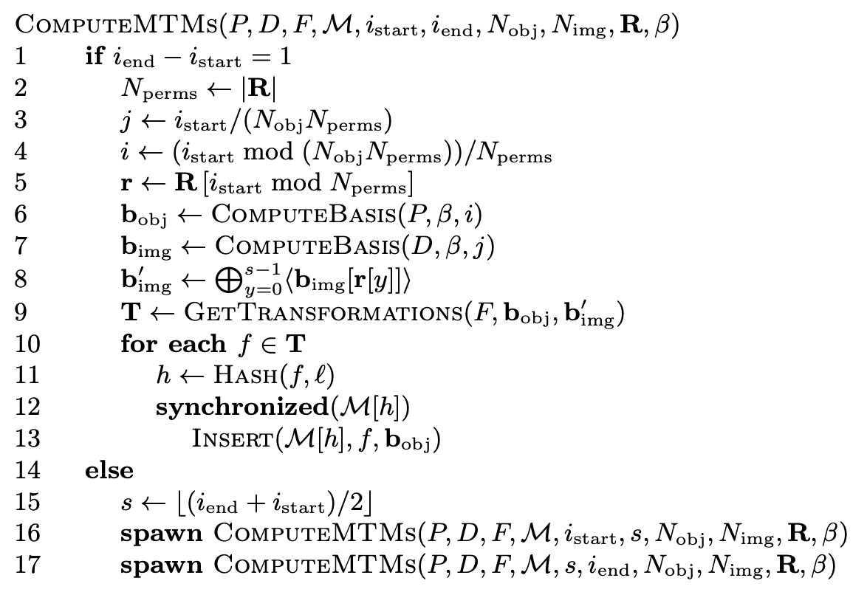
The algorithm
ComputeMTMs is a recursive kernel function that is always run on its own thread
When the base case occurs, a specific object basis from P is chosen along with a specific permutation of a specific image basis from D
  The object bases and image basis permutations are sorted into an effective order and the computation index, i_{start}, is mapped onto the indices of the current pair to be processed in lines 3-4
The transformations that map the object basis onto that permutation are computed in line 9 using the basis transformation set function for the transformation class

Slide 22
The algorithm
In lines 10-13, we iterate over the discovered transformations, computing their hash values and inserting a
(transformation, object-basis) pair into the hash table
If there already exists a pair with the same transformation at the hash slot, then the object basis points are added to that pair's second element, otherwise the pair is added as a new pair to the slot
In the recursive case, the range from i_{start} to i_{end} is split in two and each subrange is passed to newly spawned instances of ComputeMTMs which run in parallel

Slide 23
The algorithm
When all parallel calls to ComputeMTMs have terminated in line 8 of MaxMatch, the MTMs are harvested from the hash table and stored in a list which is returned.

Slide 24
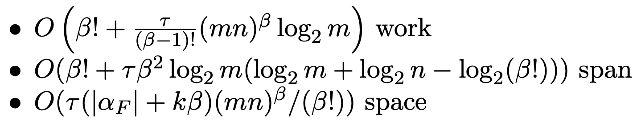
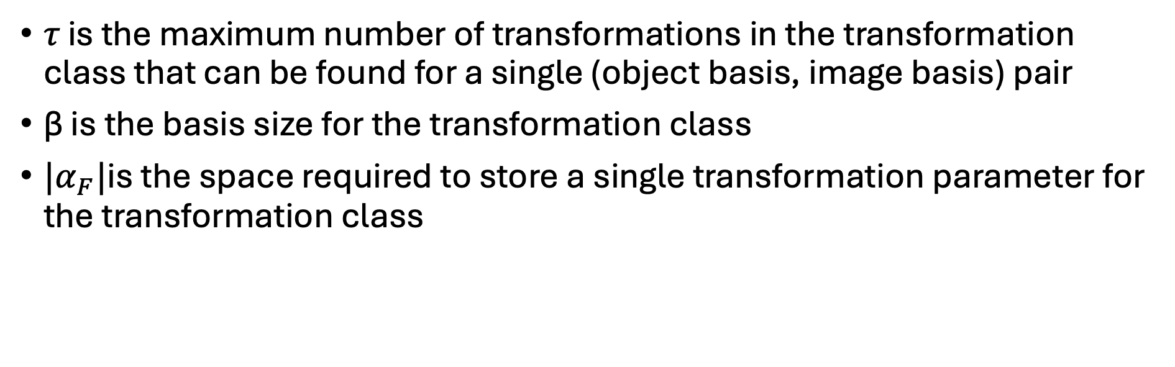
Work, span and space complexity
𝜏 is the maximum number of transformations in the transformation class that can be found for a single (object basis, image basis) pair
β is the basis size for the transformation class
${|α}_{F}|$is the space required to store a single transformation parameter for the transformation class

Slide 25
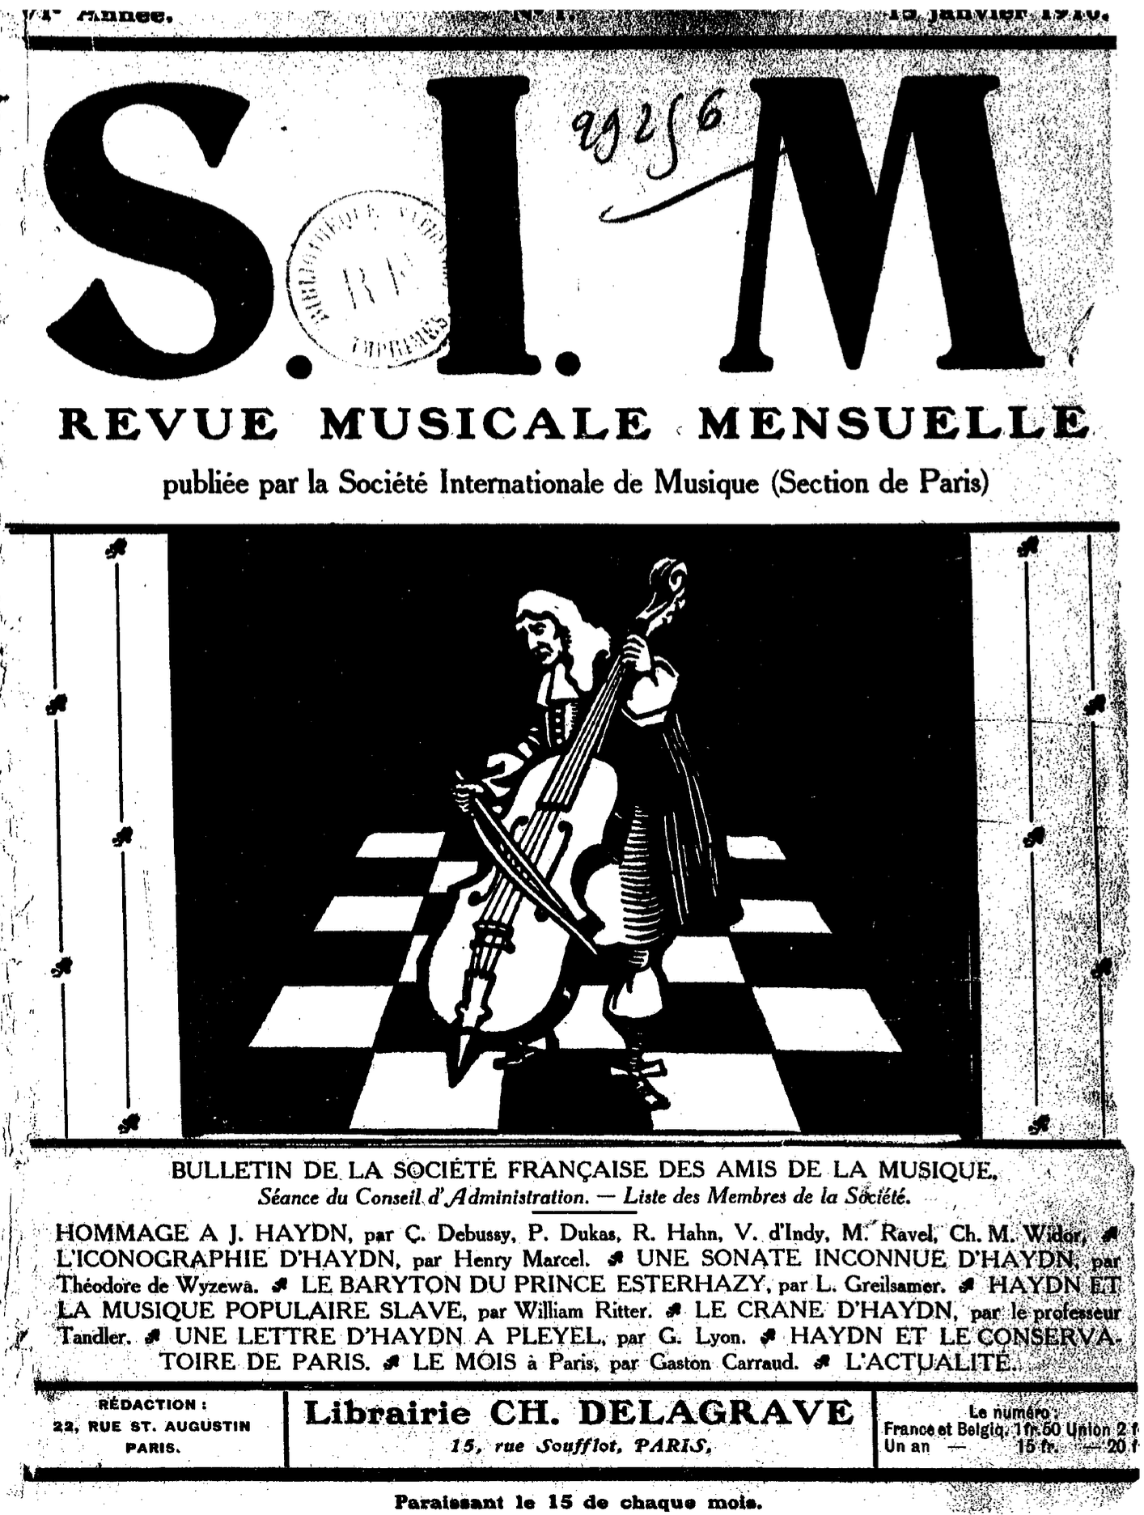
Hommage à Joseph Haydn
In 1909, the Revue musicale mensuelle de la Société Internationale de Musique (RSIM) requested six of the most prominent French composers of the time to write a piano piece incorporating a theme encoding the word, "HAYDN", on the occasion of the 100th anniversary of Joseph Haydn's death
The six composers were Claude Debussy (1862–1918), Paul Dukas (1865–1935), Vincent d’Indy (1851–1931), Reynaldo Hahn (1874–1947), Charles-Marie Widor (1844–1937) and Maurice Ravel (1875–1937)
The six pieces were published in a special issue of the RSIM on15 January 1910, under the title, "Hommage à Joseph Haydn"

Slide 26
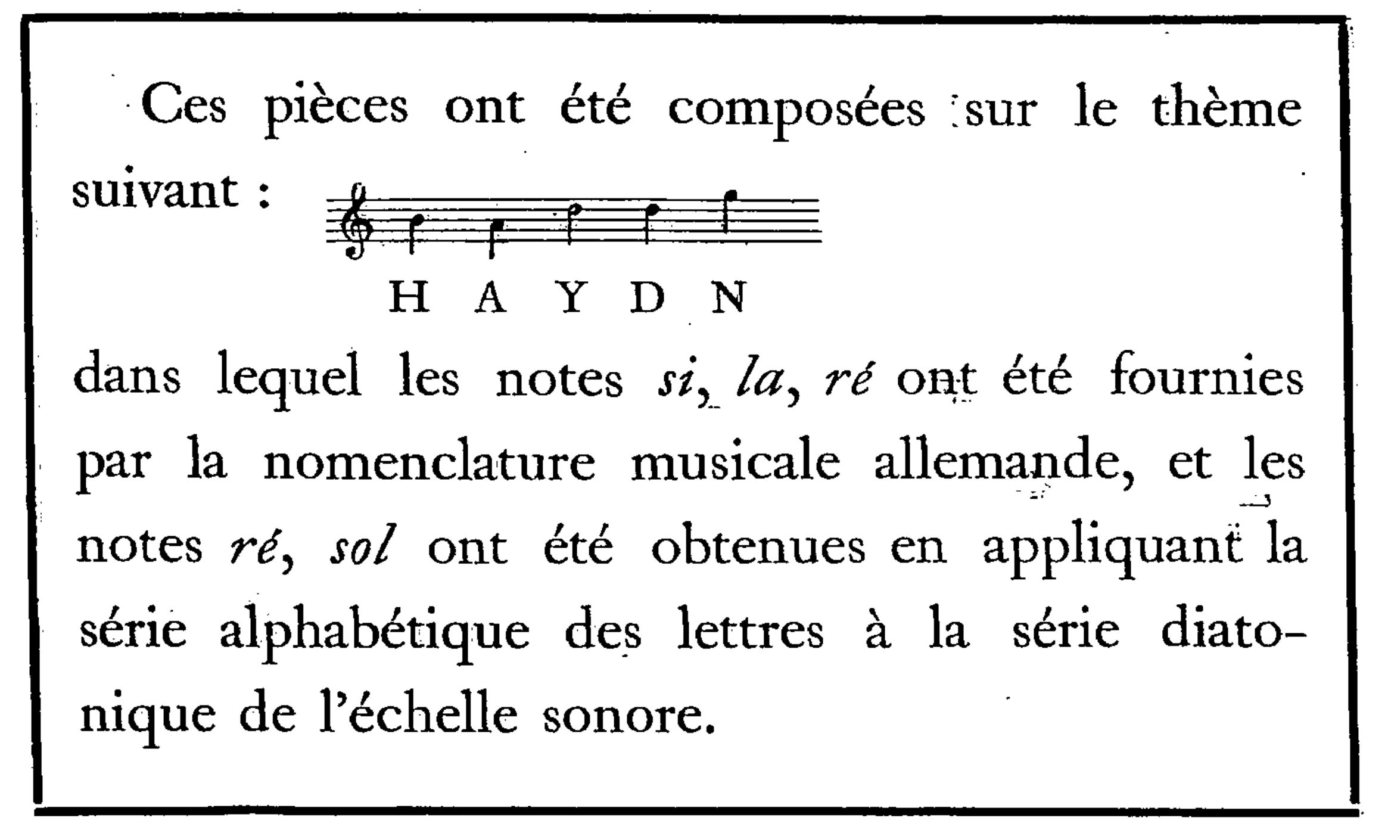
The "HAYDN" theme
This "Hommage" is preceded by an explanatory note, shown on the left, written by the editor of RSIM, Jules Écorcheville
The note states that the pieces were "composed on the theme" shown, which is simply the sequence of 5 notes, B-A-D-D-G
  "H" in the German pitch-naming system corresponds to B natural, and the first D in the theme represents the letter Y as a result of cyclically mapping the sequence of pitch letter names, A-G, onto the letters of the alphabet

Slide 27
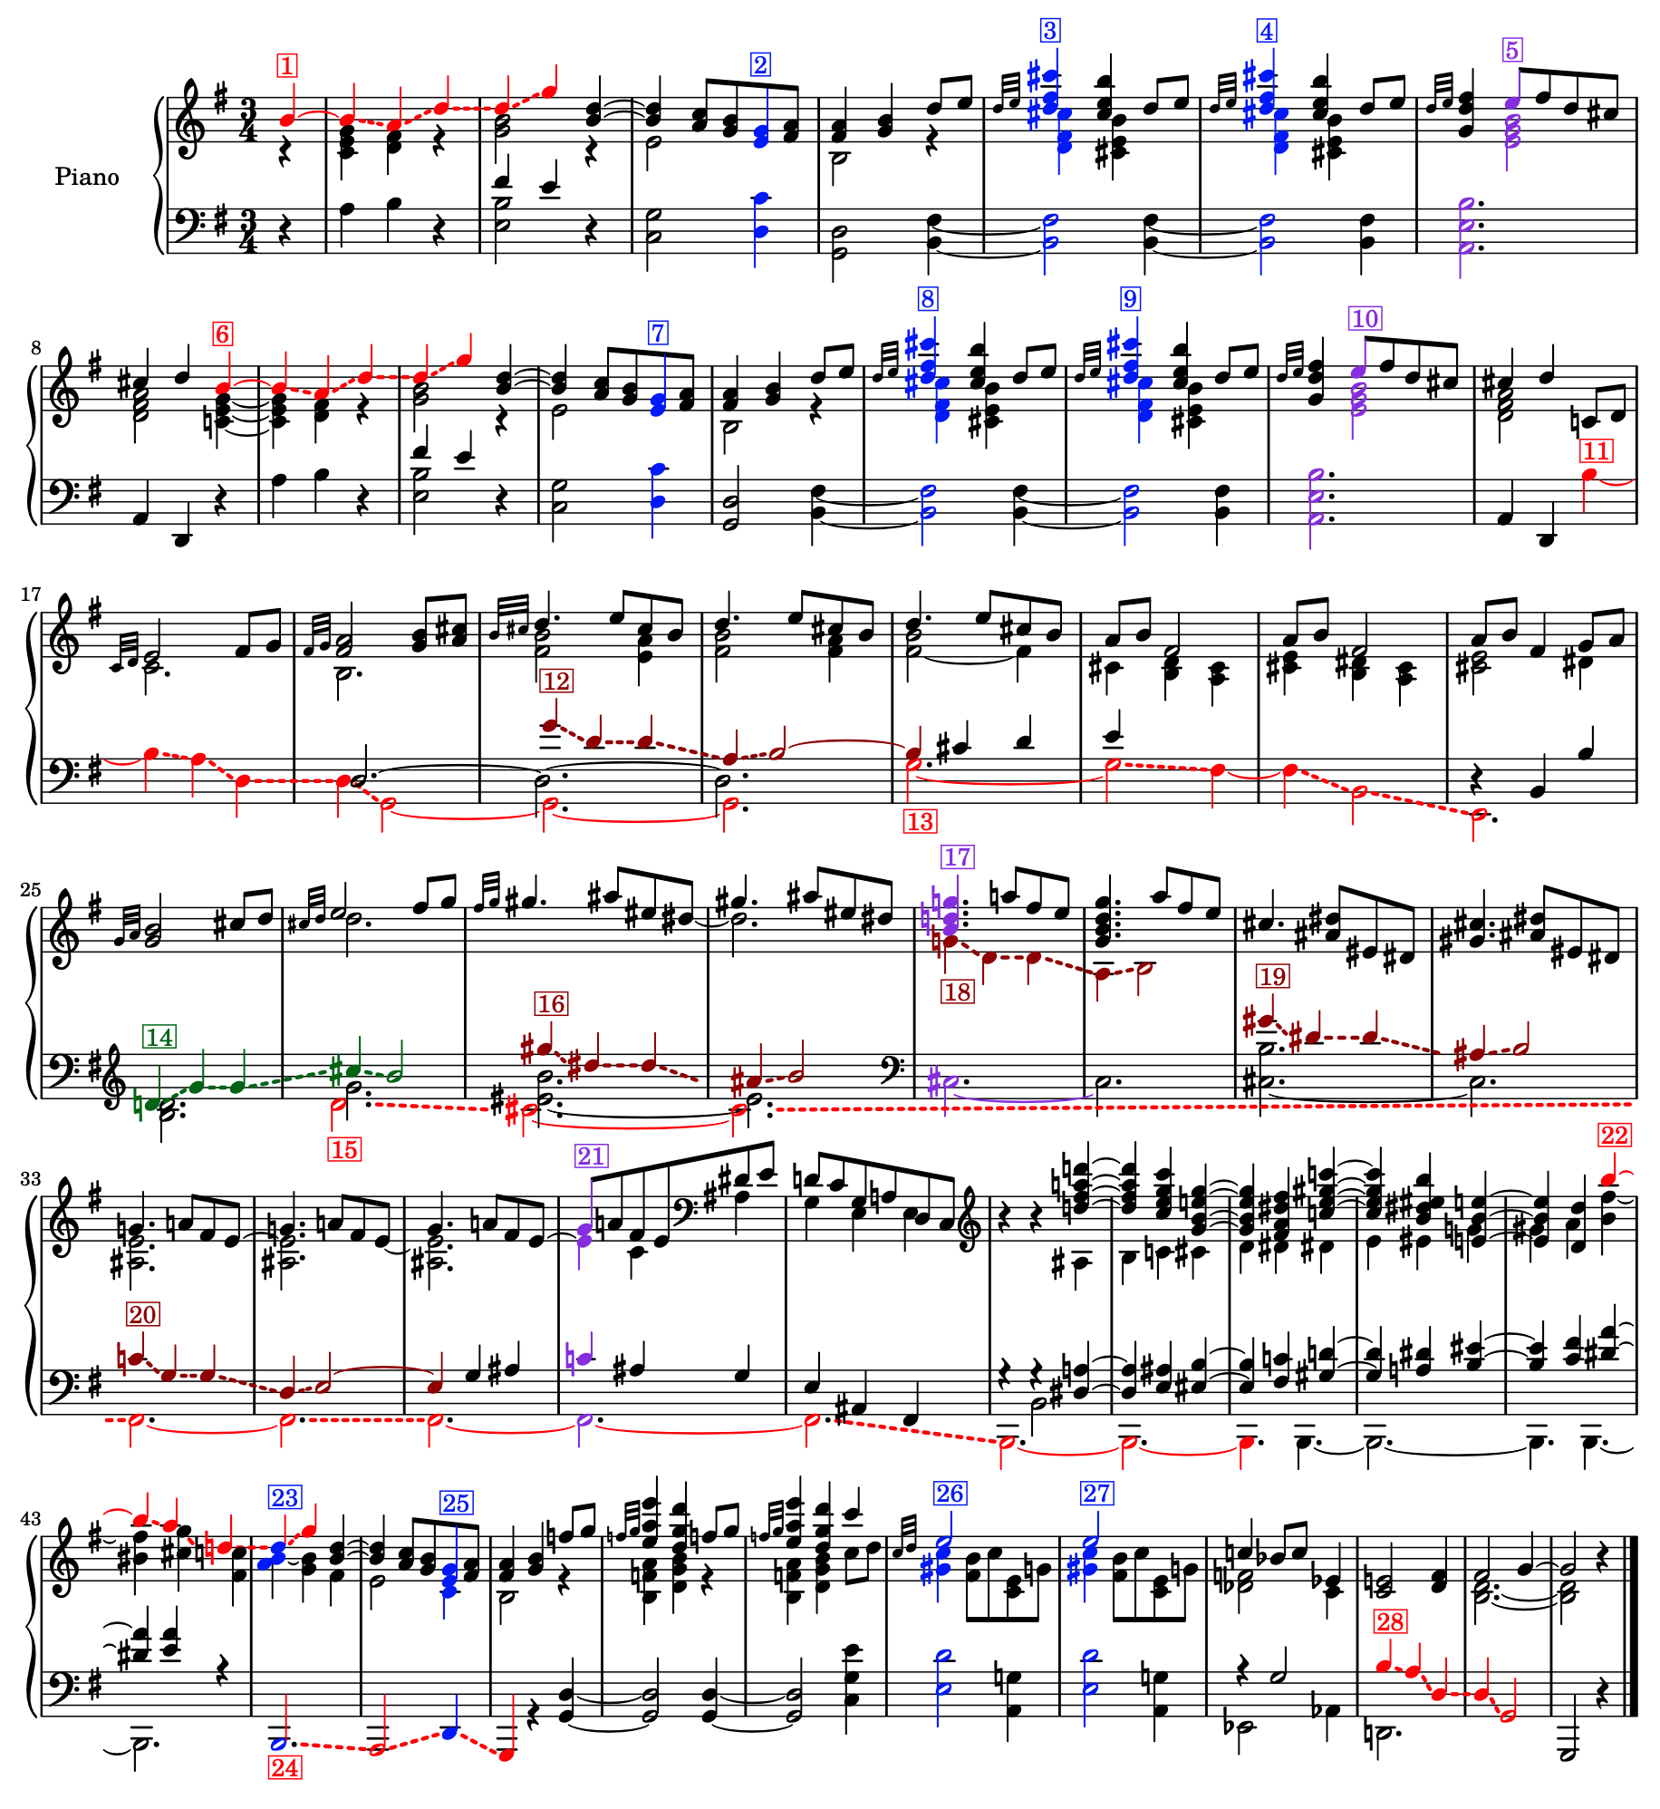
Soucy's (2009) analysis of Ravel's Menuet sur le nom d'Haydn
Ravel's contribution to the Hommage consisted of a short minuet, entitled Menuet sur le nom d'Haydn
In his masters thesis from the Schulich School of Music at McGill, Jean-Philippe Soucy presented a detailed analysis of all six pieces in the Hommage, in which he aims to identify every occurrence of the HAYDN theme in the pieces
The figure shows the 28 occurrences of the theme in Ravel's Menuet identified by Soucy
https://open.spotify.com/track/3Vcpv8QWJ3IPG9RYKFphoS?si=32ed40bc70464512

Slide 28
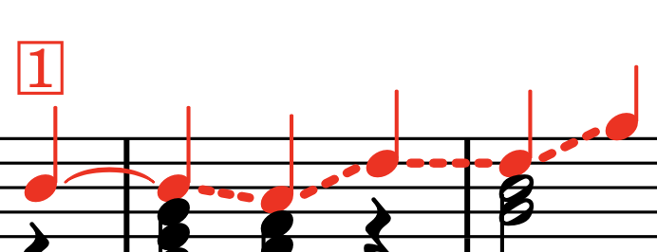
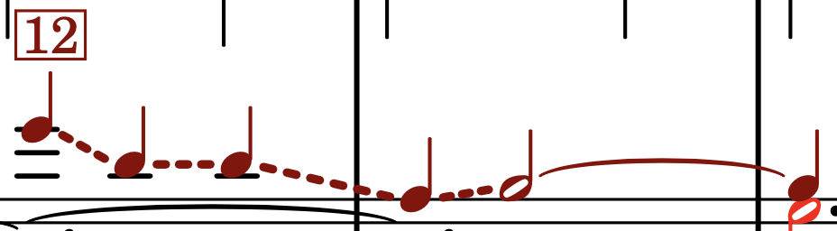
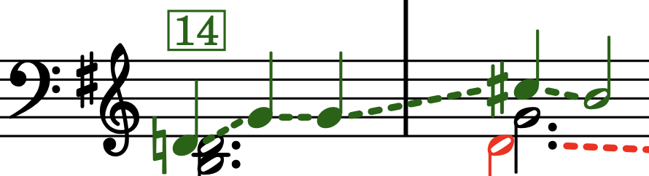
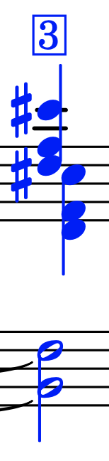

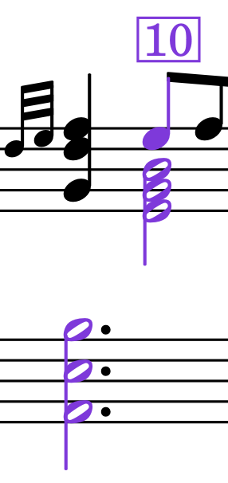
Transformed occurrences of the HAYDN theme in Ravel's Menuet, identified by Soucy
Melodic statements
  Red: notes appear in original order, possibly transposed
  Dark red: retrograde
  Dark green: retrograde inversion
Chords
  Blue: all notes played together to form an added ninth chord (without seventh)
  Lilac: notes in inversion of theme played together to form an added fourth chord

Slide 29
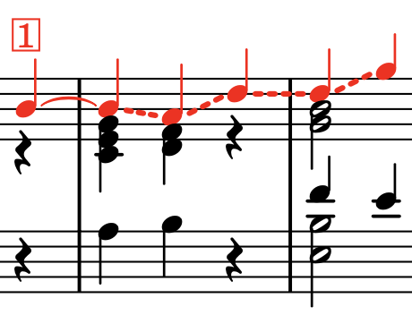
Occurrences identified by Soucy
None of the 28 occurrences of the HAYDN theme in Ravel's Menuet identified by Soucy are identical to the theme proposed by Écorcheville
Occurrences 1 and 6 extend the first note by a crotchet
The durations in the first occurrence are repeated exactly in 6, 14, 16, 18, 19 and 22

Slide 30
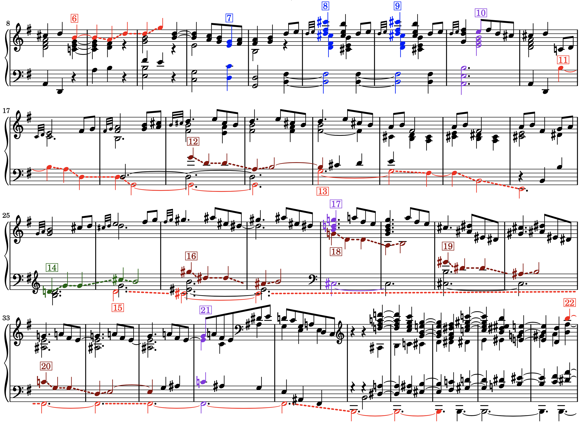
Occurrences identified by Soucy
In occurrences 11, 12 and 20, the final note is lengthened
In occurrences 13, 15 and 24, the note durations are augmented – especially occurrence 15 which has a four-bar gap in the middle
In occurrences 11, 13, 15, and 28, the rising fourths in the theme are inverted to become falling fifths
  In occurrence 22, only the first fourth is inverted to become a fifth
Occurrences 13 and 24 each lack a note corresponding to the second D in the theme, so they are incomplete

Slide 31
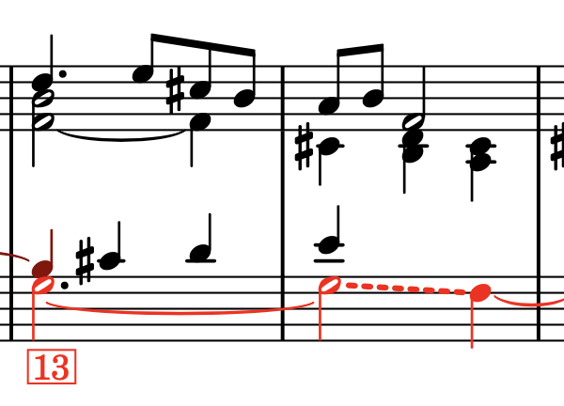
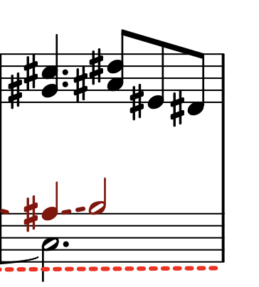
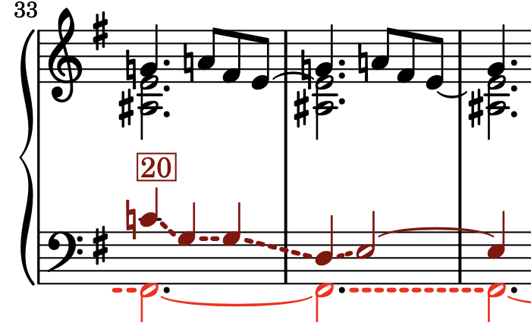
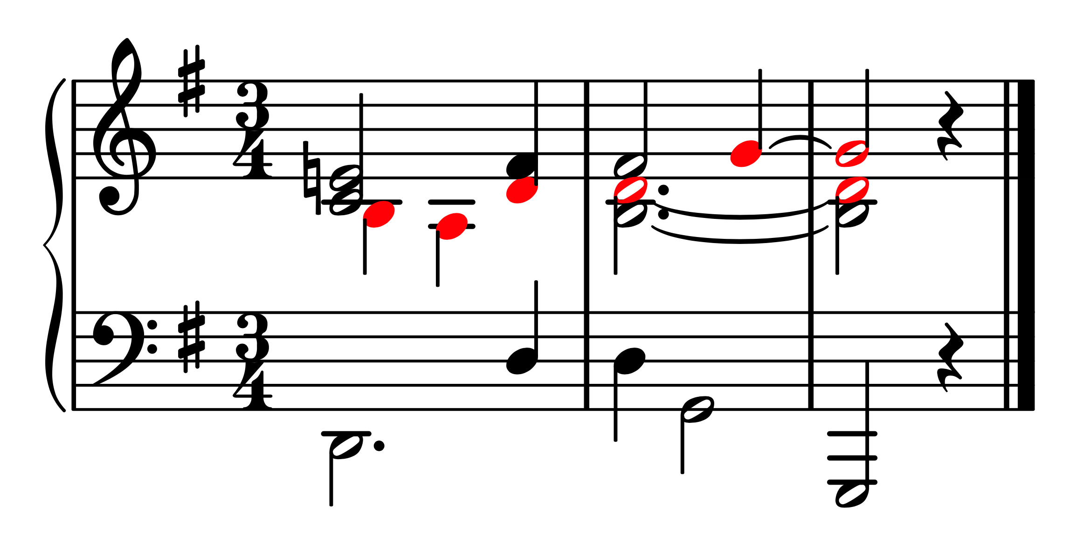
Issues with Soucy's analysis
Some of the occurrences identified by Soucy seem a bit spurious (e.g., 15 and the chordal occurrences)
He also misses out at least three occurrences that are as convincing as some of the ones he does identify (shown on the left)

Slide 32
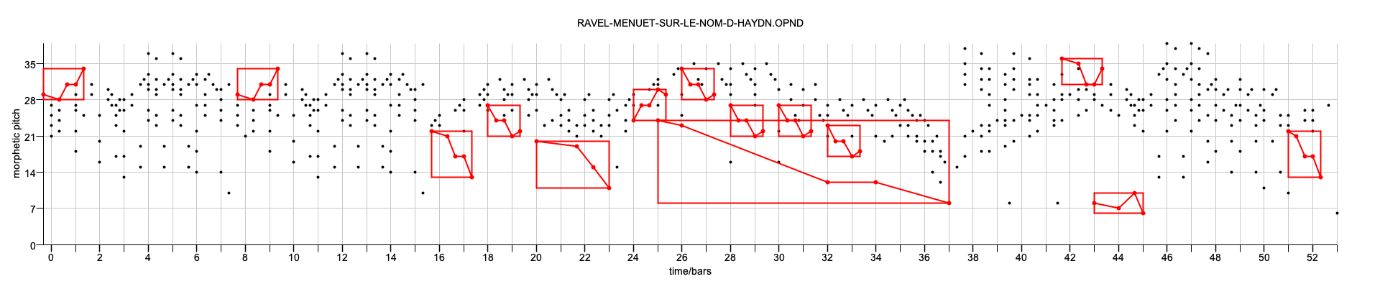
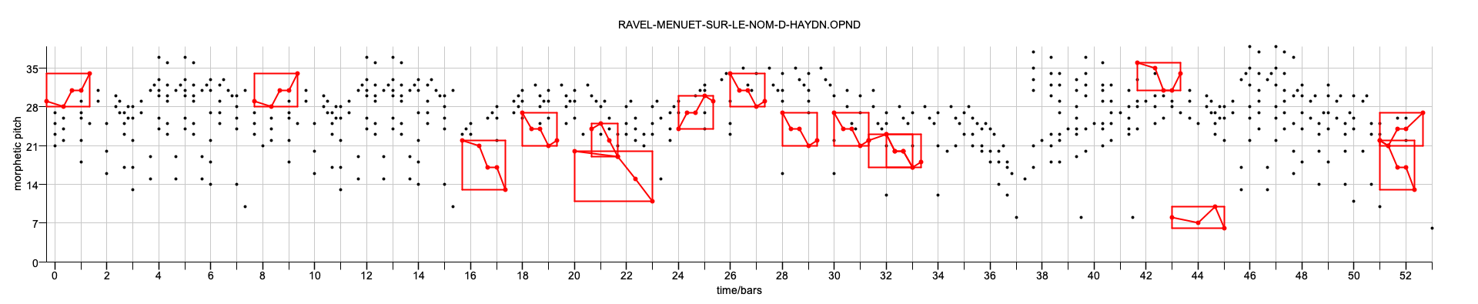
Ground truths for occurrences of the HAYDN theme in Ravel's Menuet
Soucy (modified)
Meredith
This gives us two "ground truths" for Ravel's Menuet

Slide 33
Ground truth for Bach's Contrapunctus VI from Die Kunst der Fuge
The ground truth for subject entries of Contrapunctus VI from Bach's Die Kunst der Fuge is less controversial
Here, occurrences (entries) of the subject are related to the first entry by combinations of augmentation, diminution and inversion

Slide 34
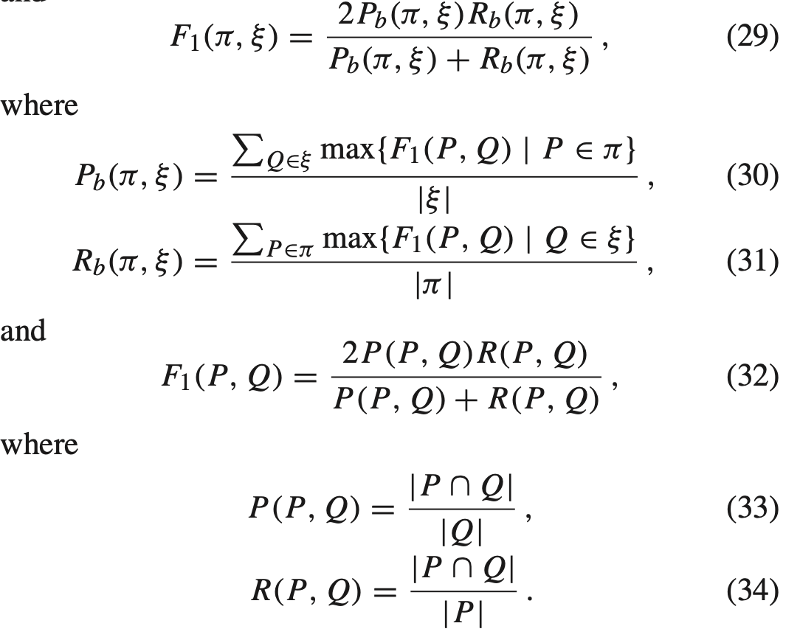
2-layer precision, recall and F1 score
2-layer precision, recall and F1 score let us measure the similarity between a computed and a ground-truth occurrence set
Eqs 32-34 let us measure the similarity between a ground-truth pattern, P and a computed pattern, Q
e.g., Eq. 33 gives us the proportion of points in the computed pattern, Q, that are in a ground-truth pattern, P
Eqs. 30 and 31 give us "soft" measures of precision and recall when comparing a ground-truth set of patterns, 𝛑, with a computed set of patterns, 𝛏
Meredith, D. (2015). Music analysis and point-set compression. Journal of New Music Research, 44(3):245-270. p. 258

Slide 35
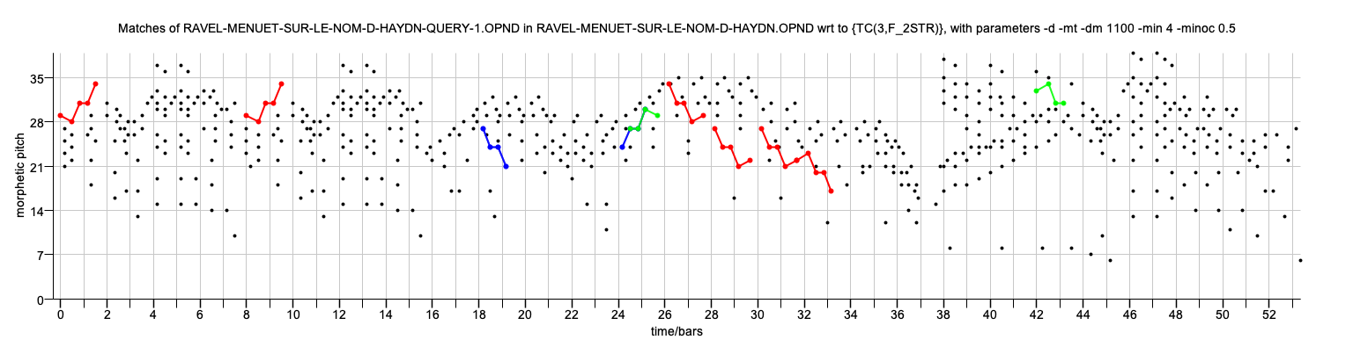
Results for Ravel with Meredith ground-truth
2-layer F1: 0.697
2-layer P: 0.911
2-layer R: 0.564

Slide 36
Results for Ravel with modified Soucy ground truth
2-layer F1: 0.698
2-layer P: 0.891
2-layer R: 0.573

Slide 37
Results for Bach, Contrapunctus VI
2-layer F1: 0.935
2-layer P: 0.949
2-layer R: 0.921

Slide 38


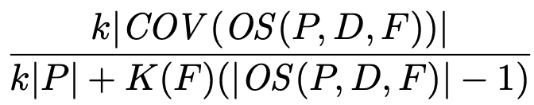

Occurrence sets
Compression factor:
achieved by encoding as:

Slide 39
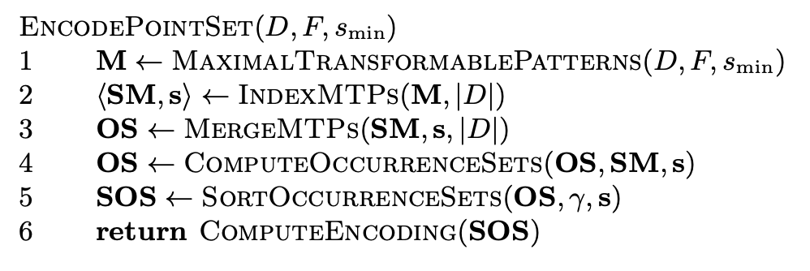
Pattern discovery and compression algorithm
Uses a simple greedy strategy, similar to Forth and SIATECCompress to find MTP occurrence sets with high compression factors (and that optimise other, user-specified heuristics like compactness and coverage, etc.)

Slide 40
Pattern discovery and compression algorithm
Line 1 uses a process like the maximal match algorithm to find all the MTPs
MTPs are indexed by size in a data structure, SM, which is a direct address table containing |D|+1 slots
  s is the sequence of distinct sizes, in increasing order
Each slot, SM[i] contains a list of the MTPs of size i, sorted into lexicographical order
This puts all the transformations for a given MTP next to each other in such a list

Slide 41
Pattern discovery and compression algorithm
A single pattern can be the MTP for two or more transformations
All <f,P> pairs with equal P form a contiguous segment in one of the lists in SM
So in line 3, we "merge" such segments to form <P,T> pairs, where T contains all the transformations for which P is maximal
These <P,T> pairs are stored in OS, which is indexed in a similar way to SM

Slide 42
Pattern discovery and compression algorithm
A single pattern can be the MTP for two or more transformations
All <f,P> pairs with equal P form a contiguous segment in one of the lists in SM
So in line 3, we "merge" such segments to form <P,T> pairs, where T contains all the transformations for which P is maximal
These <P,T> pairs are stored in OS, which is indexed in a similar way to SM

Slide 43
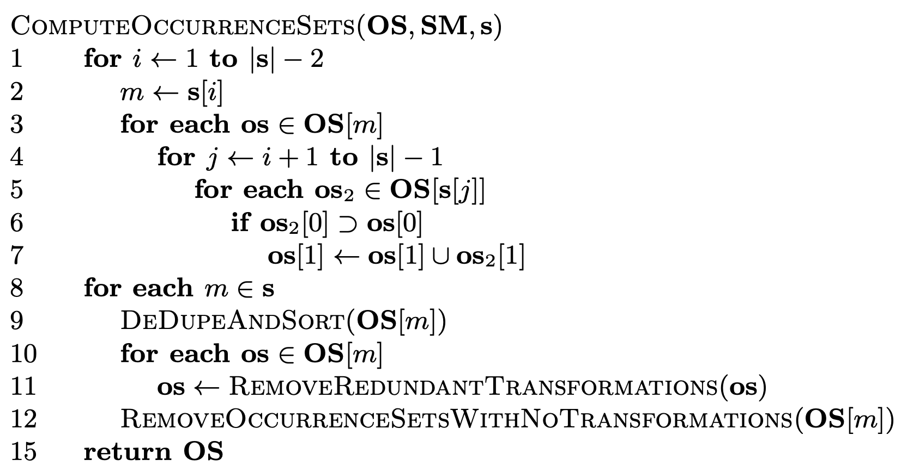
Pattern discovery and compression algorithm
If a pattern, Q, is transformable by f, then every subset of Q is also transformable by f
For every f that occurs in D, there is exactly one <P,T> pair in OS whose pattern, P, is the MTP of f
The occurrence set within D wrt F of an MTP, P, is therefore
=> the OS of P is the union of the transformation sets of the pairs in OS whose patterns contain P
Generalization of SIATEC

Slide 44
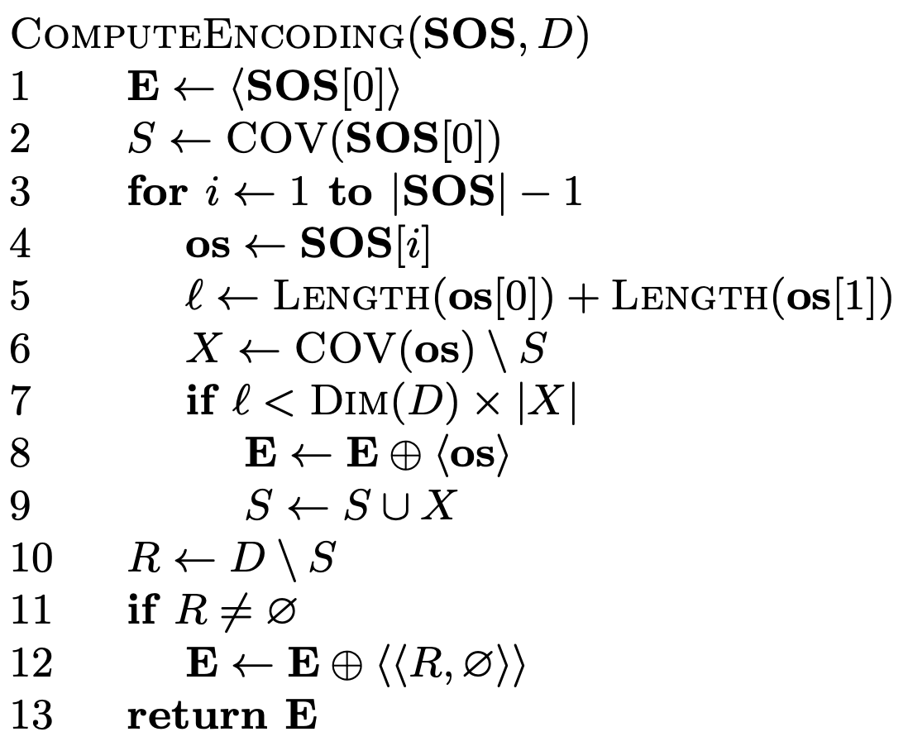
Pattern discovery and compression algorithm
Then sort OSs into decreasing order of preference (typically, decreasing order of CF)
Then use strategy like SIATECCompress to scan down this sorted list and select OSs to make a cover that add length to the encoding that is less than the number of new points covered

Slide 45
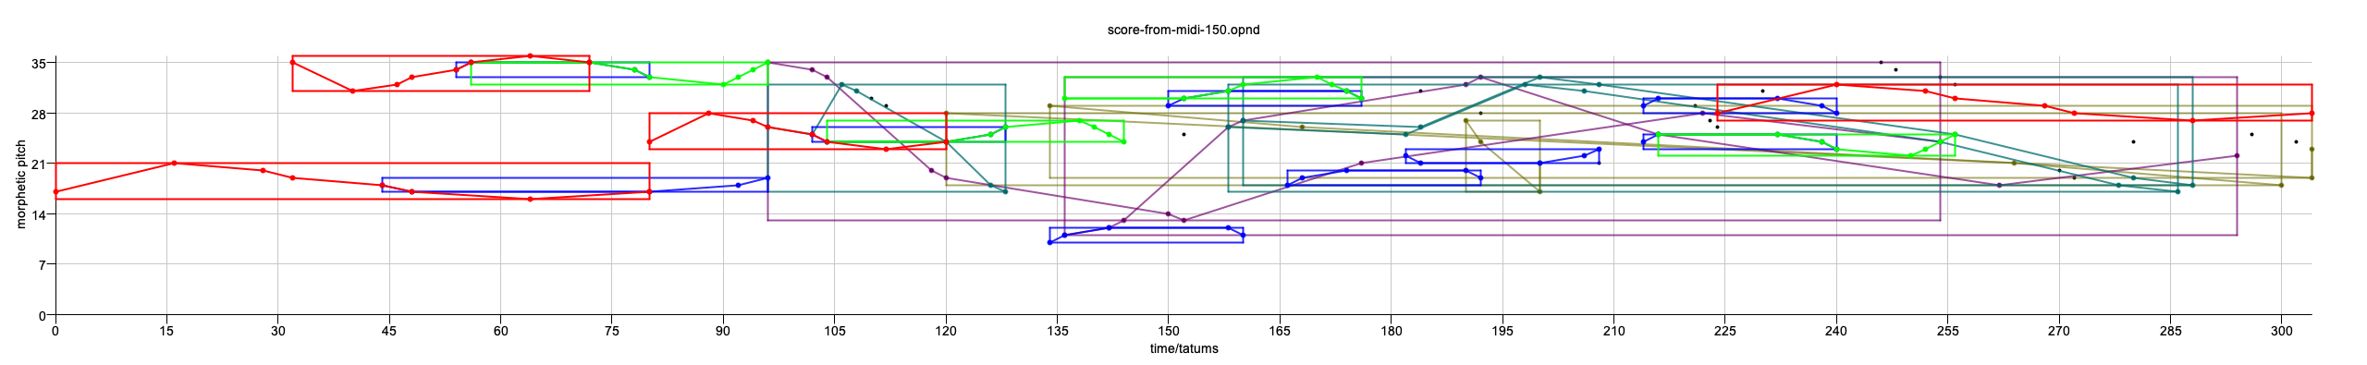
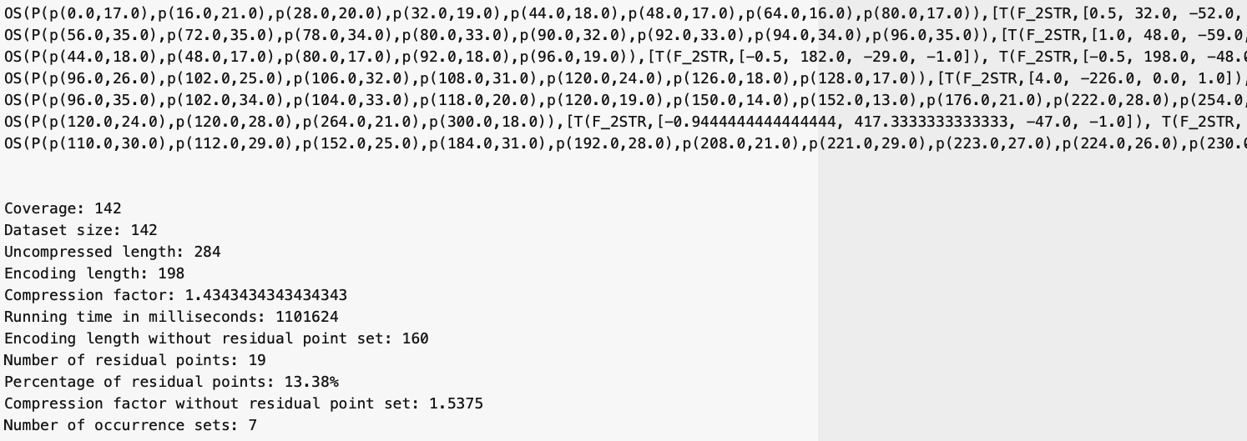
Example: first 150 notes of Contrapunctus

Slide 46
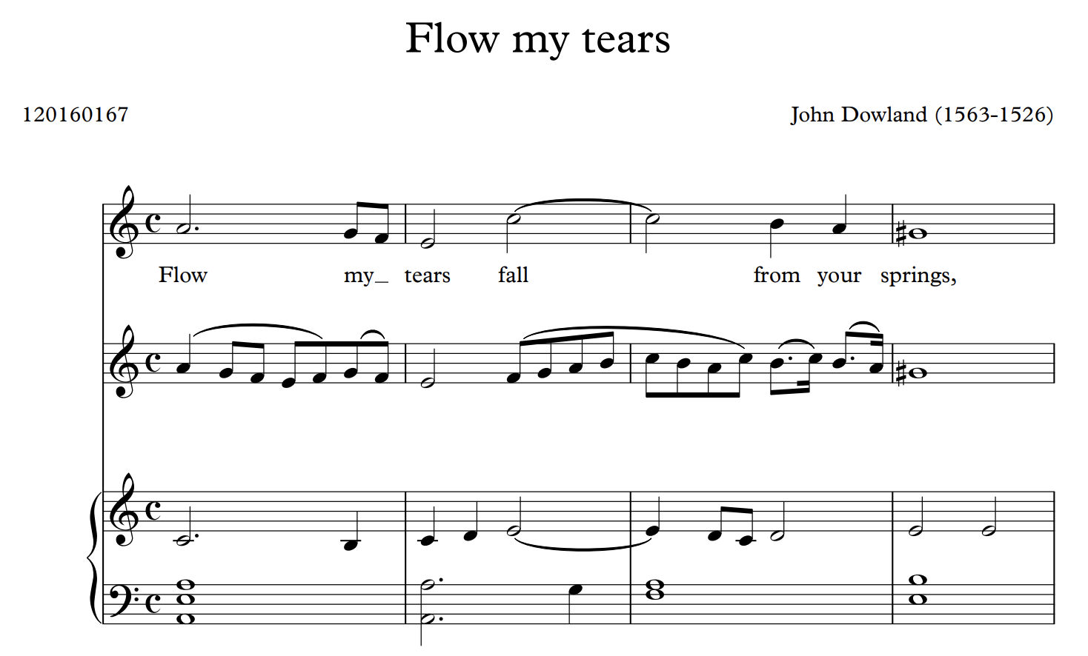
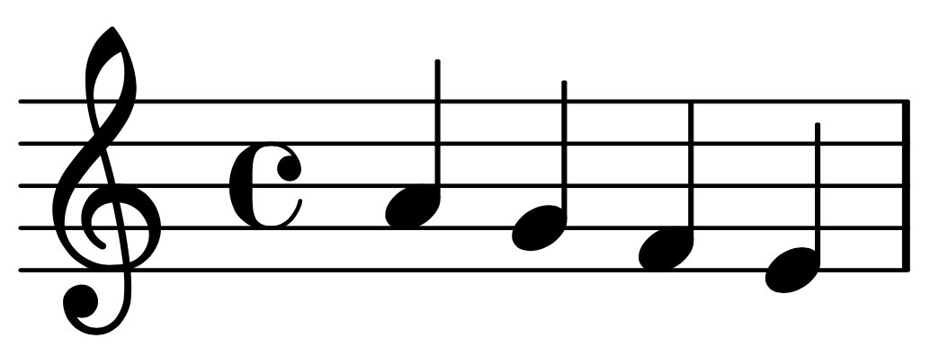
John Dowland, "Flow my tears"
Searching for "falling fourth" motif in 16th century lute music

Slide 47
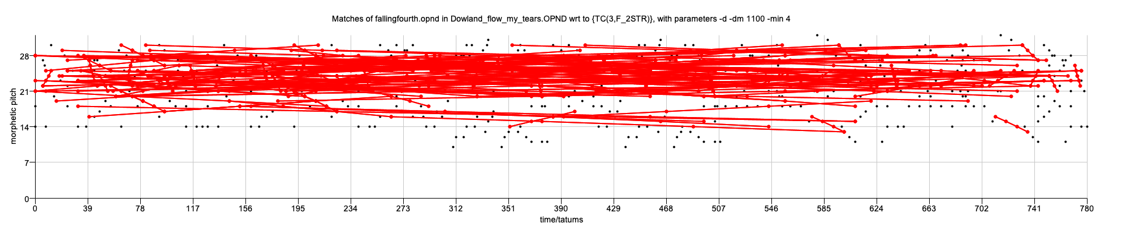
-minoc 0 (default)

Slide 48
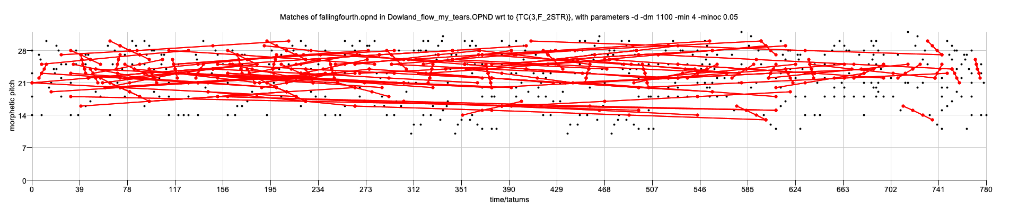
-minoc .05

Slide 49
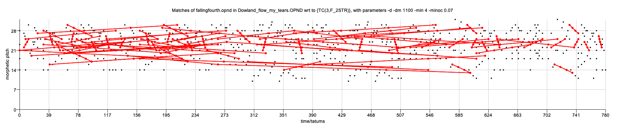
-minoc .07

Slide 50
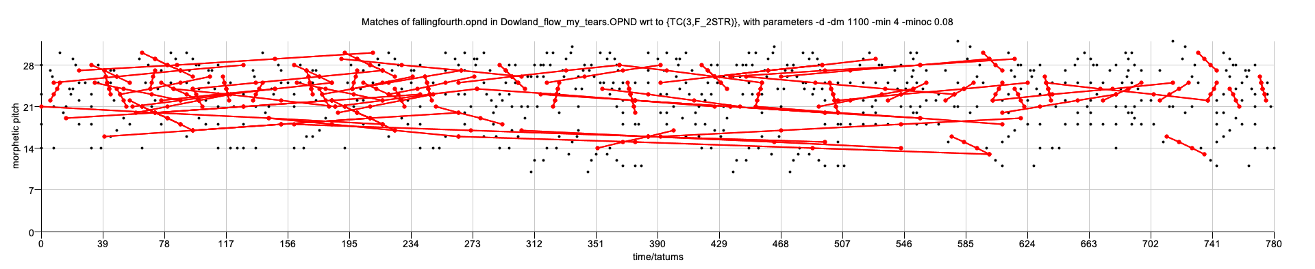
-minoc .08

Slide 51
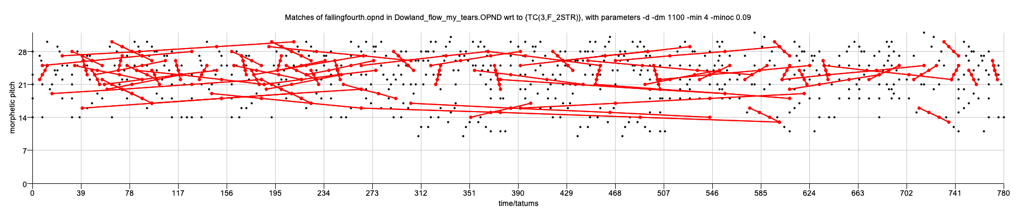
-minoc .09

Slide 52
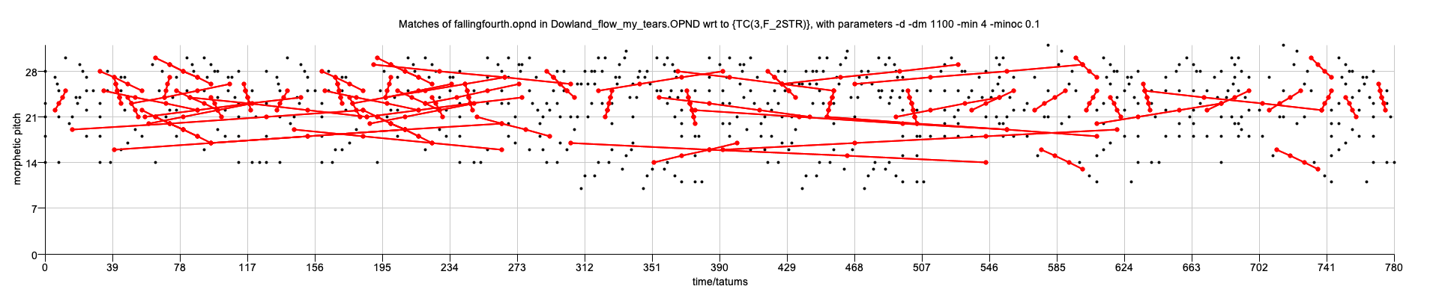
-minoc .1

Slide 53
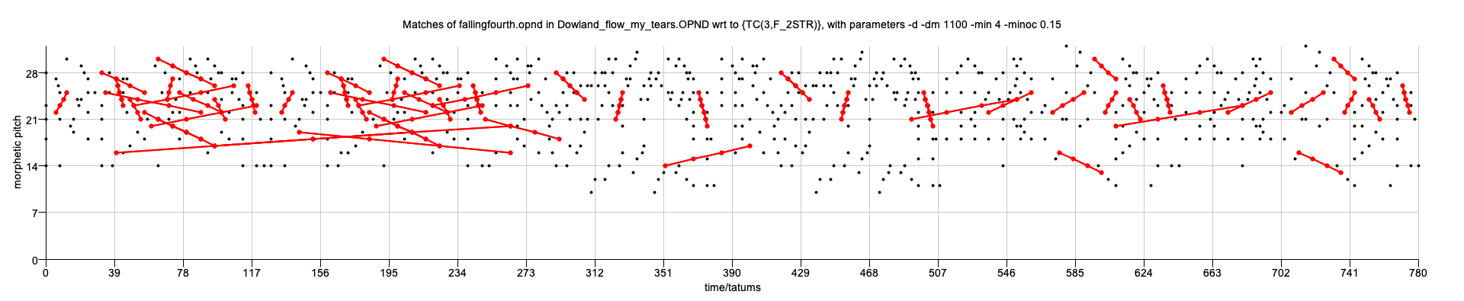
-minoc .15

Slide 54

-minoc .2

Slide 55

-minoc .3

Slide 56

-minoc .4

Slide 57

-minoc .5

Slide 58

-minoc .6

Slide 59

-minoc .7

Slide 60

-minoc .8

Slide 61

-minoc .9

Slide 62

-minoc 1.0

Slide 63

-min -1 -minoc 0.0

Slide 64

-min -1 -minoc 0.1

Slide 65

-min -1 -minoc 0.2

Slide 66

-min -1 -minoc 0.3

Slide 67

-min -1 -minoc 0.4

Slide 68

-min -1 -minoc 0.5

Slide 69

-min -1 -minoc 0.6

Slide 70

-min -1 -minoc 0.7

Slide 71

-min -1 -minoc 0.8

Slide 72

-min -1 -minoc 0.9

Slide 73

-min -1 -minoc 1.0

