Slide 1
WORKSHOP I: Interactive Technologies for Analysing and Visualizing Musical Structure
Computer-Assisted Analysis and Visualization
of 18th-Century Portuguese Keyboard Music
Mafalda S. Nejmeddine
CESEM/IN2PAST - University of Évora, Portugal
Aaron Carter-Ényì
Morehouse College, USA

Slide 2
Aim
ATAVizM software
Analysis
Visualization
Formal structure
of
PORTUGUESE SONATAS

Slide 3
Methodology
1. COMPARISON
2. ASSOCIATION
Manual score analysis
SONATA THEORY of Hepokoski & Darcy (2006)
Musical performance
Computer-assisted symbolic music analysis
ATAVizM software
Arc diagram
ATAVizM software

Slide 4
Sample
Sonata forms | Sections | Composers | Pieces
PARALLEL BINARY | Exposition Recapitulation | A. Joaquim | Sonata in G major
TYPE 2 SONATA | Exposition Development – Tonal resolution | P. A. Avondano | Sonata in C major
TYPE 3 SONATA | Exposition Development – Recapitulation | F. X. Baptista | Sonata in G major, 1st mov.

Slide 5
ATAVizM – Pattern Discovery
(Algorithmic Thinking, Analysis and Visualization of Music)

Slide 6
ATAVizM – Pattern Discovery
(Algorithmic Thinking, Analysis and Visualization of Music)

Slide 7
ATAVizM – Pattern Discovery
(Algorithmic Thinking, Analysis and Visualization of Music)

Slide 8
ATAVizM – Pattern Discovery
(Algorithmic Thinking, Analysis and Visualization of Music)

Slide 9
ATAVizM – Pattern Discovery
(Algorithmic Thinking, Analysis and Visualization of Music)

Slide 10
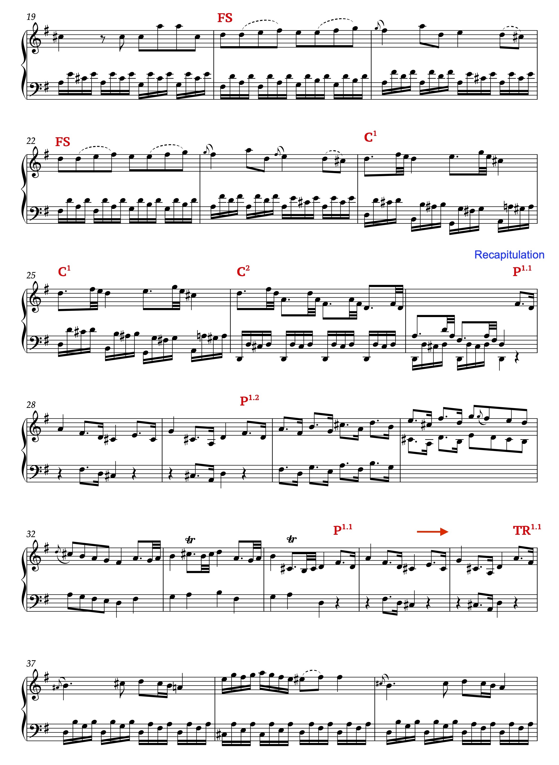
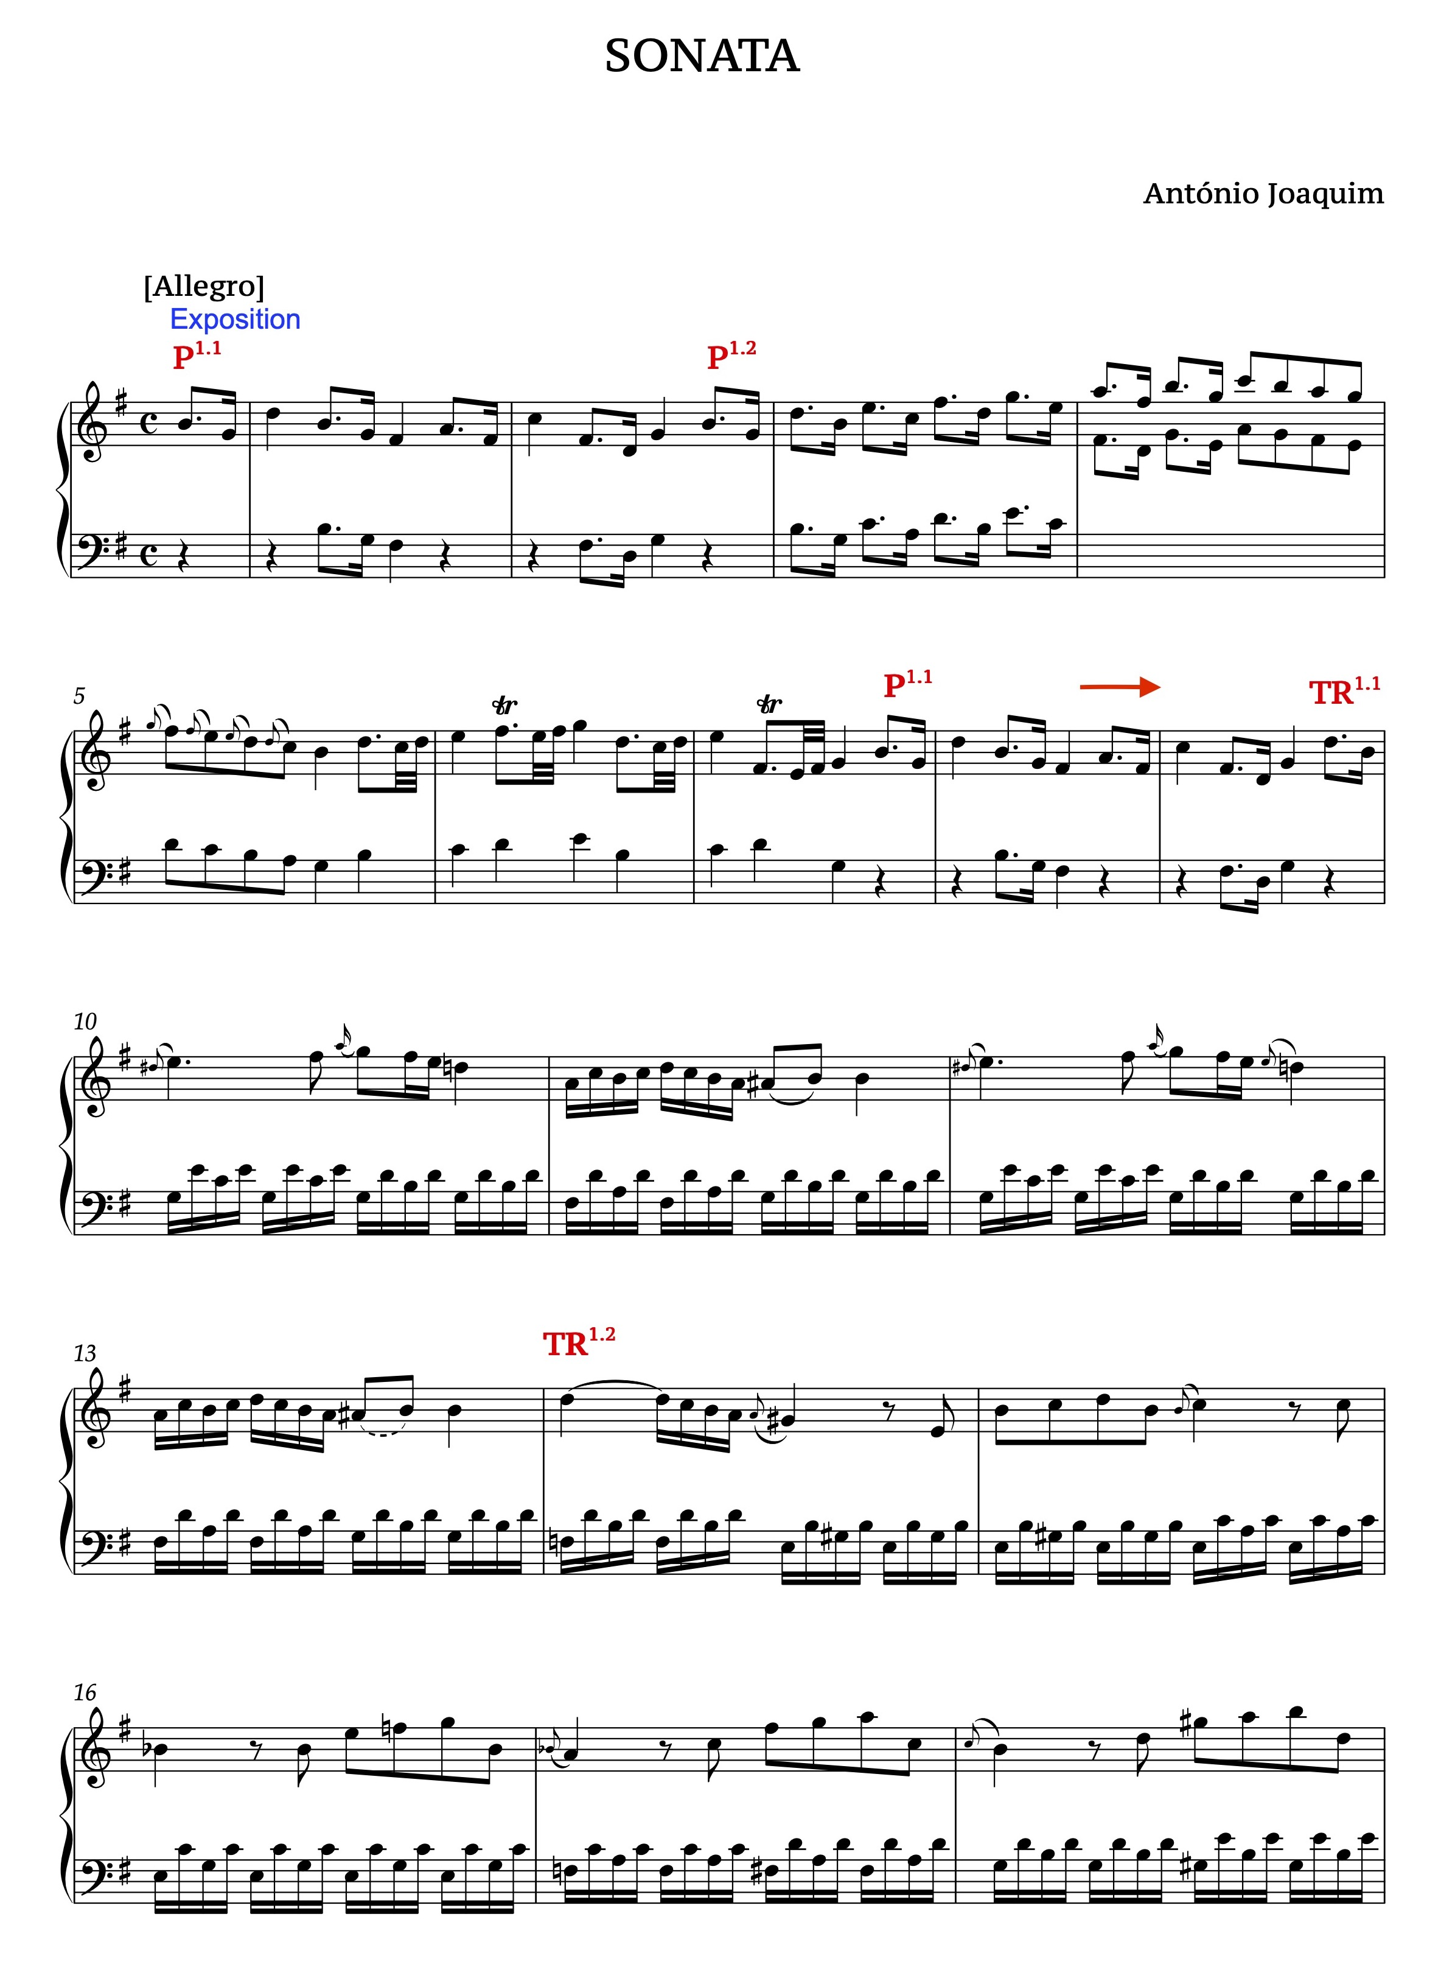
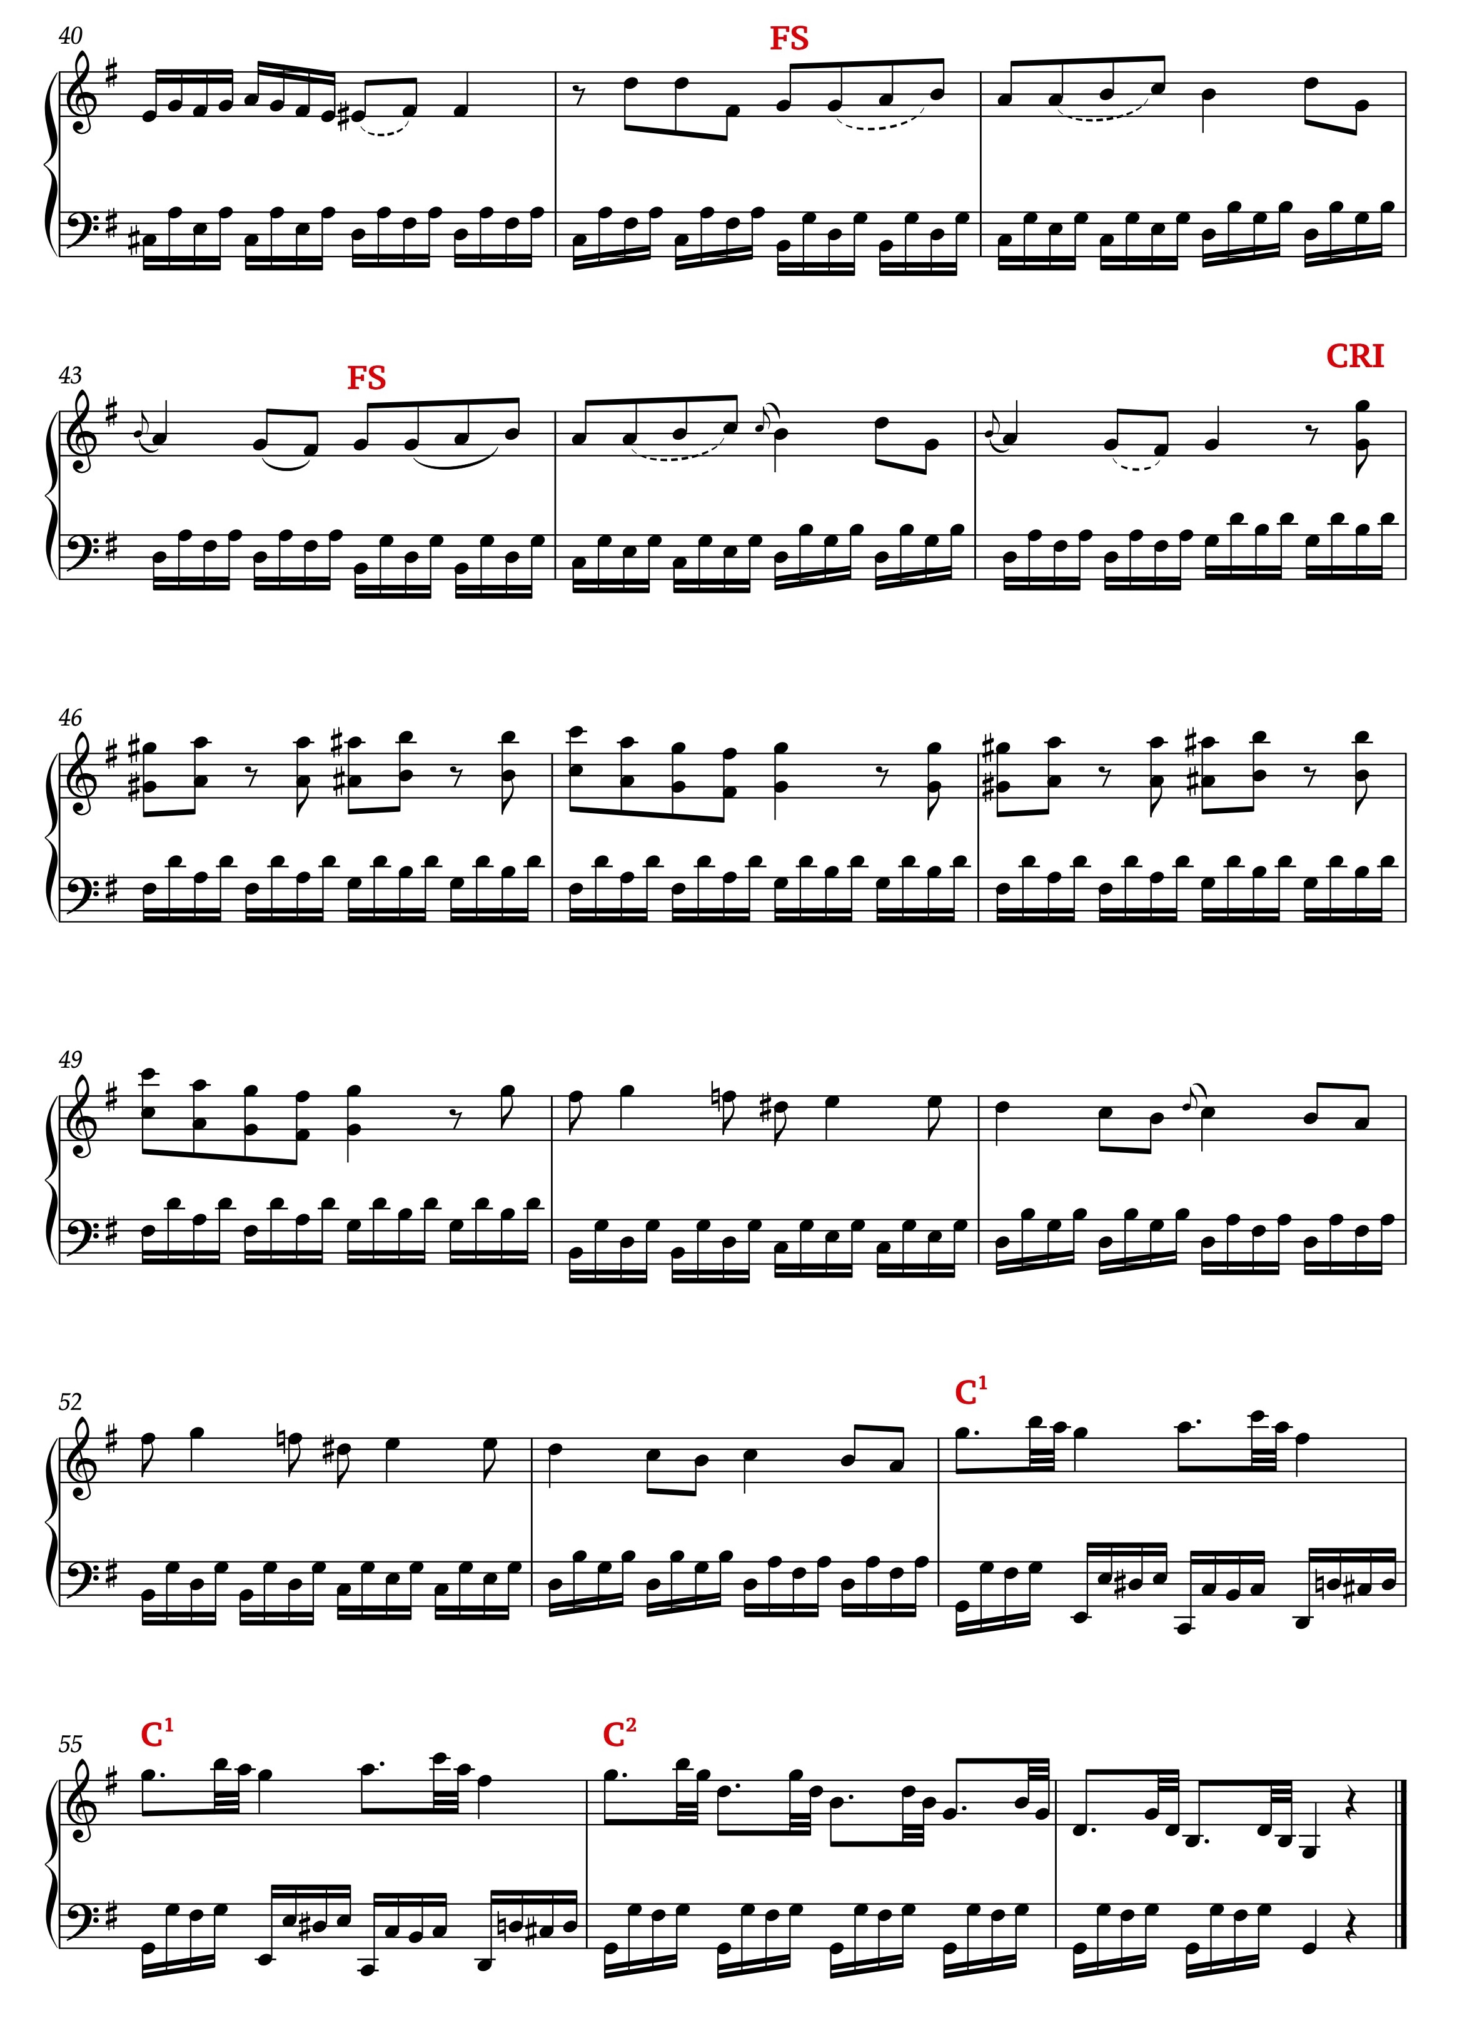
Parallel Binary -------- Manual score analysis

Slide 11
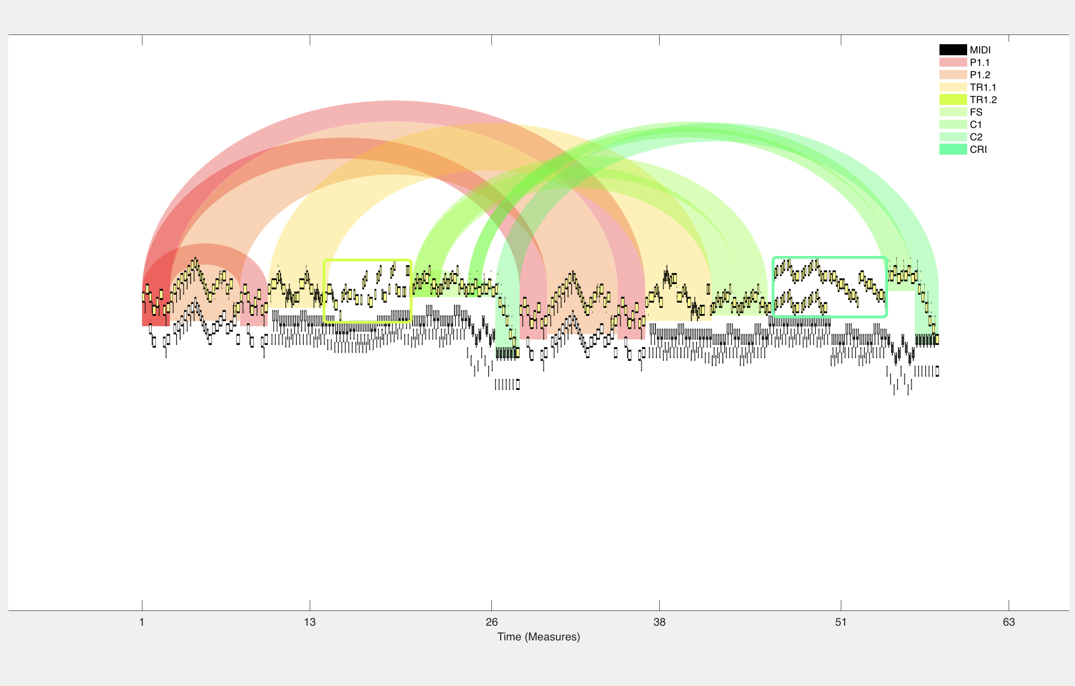
Parallel Binary -------- Computer-assisted symbolic music analysis

Slide 13
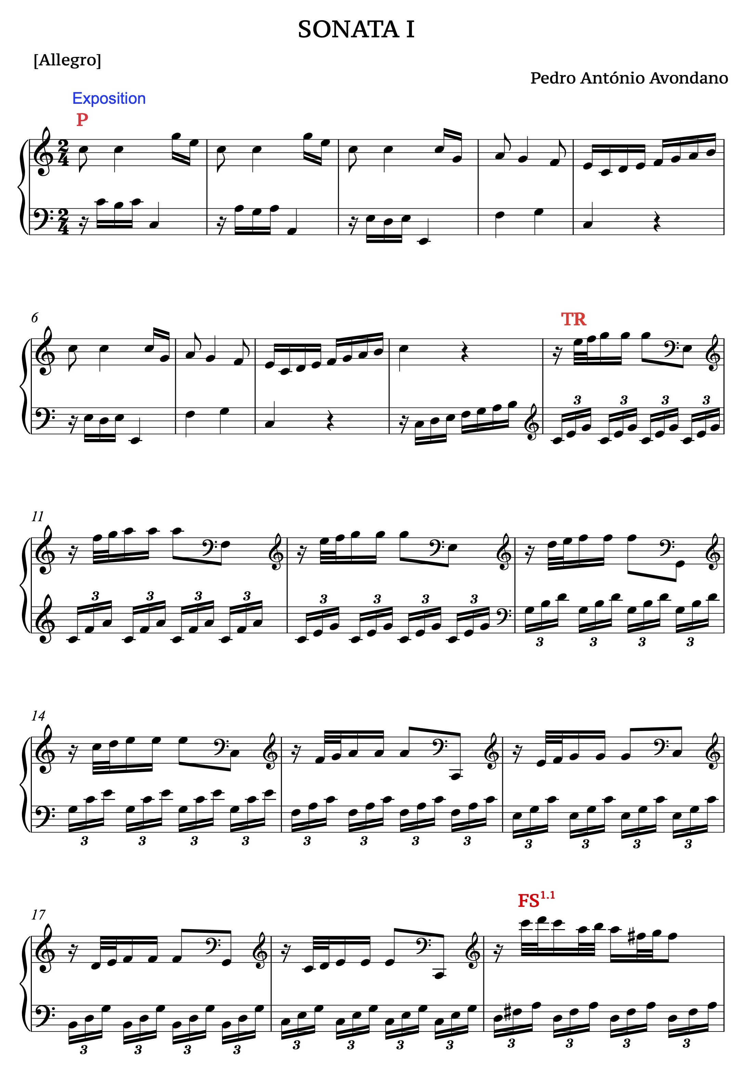
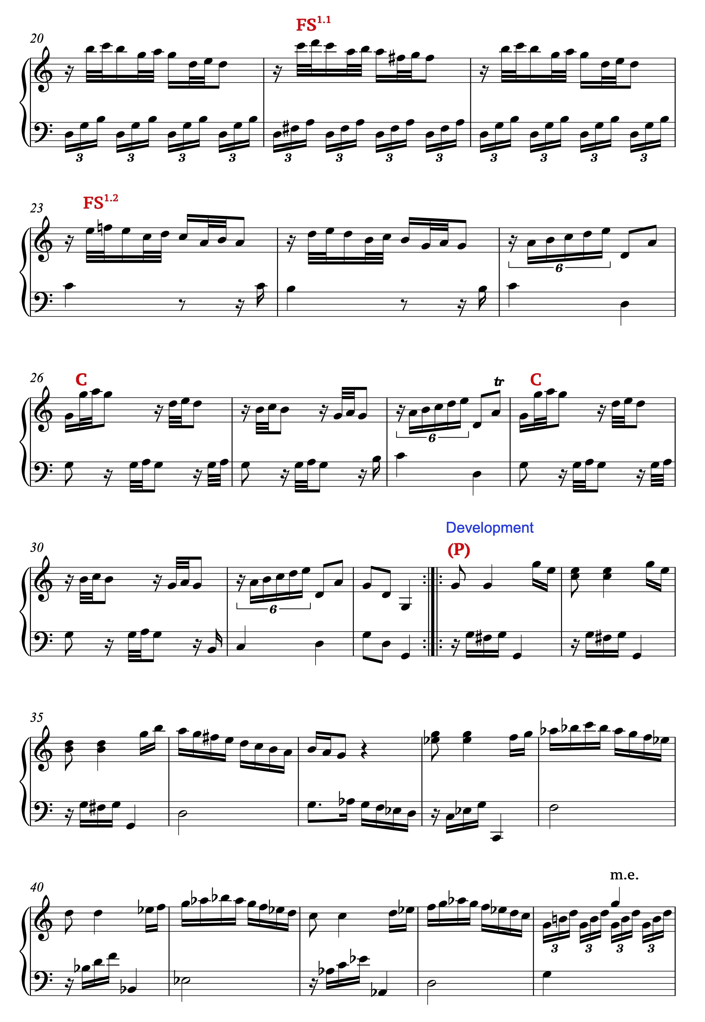
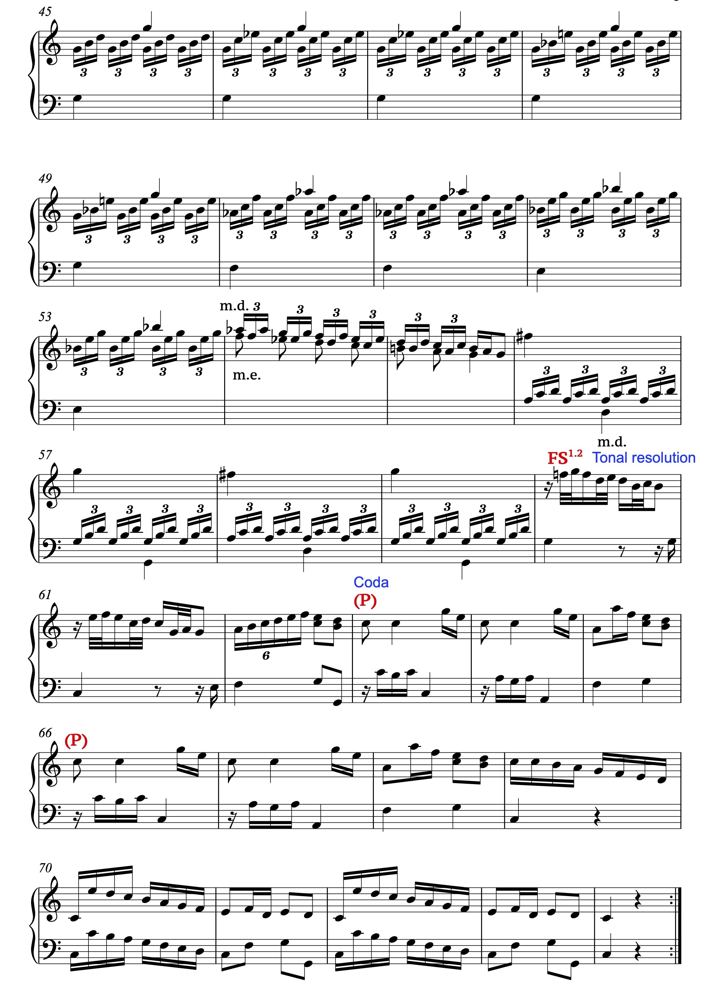
TYPE 2 SONATA -------- Manual score analysis

Slide 14
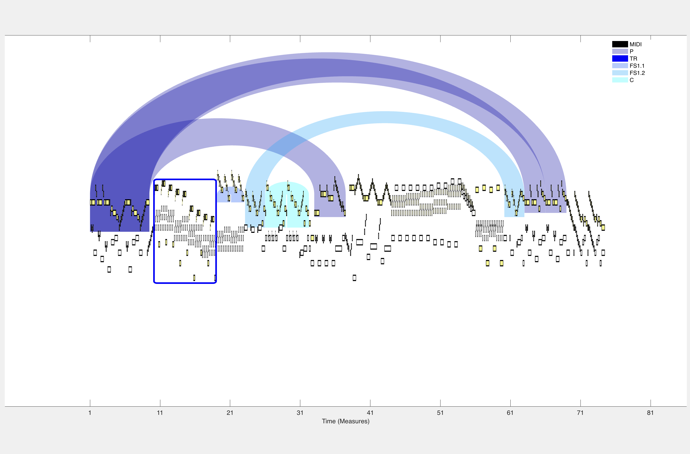
TYPE 2 SONATA -------- Computer-assisted symbolic music analysis

Slide 16
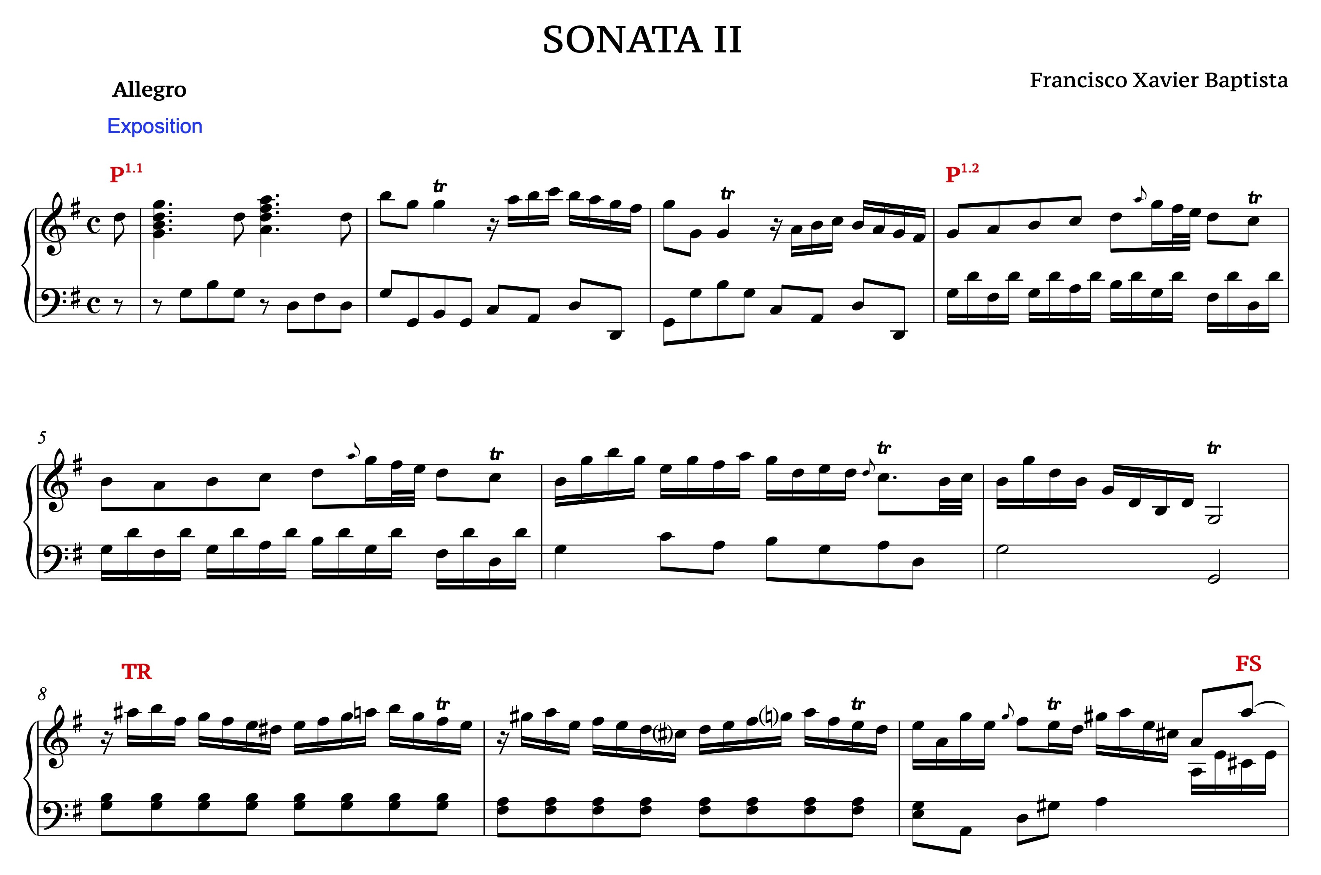
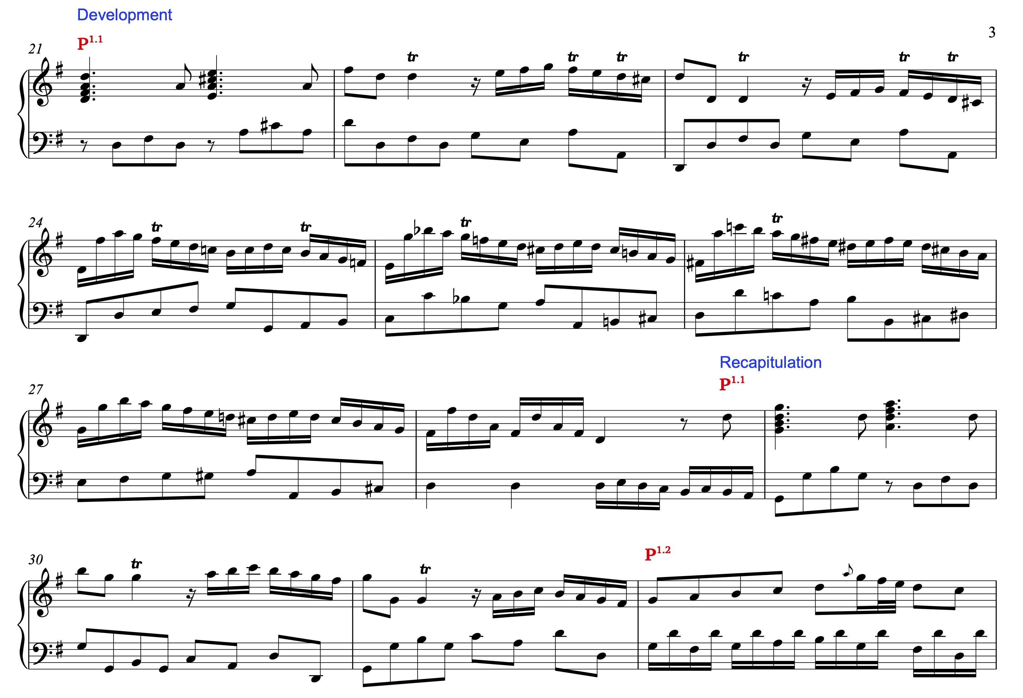
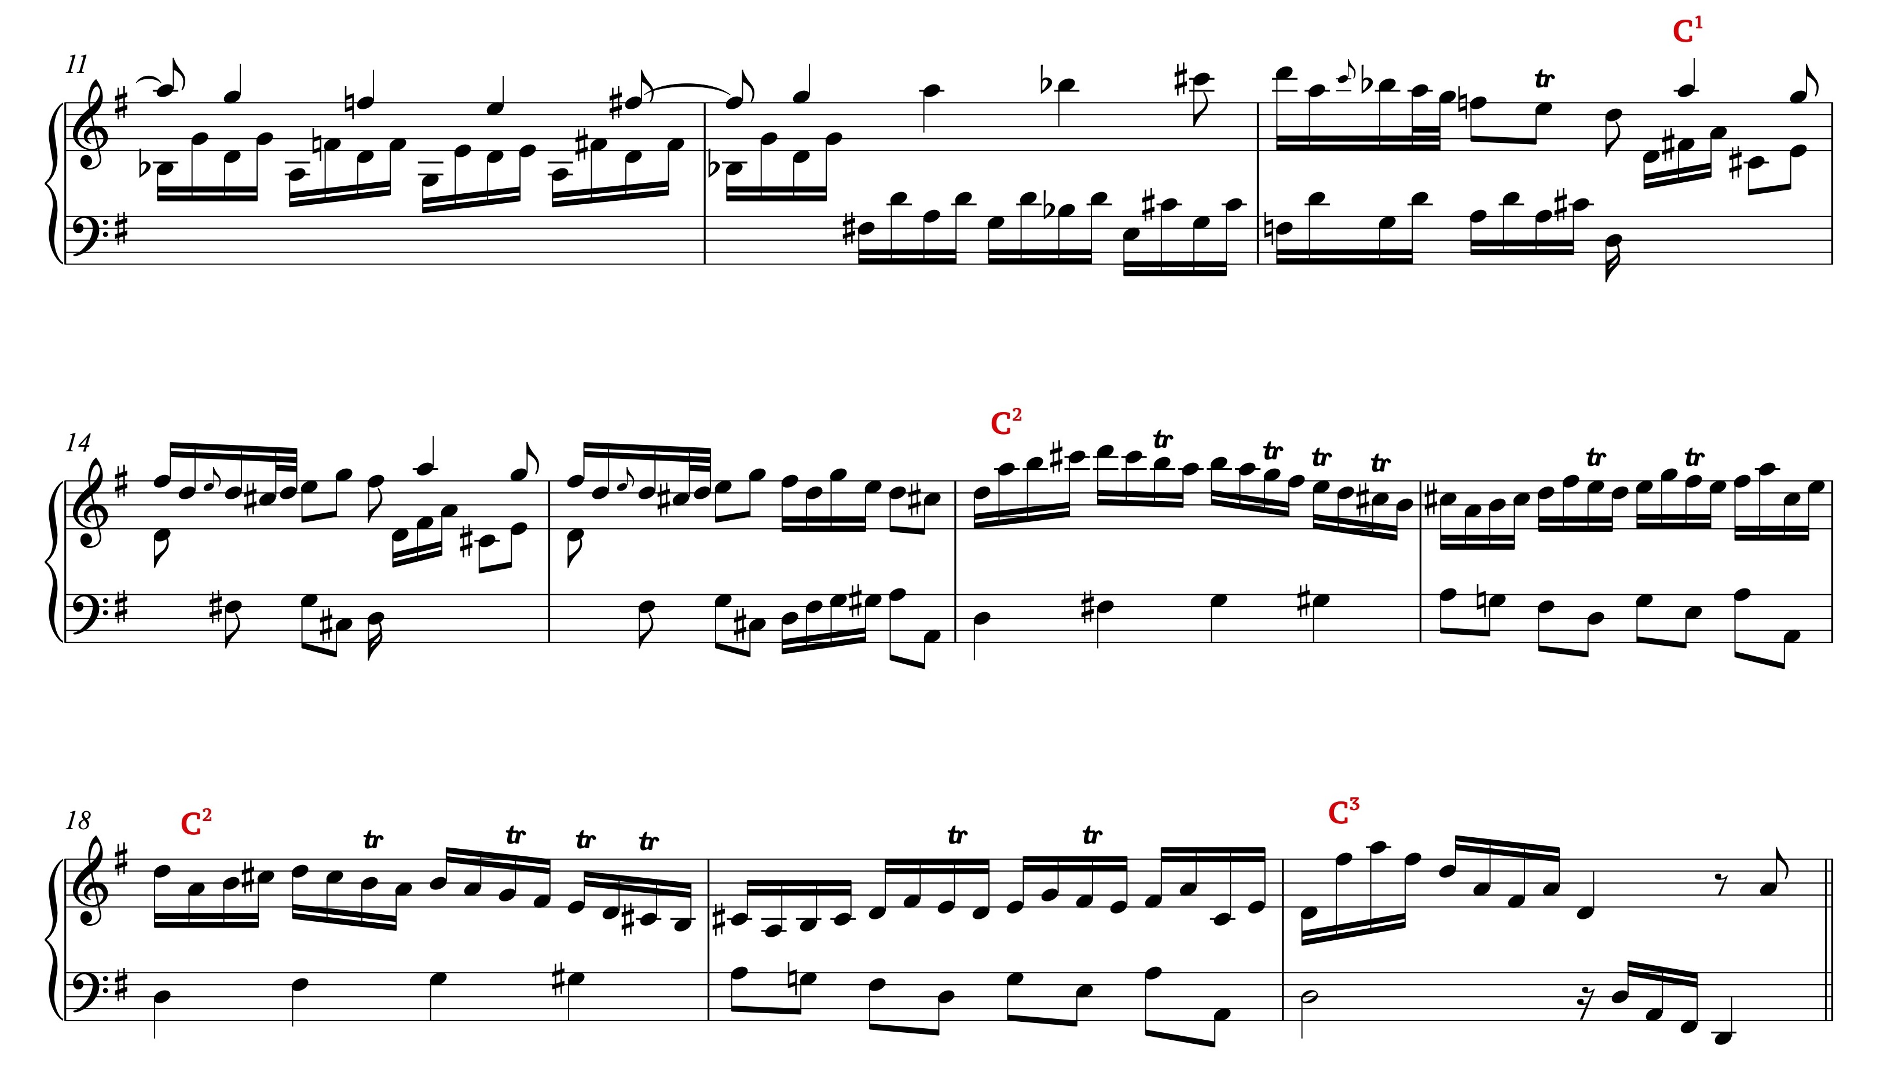
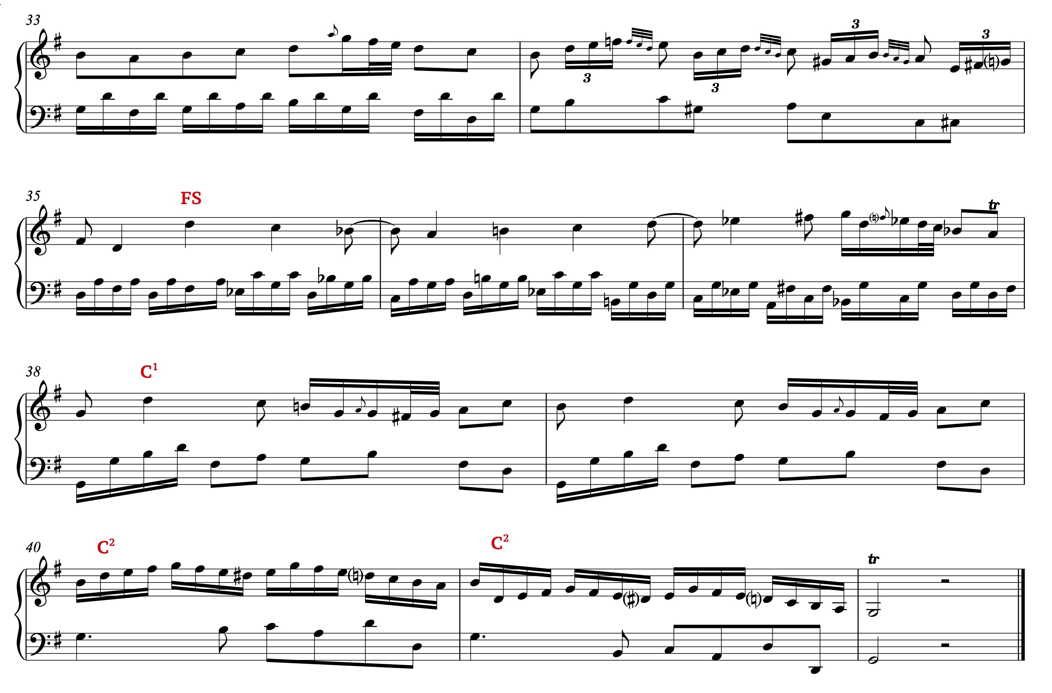
TYPE 3 SONATA -------- Manual score analysis

Slide 17
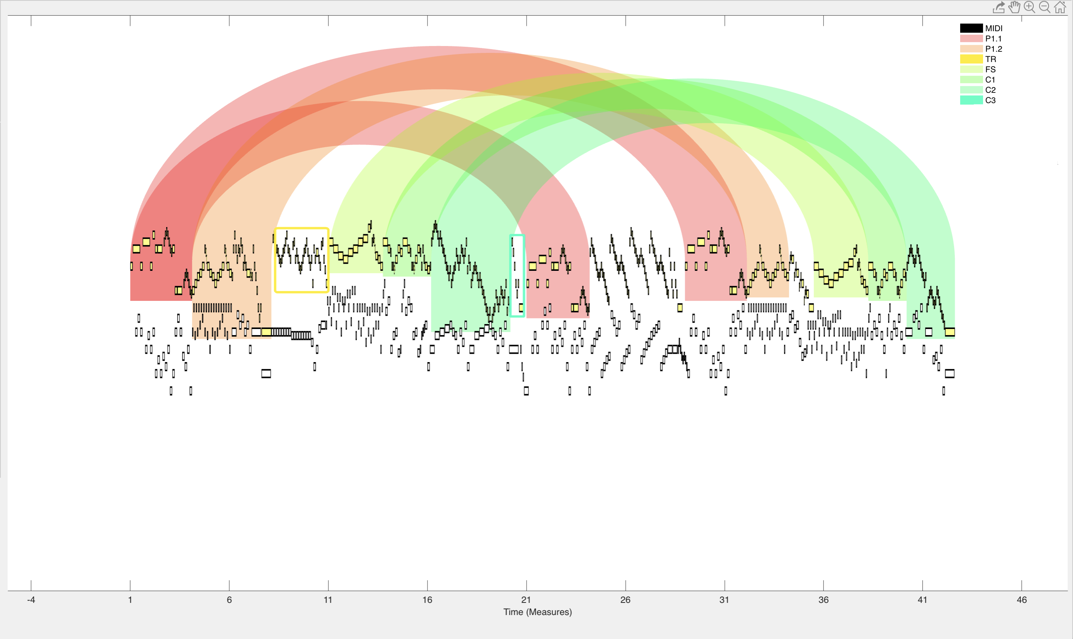
TYPE 3 SONATA -------- Computer-assisted symbolic music analysis

Slide 19
Conclusions
1. The comparison between the manual score analysis based on Hepokoski & Darcy's Sonata Theory and the computer-assisted symbolic music analysis provided by ATAVizM software showed that this software is suitable for reproducing the formal structure of Portuguese sonatas from the 18th century, as it clearly displays the sections and modules of sonata forms.
2. The association of the arc diagram produced using ATAVizM software with the musical performance of Portuguese sonatas helped to better understand their sonata forms, making the ATAVizM software an important tool for the analysis and visualization of the formal structure of the Portuguese keyboard repertoire of the 18th century.

Slide 20
Thank you!
MAFALDA S. NEJMEDDINE
msasfn@uevora.pt
AARON CARTER_ÉNYÌ
Aaron.Carter-Enyi@morehouse.edu

