Slide 1
Preliminary Report on Gathering a Larger Annotated Dataset for Pattern Discovery Tasks
Klara Žnideršič, Iris Y. Ren, Anja Volk, Matevž Pesek

Slide 2
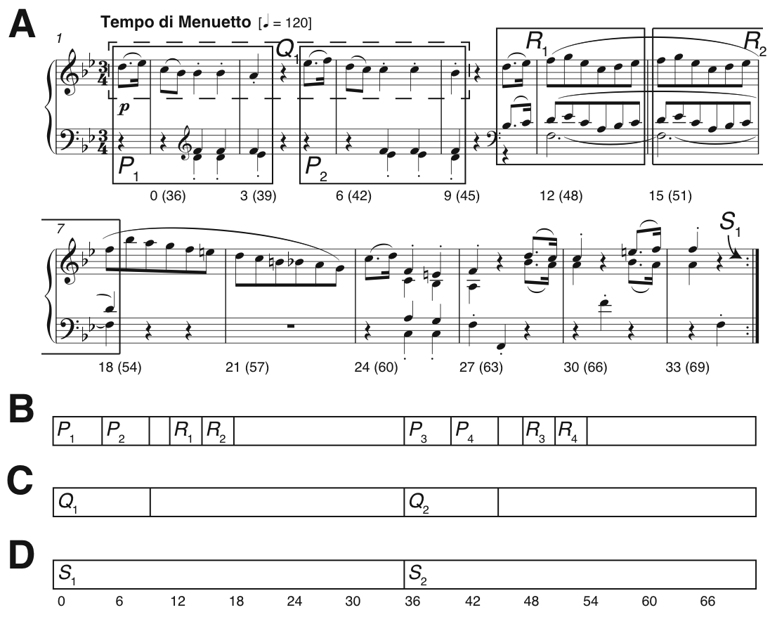
Pattern discovery
Since ~2013 @ MIREX
Johannes Kepler University Patterns Development/Test Databases
5 songs in each dataset
Four subtasks
symPoly, symMono (converted)
audPoly, audMono
Small group of participants

Slide 3
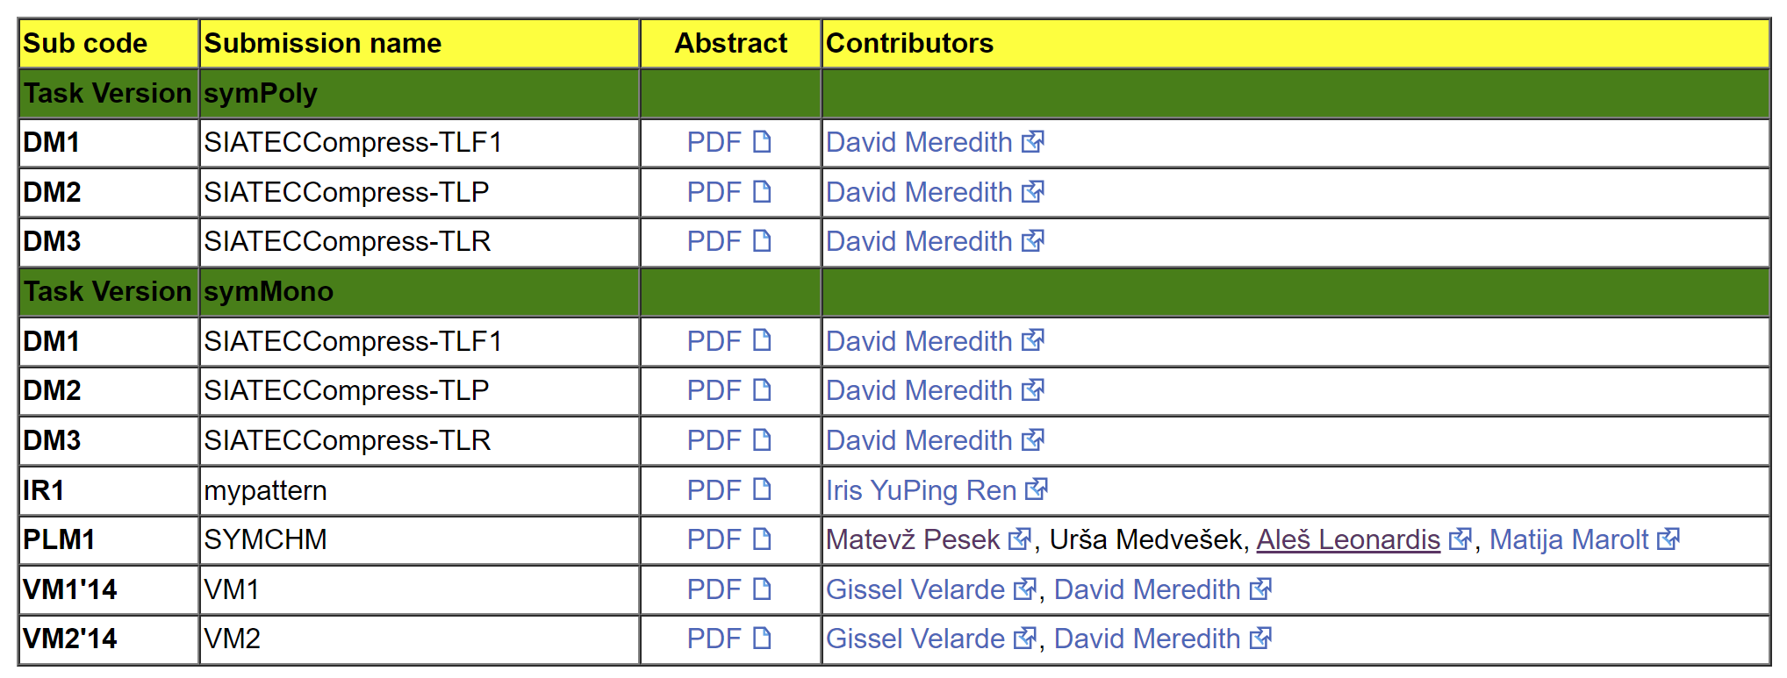
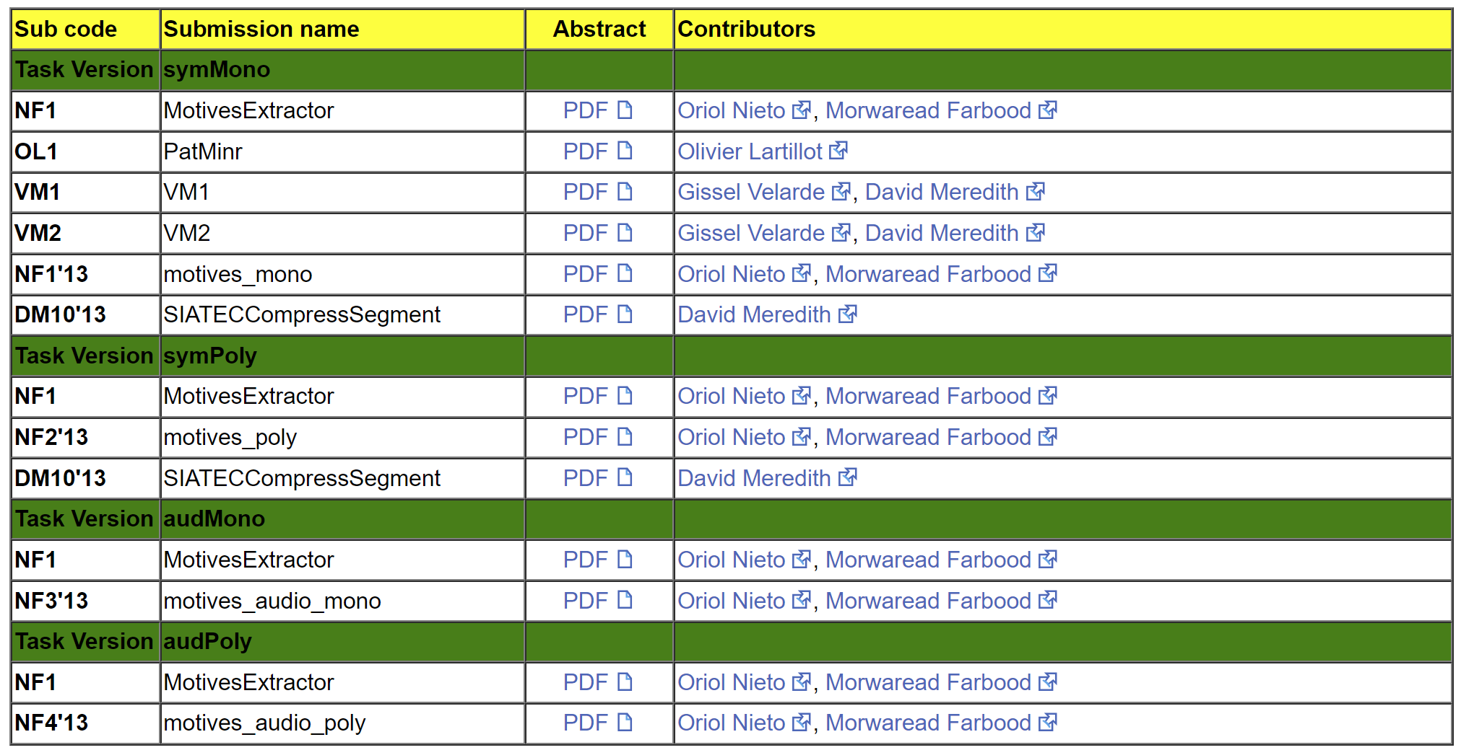
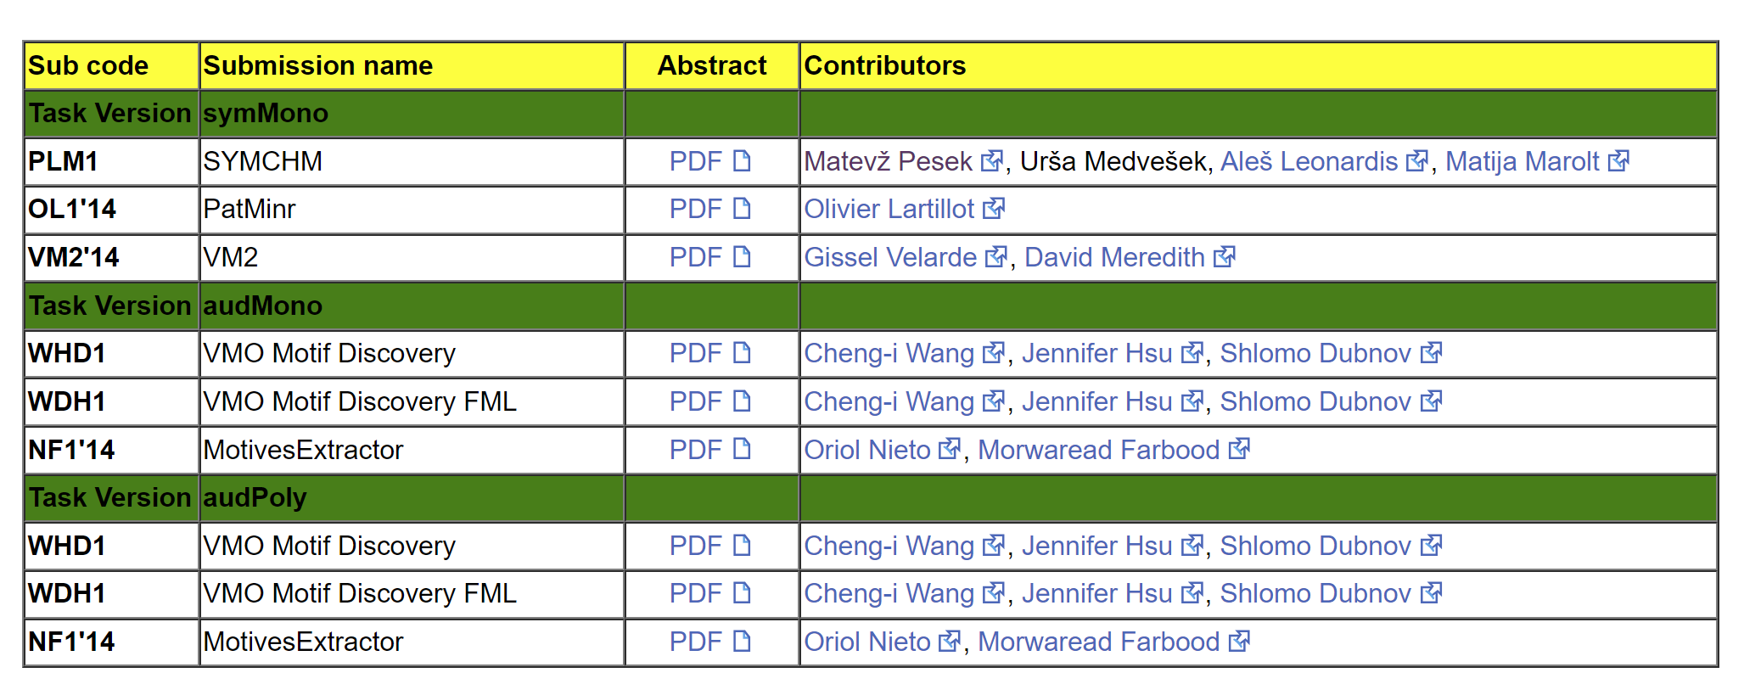
Following years
Still a small group of participants
Limitations of the JKU-PDD (5 songs)
Interest remains, but the task is somehow limited
spin-off task -> Patterns for prediction
Two subtasks
(explicit) - matching algo’s prediction with original
(implicit) – providing probability of the given continuation being genuine

Slide 4
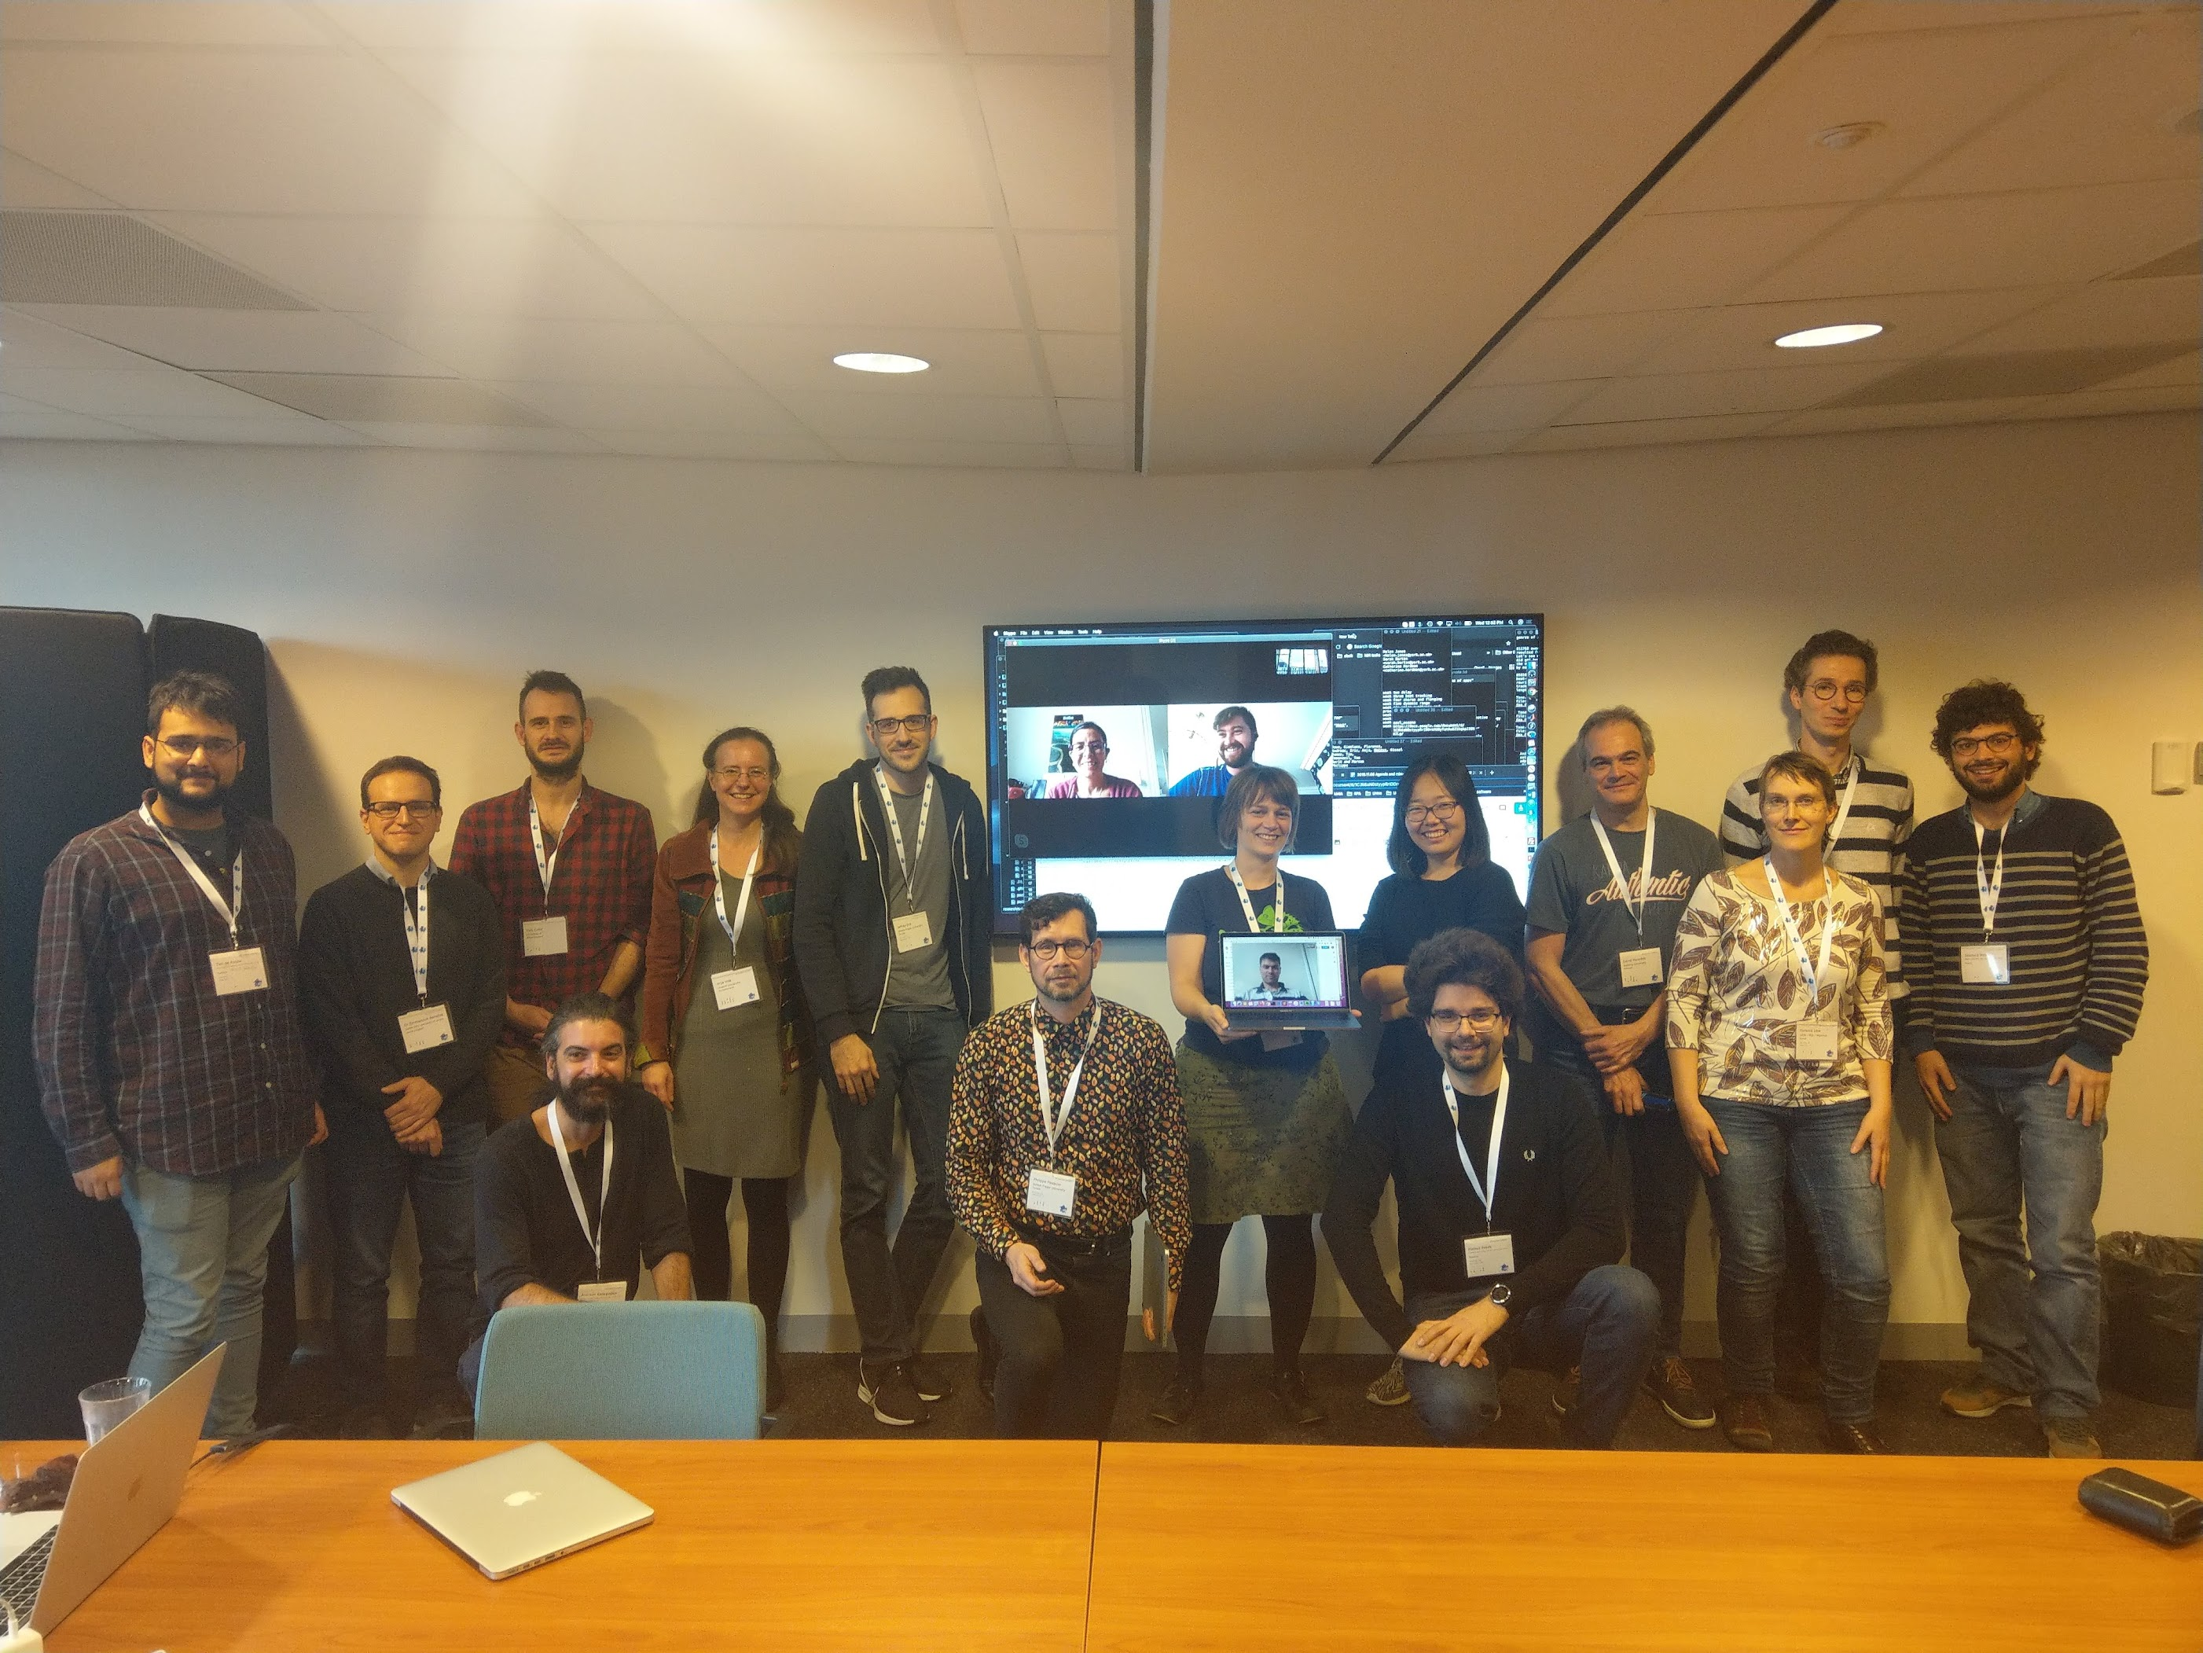
Rebooting the pattern discovery
Meetup at ISMIR 2019
Mostly researchers who submitted to MIREX tasks
High interest remained
Patterns for prediction task

Slide 5
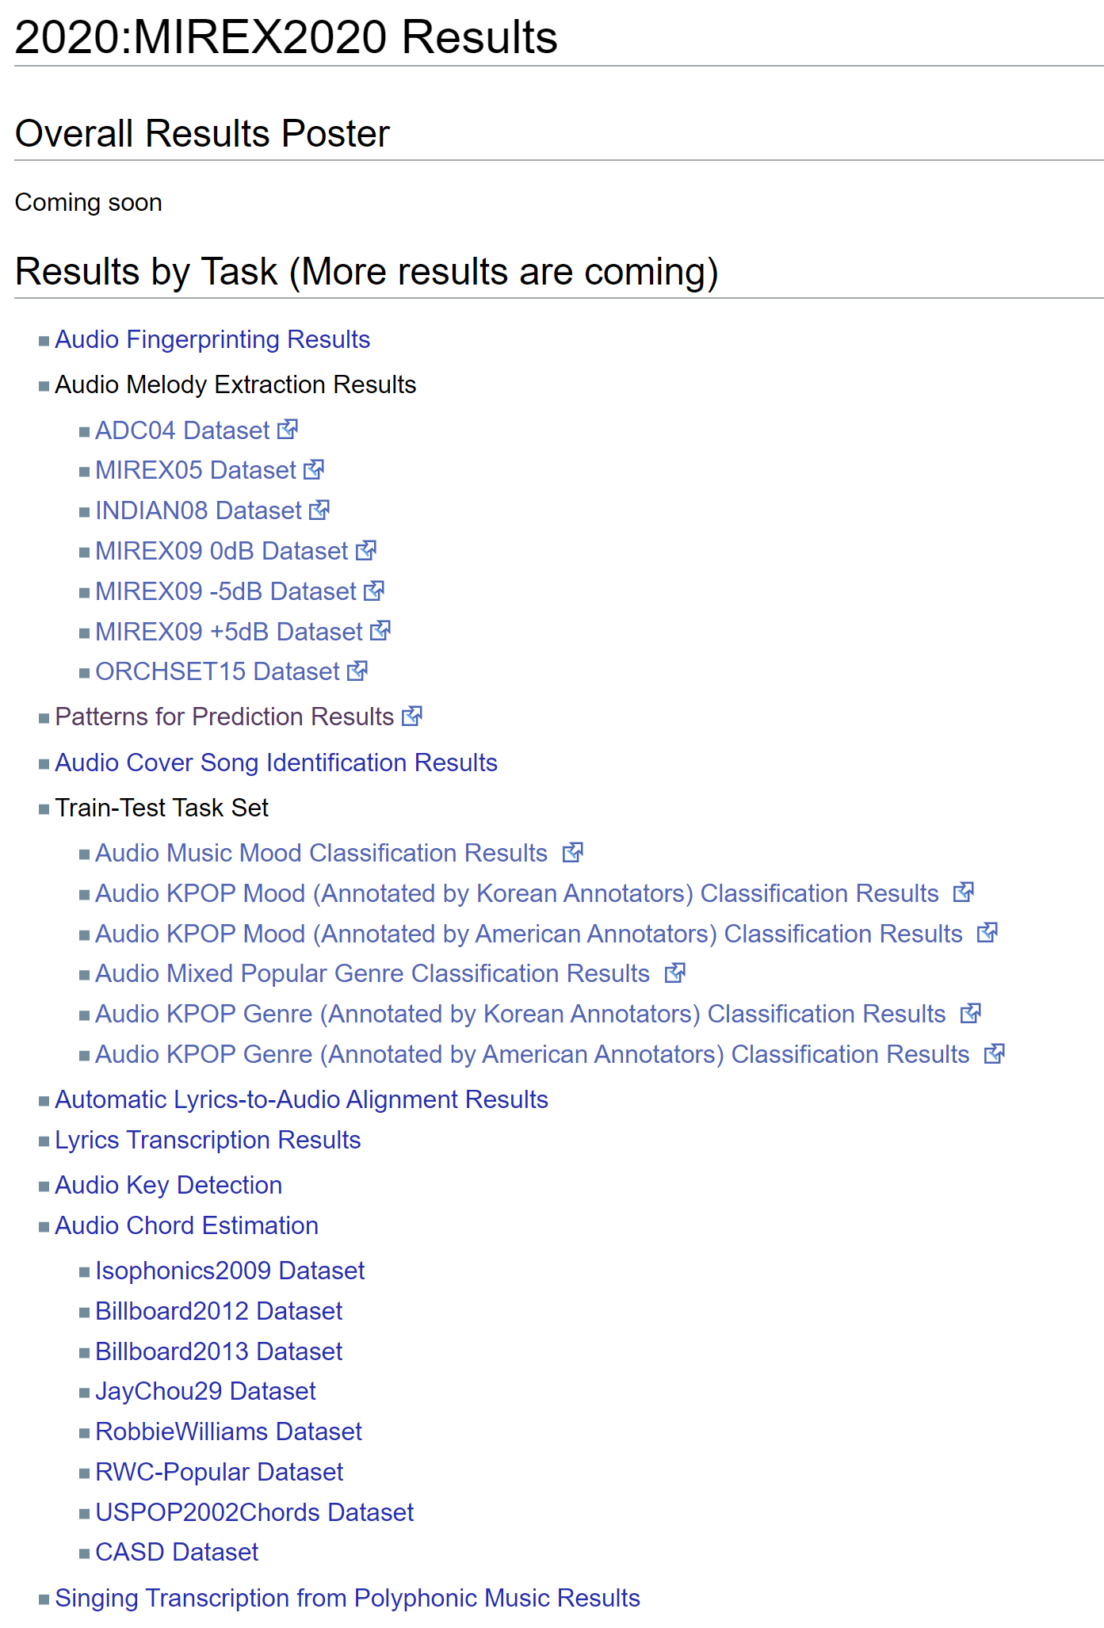
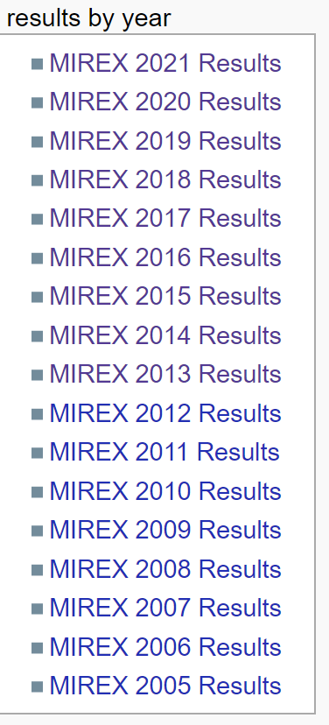
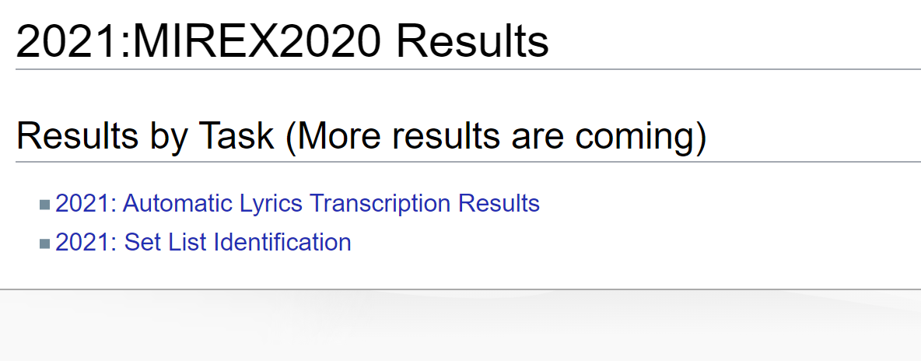
What happened?
Covid-19
Less tasks in 2020
No Patterns for prediction or Pattern discovery tasks in 2021
No MIREX tasks in 2022
Stephen Downie – interest, finances, infrastructure issues

Slide 6
However …
Activity (and hope) remains!
Submissions to ISMIR 2022/23
SIATEC-C: Computationally efficient repeated pattern discovery in polyphonic music (Björklund)
Active publications by “members” of the former Pattern discovery task
Understanding and Compressing Music with Maximal Transformable Patterns (Meredith) - 2021
Exploring annotations for musical pattern discovery gathered with digital annotation tools (Tomaševič et al.) – 2021
A Computational Evaluation of Musical Pattern Discovery Algorithms (Ren et al.) – 2020
A Comparison of Human and Computational Melody Prediction Through Familiarity and Expertise (Pesek et al.) - 2020

Slide 7
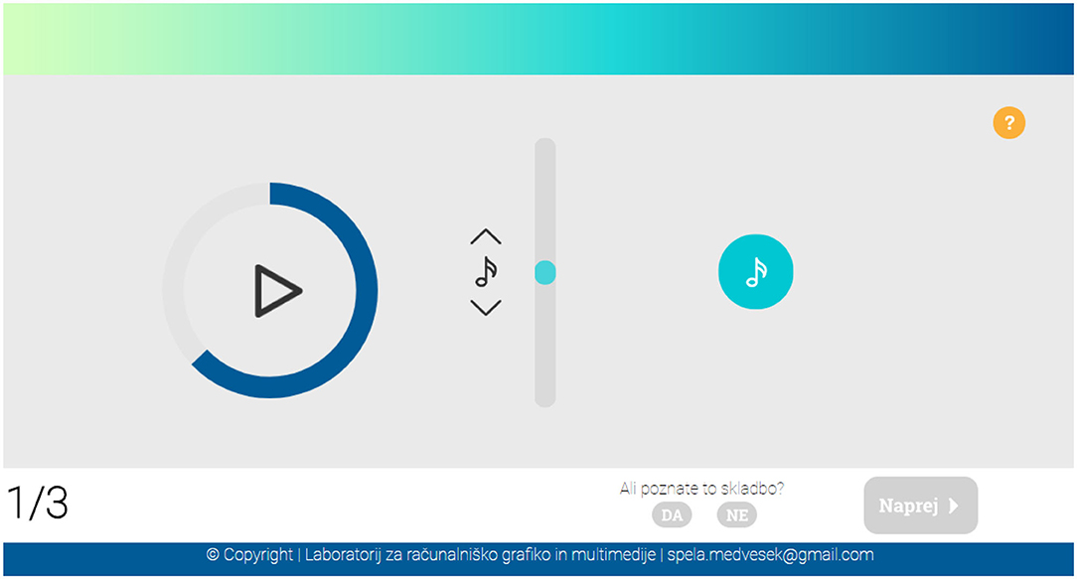
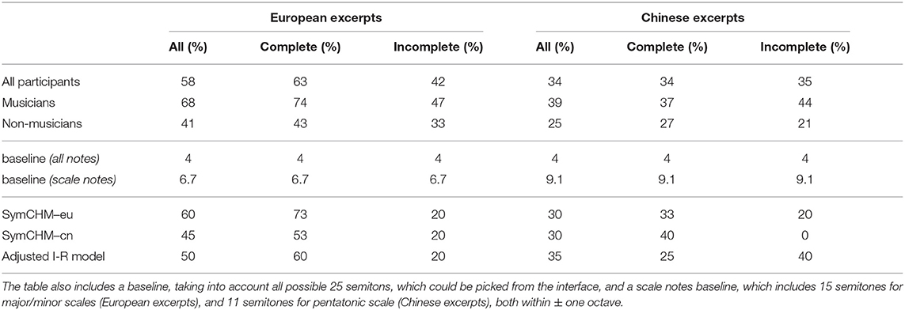
Similar topics - prediction
Predicting melody continuation
European and Chinese folk song datasets
Complete and incomplete sequences
Predicting the next note in a melodic sequence (57 participants)
Using of SymCHM model for prediction
Comparing to human participants (musicians/non-musicians)
Residual results
Slovenian translation and validation of MSI instrument (231 participants)

Slide 8
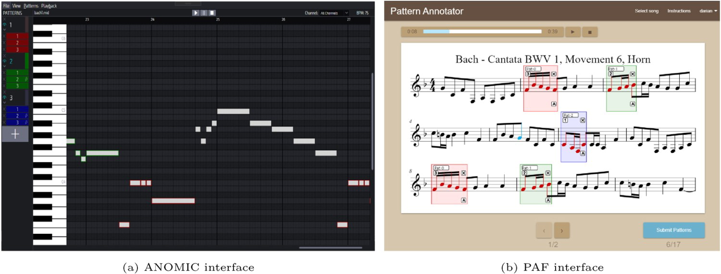
Similar topics - annotations
Brainstorming since 2019
Collecting multiple annotations -> inter-annotator agreement
Two tools (ANOMIC and PAF)
Nieto-Farbood (ANOMIC) Dataset
Bach, Beethoven, Haydn, Mozart (6 pcs)
13 (PAF) + 26 (Anomic) students
4 Musicology (MU), 3 Theory and composition (TC), 6 Pedagogy (PE)

Slide 9
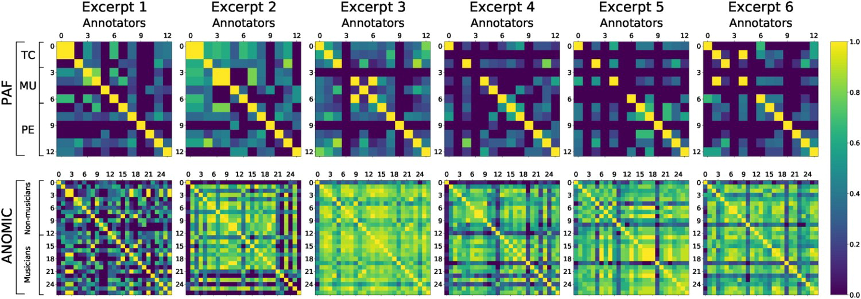
Results

Slide 10
What the #3&% is a pattern?
We all know there are patterns (or do we?)
What defines them? Why do they differ between different experts?
How is the expert’s background influencing their perception of a pattern?
Expertise, familiarity, instrument, other social aspects
Should we consider all patterns (simultaneously)?
What goal(s) should the algorithms pursue?

Slide 11
Comparing differences
Different interfaces
Music notations vs. piano roll
Standalone vs. web
Different student groups
Different background, similar age (i.e. experience)
Different annotations
Pattern importance, naming

Slide 12
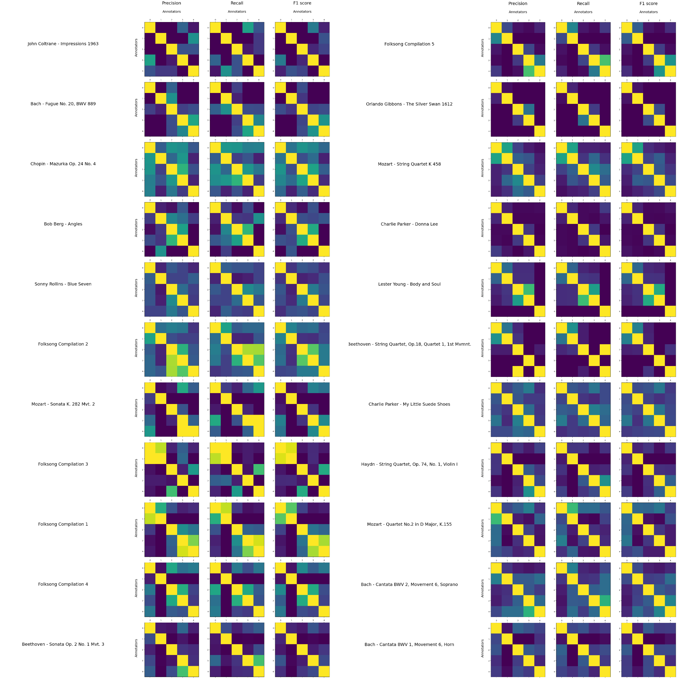
What’s with the inter-annotator agreement?
Should we consider all results as reference annotations concurrently?
Should we compare results to annotator groups (education, instrument, years of experience/profession)?
How do we take these findings into consideration?

Slide 13
The idea
We need a bigger dataset
More songs
More diverse
We need more annotators
Big (enough) group/s
Willpower (or financial motivation) to annotate that bigger dataset

Slide 14
The dataset
Retaining the comparability with the previous task
JKU-PDD - 5 songs
Excerpts (used for ANOMIC/PAF comparison) – 6 songs
Novelty
Jazz excerpts – 6 songs
Folk songs – 5 songs (each includes 6 variants within tune family, concatenated)
Potentially missing
Modern popular genres
(Maybe) more constrained pattern definition

Slide 15
The annotators
Five annotators (2F, 3M; 20-25 years old)
Musicology masters programme
14 - 30 days for annotations per annotator (may – dec 2022)
Financial motivation (student work)

Slide 16
Preliminary results
4026 patterns/occurrences in 22 songs
2.1 pattern occurrences per song
Max per annotator: 36, 19, 19, 6, 16
Average pattern duration: 8.18 notes
Pattern types:
Transformations - prime forms, inversions, retrograde, retrograde inversions (annotated explicitly)
Sub-patterns (explicitly marked)

Slide 17
Inter-annotator agreement

Slide 18
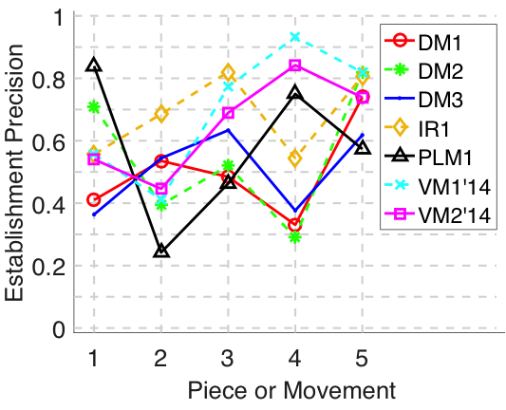
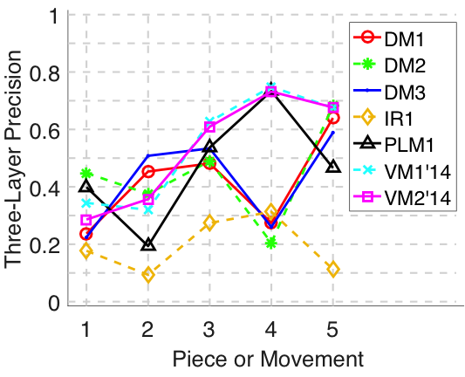
Immediate steps
Cleaning up the data
Connect differently-named patterns as single entities (complex issue, i.e. subpatterns, types etc)
Inter-annotator agreement analysis
Outlier identification, comparison of previous pattern annotations of included sub-sets
Identifying the “common ground” within a (relatively) non-diverse group
Using the data to evaluate (existing) approaches to pattern discovery
Contact MIREX task authors and evaluate their approach using the standard metrics

Slide 19
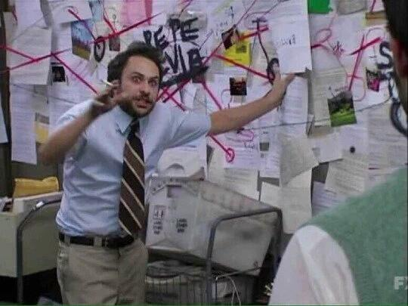
Further steps
Figuring out the adjusted metrics - how to include dis/agreement?
Fitting the algorithm’s output to one annotator group (experience, background)
Getting another group of annotators
Financial limitations and time consumption
Further enlarging the dataset
Time/finance, access to groups …

Slide 20
Looking forward to share the dataset and (re)evaluate algorithms!
Klara Žnideršič, Iris Y. Ren, Anja Volk, Matevž Pesek
matevz.pesek@fri.uni-lj.si / matevz.pesek@gmail.com

