Slide 1
Dynamic visualisation
of fugue analysis
demonstrated in a live concert by the Danish String Quartet
Olivier Lartillot, MIRAGE project University of Oslo, RITMO Centre for Interdisciplinary Studies in Rhythm, Time and Motion, Norway

Slide 2
Overview
Dynamic visualisation to guide (non-expert) listeners, to better enjoy richness
Fugues, and the particularity of Bach’s Contrapunctus 14
String quartet: real time pitch tracking
Visualisation strategy based on “dynamic paradigmatic analysis”
Concert experiment, with Danish String Quartet, and online follow-up xp
Computationally automated fugue analysis: pattern mining

Slide 3
Visualisation principles
Tool to better understand and appreciate music
Easily understood, highly accessible, no music or technical expertise needed
Self-explanatory
Catch attention throughout the music
Dynamic visualisation conveying rapid and rich fluctuations
Avoid formalisation (music notation, abstract analysis formalisations)
Minimalist, functionalist aesthetics, to show the essential beauty of music

Slide 4
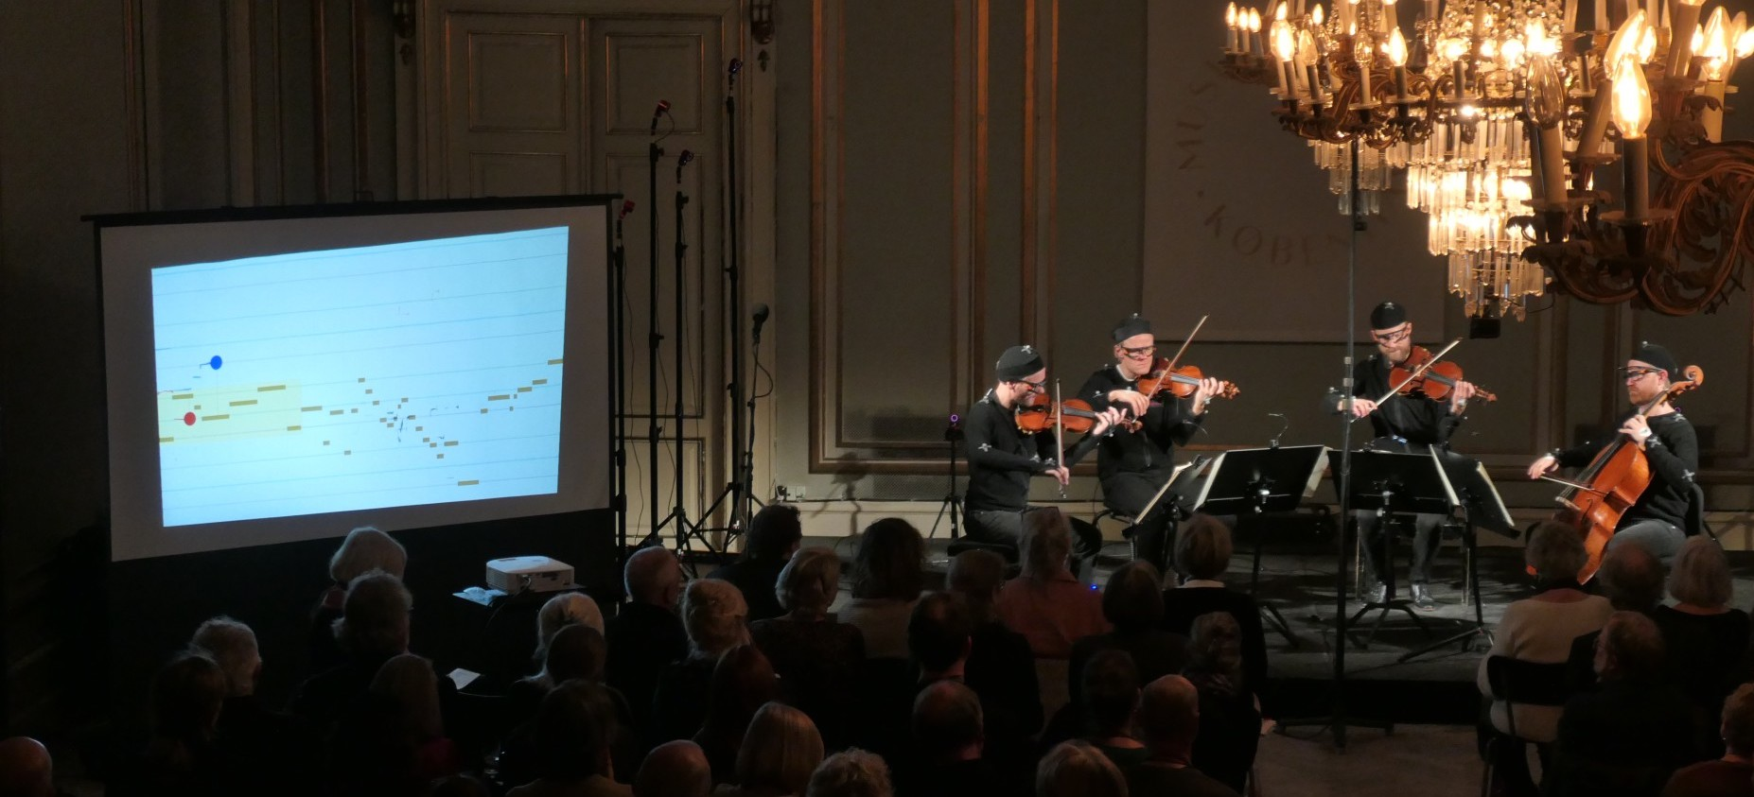
MusicLab Copenhagen concert, the Danish String Quartet
JS Bach’s Art of Fugue: Contrapunctus 14

Slide 5
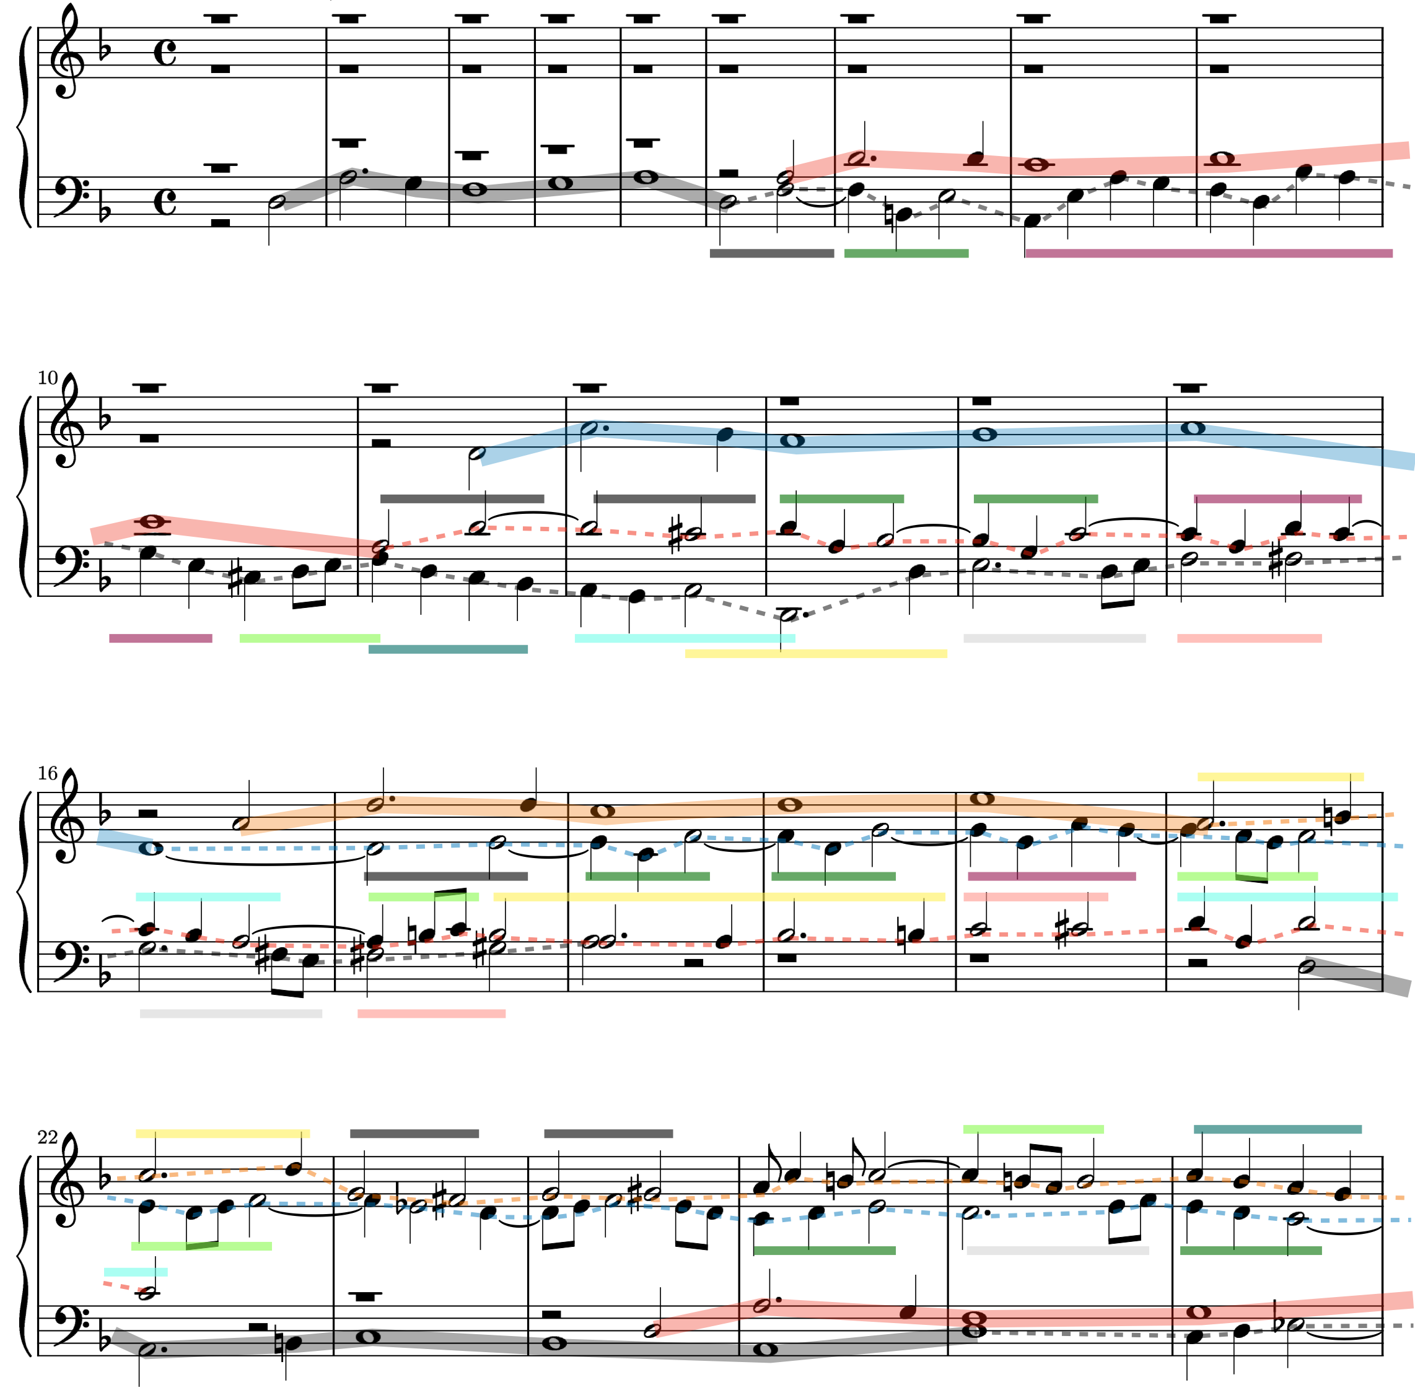
J.S. Bach
The Art of Fugue
Contrapunctus 14
Subject
Subject
Counter-subject
Subject
Counter-subject
Subject
Counter-subject
Counter-subject
Subject
Subject

Slide 6
J.S. Bach
The Art of Fugue
Contrapunctus 14

Slide 7
Overview
Dynamic visualisation to guide (non-expert) listeners, to better enjoy richness
Fugues, and the particularity of Bach’s Contrapunctus 14
String quartet: real time pitch tracking
Visualisation strategy based on “dynamic paradigmatic analysis”
Concert experiment, with Danish String Quartet, and online follow-up xp
Computationally automated fugue analysis: pattern mining

Slide 8
Subject
Subject
Counter-subject
Subject
Counter-subject
Subject
Counter-subject
Counter-subject
Subject
Subject

Slide 9
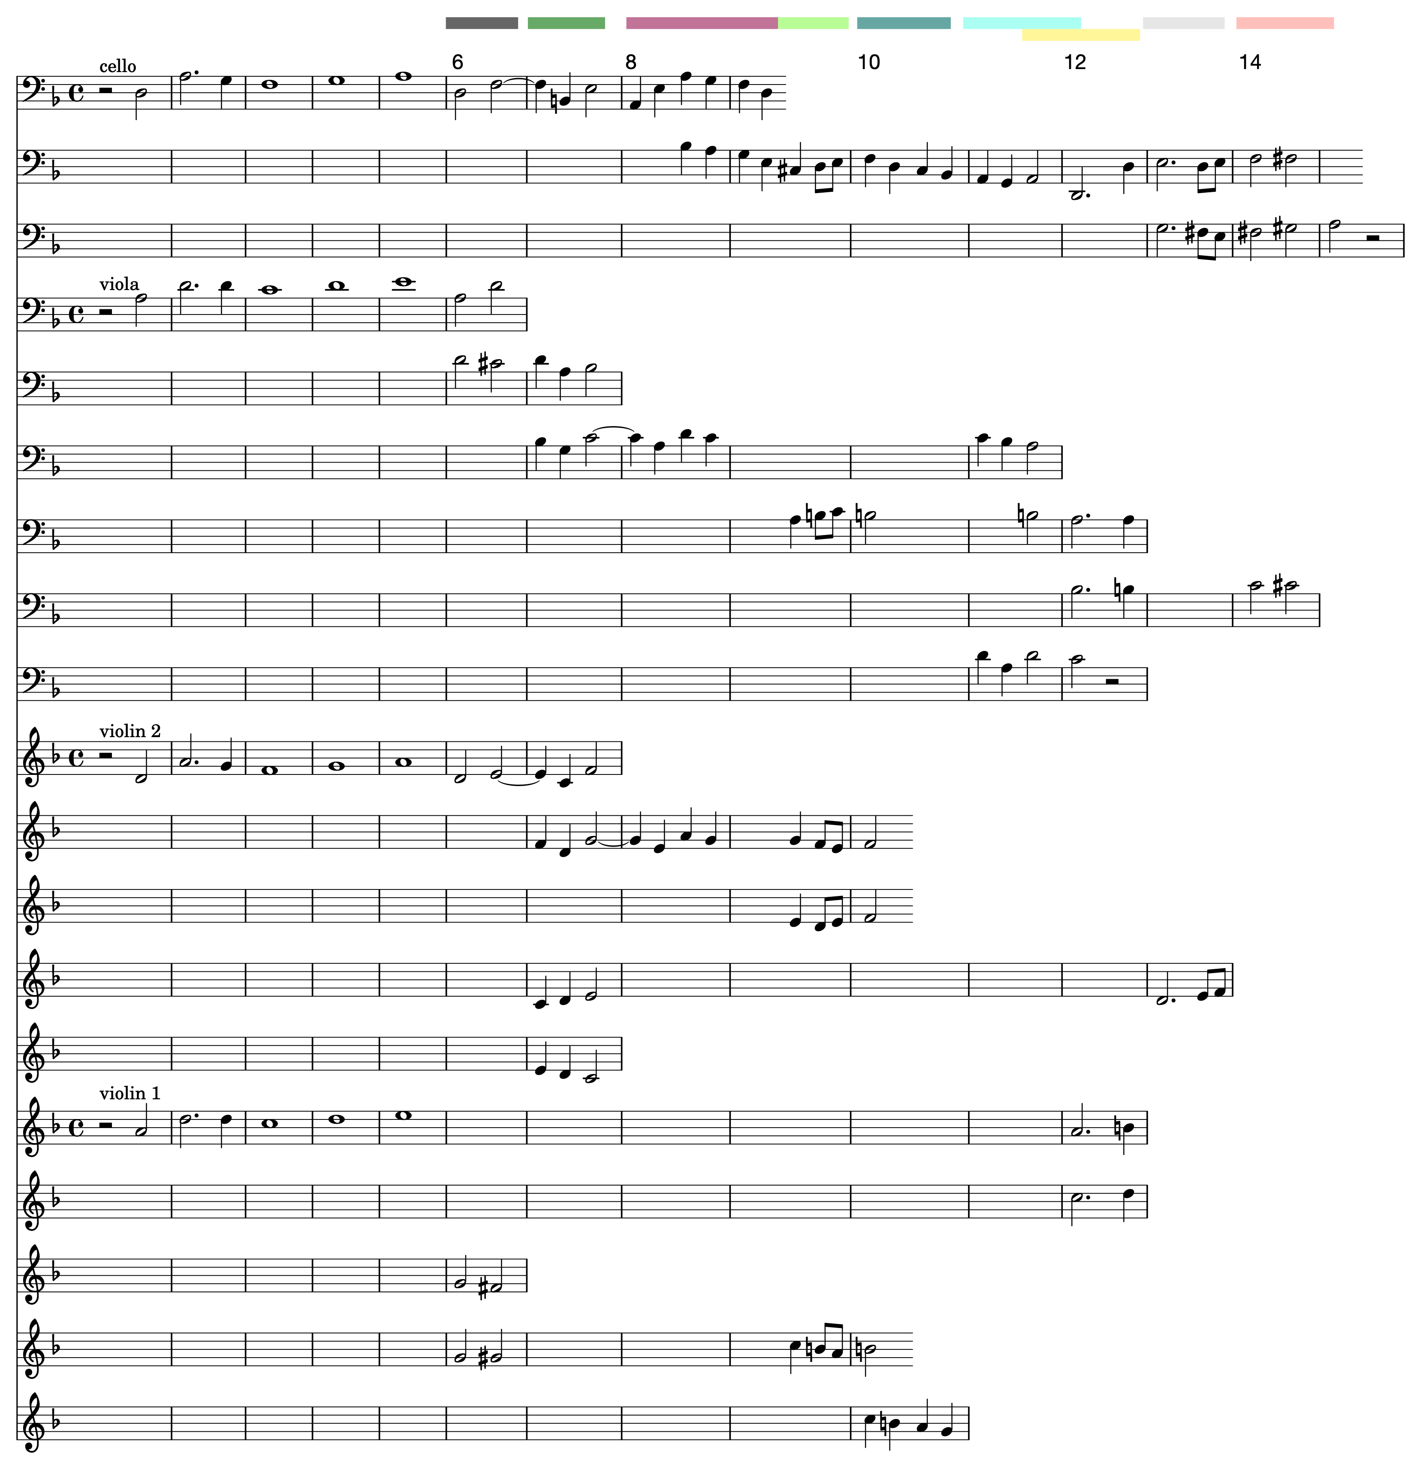
Paradigmatic analysis

Slide 10
Technical setup

Slide 11
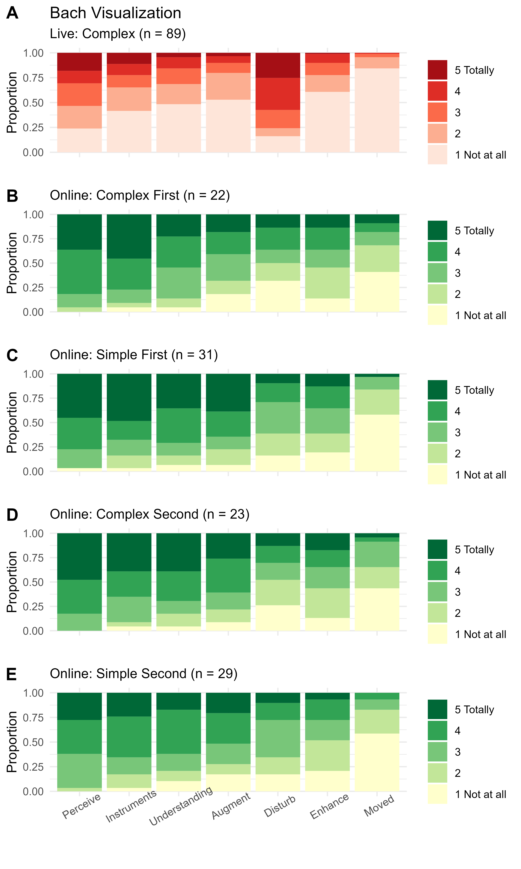
Questionnaire results

Slide 12
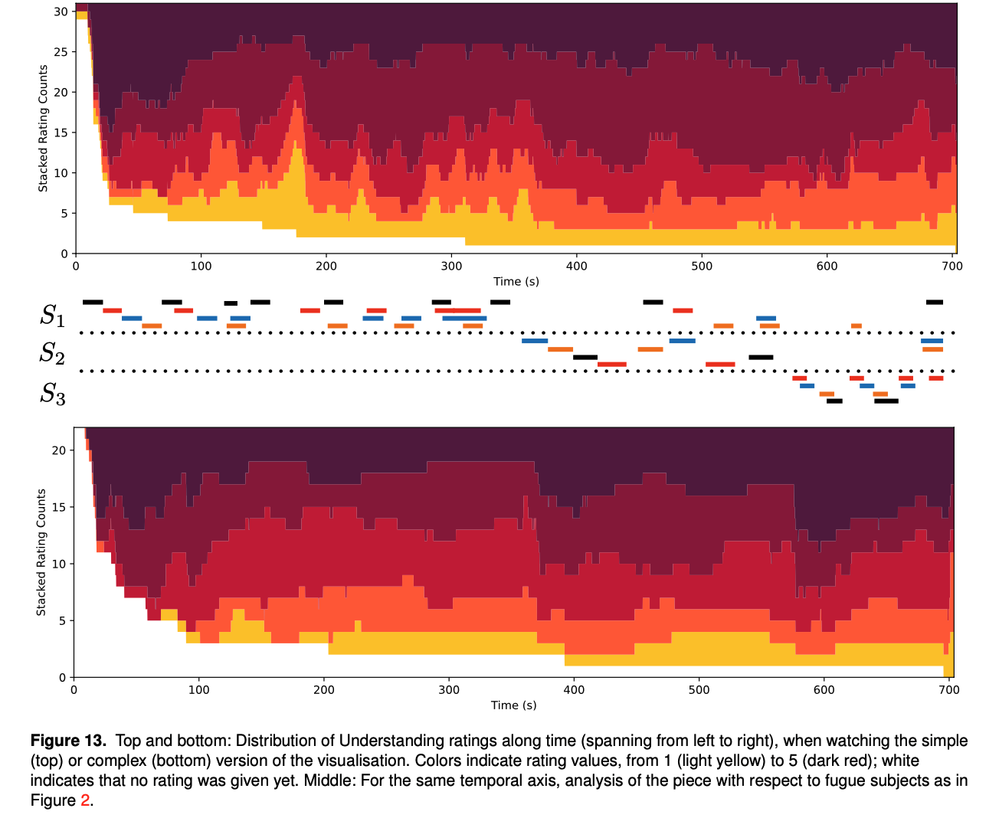
Online survey
Offline listening test

Slide 13
Subject #1
Subject
Subject
Counter-subject
Subject
Counter-subject
Subject
Counter-subject
Counter-subject
Subject
Subject

Slide 14
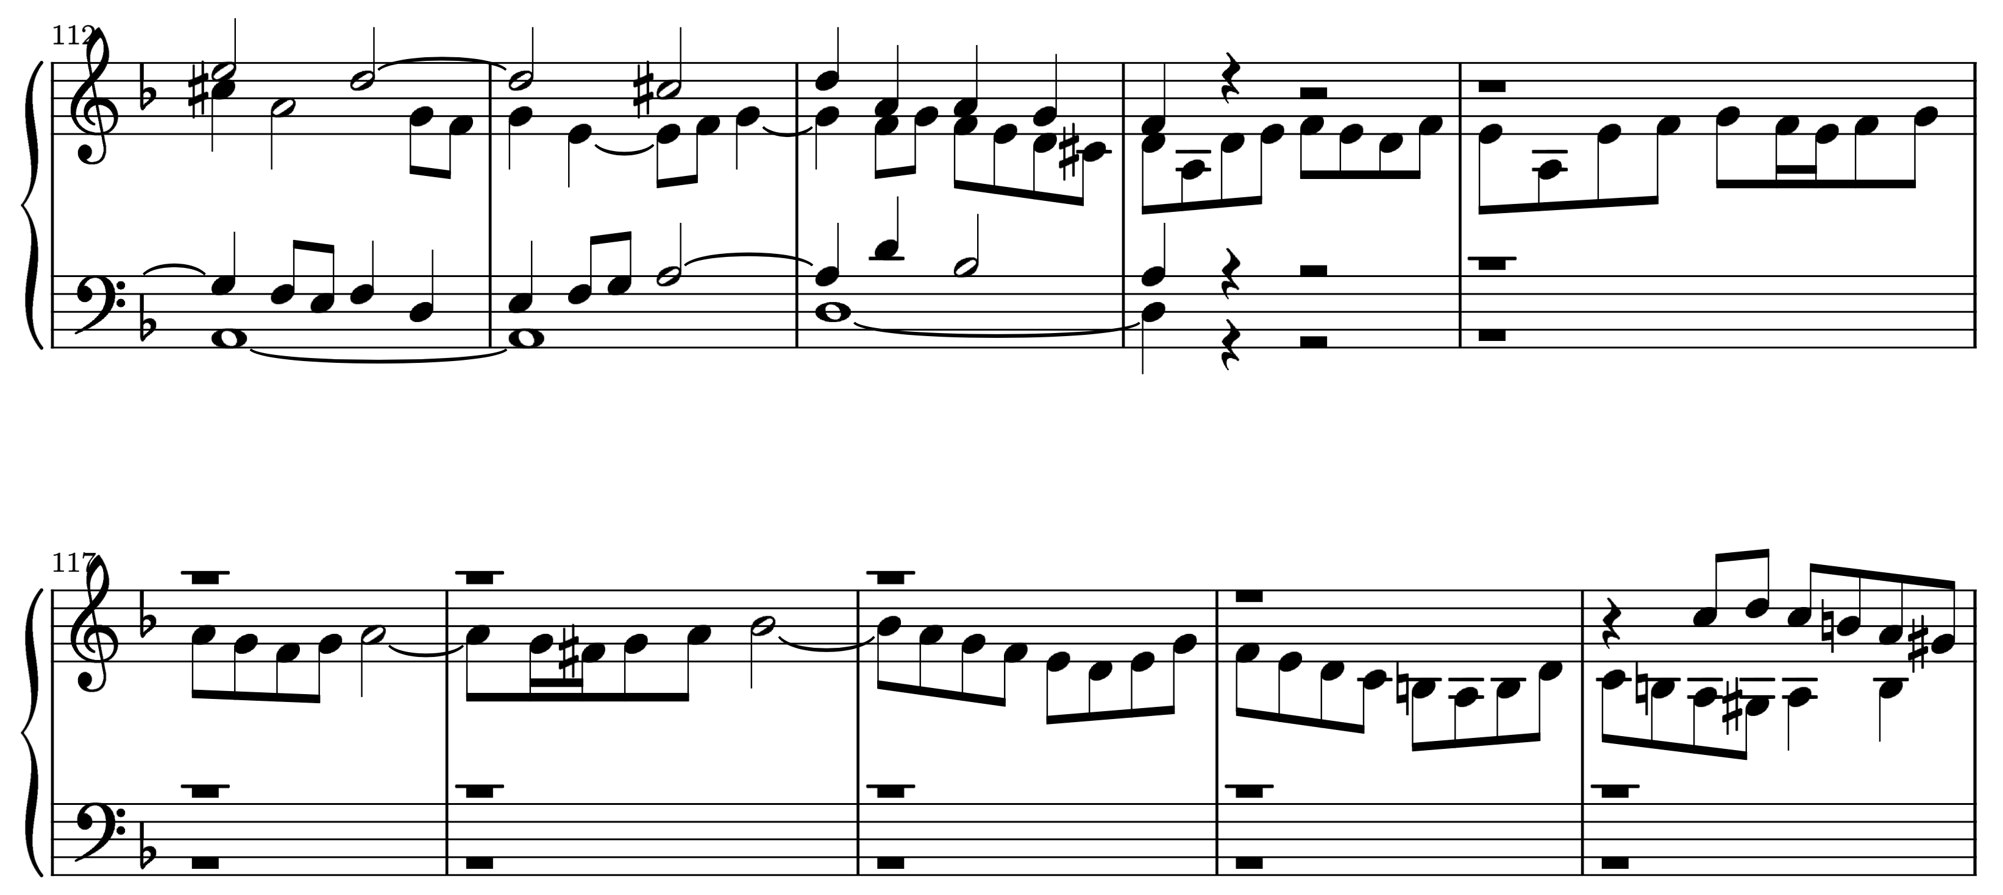
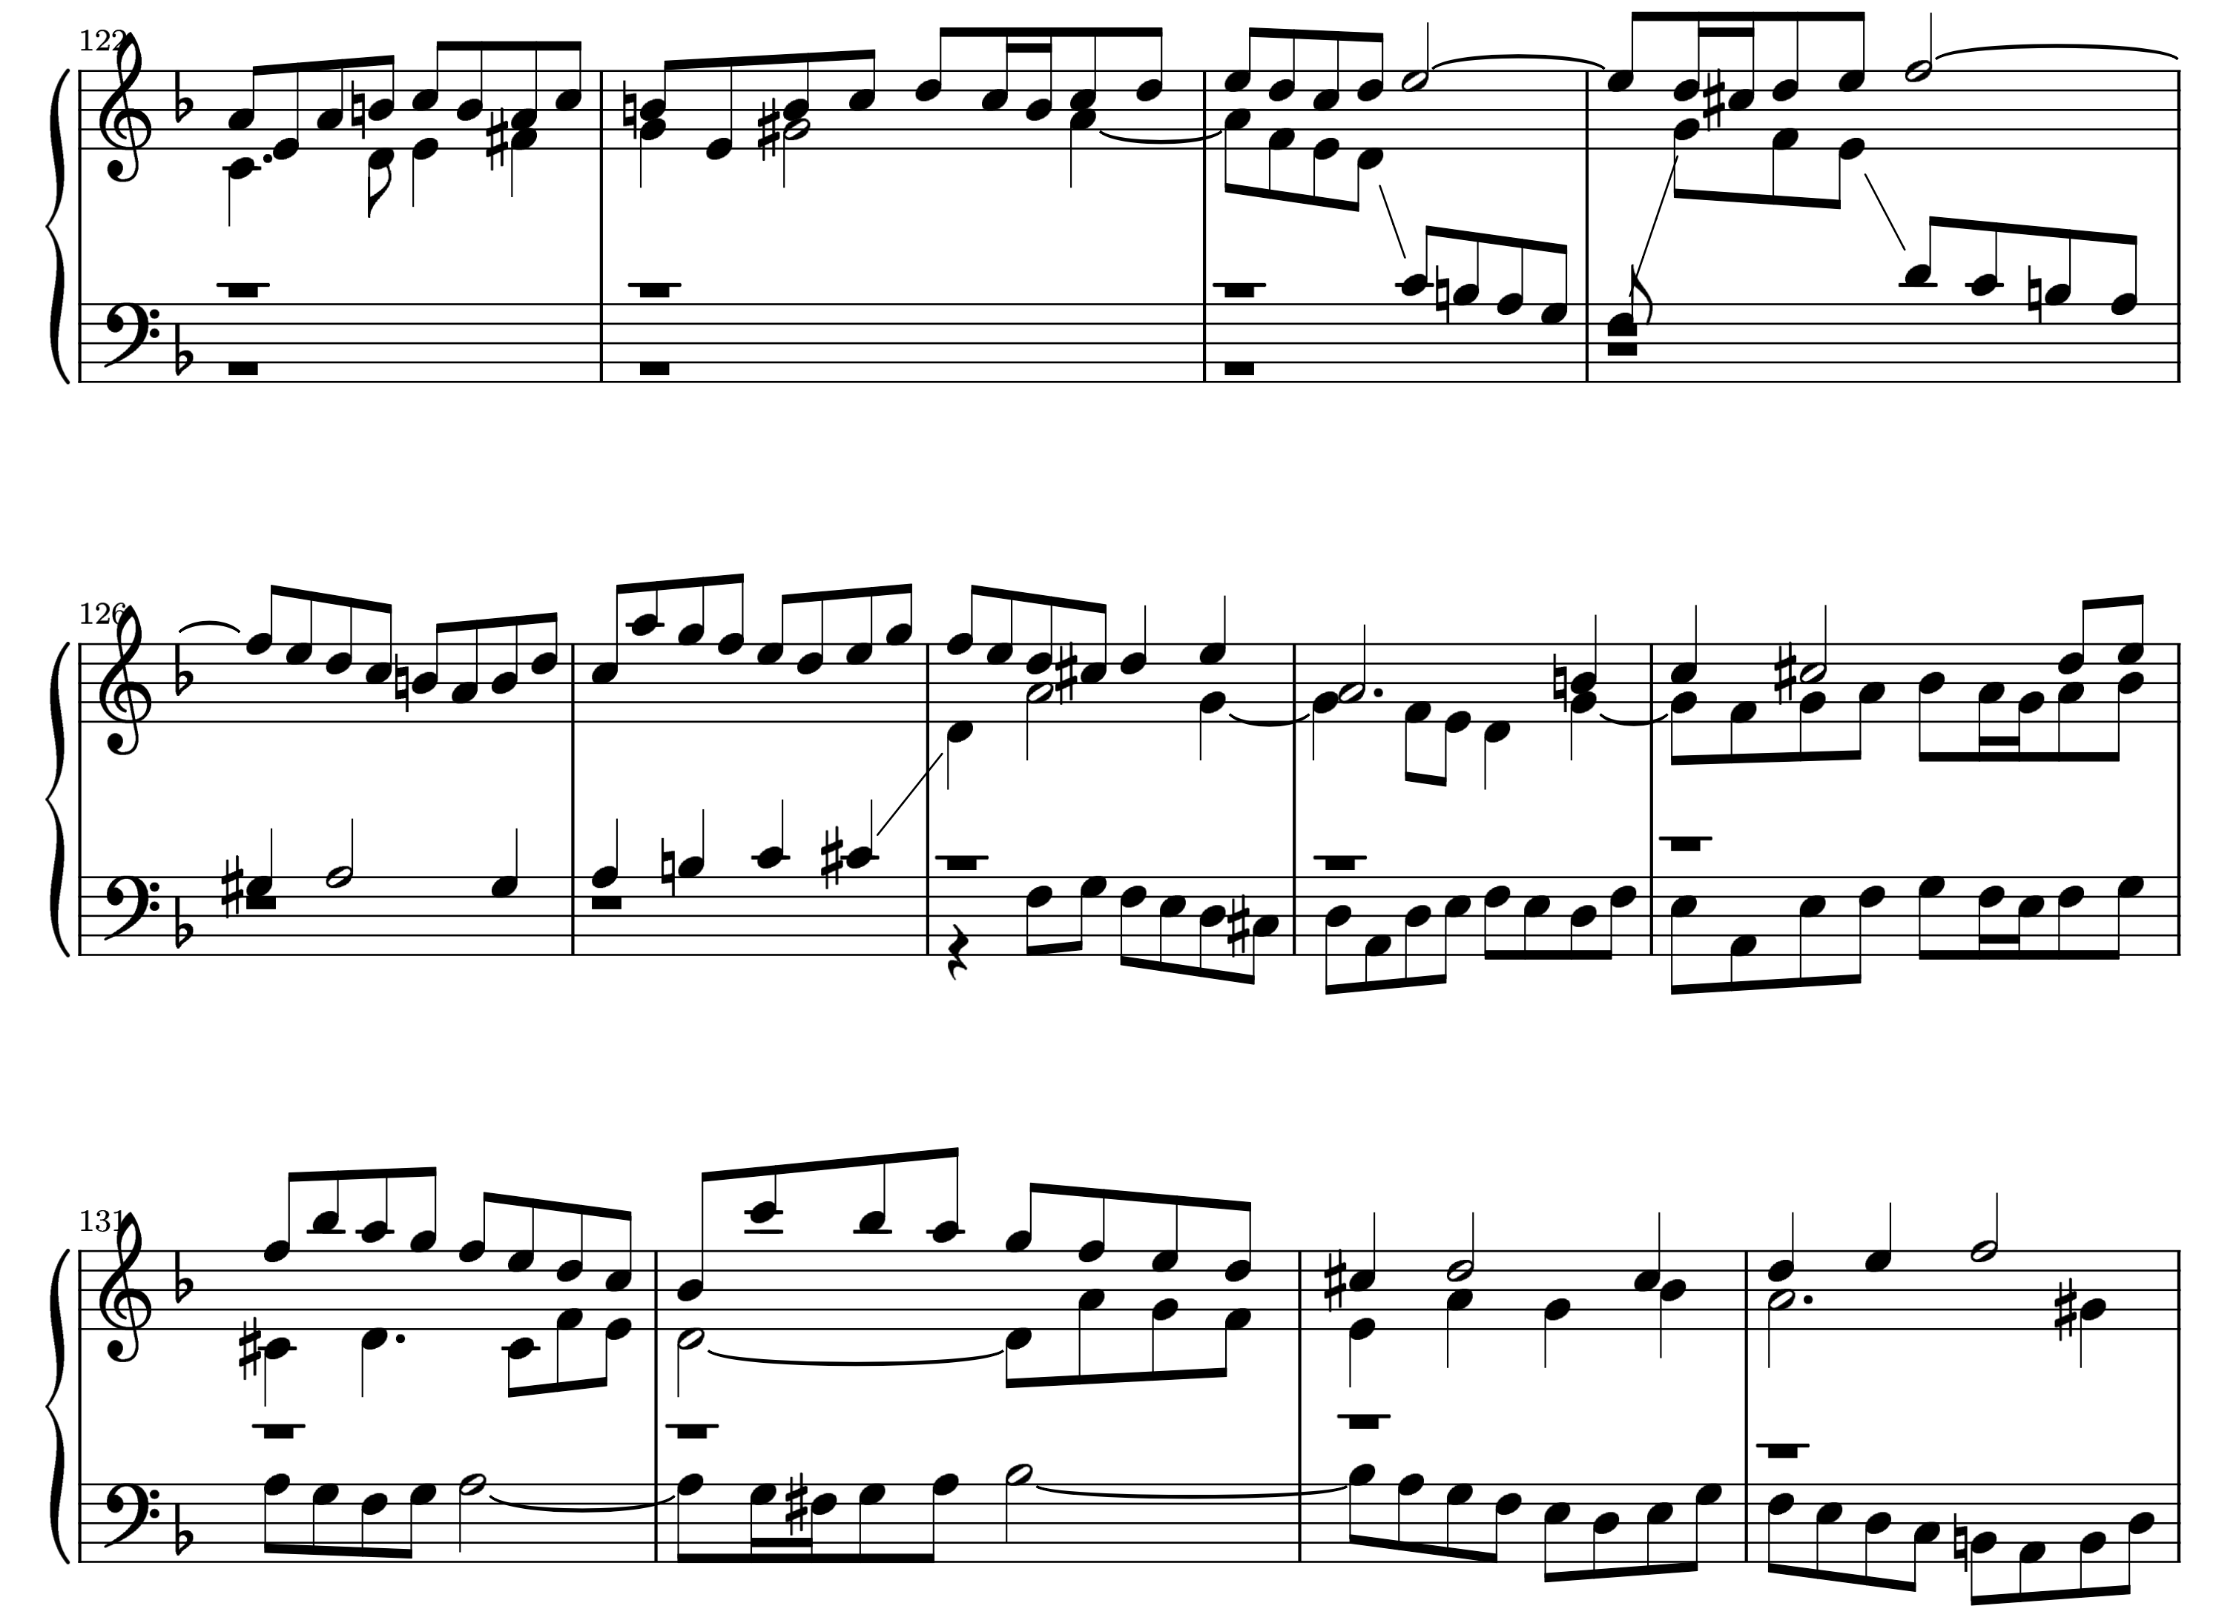
Subject #2

Slide 15
Subject
Subject
Counter-subject
Subject
Counter-subject
Subject
Counter-subject
Counter-subject
Subject
Subject

Slide 16
Paradigmatic analysis

Slide 17
Countersubject #1
Subject
Countersubject…

Slide 18
Automating the music analysis
of Bach’s fugues
Locating subjects: easy
Locating counter-subjects: generally easy
Motivic (“paradigmatic”) analysis of counter-subjects: very difficult
Olivier Lartillot, “Automated Motivic Analysis: An Exhaustive Approach Based on Closed and Cyclic Pattern Mining in Multidimensional Parametric Spaces”, in David Meredith (editor), Computational Music Analysis, Springer, 2016
Extension of that approach
Work in progress

Slide 19
Dynamic visualisation
of fugue analysis
demonstrated in a live concert by the Danish String Quartet
Olivier Lartillot, MIRAGE project University of Oslo, RITMO Centre for Interdisciplinary Studies in Rhythm, Time and Motion, Norway

